Slide 1
Lumbar Radiofrequency Ablation: indications, technique, and predictive value of medial branch blocks
Drew Trainor, DO MS FAAPMR FAAPM
The Denver Spine and Pain Institute
September 26th, 2021

Slide 2
Disclosures
No relevant disclosures
Consultant for Boston Scientific, NALU, Nevro

Slide 3
Presentation Overview
Facet Joint Anatomy
“Diagnosis” of Facet Joint Syndrome
Value of Diagnostic Blocks
Facet Joint and Medial Branch Block Technique
Lumbar Radiofrequency Ablation Techniques and factors that influence outcomes

Slide 4

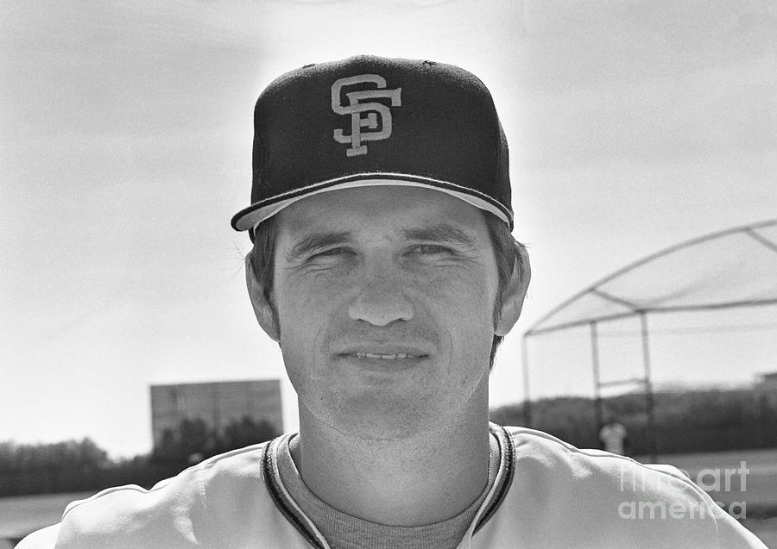
Notes:
Everybody knows the guy on the left. Mariano Rivera, arguably the best closer in history and is in the hall of fame.
Does anybody know the relieve on the right? This is Gary Lavelle. He was a closer in the 70’s and 80’s and has the record for the most blown saves in MLB history.

Slide 5
THE FACET JOINT

Slide 6
The Facet Joint
Terminology
  Zygapophysial Joint (Z-joint)
    apophysis = out-growth
    zygos = yoke or bridge
  Literature: Apophysial (British), Facet (American)

Slide 7
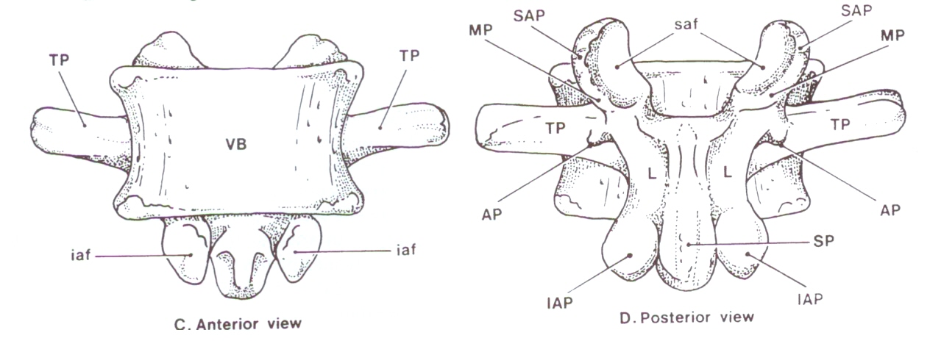
The Facet Joint

Slide 8
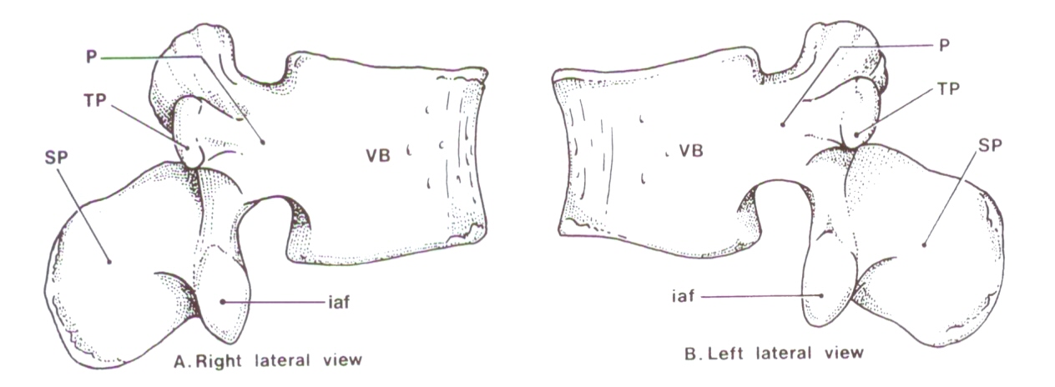
The Facet Joint

Slide 9
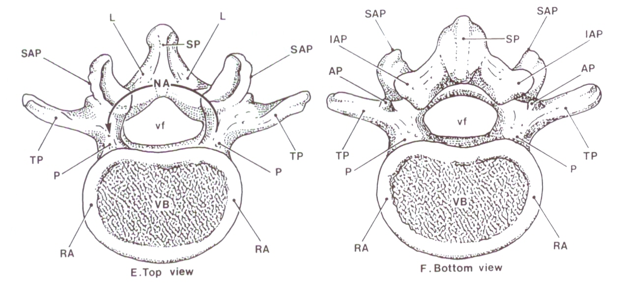
The Facet Joint

Slide 10
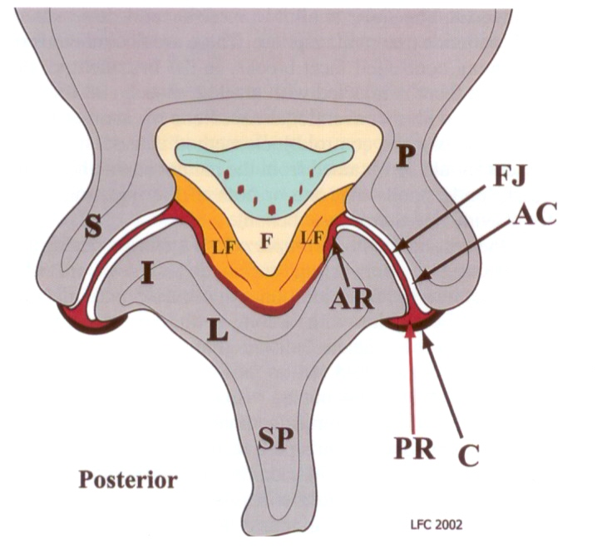
The Facet Joint
Notes:
Diarthrodial Joint: joint in which the opposing bony surfaces are covered with a layer of hyaline cartilage or fibrocartilage within a joint cavity that contains synovial fluid, lined with synovial membrane and reinforced by a fibrous capsule and ligaments; and there is some degree of free movement possible

Slide 11
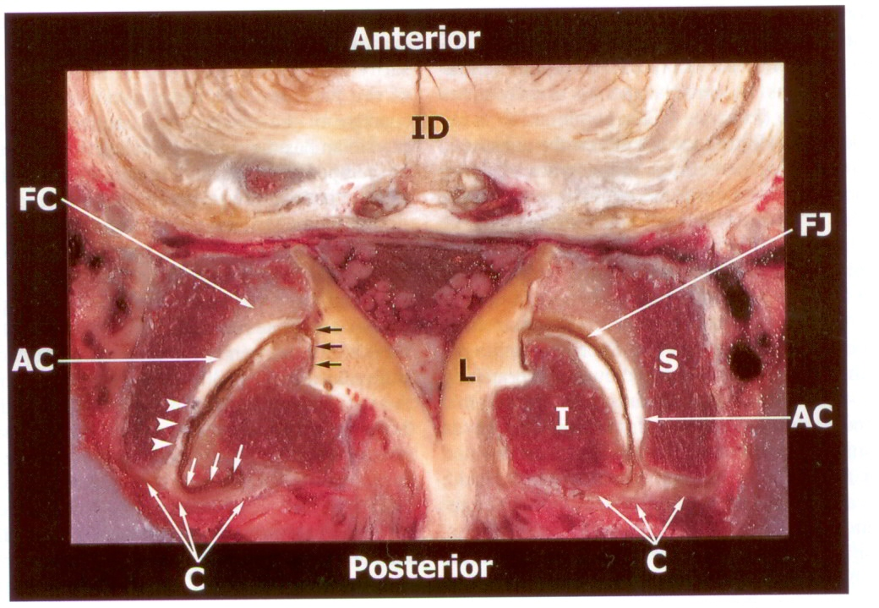
The Facet Joint
Notes:
Diarthrodial Joint: joint in which the opposing bony surfaces are covered with a layer of hyaline cartilage or fibrocartilage within a joint cavity that contains synovial fluid, lined with synovial membrane and reinforced by a fibrous capsule and ligaments; and there is some degree of free movement possible
Superior facet faces medially and the inferior facet faces laterally
Notice the concave shape of the SAP and convex shape of the IAP

Slide 12
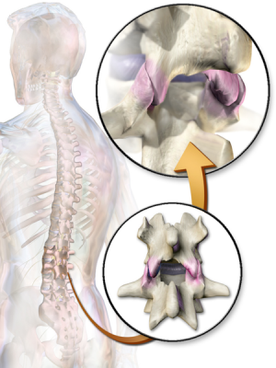
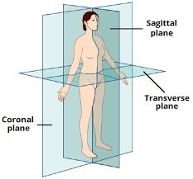
The Facet Joint
Oriented in the sagittal plane
  Flexion/Extension Only
Become progressively more oblique as you move down the lumbar spine
  At L5-S1 this prevent the spinal column from slipping forward on the sacrum

Slide 13
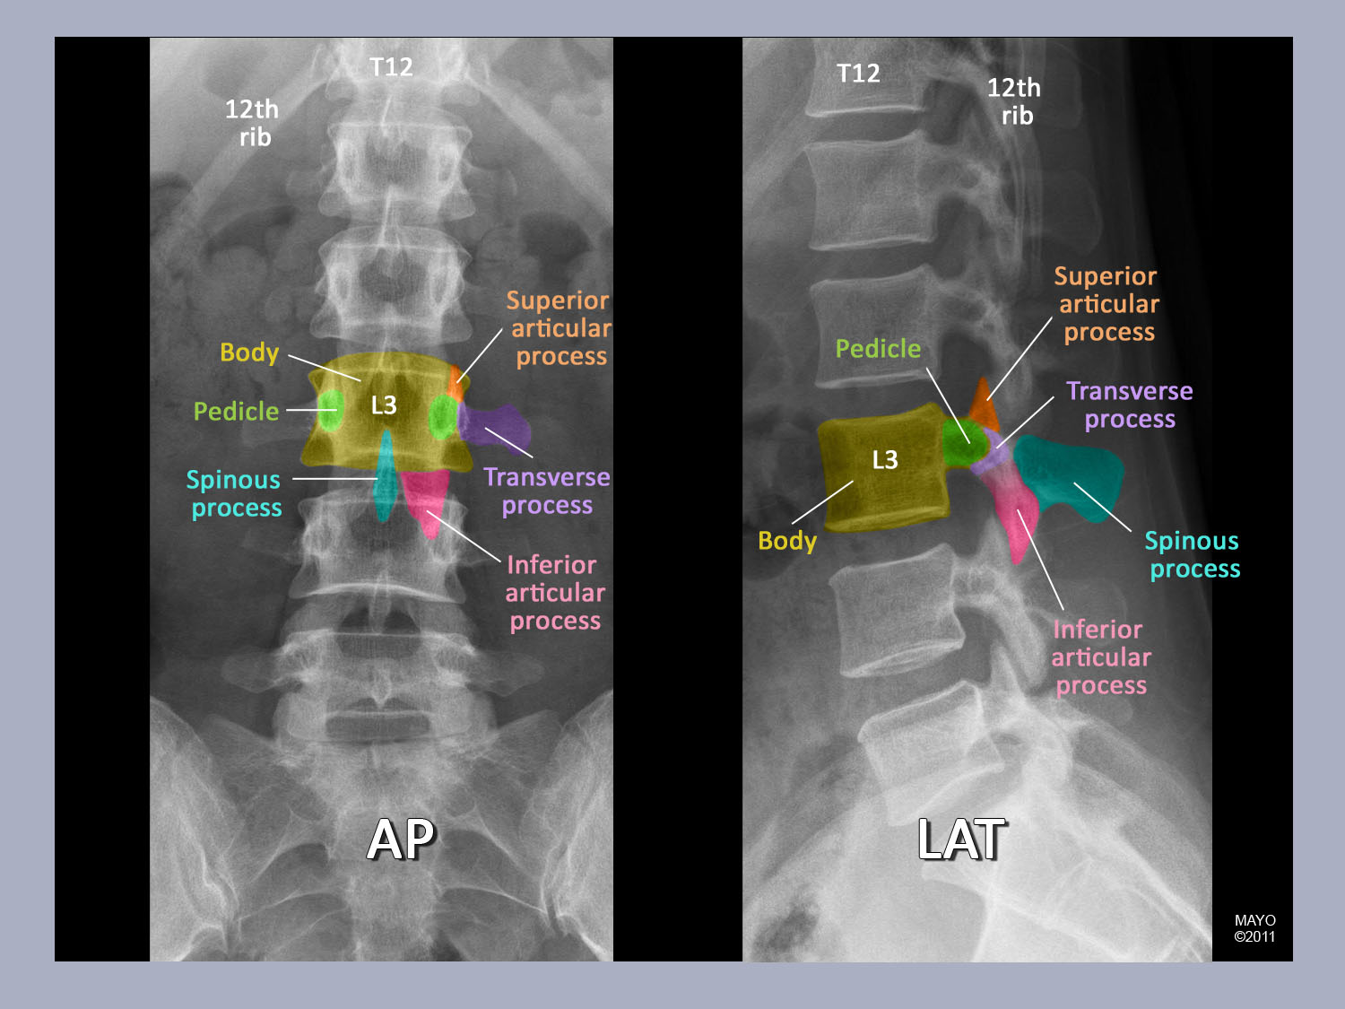
The Facet Joint

Slide 14
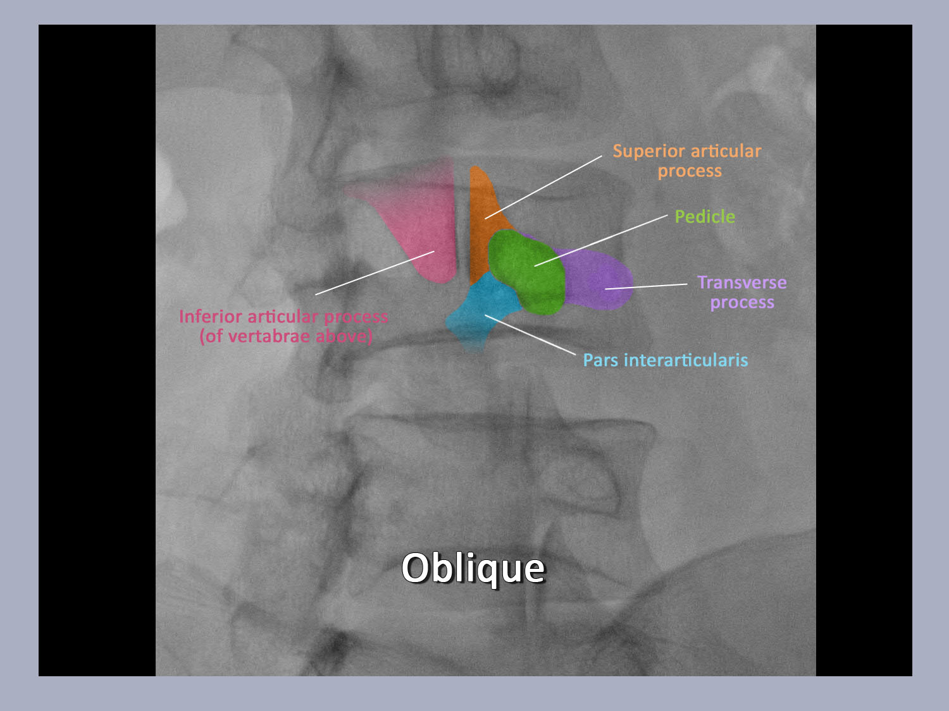
The Facet Joint

Slide 15
Diagnosis of Facet Joint Syndrome
Structure | Prevalence | Demographics
Disc | 40% | Young, injured, peak ages: 35-55
Facet (Zygapophysial) Joint (LZJ) | 10-45% | Older: > 52
Lytic L5 Pars Defect | 6-7% | Onset age 5-7, develop by age 18
Sacroiliac Joint (SIJ) | 15-30% | Trauma, older, women, lumbar fusion

Slide 16
Diagnosis of Facet Joint Syndrome
Structure | Image | History (P=pain) | Exam
Disc | MRI: HIZ, Modic Changes | P arising from sit, midline; P w bend, lift, Valsalva | Centralization (McKenzie), flexion
LZJ | DDD/DJD common (not predictive) | P standing, better walking, sitting; age > 52 | P w combined extension / rotation (absent = negative predictor)
SIJ | Not predictive or sensitive/specific but rule out fracture, stress response, tumor, inflammation | P arising from sit, P unilateral at or below PSIS | Fortin finger (pt. points to SIJ as P location; Gillet test; 3 of 5 positive: pelvic distraction, compression, FABER, thigh thrust, Gaenslen’s

Slide 17
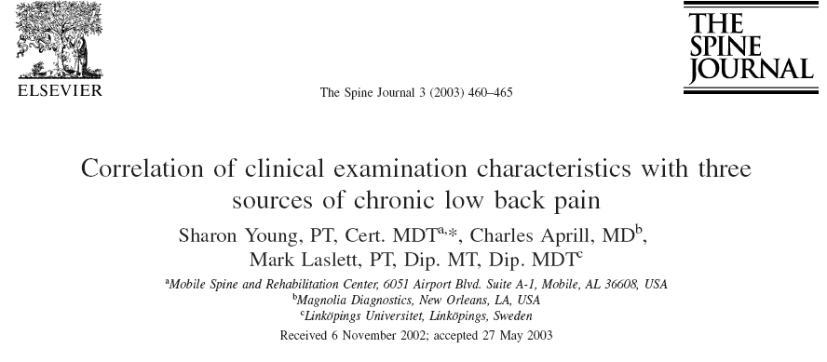
LZJ: no pain rising from sitting
Discogenic:
Centralization w McKenzie method
Pain w rising from sitting
Sacroiliac:
Unilateral pain; No lumbar pain
Pain rising from sitting
3/5 provocation tests: distraction, compression, sacral thrust, thigh thrust, Gaenslen’s

Slide 18
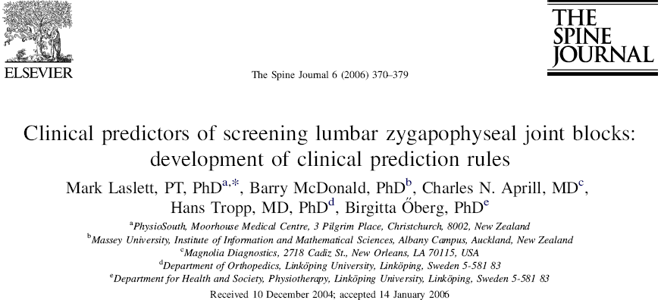
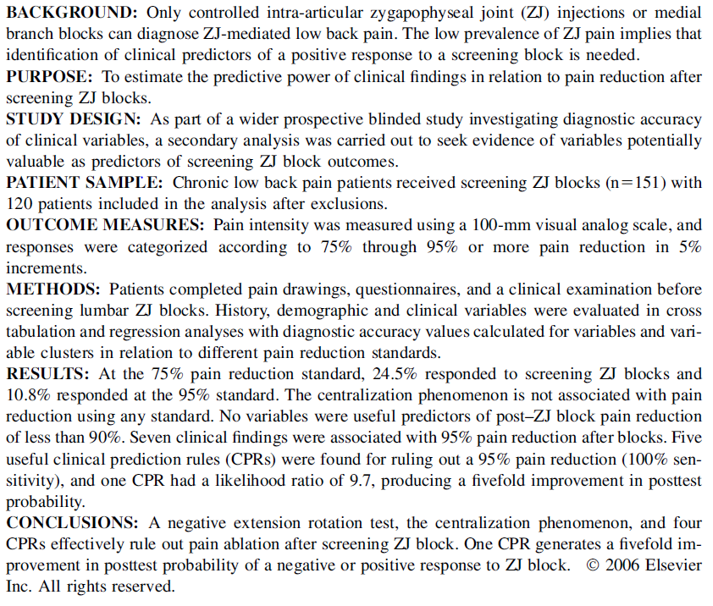

Slide 19
Diagnosis of Facet Joint Syndrome
Extension/Rotation Test
  If negative: very unlikely to have 95% pain reduction
  NPV = 100, PPV = 13
  Sensitivity = 100%
  Specificity = 22%

Slide 20
Clinical Predictive Rule (5)
Three of five: age >50, sx. better walking, sx. best sitting, onset of pain paraspinal, pain worse with combined extension/rotation
  Sensitivity 85%, specificity 91%, PPV 55, NPV 98
  Laslett, et al, Spine J. 2006 Jul-Aug;6(4):370-9

Slide 21

Spine Intervention Society (SIS) Practice Guidelines
Algorithm Highlights
  L-MRI discs normal
    Investigate synovial joints
  L-MRI abnormal
    Young person – investigate discs
  Older person – investigate synovial joints
  If pain below L5, unilateral
    Investigate SIJ
  If pain above L5, bilateral
    Investigate LZJs in stepwise fashion

Slide 22
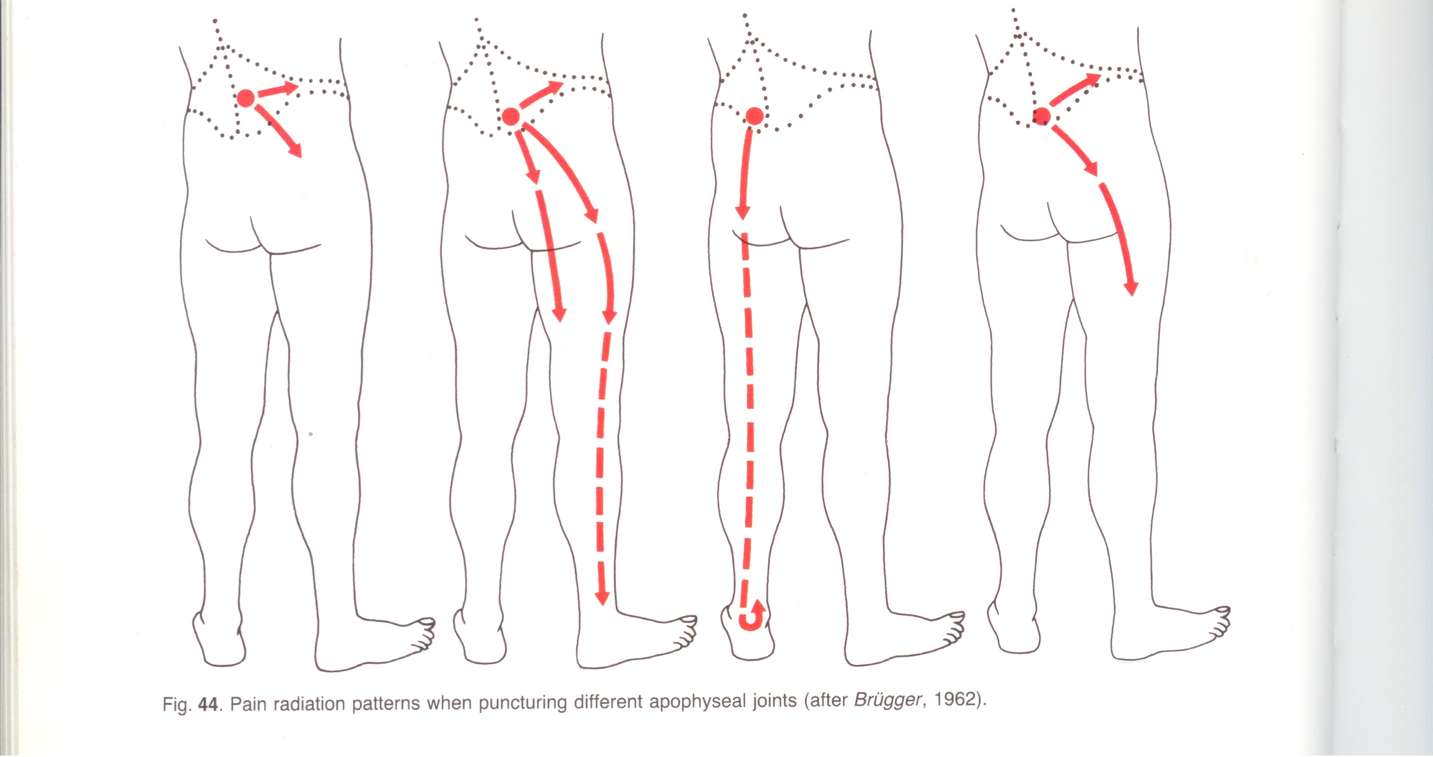
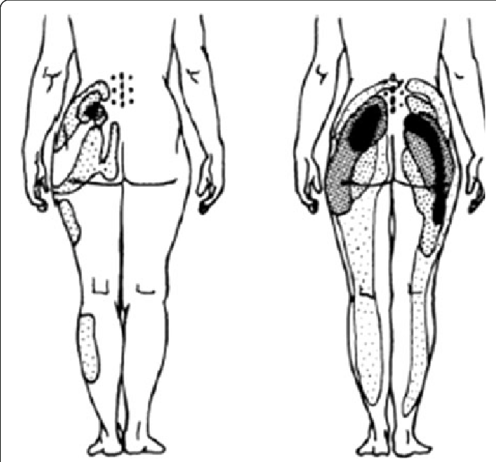
Diagnosis of Facet Joint Syndrome
Notes:
Important to note the wide variability in referral patterns for facet joint syndrome

Slide 23
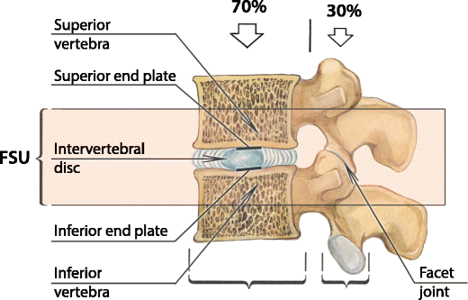
Diagnosis of Facet Joint Syndrome
Notes:
A FSU consists of two adjacent vertebrae, the intervertebral disc and all adjoining ligaments between them and excludes other connecting tissues such as muscles. The three-joint complex that results is sometimes referred to as the "articular triad". Normally 70% of the axial load is transmitted through the anterior elements while 30% of the forces are transmitted through the posterior elements

Slide 24
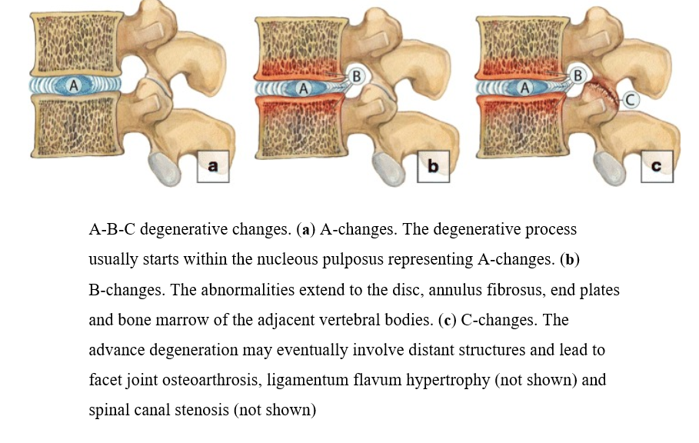
Diagnosis of Facet Joint Syndrome

Slide 25
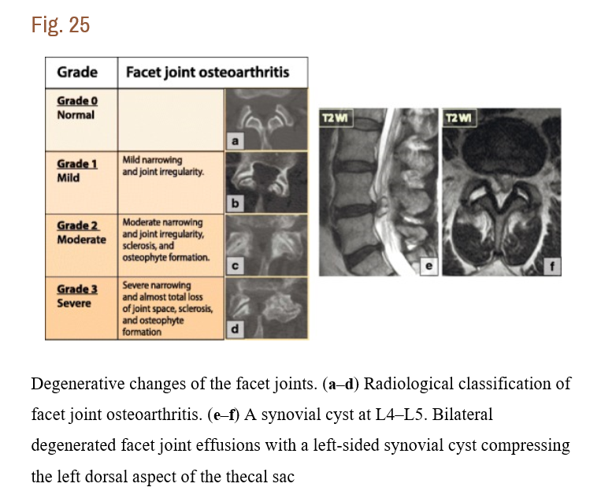
Diagnosis of Facet Joint Syndrome
Notes:
It is important to note that imaging findings can suggest a possible underlying facetogenic low back pain, but they cannot be used to diagnose it.

Slide 26
Value of Diagnostic Medial Branch Blocks

Slide 27
Question 1: Does the medial branch block effectively anesthetize the facet joint?

Slide 28
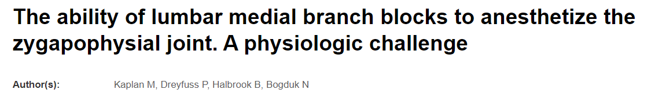
18 individuals underwent IA saline injections until pain was elicited
15 patients went on to blinded MBBs with either saline or 2% lidocaine
30 minutes after the blocks, these patients underwent repeat capsular distension
The 2% lidocaine group had a significant effect on anesthetizing the facet joint compared to the saline group

Slide 29
Question 2: Does a Response to Medial Branch Blocks Predict RFA outcomes? Does the prognostic cut-off value have an impact on outcomes?

Slide 30
The Answer is Yes and No

Slide 31
Yes argument
Manchikanti et al, 2010 (Pain Physician)
  Retrospective review
    Patients who had >50% but less than 80% relief on either one or two MBBs had poorer outcomes than the >80% pain relief group
Derby et al, 2013 (Pain Physician)
  Retrospective review of 51 patient
    Similar findings and Manchikanti
      Higher proportion of patients in the >80% relief with single and double blocks experienced >50% relief with RFA than the >50% but less than 80% group.

Slide 32
No argument
Cohen et al, 2008 (Journal of Spine)
  Retrospective study of 262 patients
    No significant difference in outcomes of RFA in patients experience >50% but less and 80%, and >80% group
Cohen et al, 2013 (Clinical Journal of Pain)
  Prospective study of 61 patients
    No statistically significant differences in RFA outcomes in patients receiving 50% to 100% (looked at each groups in 10% increments)

Slide 33
Question 3: Are single or dual Medial Branch Blocks better predictors of patient outcomes?

Slide 34
Depends on how you look at it?

Slide 35
Dual MBB superior to IA block in predicting successful RF outcomes;
Cohen, et al. 2015
Notes:
So both Derby in 2012 and Cohen in 2015 looked at facet joint injections and MBBs as a predictor of successful RFA outcomes. These studies and other eventually led to………

Slide 36
Dreyfus et al, 2000 (Journal of Spine)
15 patients who had dual MBBs and experience >80%
  87% of patients had at least 60% reduction in pain for 12-months
  60% of those patients had at least 90%
Notes:
Beck Depression Inventory to screen out patients with co-morbid depression
EMG to confirm denervation of the multifidi
16 gauge needles

Slide 37
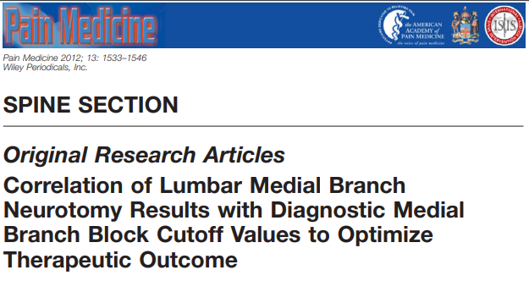

Favorable outcomes with lumbar RF ablation:
  With dual blocks with >70% relief
    % pain relief, duration of relief, activity level, reduction in pain medications
  With single blocks with > 80% relief
    Patient satisfaction and activity level
Notes:
This was an article published by Rick Derby in 2021
Patient had statistically significant results in the 70% dual block group in:
% relief
Duration of relief
Activity level
Reduction in pain medications
In the 80% single block group they had statistically significant improvement in:
Patient satisfaction
Activity Level

Slide 38
Cohen et al, 2010 (Journal of Anesthesiology)
151 patients randomized
  No block
  Single block
  Dual Block
Primary outcome measure was >50% reduction in pain at 3-months
  No block- 33%
  Single block- 39%
  Dual block- 64%
Notes:
Only RCT to compare different prognostic block paradigms
They used a >50% cut-off for the MBBs

Slide 39
Cohen et al, 2010 (Journal of Anesthesiology)
Those who experienced a positive categorical outcome
  No block group 33% of 51 patients
    17 patients had favorable outcome
  Single block group 16% of 50 patients
    8 patients had favorable outcome
  Dual block group: 22% of 50 patient
    9 patients had favorable outcome
Note: the no-block group had the lowest cost-per-effective-procedure rate

Slide 40
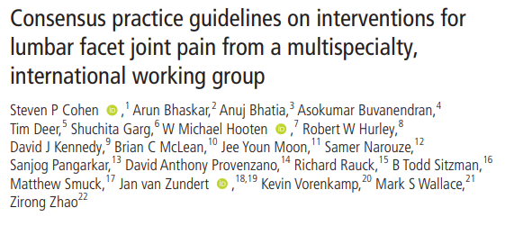
https://rapm.bmj.com/content/rapm/45/6/424.full.pdf
Notes:
Expert consensus guidelines published on February 2020 in the Journal of Regional Anesthesia and Pain Medicine
This is an open access journal and I have put a link the article on this slide for referrence

Slide 41
Purpose of Guidelines
Answer 17 key questions
  100% consensus was met by all committee members
Can physical exam identify a painful facet joint?
Can imaging identify a painful facet joint?
Should PT of conservative care be required before prognostic facet blocks? If so, how long?
Is image guidance necessary for facet blocks and RFA?
Are facet block diagnostic, prognostic, or both?
Are medial branch blocks preferrable to IA injections to select patient for RFA?
Effect of sedation on accuracy of diagnostic/prognostic information for MBBs and IA.
What is the ideal volume for prognostic facet injections?
Are IA or MBBs with steroid therapeutic?
What should the cut-off be (% relief) for designation as “positive” and is there any benefit from using non-pain score outcome measures?
How many prognostic blocks should one perform before RFA?
Is there evidence that larger lesions improve outcomes?
Should electrodes be positioned in a certain orientation, and if so, what is the orientation?
Should sensory and or motor stimulation be performed before radiofrequency ablatio?
What are the most common complications of facet interventions, and how can they be minimized?
Should there be different standards in selecting patients for RFA in clinical trials and clinical practice?
In which patients should RFA be repeated? What is the likelihood of success? Should blocks be repeated?

Slide 42
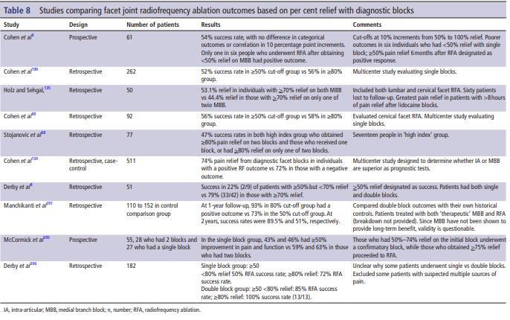
What should the cut-off be (% relief) for designation as “positive” and is there any benefit from using non-pain score outcome measures?
Recommendations:
  Greater than or equal to 50% reduction in pain should be considered a positive diagnostic block
  Acknowledged that those who receive 70 to 80% relief are more likely to have a positive response to RFA
  “A significant portion of patients who receive greater than 50% but less than 70% will benefit from RFA”

Slide 43
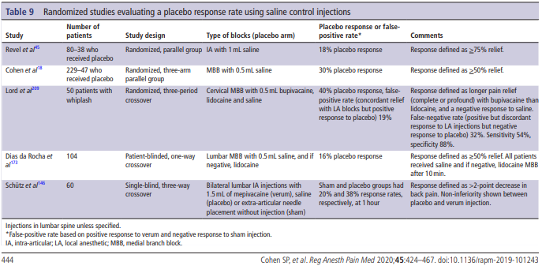
How many prognostic blocks should one perform before RFA?
Recommendations:
  Recommends a single diagnostic block

Slide 44
Controversial?
Committee justification
  Acknowledged moderate evidence that dual blocks result in higher success rates with RFA
  Use of a zero-block paradigm results in the highest number of patients with positive response to RFA
  Compromise
    Single block

Slide 45
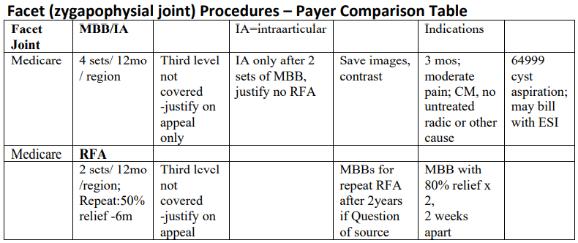
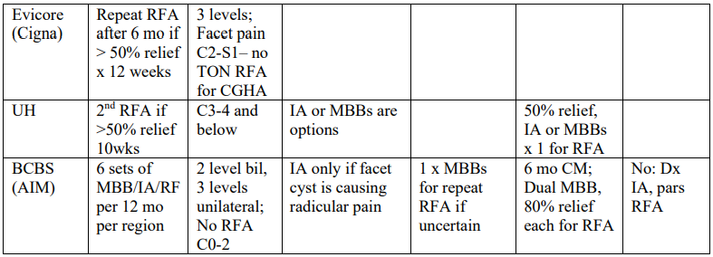
What do the payers say?

Slide 46
2021 Medicare LCD FAQ (SIS)
What criteria do I have to meet?
  Failure of 3-months of conservative care
Can I perform a diagnostic facet injection?
  Yes, but only if you cannot perform an MBB and there is intent to perform a therapeutic facet injection
Can I perform a therapeutic facet injection?
  Yes, but only if patient had 80% improvement on two dx facet injections (or MBBs) and there is a documented reason why the patient cannot have an RFA
Can I perform 3 or 4 level facet procedures?
  Yes, but only in unique circumstances and will only be approved on appeal
Do I need to perform MBBs before repeating RFA?
  No, unless it has been 2 years since last RFA or there is question about pain generator
How many facet procedures can be performed per year?
  4 diagnostic facet procedures
  2 RFA procedures
Can conscious sedation of MAC be used?
  Not routinely indicated, may be paid for on appeal in some circumstances
Can I performed a facet cyst rupture and TFESI at same time?
  Yes
What functional measures can I use for pre and post procedure?
  LCD does not specify: consider COMBI, ODI, NDI, or Roland Morris

Slide 47
Sedation and Medial Branch Blocks?
Local anesthetic?
  Deep trigger point injection
  Increased rate of false positives
Conscious Sedation?
  Analgesic effect of fentanyl increases rate of false positive (at least in most patients who are assessed prior to leaving the center)
  Can linger for longer than expected ½ life in older patients
No sedation?
  If anxious, often leads to activation of the lumbar paraspinals during procedure
  Increased post procedural soreness, can increase rate of false negative?
Ideally
  MAC sedation
  Smallest gauge needle possible
    25g or smaller

Slide 48
THE FACET JOINT INJECTION
TECHNIQUE
Notes:
Consensus is that MBBs should be performed as the diagnostic tool determining RFA candidates
However, I would be remised not to talk about lumbar facet injections:
These can be a viable treatment for patients with Lumbar Facet Joint Syndrome
Especially those who
Have a clear inflammatory etiology to their facet-related pain
Are younger, and denervation of the multifidi should be avoided
Have co-morbidities such as anti-coagulation, pacemaker (controversial), time constraints?

Slide 49
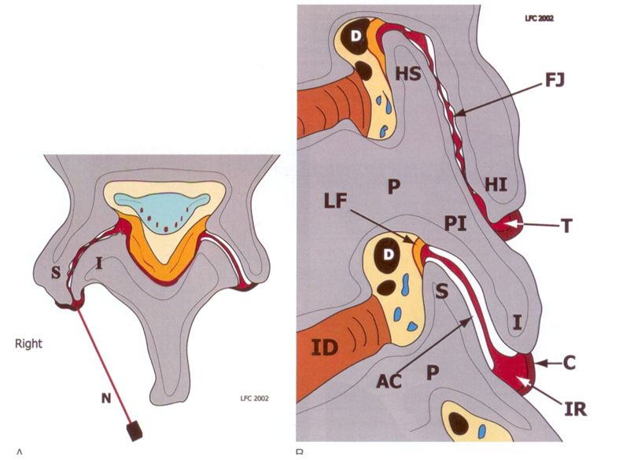
Lumbar Facet Joint Injection Technique
Align view through disc at target level
Assess sagittal plane orientation and degree of (dorsal) degenerative change (spurring)
FIND “FIRST” OPENING
Easier at superior or inferior recesses

Slide 50
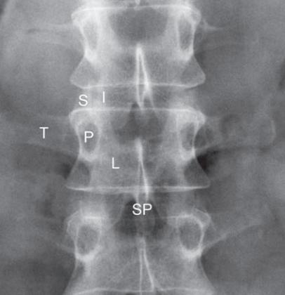
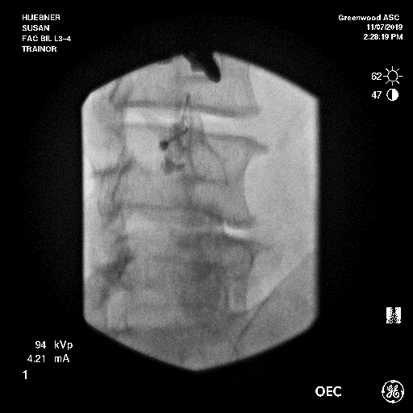
Lumbar Facet Joint Injection Technique

Slide 51
THE MEDIAL BRANCH BLOCK
ANATOMY AND INJECTION TECHNIQUE

Slide 52
Medial Branch Blocks (MBBs)
MBB vs Intra-articular Facet Blocks (IAB)
  MBB are relatively easier to perform
  MBB are safer
  IAB lack a valid subsequent treatment
  IAB lack proven predictive validity
  MBB have predictive validity
  MBB if positive can be followed by RF neurotomy

Slide 53
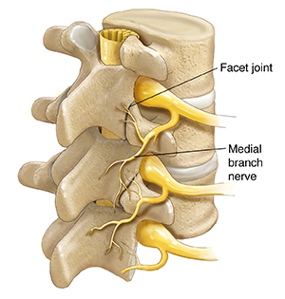
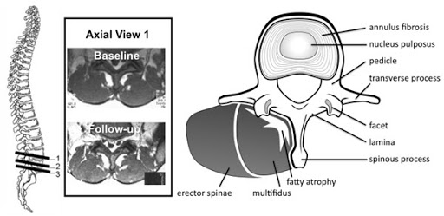
Medial Branch Blocks (MBBs)- Anatomy
Innervation
  Facet Joint
    Dual Innervation
      L4-5 facet innervation:
        Medial branch arising from L3 dorsal ramus
        Medial branch arising from L4 dorsal ramus
        Medial branch crosses junction of SAP and transverse process, beneath mamillo-accessory ligament
        L3,4 MB nerve blocks (comma)
        L4-5 Level MBBs (hyphen)
  Multifidi

Slide 54
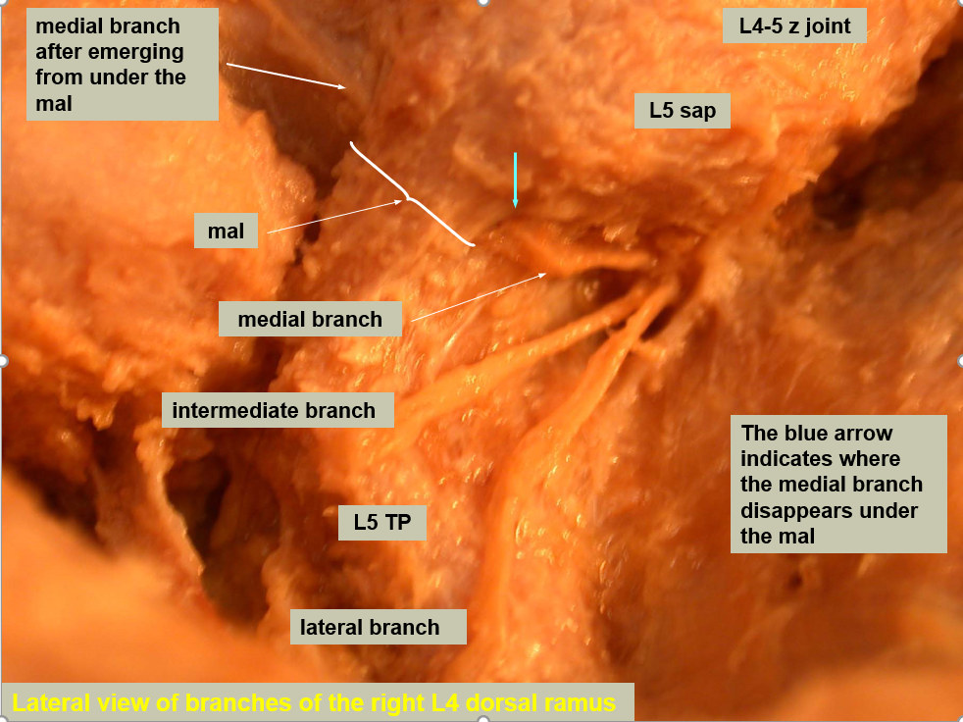
Medial Branch Anatomy

Slide 55
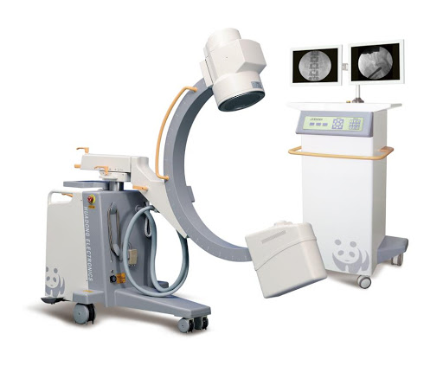
Fluoroscopic Correlation

Slide 57
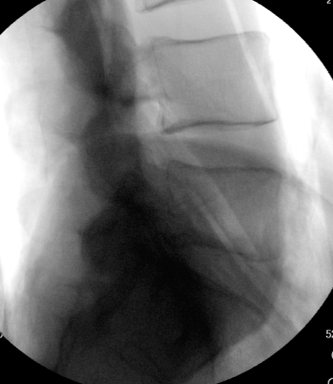
L5 sap
base of L5 TP
tip of L5 TP
LATERAL VIEW: L5 vertebra for L4 medial branch neurotomy

Slide 58
L5 sap
base of L5 TP
neck of sap
tip of L5 TP
LATERAL VIEW: L5 vertebra for L4 medial branch neurotomy

Slide 59
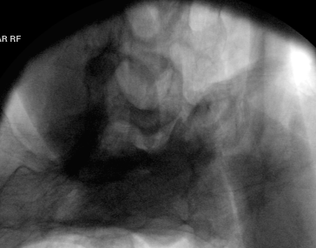
medial branch
groove
angle between sap and TP
PILLAR VIEW: L5 vertebra for L4 medial branch neurotomy

Slide 60
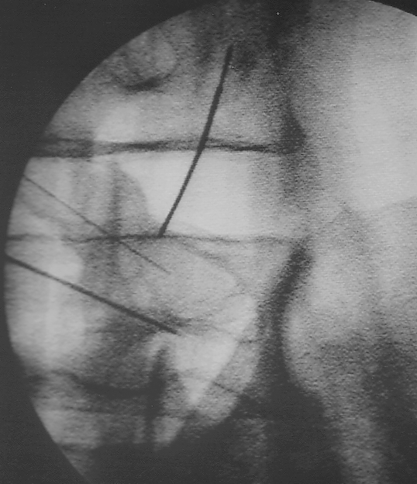
block needle
accessible segment of nerve

Slide 61
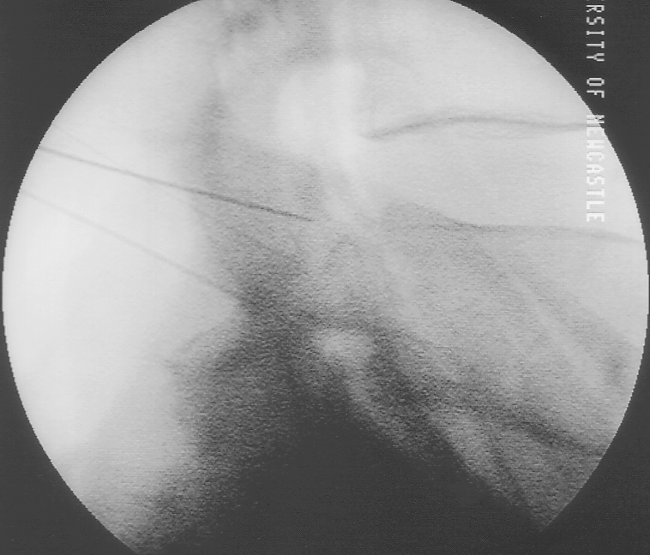
block needle
L4 Lateral view
mal
TP
accessory process

Slide 62
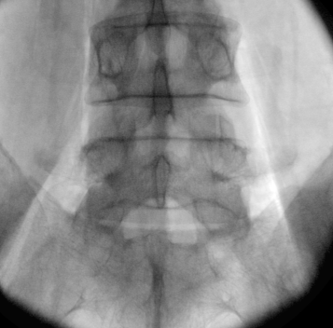
mal

Slide 63
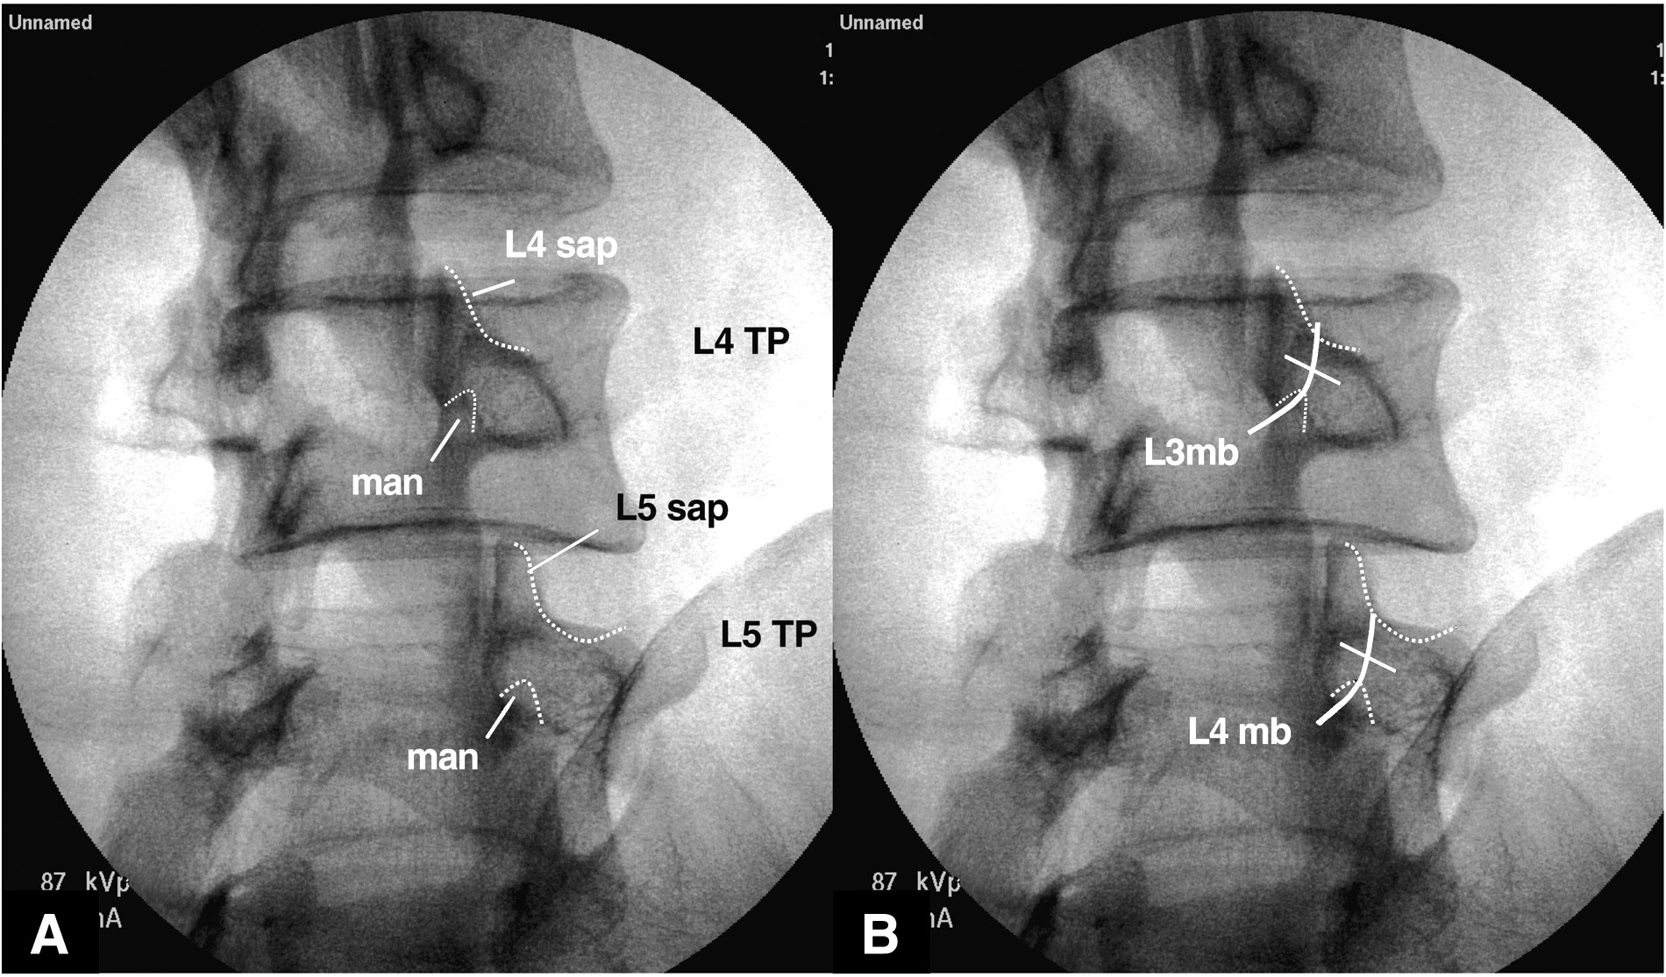
target
Image through the target disc space (segment)
Use approx. a 40^{O} oblique to be able place the needle in the target
groove and not on the posterior aspect of the SAP

Slide 64
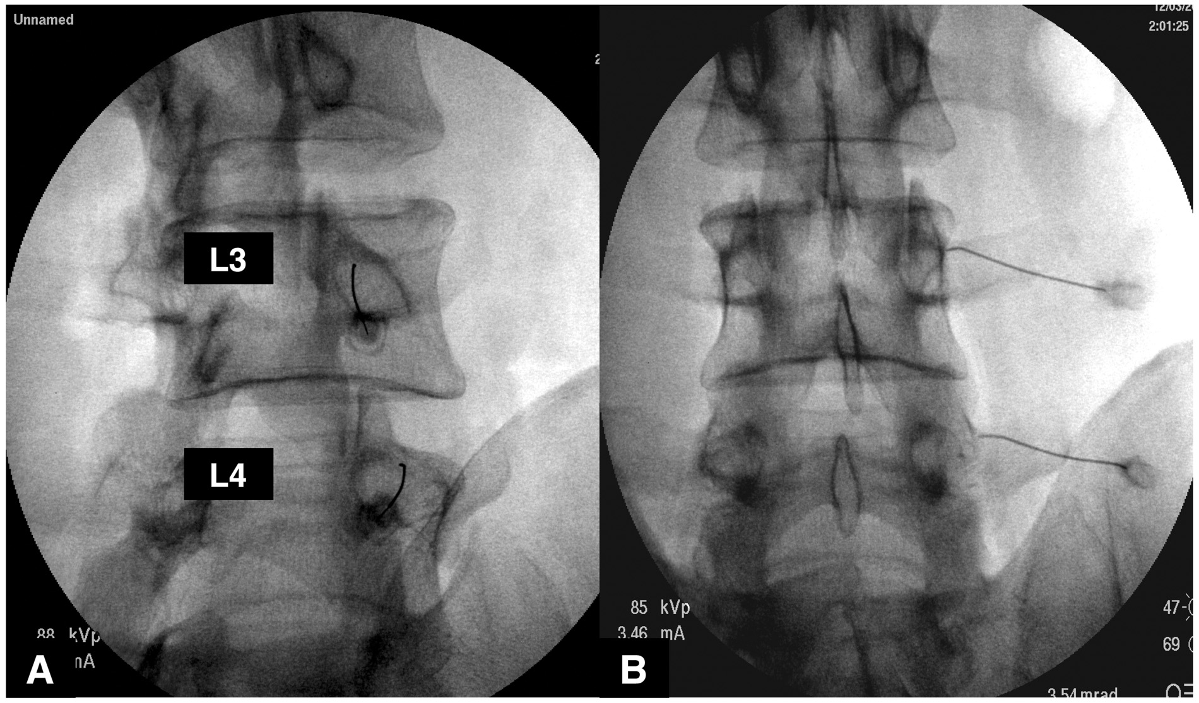
Adequate, but
slightly high
needle position
Image through the target disc space (segment)

Slide 65
Caudal decline view

Slide 66
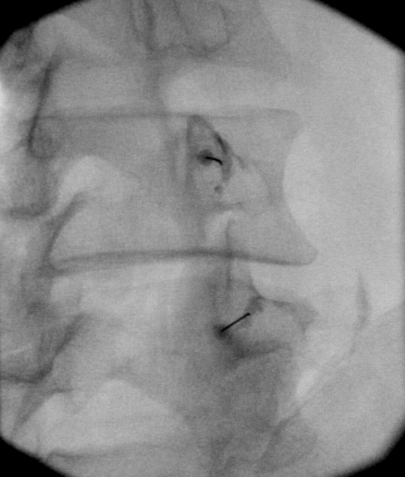
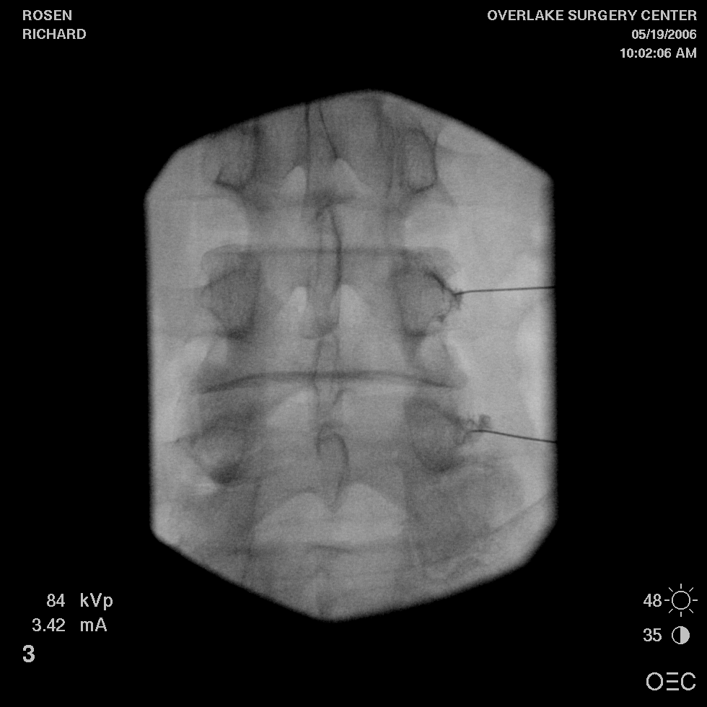
Image through the target disc space (segment)
Ideal flow and target position

Slide 67
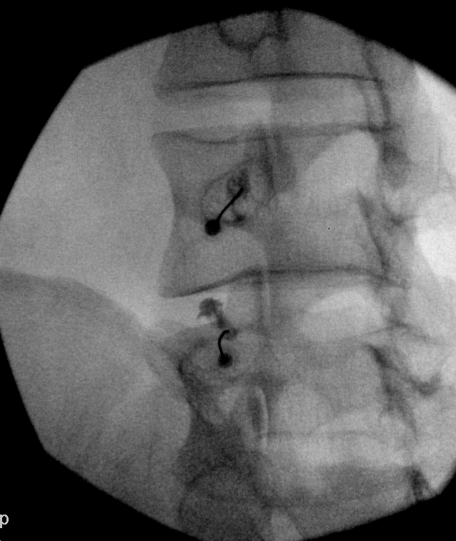
Try to avoid
Contrast flow
superior towards the IVF- consider
re-positioning

Slide 68
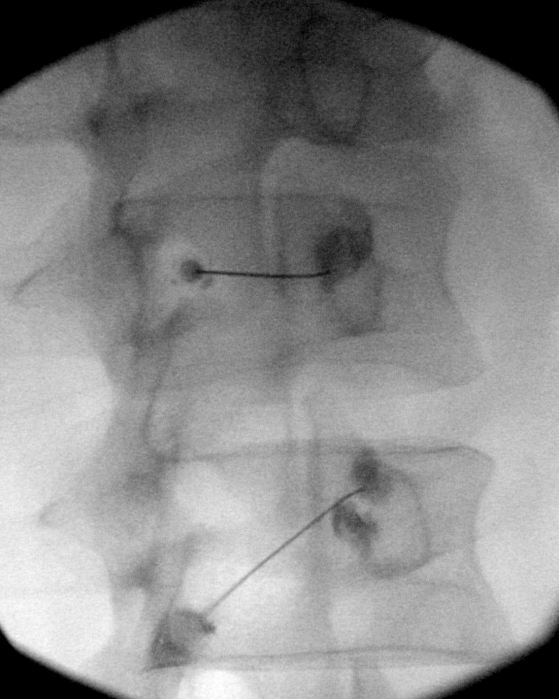
Initial flow at
MAL- needed
to redirect

Slide 69
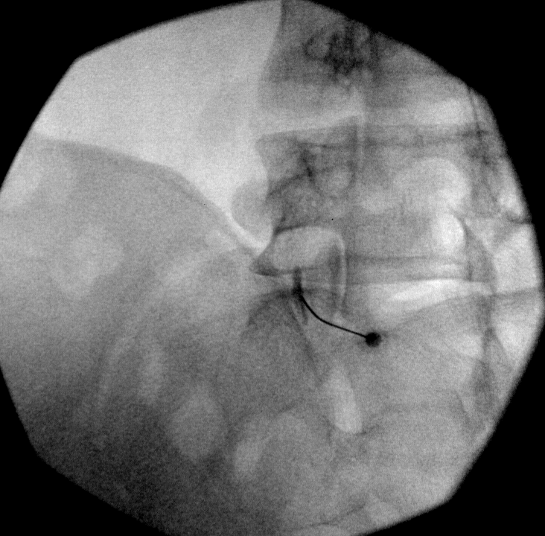
L5 DR block
Usual 15-20^{O}
Oblique to see target groove and
place the needle,
Block Approximately midway between the sup junction of S1SAP/ala and MAL
Tilt through
L5-S1 interspace
MAL
Adequate flow

Slide 70
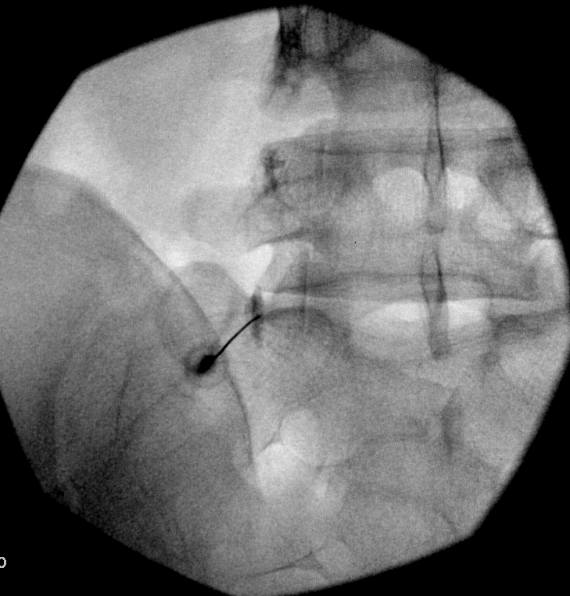

L5 DR block
Tilt through
L5-S1
Interspace
Adequate flow

Slide 71
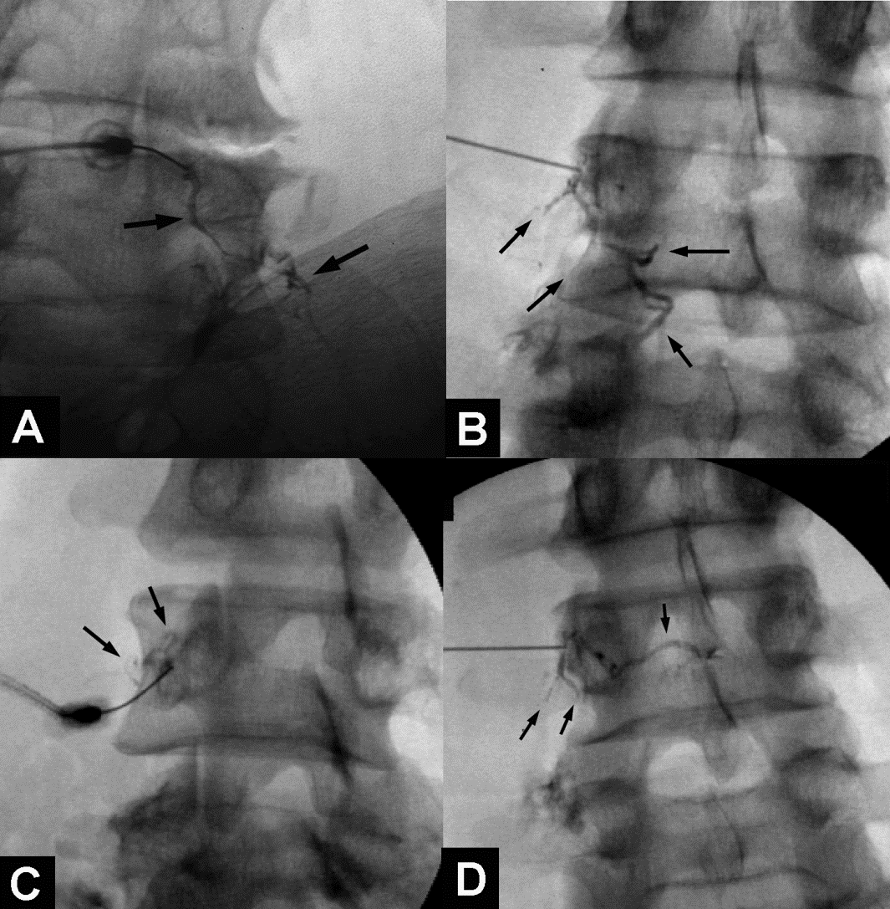
Venous Uptake:
> False negative
Provided by Dr. Paul Dreyfuss
8% incidence (Dreyfuss et al. Spine 1997;22:895-902)
3.7% incidence (Verrills. Spine 2008; 33: 174-177)
6.1% incidence (Lee et al. Anesth Analg 2008;106:1274-8)
Notes:
There is an association of 50% false negative rate in association with venous uptake, even after repositioning (Kaplan study). This spread cannot be picked up with ultrasound!

Slide 72
RADIOFREQUENCY ABLATION TECHNIQUE

Slide 73
Three Needle Views of Lumbar RFA
Pillar view (A)
  Drive View
Oblique View (B)
  Anatomic View
Lateral View (D)
  Safety View

Slide 75
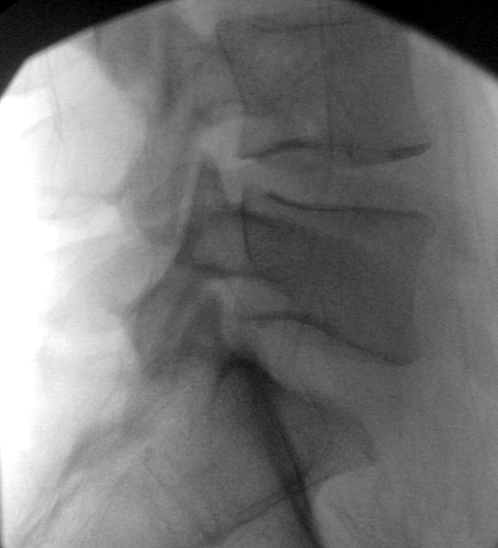
L5 sap
L4 mb
mal
L5 TP
L5
S1 sap
L5 dr
ala
S1
A
B
Lesion the middle 2/4^{ths} of the SAP for L1-4 MB RF
Lesion the mid and post 1/3 of the SAP for L5 DR RF

Slide 76
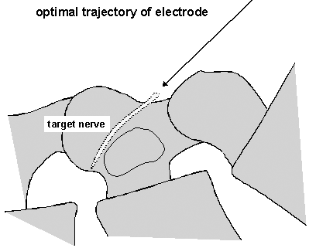
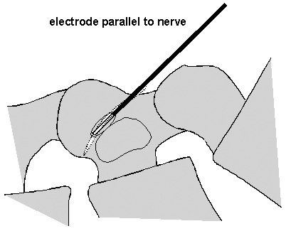

Slide 77
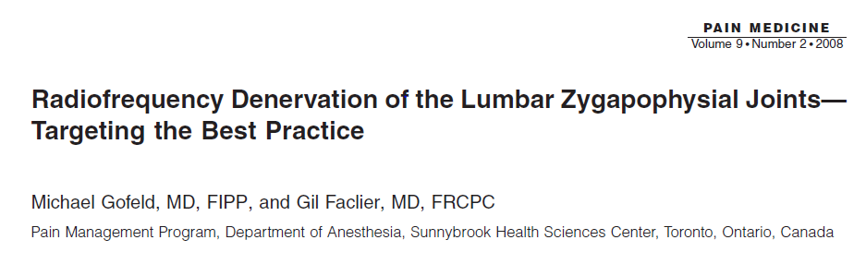


Slide 78



European
North American
Australian

Slide 79
Factors that Affect Lesion Size
Needle Gauge and Active Tip Length
Temperature of Lesion
  80-85 degrees C
Time of Lesion
  60-90 seconds
* 10-15 mm lesion corresponds = 9-12 months clinically significant relief

Slide 80
Why is Lesion Size Important?
“Larger lesions mean a larger tolerance of errors in electrodeplacement and of the inevitable variation in the anatomic positionof the medial branches.”
Lord, McDonald, Bogduk 1998

Slide 81

Needle Size and Burn Volume
Increase lesion size with 18g compared to 20g
Increased lesion size with rotation of curved cannula 180 degrees and second burn
Notice spherical shape of lesion
  No significant lesion past tip of needle

Slide 82


Slide 83



Notes:
This study was published in 2017 in Pain Physician. It compared lesion volumes as determined by lesion size in chicken breast in with three different needles types and varying gauges of each.
Cooled RF
Protruding Probe
Monopolar Probe

Slide 84

Notes:
The cooled RFA probed produced the largest volume lesion at 595 mm3 followed by the monopolar 18 gauge needles at 360 mm3
Notice the 18-gauge protruding probe produced a larger volume lesion (215 mm3) compared to its monopolar counterpart at 169 mm3

Slide 85


Slide 86


Slide 87
Optimal Technique = Optimal RF Outcomes
Study | Parallel Lesion? | Single/Multi Lesion | Needle Guage | Outcome
Leclaire, van Wijk | No |  | 22 | 33%
Burnham, van Kleef | Yes/near | single/multi | 22 | 55%
Cohen | yes | single | 20 | 64%
Dreyfuss, Reiz, Gofeld | yes | multi | 16-18 | 87%
McCormick 2015 | yes | single | 20 | 55% (pain/fx >50%)
MacVicar 2013 | yes | multi | 16 | 55% (complete relief)

Slide 88

Cohort study of 27 patients
Measured cross-sectional area of the multifid pre and post RFA via MRI
  Measured at mid-disc level, axial cuts, T2 images
No statistically significant differences in the cross-sectional area post RFA
Notes:
Should we worry about segmental instability after RFA?
Because we are undoubtedly denervating the multifidi in our practice we will only do one side at a time, 2 weeks for lumbar and one month for cervical

Slide 89
Conclusions:
Steps towards better LRF outcomes
Select patients so that odds of having facet pain are high
Meticulous medial branch block technique
Meticulous RF technique

Slide 90
Questions?

Slide 91
Thank You!

Slide 92
Citations
Bogduk, Nikolai. Practice Guidelines for Spinal Diagnostic and Treatment Procedures. International Spine Intervention Society, 2013.
Young, Sharon, et al. “Correlation of Clinical Examination Characteristics with Three Sources of Chronic Low Back Pain.” The Spine Journal, vol. 3, no. 6, 2003, pp. 460–465., doi:10.1016/s1529-9430(03)00151-7.
Laslett, Mark, et al. “Clinical Predictors of Screening Lumbar Zygapophyseal Joint Blocks: Development of Clinical Prediction Rules.” The Spine Journal, vol. 6, no. 4, 2006, pp. 370–379., doi:10.1016/j.spinee.2006.01.004.
Kushchayev, Sergiy V., et al. “ABCs of the Degenerative Spine.” Insights into Imaging, vol. 9, no. 2, 2018, pp. 253–274., doi:10.1007/s13244-017-0584-z.
Derby, Richard, et al. “Correlation of Lumbar Medial Branch Neurotomy Results with Diagnostic Medial Branch Block Cutoff Values to Optimize Therapeutic Outcome.” Pain Medicine, vol. 13, no. 12, 2012, pp. 1533–1546., doi:10.1111/j.1526-4637.2012.01500.x.
Cohen, Steven P, et al. “Consensus Practice Guidelines on Interventions for Lumbar Facet Joint Pain from a Multispecialty, International Working Group.” Regional Anesthesia & Pain Medicine, vol. 45, no. 6, 2020, pp. 424–467., doi:10.1136/rapm-2019-101243.
Cedeño, David L. “Comparisons of Lesion Volumes and SHAPES Produced by a Radiofrequency System with a Cooled, A Protruding, or A Monopolar Probe.” September 2017, vol. 6, no. 20;6, 2017, doi:10.36076/ppj.20.5.e915.
SIS 2021 Medicare LCD FAG. www.spineintervention.org/global_engine/download.aspx?fileid=7ED69984-11E9-4947-ADBC-23B83D03FCE5.

