Slide 1
Colorado Pain Society Pelvic Pain – an Updated Approach April 2018 Breckenridge, CO
Nel E. Gerig, MD
The Pelvic Solutions Center
Denver, CO
303-260-5092

Slide 2
Inflammatory
issues
Biomechanical
issues
Neuromyofascial
Pain
Neuropsychological
issues
©2018 The Pelvic Solutions Center

Slide 3
Pelvic pain lecture outline
Interstitial cystitis (bladder pain syndrome)
Pelvic nociception
Muscle tension
Pelvic neuralgias
Conditions which contribute to pelvic pain
History and physical examination tips
Treatment outline
Case presentation

Slide 4
Bladder Pain Syndrome/ Interstitial Cystitis

Slide 5
Interstitial Cystitis /Bladder Pain Syndrome = allodynia of the bladder
Frequency
Urgency
Bladder discomfort, pressure, pain with
bladder filling
usually short-lived relief with voiding
Absence of other etiologies (tumor, stone)
CLINICAL diagnosis
©2018 The Pelvic Solutions Center

Slide 6
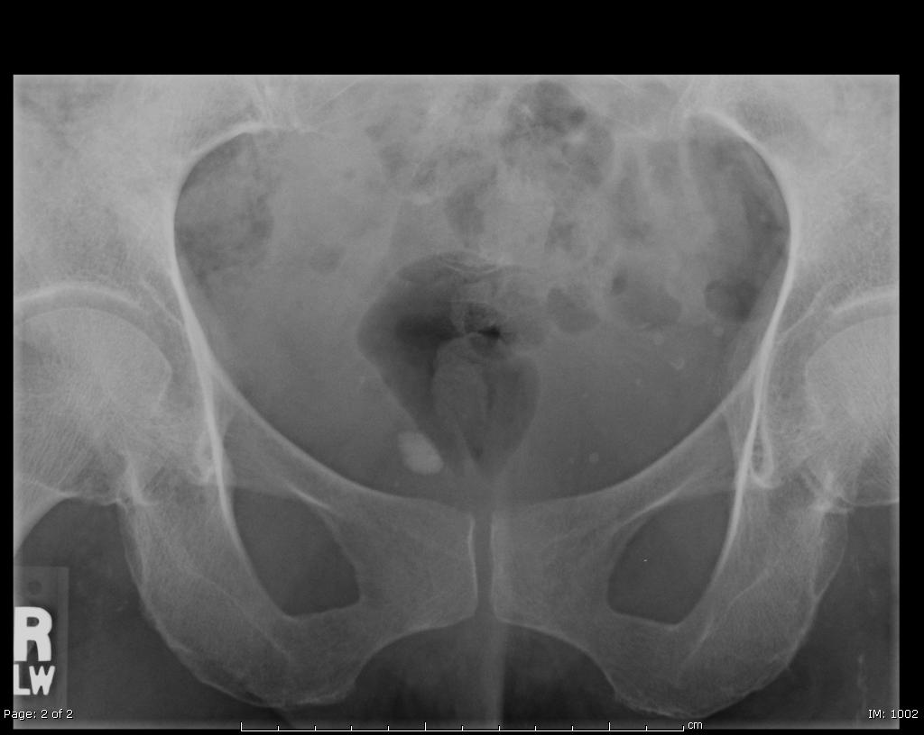

Slide 7
Role of GAG layer in IC/PBS: Defective Urothelial Barrier
Irritating Solutes
GAG Layer
Urothelium
Inflammation
Irritated Nerve
Parsons CL. Urol Clin North Am. 1994;21:93-100.
Notes:
Role of GAG Layer in IC: Defective Urothelial Barrier
This presentation will focus on the GAG deficiency as a potential cause of IC.
Normally, the GAG layer provides a permeability barrier, thereby preventing irritating solutes in urine from reaching the urothelium. A deficiency in the GAG layer allows these solutes to pass through the urothelium, which irritates the nerve cells and causes inflammation.
Parsons CL. The therapeutic role of sulfated polysaccharides in the urinary bladder. Urol Clin North Am. 1994;21: 93-100.

Slide 8
Interstitial cystitis ≠ Bladder Pain Syndrome
Ulcerative IC (Hunner’s “ulcers”)
LESS co-morbidity, severely reduced capacity, slightly older pt.s
Non-ulcerative
MULTIPLE co-morbidities
Phenotypes: myofascial, pudendal, systemic pain
?disorder of visceral or somatic hypersensitivity
? impaired function of ANS, vagus n., periaqueductal gray
Peters, KM et al UROL 78(2):301-308 2011
Chelimsky, T Intl. Pelvic Pain Society 2017
©2018 The Pelvic Solutions Center

Slide 9
Bladder Pain Syndrome/IC
The most successful rx. documented in RCCT:
Pelvic Physical Therapy
WHY?
Fitzgerald, MP et al, Randomized multicenter clinical trial of myofascial physical therapy in women with IC/PBS and pelvic floor tenderness. 2012. JU, 187(6), 2110-2118
Weiss, JM Pelvic floor myofascial trigger points: manual therapy for IC and the urgency-frequency syndrome. 2001. JU 166(6), 226-231.
©2018 The Pelvic Solutions Center

Slide 10
BPS/IC and pelvic floor muscles
Pelvic MRI pt.s with IC –
significantly shorter levator mm. bilaterally
hypertonicity
pelvic floor lifted
Clinical findings
94% levator tenderness on exam
Ackerman JU 181(4) Suppl E337 4/12
Peters, K UROL 71(4) 2008
©2018 The Pelvic Solutions Center

Slide 11
Pathophysiology of IC/PBS
Bladder
epithelial
insult
K⁺ leak
Inflammation
Release of neurotransmitters
inflammatory
mediators
“Metastatic”
pain
Muscle
spasticity
MORE
inflammation
windup
pain
Sensiti-zation
WIND-UP
©2018 The Pelvic Solutions Center

Slide 12
Pelvic nociception

Slide 13
Nociception ≠ Pain
Nociception is an input signal
The CNS attributes meaning to the signal
When the nociception is perceived/labelled as dangerous, the individual will experience pain
©2018 The Pelvic Solutions Center

Slide 14
Nociceptors of the Pelvis
Viscera autonomic nerves
bladder, urethra, ureters, prostate, uterus, adnexa, vagina, bowel, testicles
Somatic structures sensory/motor nerves
muscles, skin, fascia, bone
©2018 The Pelvic Solutions Center

Slide 15
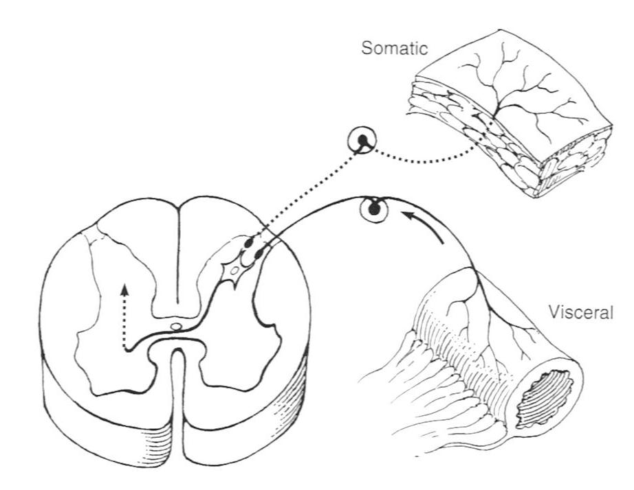
Viscerosomatic convergence

Slide 16
Viscerosomatic convergence
Normal function
coordination of body functions
Pathophysiology
severe or chronic noxious stimuli
alterations in pain processing
increased excitability, altered central processing,
messages amplified, output expanded
(allodynia, hyperalgesia, sensitization)
©2018 The Pelvic Solutions Center

Slide 17
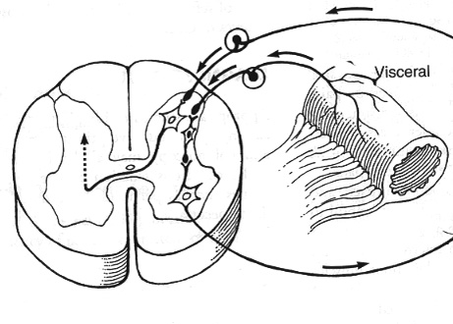
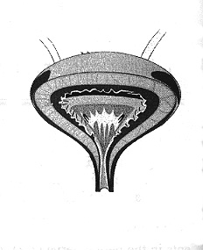
Viscerovisceral Hyperalgesia

Slide 18
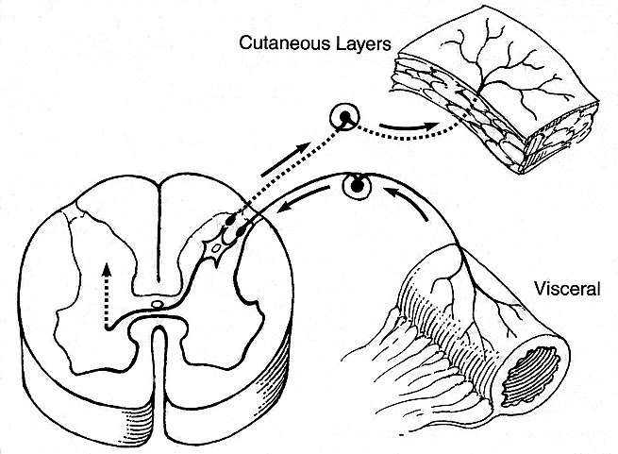
Viscerosomatic Hyperalgesia

Slide 19
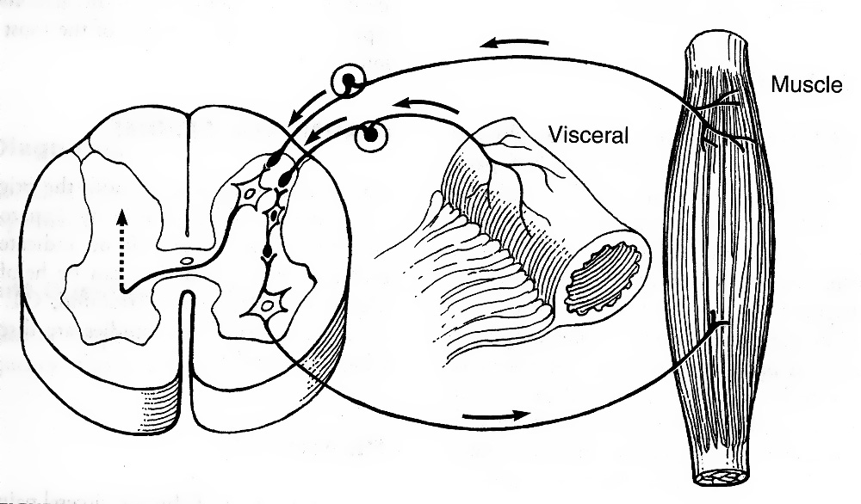
Viscero-Muscular Reflex

Slide 20
Pelvic viscerosomatic convergence
“Multiple sensory and motor signals at each spinal cord level are associated with the pelvic floor, contributing to a clinical presentation of pain patterns and behaviors that confuses and complicates the evaluation, diagnosis, and treatment of pelvic pain.”
Gorniak & King J Women’s Health PT Jan/Apr 2016
©2018 The Pelvic Solutions Center

Slide 21
Clinical Diagnoses Associated with IC
GYN | URO | GI | OTHER
Chronic Pelvic pain | Chronic prostatitis | Irritable bowel syndrome | Migraine HA
Endometriosis Dyspareunia Vaginismus | Recurrent cystitis | Proctalgia fugax | Fibromyalgia
Vulvodynia Vulvarvestibulitis Vulvar dermatoses | Urethral pain Frequency | Chronic constipation/ Dysfunctional elimination | Chronic fatigue syndrome
 | Idiopathic urinary retention | Dyspepsia | Low back pain Pelvic neuralgias Radiculopathy

Slide 22
Muscle tension

Slide 23
Myofascial pain and trigger points
Muscles with tenderness vs. trigger points
Tight AND weak
Surrounding muscle compensate, develop TPs, fascia contracts,
Alignment altered
Nerve compression
Autonomic upregulation
Lymphedema
Travell & Simons 1992
©2018 The Pelvic Solutions Center

Slide 24
Back/Pelvic floor/Abdominal muscle tension
Consequence of:
Any pelvic inflammation or chronic stimulation/pain
Instability/hypermobility
Guarding/bracing/“holding stress” in muscles
Referred pain from organs, joints, muscles, nerves, skin
Postural compensation (for injury, weakness, arthritic, etc.)
Repetitive minor trauma/straining
Injury – childbirth, surgical, athletic, traumatic
CAN originate from remote minor injury which has resolved
©2018 The Pelvic Solutions Center

Slide 25
Why the pelvis?
The unconscious (the dog)
“Medical PTSD”
Clenching
Unique relationship of supportive muscles with organs, skin, nerves
©2018 The Pelvic Solutions Center

Slide 26
Why the lumbopelvic region?
“Nodal site”
Muscles and aponeurotic fascia
attachment/movement/stabilization of:
upper extremities
spine, pelvis, SIJ
thoracic and abdominal musculature
lower extremities
©2018 The Pelvic Solutions Center

Slide 27
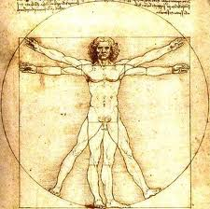

Slide 28
A case of pelvic floor muscle tension
27 y/0 M
Acute onset suprapubic, perineal, and penile pain
Urinary hesitancy
PMH: Total colectomy with ileoanal pull-through at age 7 for UC
SH: Studying for bar exam, failed first time

Slide 29
Neuralgias

Slide 30
Neuralgias which contribute to pelvic pain
Pudendal
1
Obturator
2
Ilioinguinal
Iliohypo-gastric
3
Genito- femoral
4
Cluneal
5
Other
6
Maigne’s Syndrome
7
©2018 The Pelvic Solutions Center
©

Slide 31
Pudendal neuralgia
Burning, stabbing, throbbing pain
Distribution of pudendal nerve or its branches
S2,3,4 → sacrotuberous/sacrospinous
ligaments → Alcock’s canal → 3 branches:
penile/clitoral, perineal, rectal
Labat, et al Neurourology and Urodynamics 2007.
(Nantes Criteria)
©2018 The Pelvic Solutions Center

Slide 32
Pudendal neuralgia
Pain:
clitoris/penis, distal urethra, labia/scrotum,
perineum, vagina, anus (foreign body sensation)
pain with voiding or defecation
painful orgasm or ejaculation
Exacerbated by sitting, relieved on toilet seat (sometimes)
Associated with tension/spasm of pelvic floor uscles
©2018 The Pelvic Solutions Center

Slide 33
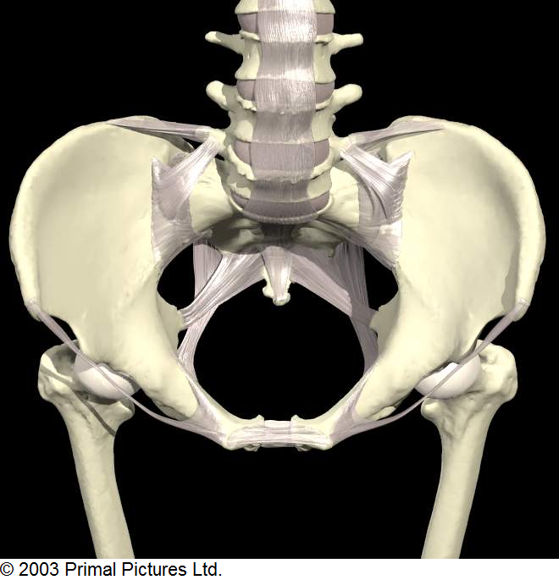

Slide 34
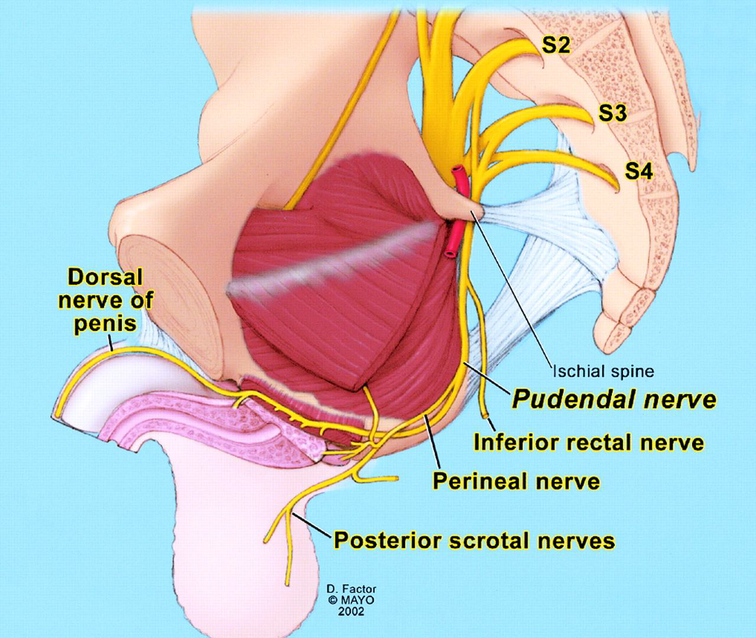

Slide 35
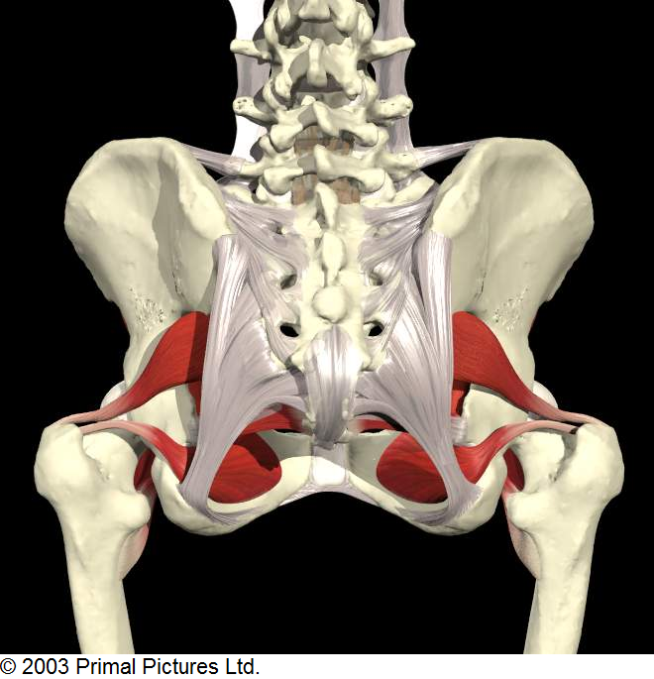

Slide 36
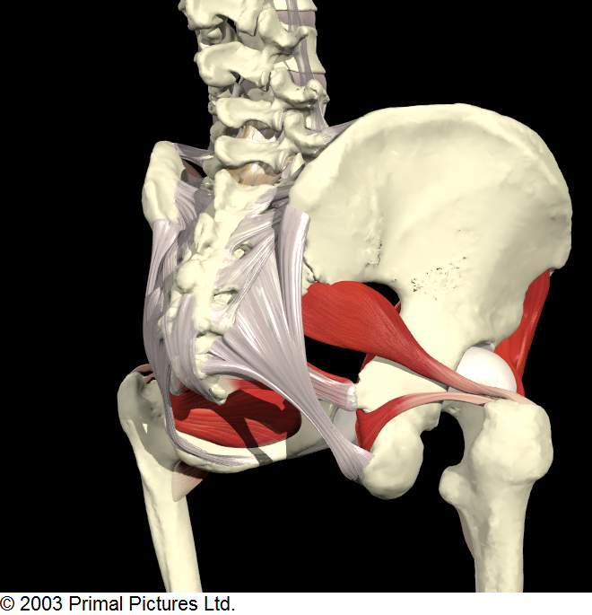

Slide 37
Causes of pudendal neuralgia
Malalignment
Spasm of obturator internus, levators
Trauma
(iatrogenic or other)
©2018 The Pelvic Solutions Center

Slide 38
Gynecological conditions which contribute to pelvic pain
Endometriosis
Painful menses
Recurrent infections (PID, BV, Candida)
Pregnancy/Labor/Delivery
Surgical procedures
Vulvar vestibulitis, other vulvar dermatoses
Ovarian cysts, adhesions
©2018 The Pelvic Solutions Center

Slide 39
Urological conditions which contribute to pelvic pain
Recurrent UTIs
BPS/IC
Prostatitis/chronic prostatitis
Surgical procedures
STDs
Fear of STDs
Prior painful experiences
Recurrent stone disease
©2018 The Pelvic Solutions Center

Slide 40
Orthopedic conditions which contribute to pelvic pain
Scoliosis
SI or SP instability/Iliac or sacral rotation
Hamstring tendinopathy
L5-S1 or other lumbar disease
Maigne’s syndrome
Hip labral tears/impingement
Extra-articular hip disorders/Pelvic girdle issues
Osteitis pubis
Extremity injury
©2018 The Pelvic Solutions Center

Slide 41
Neurological conditions which contribute to pelvic pain
Nerve injury/irritation/compression
LCFN, sciatic, (pyriformis syndrome)
obturator, ilioinguinal, iliohypogastric
genitofemoral, pudendal
Prior episodes of pain
MS
CRPS
©2018 The Pelvic Solutions Center

Slide 42
Rheumatological conditions which contribute to pelvic pain
Arthritis
Spondyloarthropathies
Systemic inflammatory disorders
Connective tissue disorders
hypermobility<-----------------> Ehlers-Danlos
©2018 The Pelvic Solutions Center

Slide 43
Oncological conditions which contribute to pelvic pain
Gyn/Urological/Colorectal/Other cancers
Surgical procedures
Radiation
Chemotherapy
Complications
Infections/abscess/fear of recurrence
Obstructive GI/GU pathology
©2018 The Pelvic Solutions Center

Slide 44
GI conditions which contribute to pelvic pain
Constipation
(NRPR, dysfunctional elimination in childhood)
Prolapse
Surgical procedures
Inflammatory bowel disease
IBS
Chronic diarrhea
©2018 The Pelvic Solutions Center

Slide 45
Vascular conditions which contribute to pelvic pain
Pelvic venous congestion syndrome
Arterial insufficiency
Smoking
©2018 The Pelvic Solutions Center

Slide 46
Psychological conditions which contribute to pelvic pain
Depression
Anxiety
Castrophizing/Rumination
Fear-avoidance
©2018 The Pelvic Solutions Center

Slide 47
Psychological conditions which contribute to pelvic pain
History of trauma
Early life trauma
abuse, family dysfunction, loss, MVA →
more likely to have any painful syndrome
childhood trauma → visceral hypersensitivity
Felitti, ACE Study Am J Preventive Med 1998
Greenwood & Johnson Stress-Induced Chronic Visceral Pain of GI Origin
Front. Syst. Neurosci. Nov. 2017; 11:86
©2018 The Pelvic Solutions Center

Slide 48
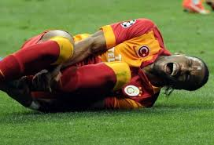
Societal conditions which contribute to pelvic pain
Trauma/abuse/family dysfunction
Athleticism
Expectations
©2018 The Pelvic Solutions Center

Slide 49
Inflammatory
issues
Biomechanical
issues
Neuromyofascial
Pain
BPS/IC
Endometriosis
IBD
Rec. infections
Malalignment
LE injury
Pelvic venous congestion
Neuropsychological
issues
Anxiety
Depression
h/o trauma
Learned pain behaviors
CNS/periph. n. injury
©2018 The Pelvic Solutions Center

Slide 50
Pause

Slide 51
History and Physical Examination of the patient with pelvic pain

Slide 52
AK
53 y/o F awakened during night w/ left-sided deep pelvic/LLQ aching/burning
Pain became excruciating → 5 ER visits, hospitalization
Pelvic USN neg.
Lumbar MRI: bulging discs L1 – 4, received ESIs L1 – 4 which did help some
During hospitalization:
“Back injections”
Diagnostic laparoroscopy by GYN, Gen Surg (neg., no hernia)
Cystoscopy, left ureteral stent placement (not beneficial)
Post-hospitalization lap hyst, BSO (planned prev.) → no benefit
Ilioinguinal/iliohypogastric block helped for 2 days

Slide 53
History
Quality, location, exacerbating/relieving factors
PRIOR history
The Pelvic Pain ROS

Slide 54
AK history
Prior history: 4 hr. road trip, felt twinge or pop in left back
Pelvic Pain ROS:
Pain with sitting: At onset, could NOT sit due to pain. Better now.
Bladder issues: Rec. UTIs, always respond to abx., < 2/year
Bowel issues/pain: Constipation from narcotics, nothing prior
Gyn issues/pain: h/o uterine ablation, bleeding continued. Hysteroscopy could not be done due to tight cervix. Now S/P hyst. No h/o endometriosis.
Sexual issues?: No prior dyspareunia, present now. Pain flares after intercourse.
Back: as per HPI. Now gets mild LBP and back “feels crunchy”.
Coccyx: no h/o injury/fracture

Slide 55
AK pelvic pain ROS, cont.
Hips: no pain, clicking, or popping
Extremities: h/o Left ACL repair x 2. Still very bothersome.
Hypermobility: Yes Beighton score 6/9
Sports participation: gymnastics through college
adult: has continued to run and use elliptical despite L knee pain

Slide 56
AK pelvic pain ROS, cont.
Mood: frustrated by ongoing pain, denies depression
Sleep: can be interrupted by pain
Clenching behaviors: denies
Trauma hx: TIA vs. complex migraine, resolved.
Exacerbating factors: sitting
Relieving factors: lying flat, standing, chiropractic rx. with accupuncture

Slide 57
Physical examination of the patient with pelvic pain
Back: spine, paraspinals, SIJ, QL, CVA
Abdomen: rectus abdominus
Iliopsoas
Inguinal region
Pelvic girdle:
hip
glutes
sacrum
ITB
symphysis pubis

Slide 58
Pelvic examination (female)
©2018 The Pelvic Solutions Center

Slide 59
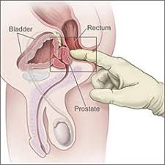
Pelvic examination (male)
©2018 The Pelvic Solutions Center

Slide 60
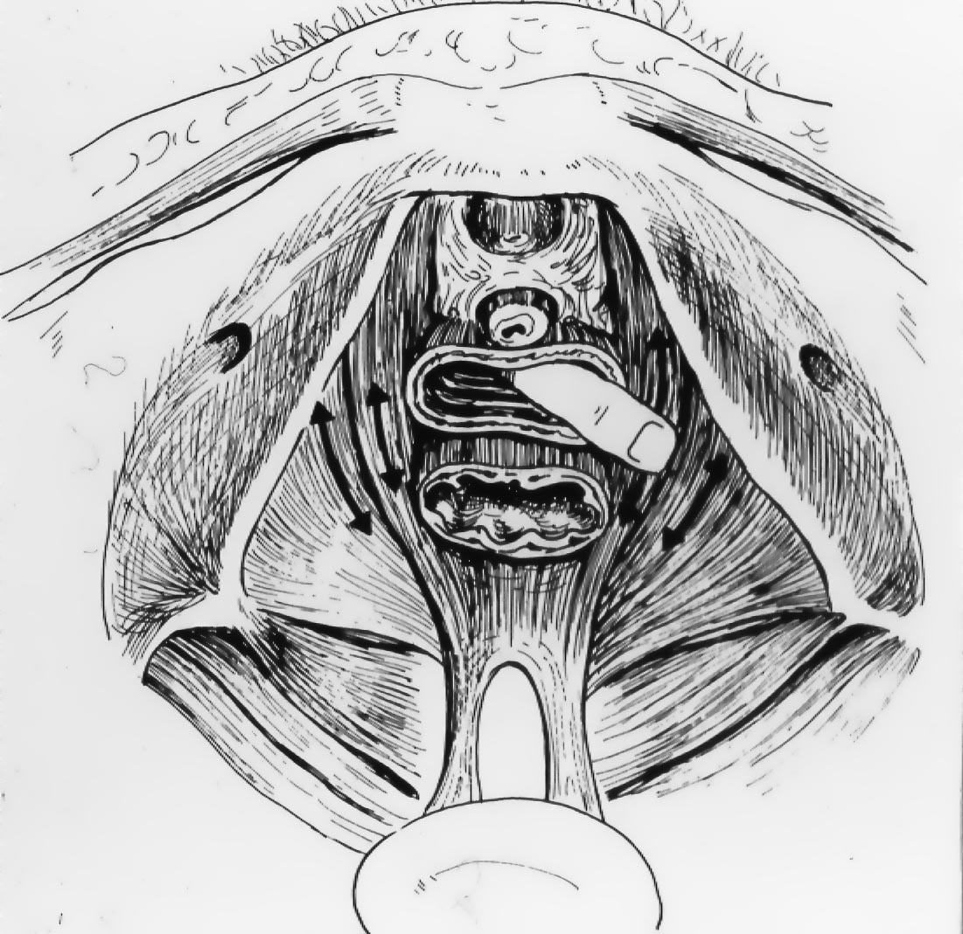
Pelvic
examination
for
pain
(as
demonstrated
for
female
patient)

Slide 61
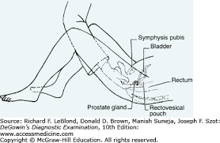
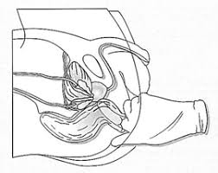
Pelvic examination for male patient
©2017ThePelvicSolutionsCenter
©2018 The Pelvic Solutions Center

Slide 62
AK Physical exam
Lean, fit, healthy-appearing. Normal mood/affect. Husband present for visit.
Gait not evaluated
Back: neg.
Abd: PSOAS - mod. tender left, mildly tender right
ILIACUS - very tender left, mod. tender right
Rectus - tender left mid-abd.

Slide 63
AK Physical exam
Pelvic: adductors, ischial tuberosities NT
ext. genitalia nl., bladder and urethra NT, no prolapse, introitus/vestibule nl.
LEVATORS: all tender left
OBTURATOR INTERNUS: tender left
Alcock’s canal: slightly tender left
Sacrospinous ligament, coccyx NT

Slide 64
Pelvic pain goals of treatment
Optimize alignment
Reduce muscle tension
Address neurological issues
nerve compression
sensitization/neurological upregulation
Treat inflammation
Other
©2018 The Pelvic Solutions Center

Slide 65
Goal: Optimize alignment
Physical therapy
Osteopathic manipulation
Prolotherapy
Surgical stabilization/repair
©2018 The Pelvic Solutions Center

Slide 66
Goal: Reduce muscle tension
Physical therapy
Trigger point dry needling/injections
Muscle relaxants
Stress management
Mindfulness Meditation
Massage (?)
Botox
©2018 The Pelvic Solutions Center

Slide 67
Goal: relieve nerve compression address sensitization
nerve compression (named, unnamed nerves)
address sensitization with NEUROMODULATION
PT
heat/ice
meditation
yoga
medications
nerve blocks
TENS
neurostimulator
©2018 The Pelvic Solutions Center

Slide 68
Goal: treat inflammation, any other pain generators
IC, Endometriosis, IBD, etc.
Trauma-based therapy
Psychological pain therapy
©2018 The Pelvic Solutions Center

Slide 69
AK
Diagnosis: left abdominopelvic muscle tension due to compensatory posturing
Treatment:
Left TKA
Physical therapy
Gabapentin, muscle relaxants, tapering narcotics
Two years after initial visit:
off all meds except Lidoderm patch prn.
nagging numbness/tingling L groin, not constant, does not prevent sleep
still getting some myofascial work on left iliopsoas

Slide 70
docgerig@gmail.com

