Slide 1
Sleep Medicine: Relevance of Sleep Disorder for Chronic Pain Specialist
Joe Forrester, MD: NO financial conflicts
Board Certified Sleep Medicine
Sleep Director: The Medical Center of Aurora
North Suburban Medical center

Slide 2
Overview
Prevalence of Sleep Disorders in General Population
Increased Prevalence in Chronic Pain Patients
Relationship between Sleep and Chronic Pain
How to Evaluate Sleep Disorders
Role of Polysomnogram
Central Sleep Apnea’s Relationship to Chronic Narcotic Use

Slide 3
Prevalence of Sleep Disorder Symptoms in the General Population
Insomnia- perception of inadequate sleep or ability to feel rested.
30% of population intermittent
6-15% chronic insomnia.
Hypersomnia- excessive daytime sleepiness
9% of general population
Sleep Apnea found in 2-4%
RLS 5%
Narcolepsy 0.04%
Depression and Chronic Pain- Bidirectional
JAMA. 1989;262(11):1479-1484.
Sleep Medicine Research (SMR) 2011; 2(1): 1-9.

Slide 4
Symptoms of a Sleep Deprivation are more Common in patients with Chronic Pain than in General Population
Chronic Insomnia
40%-70% of chronic pain patients complain of poor quality sleep based on Pittsburgh Sleep Quality Index score.
20% of patients with chronic neck and back pain report sleeping less than 4 hours per night.
Hypersomnia?
36% of 140 patients in a pain clinic who were not screed for risk of sleep apnea underwent polysomnograms and were found to have severe sleep apnea with an AHI >30/hr. Pain Med. 2008 May-Jun; 9(4):425-32
Eur Rev Med Pharmacol Sci. 2014;18(17):2475-81.

Slide 5
Pain and Fragmented Sleep Share other Comorbidities
Sleep and pain disorders share increased frequency: obesity, type 2 diabetes mellitus, and depression.
Many Patients with Chronic Pain have other medical conditions that have a high incidence of sleep disorders.
COPD
Cerebral Vascular Disease
Atrial fibrillation
Hypertension
CHF

Slide 6
What is the Impact of Pain on Sleep
Reduced sleep duration and efficiency.
Less control over sleep.
Worry about lack of sleep effecting their health
More sensitive to environmental factors: noise, light, temperature, etcetera.
2015 Sleep in America Poll
Chronic pain patients sleep on overage 42 minutes less
Only 40% of chronic pain patients report good or very good quality sleep.

Slide 7
Interim Summary
Sleep disorders are common in chronic pain patients
Both insomnia and hypersomnia are common symptoms
Comorbidities Increase the prevalence of sleep disorders in chronic pain patients.

Slide 8
Directional Model of Sleep and Pain
Insomnia
Sleep Deprivation
Or
Fragmentation
Pain
Hypersomnia
Finan, Patrick et al. The association of sleep and pain: Anupdate and a path forward. J Pain 2013

Slide 9
Data Supporting the Directional Relationship: Insomnia Pain
Danish patients with insomnia and infrequent episodic tension-headaches were more likely to develop chronic tension type headaches. Eur J Epidemiol. 2005;20:243-249.
Insomnia symptoms in a headache-free Norwegian population was predictive of both the development of tension-type and migraine headaches over an 11years follow-up. The Journal of Head and Face Pain. 2011;51:570-580.
Population based study found that insomnia symptoms at baseline significantly increased the risk of developing chronic musculoskeletal pain at 17 years follow-up. Scandinavian Journal Pain. 2012;3:210-07.
Population based study of Norwegian women found that women who reported frequent difficulty falling asleep or having sleep disorder were significantly more likely to develop fibromyalgia. Arthritis Rheum. 2012;64:281-4.
Transition from insomnia to Quality sleep over 15 months has been shown to predict resolution of chronic widespread pain syndrome. Rheumatology 2008:47,1809-1813

Slide 10
Data Supporting the Directional Relationship: Pain Insomnia
Tang compared 70 patients with chronic back pain to 70 age-gender matched pain-free controls.
Measured sleep disturbance, pain perception, health status, anxiety and depression, and other psychologic variables.
Insomnia severity associated with pain severity and general anxiety
McCraken et al evaluated 159 patients referred to a pain center for sleep disturbance.
79% met criteria for significant insomnia based on self reporting
Clinical Insomnia was Reported in:
53% of chronic pain patients
3% of controls

Slide 11
Data Supporting the Directional Relationship: Hypersomnia Pain
22 Healthy subjects subjected to 2 nights of sleep deprivation(<4hours) increased frequency of pain complaints and this effect increased as the number of nights of partial sleep deprivation increases. Pain. 2005;119:56-64.
A study of 27 normal controls and 27 patients with RA underwent 4 hour sleep restriction for one night.
pain, fatigue, depression and anxiety was reported by the RA patients but not controls. Disease specific measures of pain severity and painful joint counts increased in the RA patients. Sleep 2012;35;537.
A Forced Awakening study in a small group of otherwise normal female subjects resulted in increase report of spontaneous pain.
Women with OSA have a 10 fold increased frequency of Fibromyalgia.

Slide 12
Objective Testing of Sleep in patients with Insomnia finds less severe disruption than when Subjective reporting by Patients with Chronic Pain
Self reported sleep diaries overstate SOL, loss TST, WASO, reduced SE when compared to Actigraphy or PSG.
Insomnia patients with or without pain have a similar difficulty with sleep maintenance on nocturnal PSG testing.
Minor Changes in SOL, TST, WASO, SE on nocturnal PSG
No Consistent change in sleep architecture
No increase in PLMS
No Increase in Sleep Apnea without comorbidities or respiratory affecting medications

Slide 13
Summary
Strong support for bidirectional relationship between fragmented sleep and pain.
Patient self report sleep disturbance more frequently than objective measurements.
Insomnia reported more frequently than hypersomnia.
Few changes in nocturnal polysomnograms in patients with chronic pain and insomnia compared to controls

Slide 14
Evaluation Tools for Patients with Disruptive Sleep Symptoms
Efficient evaluation for sleep disorder for patients in your practice
Questionnaire
Personal Sleep Tracker, Actigraphy, or Sleep Log
Sleep Study: Home or In-lab sleep study

Slide 15
Questionnaires as Screening Tools Over 30 to choose from
Time efficient
Easy for office staff to use
Reasonable sensitivity and Specificity

Slide 16
Insomnia Severity Index rate in the last 2 weeks 7 symptoms < 8 no significant insomnia; >15 insomnia or sleep problem
Percentage of clinical sample who endorsed each item response
Item ISI | Item response choice*
 | 0 | 1 | 2 | 3 | 4
1. falling asleep
2. staying asleep
3. Early awakening
4. satisfaction
5. interference
6. noticeable
7. worry
0 no problem and 4: (very severe, dissatisfied, interfere, noticeable, worried,)

Slide 17
Hypersomnia Sleep Questionnaire
Berlin Questionnaire
11 questions
Epworth Sleepiness Scale
24 point scale
STOP-BANG Questionnaire
8 Questions

Slide 18
STOP-BANG Questionnaire Simple: no 0/yes 1
Stop
Tired
Observed
Pressure
BMI
AGE
Neck Size
Gender
Stop
Tired
Observed
Pressure
BMI
AGE (>50)
Neck Size (17in)
Gender (M)
Low risk: 0-2
Intermediate 3-4
High 5-8

Slide 19
Tools for Tracking Sleep over Time
Personal Sleep Tracker: A number of smart phone/watch products such as: Use with Sleep Diary.
Sleep tracker
Autosleep
Two week Sleep Diary- Subjective
Actigraphy an office based device with CPT code- Objectivity
Day/night
Sleep and wakefulness based on movement

Slide 20
Polysomnograms
Unexplained Insomnia—particularly in women
Hypersomnia
Nocturnal Hypoxemia
Presence of comorbidities with risk OSA
Obesity, atrial fibrillation, CHF, COPD, CVA
Presence of comorbidities with high risk of CSA.
Narcotic Use

Slide 21
Insomnia
History suggests to you Insomnia
Insomnia Severity Index: > 15

Slide 22
Causes of Chronic Insomnia:
Psychiatric disorders
Medical disorders: COPD,CHF, GERD, Endocrine disorders
Medications
Neurologic disorders
Sleep disorders: OSA/CSA; RLS; Circadian Rhythm disorders

Slide 23
Evaluation and Treatment of Chronic Insomnia for Pain Specialist
Non-pharmacotherapy
Components of CBT-I that can be provided by pain specialist
Assess the risk for Hypersomnia Syndromes
Ordering a Sleep Study
Medications for Insomnia
Non-dependent
Dependent
Psychiatric or Insomnia Specialist

Slide 24
Components of CBT-I than can be partially addressed more simply and with Handouts
Sleep hygiene
Increases patients awareness of behavior or environmental factors that impact sleep
Stimulus control
Limit use of bed to sleep and sex, limit daytime naps
Sleep restriction
Limit time in bed to actual sleep time

Slide 25
Medications for Insomnia
Non-Addictive
Addictive
Melatonin/ramelteon-hallucinations
Orexin antagonists – very limited benefit and expensive
Antidepressant-neuropathic pain/CGP
Antipsychotics Anxiolytic—anxiety
Gabapentin—neuropathic pain and RLS
Non-benzodiazepine GABA receptor
reports possible contribution to death when used in combination with opiates
Zolpidem/zaleplon
Eszopiclone- antidepressants/ anxiolytics
Benzodiazepine
Potentiates Respiratory Depression
Opiates- RLS

Slide 26
Cognitive Behavior Therapy for Insomnia
Has been shown to improved sleep in patients with Chronic Pain and sustain improvement for 6 months
Equally effective or more effective than pharmacotherapy
Referral to a Professional trained in CBTI
Psychoeducation about sleep and Insomnia
Stimulus control
Sleep restriction
Sleep hygiene
Relaxation training
Cognitive Therapy

Slide 27
Hypersomnia
History or observation suggests sleepiness
Supporting Questionnaire –STOP-BANG: >8

Slide 28
Diagnosis Tests and Causes for Hypersomnolence
Sleep Apnea— PSG
RLS- Historical Diagnosis
Narcolepsy-PSG/MSLT
Insufficient Sleep-History
Depression- History/Questionnaire
Circadian Rhythm Disorders- Sleep Diary

Slide 29
Treatment of Hypersomnia Conditions
OSA---CPAP/Dental Devices/Surgery
RLS-----Iron replacement, symptomatic treatment, Dopamine agonists, gabapentin, opiates
Narcolepsy--------wakefulness medications
Insufficient Sleep------Sleep Hygiene Education
Depression-----Antidepressants
Circadian Rhythm Disorders—Light therapy/melatonin

Slide 30
Narcotics and Central Sleep Apnea

Slide 31
Narcotics for Pain and SDB
*In 1997 the American Academy of Pain Medicine and the American Pain Society stated that “it is now accepted…that respiratory depression induced by opioids tends to be a short lived phenomenon, generally occurs only in opioid-naïive patients and is antagonized by pain. Therefore, withholding the appropriate use of opioids from a patient who is experiencing pain on the basis of respiratory concerns is unwarranted.”
* In 2007 the broad spectrum of SRBD under opioids were described retrospectively by Walker et al. Besides obstructive disturbances, they found central apneas, ataxic or irregular respiration, and periods of sustained hypoventilation.
Winifred, et al. Opioid Induced Sleep Apnea: Is it a real problem. J Clin Sleep Med 2012

Slide 32
Prevalence of Sleep Apnea in Patients on Chronic narcotics for Pain control
Recent studies have shown that 75-85% of patients on opioids have at least mild sleep apnea, and 36-41% have severe sleep apnea, of which the severity is dose dependent.
Mogri etal. Hypoxemia in patients on chronic opiate therapy with and without sleep apnea. Sleep Breath. 2009;13:49–57
36% of 140 patients in a pain clinic who underwent polysomnograms independent of risk factors for sleep apnea had an AHI >30/hr.—severe.
Pain Med. 2008 May-Jun; 9(4):425-32
20 patients referred to a sleep center from a pain clinic with symptoms c/w sleep apnea had an average AHI was 64/hr.
16/20 had central sleep apnea.
J Clin Sleep Med. 2014 Jun 15; 10(6): 637–643.

Slide 33
Medical Malpractice and prescription painkillers
The following are examples of medical malpractice when doctors negligently prescribe prescription painkillers that may injure, harm, or even cause death to patients.
Some physicians place patients on high doses of painkillers when unnecessary, putting them at risk of an overdose
Patients are treated with these drugs for longer than necessary, increasing the likelihood that they may become addicted
Patients are not a proper candidate for a particular opioid painkiller, but it's prescribed to them anyway (e.g. patients suffer from conditions such as sleep apnea and pulmonary problems) which make the use of opioid painkillers very dangerous.
Patients are switched from one powerful painkiller to another by their doctor (practice is known as opioid rotation) may also face serious health risks, either from an interaction between two drugs, or because a new medication is much stronger than the old.

Slide 34
Opiate Effect on Breathing
Suppress respiratory rate and tidal volume by directly binding to mu receptors in CNS.
Most patients have little or no daytime hypercapnia unless the narcotic dose is very high or the patient has comorbidities such as CHF or COPD.
Narcotics may also disrupt sleep architecture by decreasing stage REM sleep, stage N3 sleep, and reduce sleep efficiency.
Large number of arousals from sleep due to inducing sleep related breathing disorder.
J Clin Sleep Med. 2014 Jun 15; 10(6): 637–643.

Slide 35
What does Central Sleep Apnea look like in Chronic Narcotic Use
Occurs during non-REM Sleep
Somewhat chaotic pattern of breathing between apnea episodes---Very different from Cheyne Stokes apneas.
Apnea events have variable duration
Often high frequency

Slide 36
Patterns of Central Sleep Apnea
Biot’s Breathing
* Pattern in Narcotic associated
Cheyne Stokes Breathing
* pattern in CHF with low EF
Images from SEEK ACCP for sleep medicine 2017

Slide 37
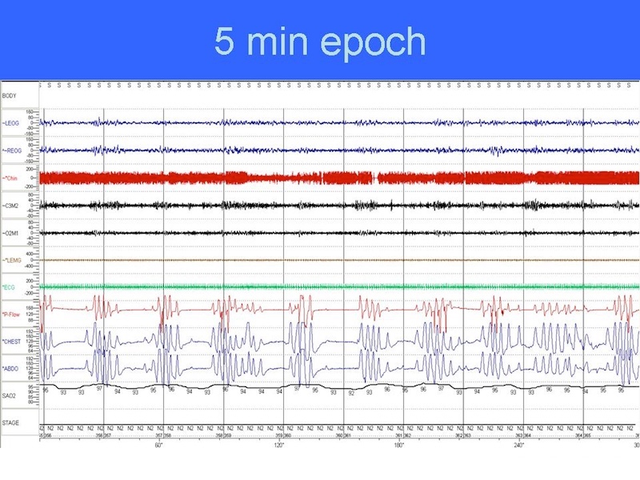
Typical PSG in a patient with Narcotic Induced CSA

Slide 38
How do you evaluate Sleep Apnea in a Patient with Chronic Pain?
Index of suspicion that it is present
Establish risk of isolated OSA vs. mixed OSA/CSA
Comorbidities?
Decide test:
Home Sleep Testing or In-lab Polysomnogram

Slide 39
Home Sleep Testing Unattended
Level III HST devices require 4 channels
2 devices: airflow and respiratory movement
ECG or pulse
Oxygen saturation
WatchPAT
Peripheral arterial tone---also pulse and oxygen saturation
Respiratory Effort generator
Does Not measure of flow
Do not measure limb movements
Most Record time in bed not sleep time or sleep stages although many combine with actigraphy to determine sleep time

Slide 40
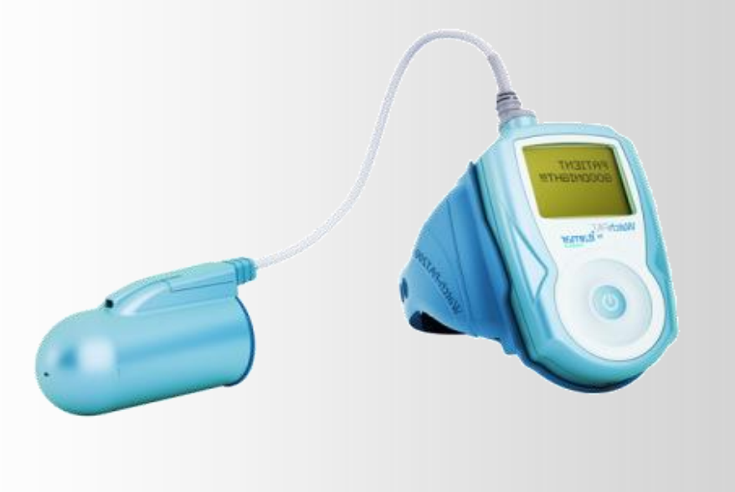
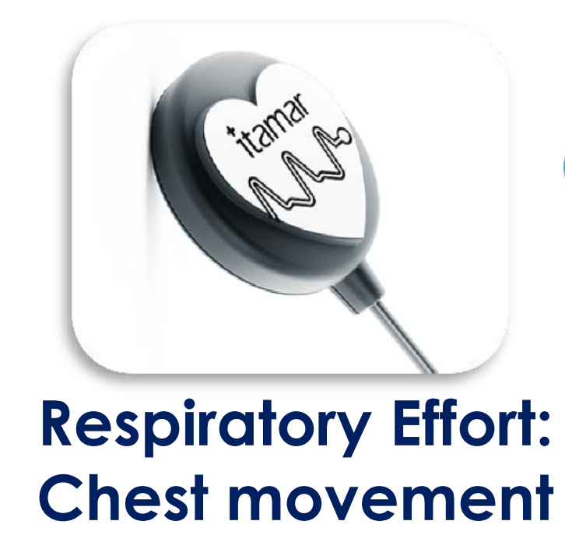
WatchPat Home Sleep Testing device
PAT signal
Peripheral Arterial Tone
Central Pulse Respiratory Effort generator

Slide 41
When do you use Home Sleep testing and when do you order in-lab testing?
Home sleep Testing(Type III)
Patients with high pretest probability of OSA who are candidates for Auto-PAP.
Patients unlikely to need supplemental oxygen
Low pretest probability of OSA
CSA?—screening tool
Low pretest probability
Does not want an in-lab test
Assist with guiding narcotic therapy
In-lab Sleep testing
Patients with insomnia
Patients with specific comorbidities
COPD with hypoxemia
CVA
CHF
Patients with significant risk of central sleep apnea
CHF with LV failure
Narcotic associated CSA

Slide 42
Benefit of In-Lab Sleep Study
Evaluates total sleep time rather than time in bed
Measure airflow rather than a surrogate for airflow such as vascular tone.
Attendant can ensure device is applied and adjusted correctly.
Measures Sleep, Respiration, and body movement disorders.
Therapy for central sleep apnea the same night.
ASV
Approval for supplemental oxygen the same night.

Slide 43
ASV is the PAP treatment of choice for narcotic associated CSA
Studies now support adaptive servo ventilation(ASV) with or without demonstration of CPAP failure during in lab diagnostic split night sleep study.
ASV can eliminate Central Apneas.
J Clin Sleep Med. 2014 Jun 15;10(6):637-43.
J Clin Sleep Med. 2012 Oct 15;8(5):569-76.
J Clin Sleep Med. 2008 Aug 15;4(4):305-10.

Slide 44
Ordering In-Lab Split Night Sleep Study in Patients on Chronic Narcotics
Specify Split night study
State in the order risk for CSA due to narcotic use and titrate with ASV if CSA present.

Slide 45
What is ASV?
It is a pressure therapy like CPAP or Bilevel.
Detects pauses in breathing—Apneas
Ensures a certain number of breath per minute in patients who fail to initiate a breath.
Varies the inspiratory pressure support based on that breaths inspiratory pressure needs.
Does not ensure a tidal volume.

Slide 46
When should ASV not be used?
Patients with Cheyne Stokes central apneas and systolic heart failure with ejection fraction less than 45%.
SERVE-HV study NEJM 2015
Patients who need non-invasive volume regulated ventilation.
Neuromuscular weakness disorders
Chronic severe hypoventilation
Severe COPD with hypercarbia

Slide 47
Summary:
Insomnia
Sleep Deprivation
Or
Fragmentation
Pain
Hypersomnia

Slide 48
Summary
Simple screening for sleep disturbance in patients with chronic pain is important.
Screening can be adequately performed with simple questionnaires for Insomnia and hypersomnia.
Some aspects of Insomnia can be managed relatively simply by non psychiatrists/therapists.
Sleep studies are important for patients with hypersomnia or chronic narcotic therapy.
Generally in-patient sleep studies should be performed in those who have a risk for central sleep apnea.
Narcotic associated central sleep apnea is best treated with ASV modality when patients must continue narcotic analgesics.
Bilevel ASV is not a mode for patients who need an ensured tidal volume.

