Slide 1
Cervical ESIs: What’s the Evidence?
Haley Burke, MD
April 7th, 2018
Colorado Pain Society Annual Meeting

Slide 2
Objectives
Identify the common pathologies treated by C-ESI
Understand obstacles to determining efficacy of this procedure
Understand current literature support for different approaches to cervical epidurals

Slide 3
Disclosures:
Speakers Bureau for Amgen and Depomed

Slide 4
Neck Pain: Background
Annual Prevalence rate exceeds 30%
50% of all individuals experiencing neck pain will have chronic symptoms
Lifetime risk of developing cervicalgia approaches 50% in the general population.
4th leading cause of disability in the United states according to the Global Burden of Disease 2010.
Ranks behind back pain, depression, and arthralgias, though associated with all 3
Cohen S. Epidemiology, Diagnosis, and Treatment of Neck Pain. Mayo Clin Proc. 2015:90(2).

Slide 5
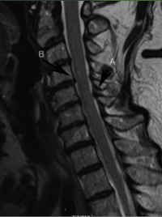
Who Develops Neck Pain?
Women more than men
Possibly most common in middle age.
Contributing factors associated with other rheumatologic conditions:
Genetics
Depression, anxiety, poor coping skills, somatization
Sleep disorders
Smoking
Sedentary lifestyle
Obesity?
Trauma
Sports
Cohen S. Epidemiology, Diagnosis, and Treatment of Neck Pain. Mayo Clin Proc. 2015:90(2).

Slide 6
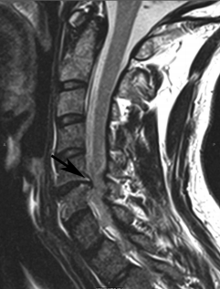
Neck Pain Classification
Acute: < 6 weeks
Subacute: 6 weeks – 3 months
Chronic: > 3 months
Type:
Mechanical: facets, ligaments, muscles, discs
Neuropathic: usually nerve root affected
Mixed:
postlaminectomy syndrome
DDD and radiculitis
Referred: e.g. vascular pathology
Cohen S. Epidemiology, Diagnosis, and Treatment of Neck Pain. Mayo Clin Proc. 2015:90(2).

Slide 7
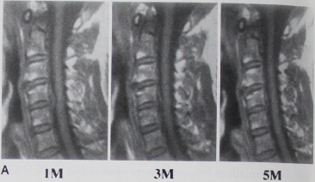
Natural Course of Neck Pain
Most acute cases will resolve to a large extent within 2 months
~50% will have some pain or frequent recurrences 1 year after initial onset.
More severe pain or symptoms associated with radiculopathy have greater likelihood of persistent pain¹
Significant disk resorption occurs in 40-70% of cervical disk herniations²
Resorption more common in herniations associated with migration/extrusion and with lateral herniations²
Gore Dr et al. Neck pain: a long-term follow-up of 205 patients. Spine. 1987;12
Mochida K et al. Regression of cervical disc herniation observed on magnetic resonance images. Spine. 1998;23(9)

Slide 8
Cervical Radiculopathy
Usually presents as cervicalgia associated with upper extremity pain
Affects 1:1000 adults per year
Mechanical compression of the cervical nerve roots, usually by age-related spondylosis or disk herniation, may result in compressive nerve damage
Proinflammatory pathways initiated by neural ischemia perpetuate and aggravate regional pain
Radiculopathy may be self-limited, but persistent pain, weakness, or paresthesia often prompts therapy efforts²
House et al. Cervical Epidural Steroid Injection Techniques and Evidence. Phys Med Rehabil Clin N Am. 2018(29).
Van Boxem K et al. Pulsed radiofrequency: a review of the basic science as applied to the pathophysiology of radicular pain: a call for clinical translation. Reg Anesth Pain Med 2014;39(2).

Slide 9
Accepted Cervical Radiculopathy Treatment Modalities
Oral analgesics, Neuropathic pain medication
Physical Therapy
Manipulation*
Local Injection of medication into the epidural space
Surgical decompression
House et al. Cervical Epidural Steroid Injection Techniques and Evidence. Phys Med Rehabil Clin N Am. 2018(29).

Slide 10
Cervical Epidural Steroid Injections
Rate of C/T ESIs has doubled (119% increase) among Medicare enrollees in the US over the past decade
House et al. Cervical Epidural Steroid Injection Techniques and Evidence. Phys Med Rehabil Clin N Am. 2018(29).

Slide 11
Anesthesiology, V 121 (5). November 2014.

Slide 12
Cervical Epidural Steroid Injections
Currently exists a lack of consensus regarding the ideal technique for Cervical ESI to best balance safety and efficacy
Epidural administration of medication
Achieves high concentration of treating agent within the epidural space to inhibit inflammation and reduce nociceptive afferent signaling
Transforaminal
Interlaminar
House et al. Cervical Epidural Steroid Injection Techniques and Evidence. Phys Med Rehabil Clin N Am. 2018(29).

Slide 13
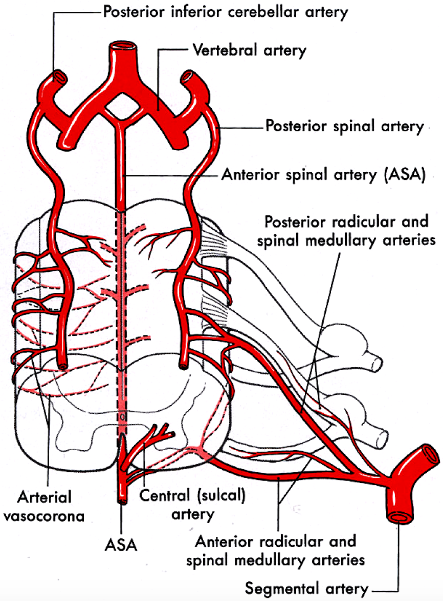
Anatomy
1 anterior spinal artery and 2 posterior spinal arteries
Ascending cervical, deep cervical, and vertebral arteries branch to radicular and spinal and radicular medullary arteries
Spinal and radicular medullary arteries traverse the neuroforamina
Perfuse the exiting spinal nerve root
Penetrate the dura then anastomose with anterior and posterior spinal arteries
Vertebral arteries provide blood supply to brainstem and posterior regions of the brain.
Traverse cephalad between transverse foramina of C2-C6
Anterior to the facets
Usually anterior to ventral ramus
Notes:
One cadaveric dissection study found > 22% of cervical neuroforamina contained an arterial vessel within 2mm of the needle trajectory using a posterior foraminal approach.

Slide 14
Safety Considerations with Transforaminal ESI
Serious complications are rare when standard techniques are employed
Consult SIS recommendations
Multiple case reports of CNS infarction have been published subsequent to use of particulate steroids.
Dexamethasone particles are 10X smaller than RBCs and do not aggregate under light microscopy.
Comparative outcomes research suggests no advantage for particulates¹
DSA: improves detection of intravascular contrast flow up to 2-fold
DSA: increases radiation exposure 2-4 fold – so prudent as opposed to routine use may be recommended²
Mehta P et al. Systemic review of efficacy of particulate versus nonparticulate corticosteroids in epidural injections. PMR 2017;9(5).
Rathmaell J et al. Safeguards to prevent neurologic complications after epidural steroid injections: consensus opinions from a multidisciplinary working group and national organizations. Aneesthesiology 2015;122(5).

Slide 15
Effect of Injectate
Dreyfuss 2006: Randomized 30 pts with unilateral radiculopathy.
TFESI with 1mL 4% lidocaine and either Dexamethasone 12.5mg or Triamcinolone 60mg
Clinically and statistically significant improvement at 4 weeks.
Nonsignificant trend favoring particulate steroids
Lee et al 2009: Retrospective review of 159 pts with radiculopathy
TFESI with Dexamethasone 10mg compared to Triamcinolone 40mg
Nonsignificant trend favoring particulate steroid
Shakir et al 2013: Retrospective review of 441 pts with radiculopathy
TFESI with 1ml 1% lidocaine and either Dex 15mg or Triamcinolone 40mg
No difference in pain reduction between groups.

Slide 16
A note about Local Anesthetic
Risk of subdural or subarachnoid injection leading to high spinal block
Risk of intra-arterial injection leading to seizure
Hwang et al 2016: studied 1 LA: ( Ropivacaine, bupivacaine, and lidocaine) combined with 1 steroid (triamcinolone, dexamethasone, and betamethasone)
Each combination observed under light microscopy
NaOH added and pH recorded
Ropivacaine crystal precipitates larger than arterioles were seen at physiologic pH
Other LA did not precipitate into crystals.

Slide 17
Safety Considerations with Interlaminar ESI
Minimal risk of ischemic infarction
Venous plexus in the dorsal epidural space lends towards risk of epidural hematoma
Risk of dural puncture or direct spinal cord trauma¹
Increased risk above C7
2005-2008: review of malpractice claims presented 20 cases of direct spinal cord injury from cervical ESI²
House et al. Cervical Epidural Steroid Injection Techniques and Evidence. Phys Med Rehabil Clin N Am. 2018(29).
Rathmell J et al. Injury and liability associated with cervical procedures for chronic pain. Anesthesiology 2011;114(4)

Slide 18
Evidence Base for Cervical ESI – Why is this so hard?
For cervical procedures, ILESI studies outnumber investigations of TFESI
Methodological heterogeneity limits interpretation of the clinical outcome literature
Various definitions of clinical effectiveness in pain reduction, analgesic use, and disability
Different Injectate mixtures between studies
Results confounded by natural history of cervical pain and radiculopathy
Results confounded by oral medications, other concurrent treatments which may be provided
House et al. Cervical Epidural Steroid Injection Techniques and Evidence. Phys Med Rehabil Clin N Am. 2018(29).
Notes:
Not as simple as it may seem on the surface

Slide 19
Evidence Base for Cervical ESI – Why is this so hard?
ESIs may treat numerous types of pathologies
Lack of standard technique – blind vs. fluoro
Pain metrics may vary
Numeric rating scale, % decrease in NRS
Proportion of pts with > 50% improvement in NRS or VAS
Functional outcomes assessment included:
Pain disability index (PDI)
Neck disability index (NDI)
Oswestry NDI
Work status
MAJOR WEAKNESS: LACK OF PLACEBO CONTROL TREATMENT GROUPS
“Placebos” employed: IM steroid, or epidural LA

Slide 20
C-ESI – Are they effective?
Benyamin, Abdi et al. were the first to conduct a systemic review to evaluate the effect of C-ILESI in various types of neck pain and UE radicular pain
Reviewed literature from 1966-2008.
Review limited by paucity of literature and lack of randomized trials using fluoroscopy
Analysis of evidence: 5 levels, each with 3 subcategories.
For positive outcome, only studies with clinically relevant and effective ESI compared to placebo or active control in randomized trials were considered.
Benyamin et al. .Systemic review of the effectiveness of cervical epidurals in the management of chronic neck pain. Pain Physician. 2009.

Slide 21
Systemic review of effectiveness of ILESI in chronic neck pain
Initially 1,994 articles were considered, eventually 3 randomized trials were included.
Castagnera et al: N = 24, High volume C-ESI (avg ~8.5cc).
Group 1: Lidocaine 0.5%, Triamcinolone, Group 2: Lidcoaine, Triamcinolone, and 2.5% morphine.
Documented “complete or excelling” (>75% pain relief) pain relief in about 70% of both groups on avg for 48 mo and for some, up to 60 months. No benefit from addition of morphine.
Stav et al: ESI + LA vs. steroid and lidocaine injected into neck muscles
Pain relief/ROM, Decreased Rx at one week: 76% vs. 36%
Outcome measures at one year: 68% vs. 12%.
Pasqualucci et al: evaluated ESIs given X 3 Q5 days vs. a continuous ESI X 30 days
Positive short term results only (< 6 mo) for both
Notes:
No Fluoro was used. Pt pre-treated with an epidural saline “wash” up to 10cc to determine what volume would cause pain, and the follow up treatment ESI would remain at volumes lower than that.

Slide 22
Systemic review of effectiveness of ILESI in chronic neck pain
Effectiveness: All 3 RCTs demonstrated effectiveness short term and 2 were positive for long term relief.
Ultimately, this systemic review attributed Level II-1 evidence - USPSTF
Evidence was obtained from well-designed controlled trials without randomization (observational studies also included)
Grading recommendations for cervical ILESI: 1C: strong recommendation despite relatively low-quality evidence – benefits outweigh risks.
Implication from this grading system is that the recommendation may change when higher quality evidence is available.

Slide 23
Effectiveness of C-ESI in the Management of Chronic Neck and Upper Extremity Pain
Systemic Review by Diwan and Abdi et al 2012
Comprehensive systemic review
Objective: evaluate CILESI for various types of chronic neck and UE pain secondary to different cervical pathologies.
Studies included:
RCTs
Non-randomized observational studies
Case reports and reviews for adverse effects
Interventions: fluoroscopic or CT guided
Outcomes measured:
Primary: pain relief
Secondary: functional improvement, change in psychological status, return to work, reduction of medication or other interventions

Slide 24
Effectiveness of C-ESI in the Management of Chronic Neck and Upper Extremity Pain
Search strategy: Emphasized chronic neck and UE pain, disc herniation, discogenic pain, post cervical surgery syndrome, cervical spinal stenosis, radiculitis and radiculopathy treated with C-ILESI.
Clinical Relevance evaluated according to the Cochrane Back Review Group and quality of each article used was assessed by Cochrane review criteria.
Studies’ Outcome: positive only if the ESI met criteria to be clinically relevant and effective and was compared to placebo or active control.
Statistical significance must be met.

Slide 26
Effectiveness of C-ESI in the Management of Chronic Neck and Upper Extremity Pain
Eventually, 7 trials were assessed out of 34 considered
4 studies regarding disc herniation and radiculitis
3 previously included in the review by Benyamin. 1 by Manchikanti.
3 of 4 studies demonstrated pain relief from 1-4 ILESI at 12 months for 68-79% of participants
1 study considered discogenic pain without herniation – active control LA only
N= 120. Pain relief and function improved in 72%% and 68% at 12 mo
1 study considered spinal stenosis – active control LA only
N = 60. Pain relief and function improved in 73% vs. 70% at 12 mo
1 study considered cervical post-surgery syndrome – active control LA only
N= 56. Pain relief and function improved in 71% vs. 64% at 12 mo.

Slide 27
Rating Scale

Slide 28
Effectiveness of C-ESI in the Management of Chronic Neck and Upper Extremity Pain
Bottom line:
Cervical disc herniation: evidence is good for C-ILESI with steroid + LA and fair for LA only
Axial or discogenic pain: evidence is fair for LA +/- steroids
Spinal stenosis: Evidence is fair for LA +/- steroids
Post-surgery syndrome: evidence is fair for LA +/- steroids
Note: ‘fair’ evidence largely due to paucity of quality studies

Slide 29
Evidence base for C-ESI
One systemic review of cervical ESI published in the past 5 years.
This review notes all RCTs for c-TFESIs were unfit for inclusion based on inadequate quality.

Slide 30
House et al. Cervical Epidural Steroid Injection Techniques and Evidence. Phys Med Rehabil Clin N Am. 2018(29).

Slide 31
Evidence for: C-ILESI vs. catheter directed ILESI treating unilateral radicular pain
McCormick et al 2017: Prospective, randomized, single-blinded comparative trial of targeted steroid injection via epidural catheter versus standard C7-T1 IL approach
First published study on this topic
Primary outcome: proportion of participants with > 50% pain reduction on NRS at 1 mo.
Secondary outcomes: Oswestry Neck Disability Index, Pain Disability Index, McGill Pain Questionnaire, Patient Global Impression of Change, Daily Morphine Equivalent, Medication Quantification Scale III score.

Slide 32
Evidence for: C-ILESI vs. catheter directed ILESI treating unilateral radicular pain
Methods: Diagnostic criteria
C2-C6 radicular pain
MRI imaging c/w clinical symptoms
NRS > 4
Pain duration > 4 weeks despite conservative therapy
Among several contraindications: ESI w/in past 6 months, prior cervical surgery, pt request for procedural sedation.
79 subjects randomized
Injectate: 2mL triamcinolone 40mg/mL in 1mL 1% lidocaine = total 3mL injected
Measures/surveys listed earlier were obtained before the initial injection, at 2 weeks, 1 mo, 3 mo, and 6 months by blinded researcher.

Slide 33
Evidence for: C-ILESI vs. catheter directed ILESI treating unilateral radicular pain
Results: Vast majority of subjects (all but 2) had pathology noted clinically and radiographically at C5 and C6 root levels.
62% had C6 radic
35% had C5 radic
39% of catheter directed subjects and 47% of standard subjects had second injections, 3 participants in the catheter group and 1 subject in standard group received a 3rd injection.
At 1 mo: a greater proportion of subjects with >50% NRS pain reduction were in the catheter targeted group change in median pain score from baseline: 7-2 vs. 6-3 in the standard group.
No statistically significant difference between groups
The targeted group had more frequently reported clinically meaningful improvement in NRS< ONDI, and PGIC scores at all follow up intervals vs. the standard group. Also lower incidence of spine surgery in targeted group.
Also not statistically significant
Notes:
Come back to this study

Slide 34
Evidence for: C-ILESI vs. catheter directed ILESI treating unilateral radicular pain
Both groups had significant benefit, avg 4 NRS points, lower than baseline at 6 months.
Study underpowered to detect group differences in secondary measures.
Anatomic differences likely explain smaller effect size
Both associated with clinically meaningful improvement in pain, function, disability, and medication use for the duration of the 6 month follow up.
Determined that radicular Sx unrelated to antecedent trauma or injury and lower baseline MPQ were associated with greater likelihood of clinical improvement after ESI.

Slide 35
Distribution of Cervical ILESI 2.5, 5, and 10mL patterns:

Slide 36
Two year Follow up Results of CESIs in chronic axial or discogenic neck pain
Objective: assess effectiveness of CILESI of local anesthetic with or without steroids for axial or discogenic pain in patients without disc herniation, radiculitis, or facet joint pain.
Design: randomized, double-blind, active-controlled trial
Methods: 120 patients included, all of whom had negative diagnostic MBBs.
Manchikanti L et al. Two-year follow up results of fluoroscopic cervical epidural injection in chronic axial or discogenic neck pain: a randomized, double-blind, controlled trial. 2014.
Notes:
Maybe MBBs just done at wrong level

Slide 37
Two year Follow up Results of CESIs in chronic axial or discogenic neck pain
Group 1: lidocaine 0.5% 5mL
Group 2: lidocaine 0.5% 4mL + 1mL (6mg) nonparticulate betamethasone
Procedures per year: Average 3.6 the first year and 5.8 at the end of the second year
Primary outcome: > 50% improvement in pain and function.
NRS
NDI
Opioid intake
Employment, changes in weight
ILESIs were performed under fluoro from C7-T1 to C5-6 (yike!)
All patients provided with PT and medication therapy

Slide 38
Two year Follow up Results of CESIs in chronic axial or discogenic neck pain
Findings:
Baseline NRS score for Group 1: 7.9 and for Group 2: 7.6
At 3 months: 73% of Group 1 and 85% of group 2 had > 50% pain relief
At 3 months: both had significant improvement in pain to 3.7 and 3.3 respectively
At 24 months, continued pain relief present in 75% of both groups and avg NRS score of 3.7 and 3.5%.
Difference between groups not significant.
Decrease in opioids:
Average Baseline MED Group 1: 47 and group 2: 39.1
At 24 months: 36.9 and 34.5 (both statistically significant compared to baseline)

Slide 39
Two year Follow up Results of CESIs in chronic axial or discogenic neck pain
Bottom line: 71% of patient experienced at least 50% pain relief at 24 months with or without steroids.
Average of 6 procedures over a period of 2 years was required for 72 week effective period during a 2 year process

Slide 40
C-ILESI in treatment of cervical spinal stenosis
Design: randomized, double-blind, active control trial
Methods: 60 patients randomized – to LA and LA + steroids
Outcomes assessment:
NRS
NDI
Employment status
Opioid intake
Assessed at 3, 6, 12 months
Significant pain relief or functional status defined as 50% or more reduction of NRS or NDI
Manchikanti et al. Fluoroscopic epidural injections in cervical spinal stenosis: preliminary results of a randomized, double-blind, active control trial. Pain Physician. 2012.
Notes:
Briefly discussed beforehand.

Slide 41
C-ILESI in treatment of cervical spinal stenosis
Significant pain relief seen in 73% of group I and 70% of group II
Both with significant pain relief and functional improvement
After 1 procedure: pain relief for 11.3 and 8.6 weeks respectively
After 2 procedures: pain relief 13.7 and 13.6 weeks
Average total relief in one year period: 42.2 and 34.3 weeks

Slide 42
Comparison of clinic efficacy between Interlaminar and Transforaminal Epidural Injection in Patients with Axial Pain due to cervical disc Herniation
Methods:
All for axial cervical pain associated with central or paramedian cervical disc herniation
56 pts underwent ILESI and 52 underwent TFESI
ILESI performed at C5-6 (yikes), C6-7, and C7-T1
ILESI: 5mg Dex in 3cc 0.5% lidocaine
TFESI performed at the level of targeted pathology
TFESI: 5mg dex in 1.5cc 0.5% lidocaine
Outcomes assessed: NRS and NDI
Lee and Lee. Comparison of clinical efficacy between interlaminar and transforaminal epidural injection in patients with axial pain due to cervical disc herniation. Medicine. 2016.
Notes:
NRS numeric rating scale, Neck Disability Index – evals pain intensity, personal care, lifting, reading, headaches, concentration, work, recreation, driving, sleeping.

Slide 43
Comparison of clinic efficacy between Interlaminar and Transforaminal Epidural Injection in Patients with Axial Pain due to cervical disc Herniation
Successful relief: defined as 50% or more reduction of NRS in comparison with pre-treatment
Successful functional improvement: at least 40% reduction of NDI
Overall: 79 and 57 among 108 pts had successful pain relief at 2 and 8 weeks
Approximately 48% of patients had pain relief lasting at 8 weeks
No significant difference in ILESI vs. TFESI in proportion of successful results of NRS after 2 weeks and 8 weeks
No significant difference in proportion of successful NDI between each group at 2 and 8 weeks noted
On note: relatively low concentrations of steroid and LA were used for both ESI
Results may vary with high concentrations of steroid and LA

Slide 44
References:
Benyamin et al. .Systemic review of the effectiveness of cervical epidurals in the management of chronic neck pain. Pain Physician. 2009.
Cohen S. Epidemiology, diagnosis, and treatment of neck pain. Mayo Clin Proc. 2015:90(2).
Diwan et al. Effectiveness of cervical epidural injections in the management of chronic neck and upper extremity pain. Pain Physician 2012.
Engel A et al. The effectiveness and risks of fluroscopically guided cervical transforaminal injections of steroids: A systematic Review with Comprehensive Analysis of the published Data. Pain Medicine. 2014.
Gore Dr et al. Neck pain: a long-term follow-up of 205 patients. Spine. 1987;12
House et al. Cervical Epidural Steroid Injection Techniques and Evidence. Phys Med Rehabil Clin N Am. 2018(29).
Lee and Lee. Can repeat injection provide clinical benefit in patients with cervical disc herniation and stenosis when the first epidural injection results only in partial response? Medicine. 2016.
Lee and Lee. Comparison of clinical efficacy between interlaminar and transforaminal epidural injection in patients with axial pain due to cervical disc herniation. Medicine. 2016.
Manchikanti et al. Cervical radicular pain: the role of interlaminar and transforaminal epidural injections. Curr Pain Headache Rep. 2014.
Manchikanti L et al. Two-year follow up results of fluoroscopic cervical epidural injection in chronic axial or discogenic neck pain: a randomized, double-blind, controlled trial.
Manchikanti et al. Fluoroscopic epidural injections in cervical spinal stenosis: preliminary results of a randomized, double-blind, active control trial. Pain Physician. 2012.
McCormick Z et al. A prospective randomized comparative trial of targeted steroid injection via epidural catheter versus standard C7-T1 interlaminar approach for the treatment of unilateral cervical radicular pain. Reg Anesth Pain Med 2017;42(1)
Mehta P et al. Systemic review of efficacy of particulate versus nonparticulate corticosteroids in epidural injections. PMR 2017;9(5).
Mochida K et al. Regression of cervical disc herniation observed on magnetic resonance images. Spine. 1998;23(9)
Rathmell J et al. Safeguards to prevent neurologic complications after epidural steroid injections: consensus opinions from a multidisciplinary working group and national organizations. Anesthesiology 2015;122(5).
Rathmell J et al. Injury and liability associated with cervical procedures for chronic pain. Anesthesiology 2011;114(4)
Van Boxem K et al. Pulsed radiofrequency: a review of the basic science as applied to the pathophysiology of radicular pain: a call for clinical translation. Reg Anesth Pain Med 2014;39(2).

