Slide 1
Key Determinants of Lumbar Medial Branch RF Ablation Outcomes
J. Scott Bainbridge, M.D.
www.DenverBackPainSpecialists.com
Colorado Pain Society Annual Meeting, April 22, 2017
Breckenridge, CO

Slide 2
Disclosures
Spine Intervention Society (SIS) Senior Instructor
Spine Intervention Society (SIS) prior board member
Research Funding:
  Mesoblast Ltd. funding: Principal Investigator for MSB-DR003 (Lumbar intra-discal stem cell study)
  Seikagaku Corporation funding: Principal Investigator for SI-6603/1131 (Intra-discal chondroitinase for lumbar HNP/radicular pain)
  And: A Multi-center, Open-label Study of SI-6603 in Patients with Lumbar Disc Herniation
  Grunenthal “Low back pain study”
    Quantitative Research in chronic Low Back Pain for the Development of a New Patient Reported Outcome Measure
Speaker for Medical Education Resources, Inc.

Slide 3
Objectives
Attendees should be able to:
Understand the anatomy of the spinal medial branches of the dorsal rami and how this guides medial branch blocks and RF ablation technique
Appreciate the importance of clinical selection of patients for facet (Z-joint) procedures
Discuss the use of medial branch blocks in selecting patients for RF ablation
Understand RF ablation technique and its relationship to outcomes
Discuss how literature reviews and Health Technology Assessments affect medical policy and access to spinal procedures

Slide 4
Terminology
Zygapophysial Joint (Z-joint)
  apophysis = out-growth
  zygos = yoke or bridge
Literature: Apophysial (British), Facet (American)

Slide 5
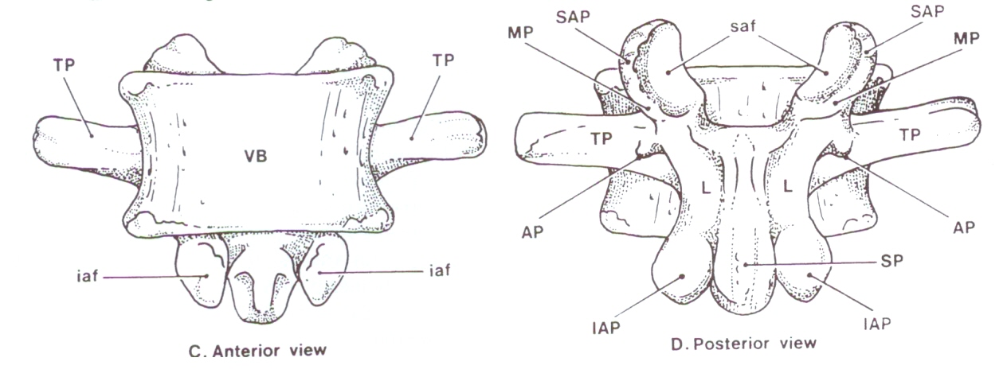

Slide 6
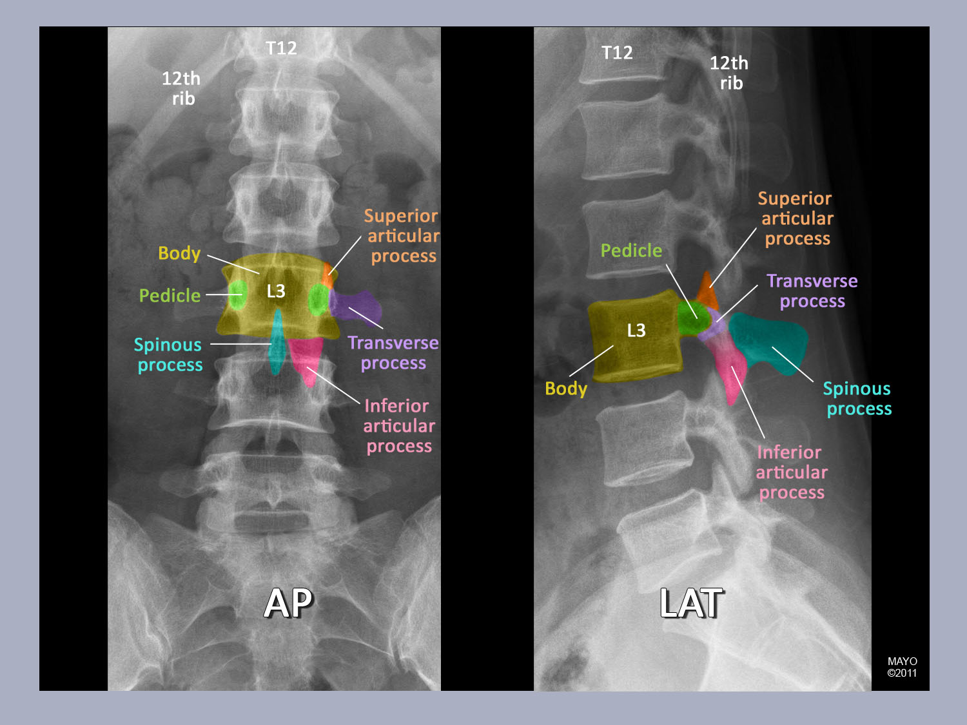

Slide 7
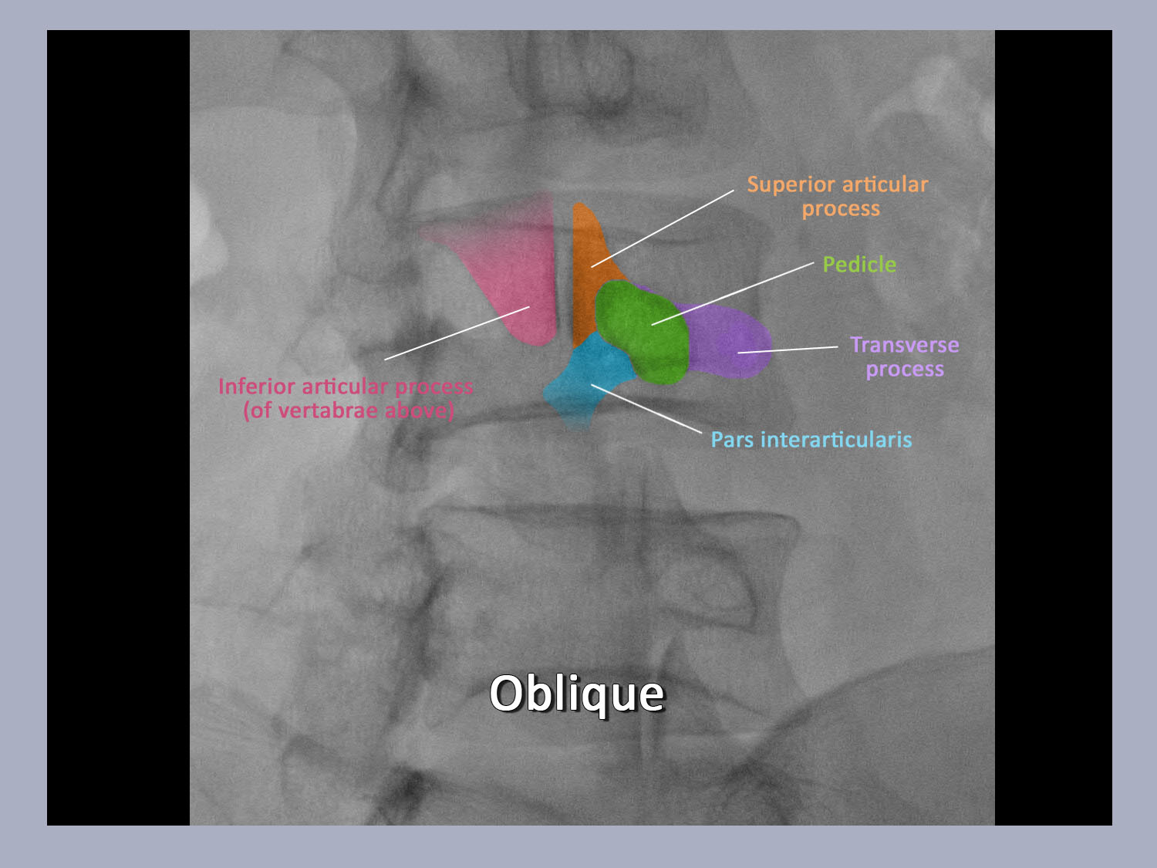

Slide 8
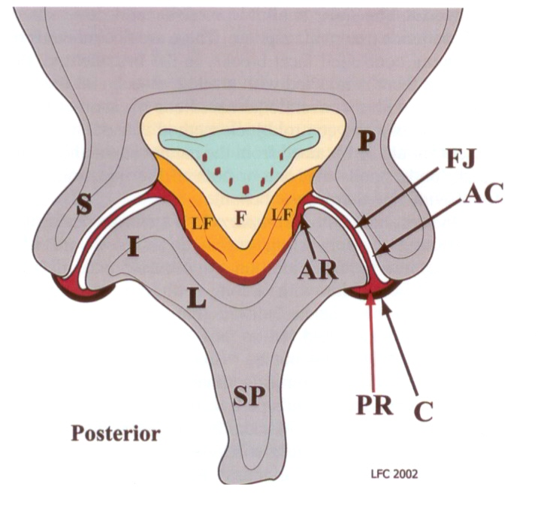
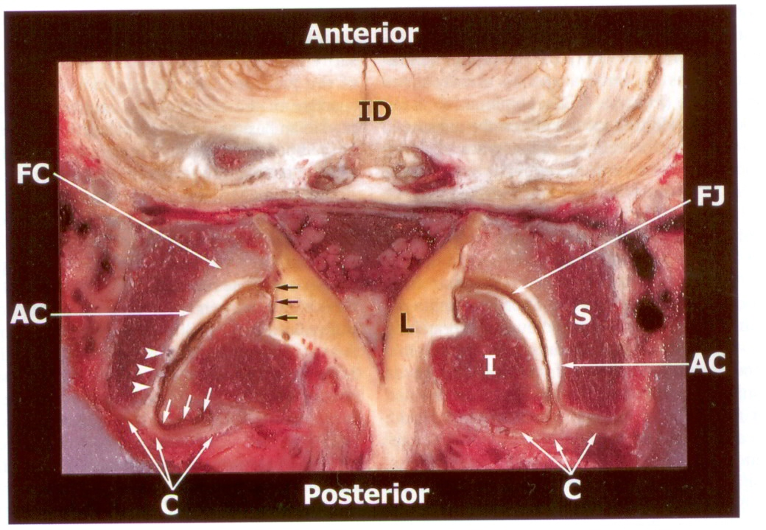

Slide 9
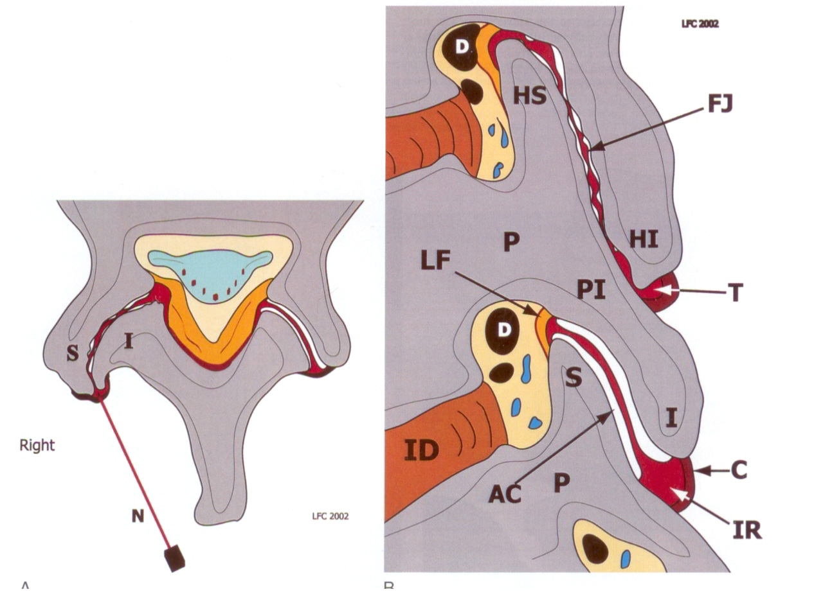
IA LZJ Injection Technique
Align view through disc at target level
Assess sagital plane orientation and degree of (dorsal) degenerative change (spurring)
FIND “FIRST” OPENING
Easier at superior or inferior recesses
Updated evidence review of lumbar intra-articular steroid injection data in appendix
  Reasonable if positive diagnosis with MBB or SPECT scan but not predictive of RF outcomes – start with medial branch blocks (MBBs)

Slide 10
Lumbar/Cervical IA Steroid: Evidence Review - Thank you to BM and PD
Brandon Messerli DO and Paul Dreyfuss MD
  Evergreen Health Sport & Spine Care
  Presentation of evidence in response to Washington state’s consideration of non-coverage for interventional spine procedures (consideration based on Spectrum’s HTA)
    Multiple study summary slides are from their presentation

Slide 11
Lumbar Facet Pain:
IA steroid injections
Prior HTCC non-coverage determination largely based on the negative RCTs of Lilius and Carrette
These studies do not represent best practice methods - COMMON PROBLEM WITH PAIN STUDIES
  e.g. diagnosis not confirmed with diagnostic blocks, large volume injectates which do not remain IA, suboptimal outcome measures
  See appendix for details

Slide 12
Facet IA Steroid Injections
Consider a coverage determination of facet injections
We endorse the Multi-specialty Pain Workgroup (MPW) Guidelines, which were utilized by Medicare LCDs in 47 of 50 states.
  See Appendix for guidelines
New moderate quality trials show benefit of IA steroid injections vs. IM injections, and equal benefit to RF neurotomy
Spectrum excluded evidence that shows patients with SPECT+ joints can benefit from IA facet steroid injections for 3 months
Although there are no new efficacy trials in cervical facet injections there is one small prospective trial showing effectiveness of IA facet steroid injections in those with facet arthritis

Slide 13
MPW* Guidelines: Facet injections
*Multi-specialty Pain Workgroup
For predominately axial pain, but a lesser degree of somatic referred pain into the lower extremity is not an exclusion.
Pain has been present for at least 3 months.
Radicular pain or neurogenic claudication is an exclusion to performing a facet injection unless the radicular pain is caused by a facet synovial cyst.
Failure of ≥ 4 weeks of a conservative care trial unless patient is unable to tolerate such or co-morbidities limit such a trial.
Must use fluoroscopy or CT guidance and contrast media.
Repeat injections of same joint(s) only allowed if ≥ 50% relief and improved ADLs for a minimum of 3 months.

Slide 14
Lumbar Medial Branch Blocks
MMB vs Intra-articular Facet Blocks
MBB are relatively easier to perform (but harder to get right)
MBB are safer
MBB more easily subject to controls
IAB lack a valid subsequent treatment
MBB if positive can be followed by RF neurotomy
MBB have predictive validity
  Predictive of RF outcome
  Useful in surgical and other treatment planning

Slide 15
LZJ – Anatomy of the Innervation
Bogduk
  The anatomy of.. articular nerves and their relationship to facet denervation; J Neurosurg 1979
  Clinical Anatomy of the Lumbar Spine and Sacrum; Elsevier 1987, 1991, 1997, 2005
  Lau, Mercer, Bogduk; The surgical anatomy of lumbar medial branch neurotomy. Pain Med 2004.

Slide 16
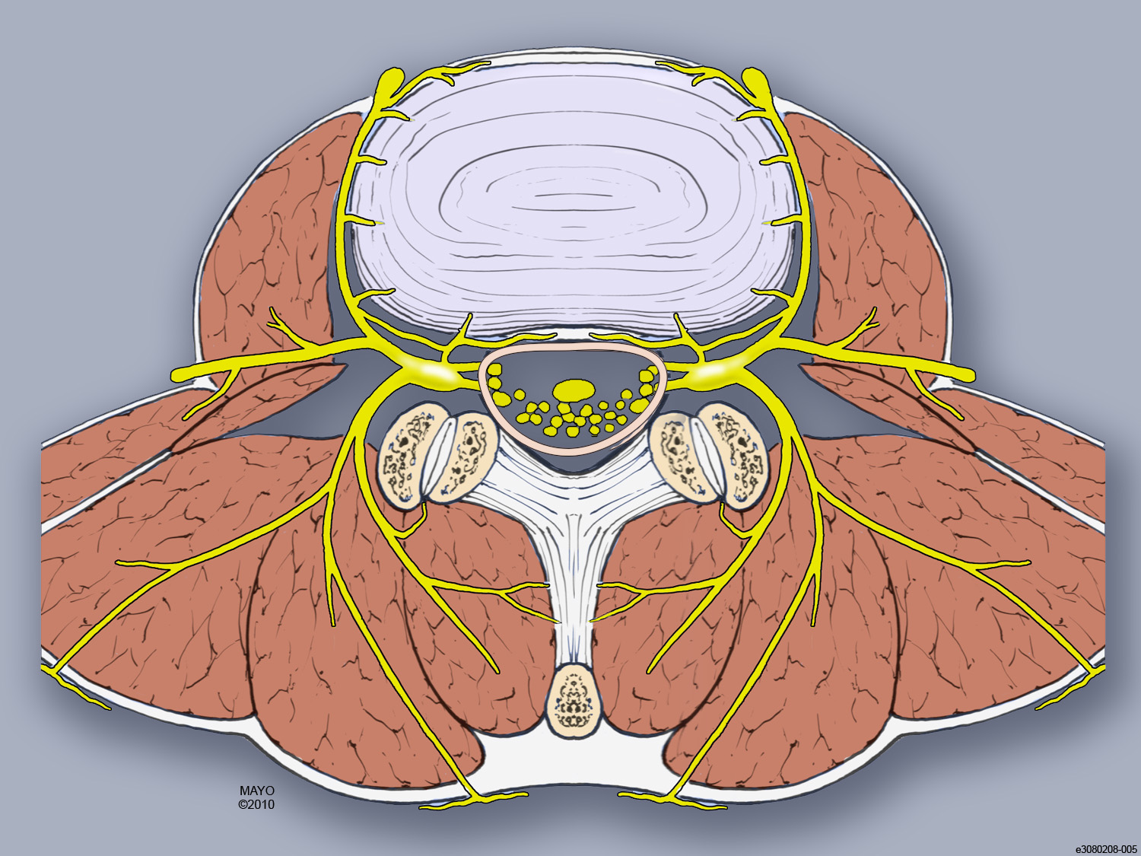
Spinal Innervation
Disc: outer annulus
  Sinuvertebral nerve
  Grey rami
  Sympathetic plexus
Ventral epidural space
  Sinuvertebral nerve
Facet, multifidus muscle
  Medial br, dorsal ramus
  Dual level innervation
Longissimus muscle
  Intermediate branch, dorsal ramus
Iliocostalis muscle
  Lateral branch, dorsal ramus

Slide 17
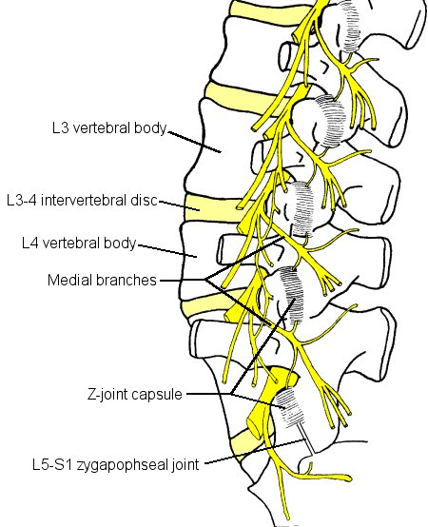
Spinal Innervation: Facet Joint
Dual level innervation
L4-5 facet innervation:
  Medial branch arising from L3 dorsal ramus
  Medial branch arising from L4 dorsal ramus
  Medial branch crosses junction of SAP and transverse process, beneath mamillo-accessory ligament
L3,4 MB nerve blocks (comma)
=
L4-5 Level MBBs (hyphen)

Slide 18
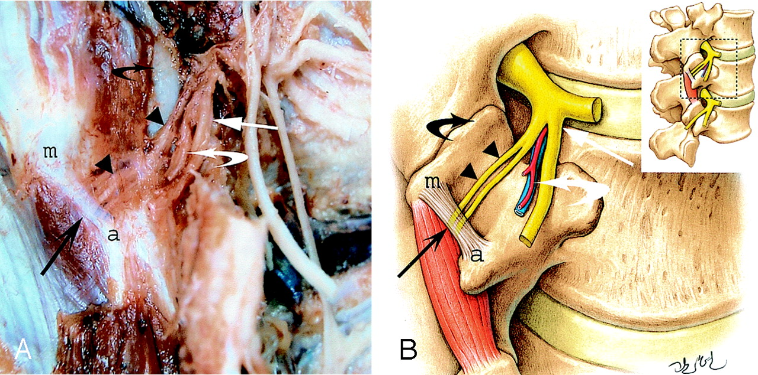
Dorsal ramus and its divisions at L2–L3. The medial branch of a L2 posterior ramus (arrowheads) runs against the lateral surface of the caudal edge of the superior articular process (black curved arrow) and then passes under a ligament (long black arrow) connecting the accessory process (a) and the mamillary process (m). Lateral branch of L2 posterior ramus (long white arrow) and vessels (white curved arrow) as well as the duplicity of the medial branch in the fibroosseous canal (twin medial branch).
Demondion, et al AJNR Am J Neuroradiol. 2005 Apr;26(4):706-10

Slide 19
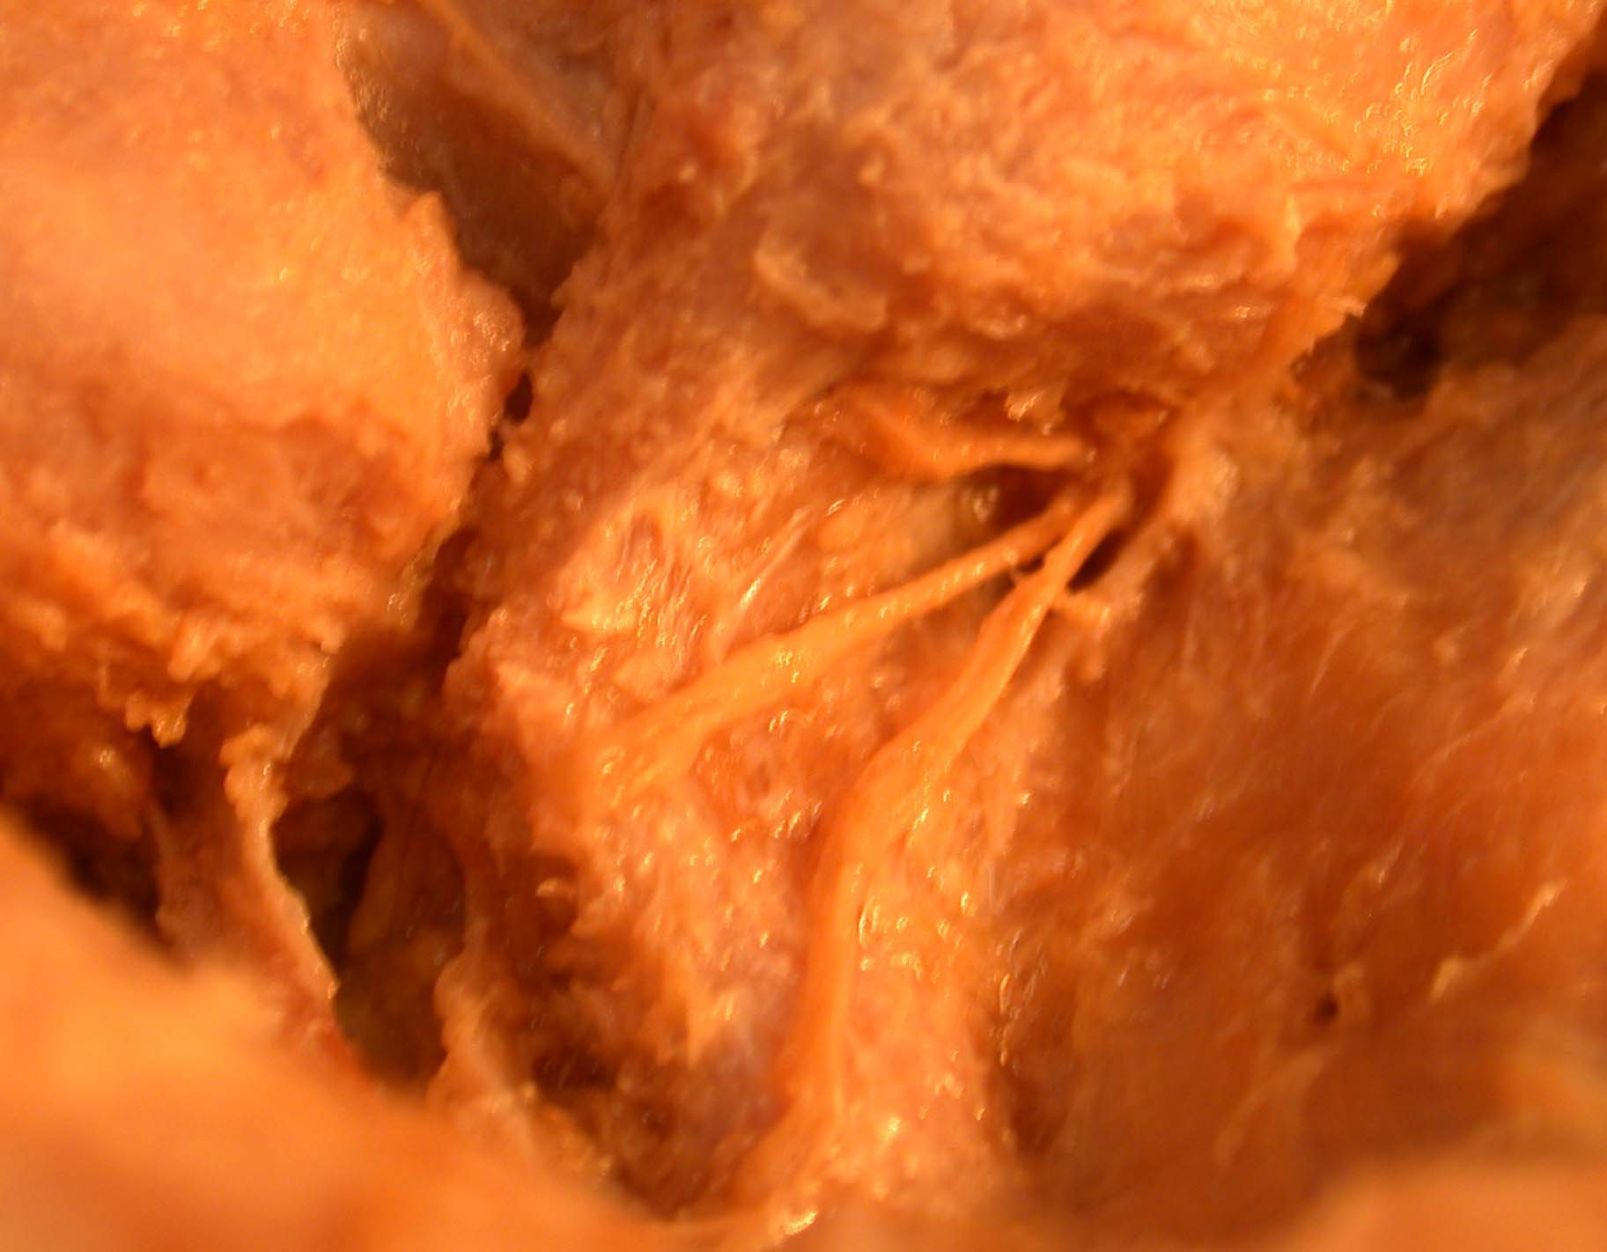
medial branch after emerging from under the mal
L4-5 z joint
L5 sap
mal
medial branch
intermediate branch
The blue arrow indicates where the medial branch disappears under the mal
L5 TP
lateral branch
Lateral view of branches of the right L4 dorsal ramus

Slide 20
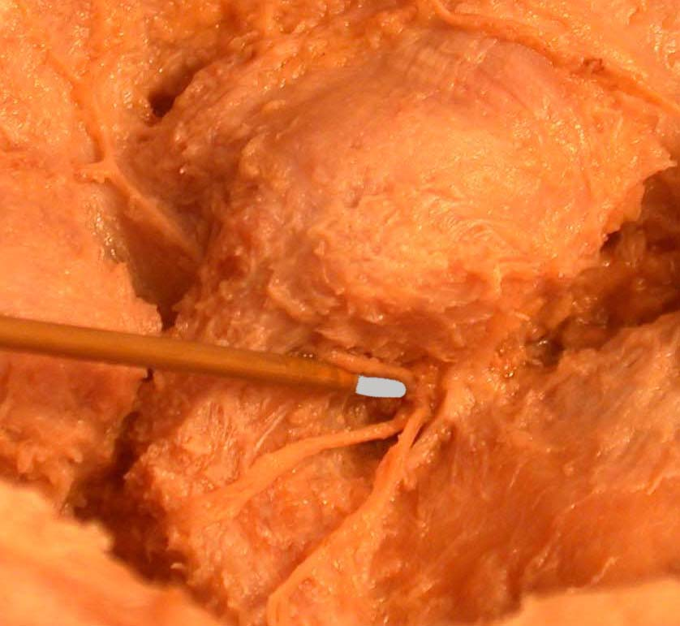
Electrode inserted as far as possible along medial branch
L4-5 z joint
L5 sap
mal
mb
ib
lb

Slide 21
L5 DR Anatomy; Lau, et al
L4 MB

Slide 22
Resource for Technique and Background Information
Practice Guidelines for Spinal Diagnostic and Treatment Procedures
  International Spine Intervention Society
  Second Edition
  Edited by Nikolai Bogduk
  www.spinalinjection.org (Spine Intervention Society)

Slide 23
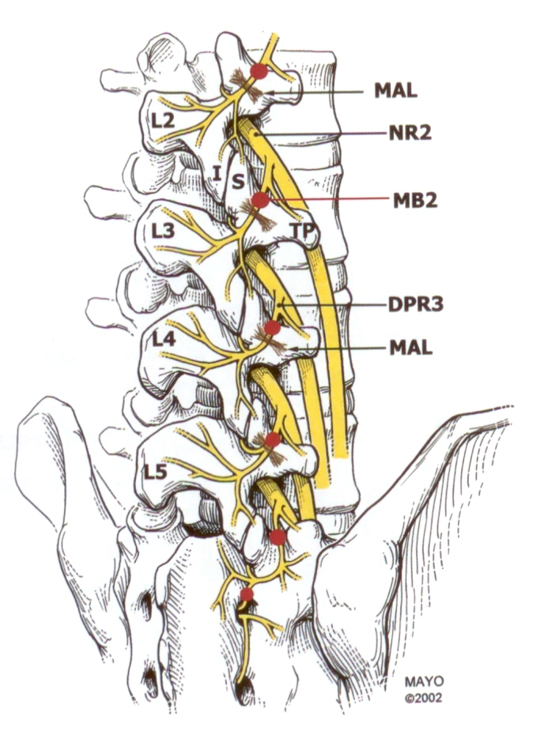

Slide 24
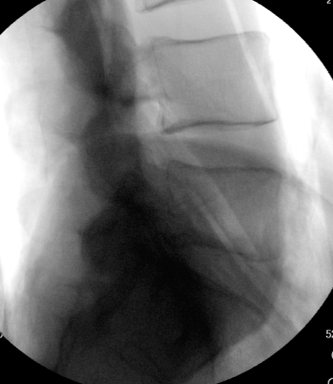
L5 sap
base of L5 TP
tip of L5 TP
LATERAL VIEW: L5 vertebra for L4 medial branch neurotomy

Slide 25
L5 sap
base of L5 TP
neck of sap
tip of L5 TP
LATERAL VIEW: L5 vertebra for L4 medial branch neurotomy

Slide 26
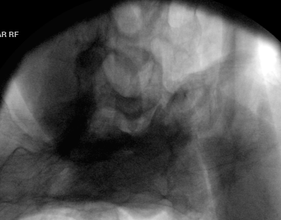
medial branch
groove
angle between sap and TP
PILLAR VIEW: L5 vertebra for L4 medial branch neurotomy

Slide 27
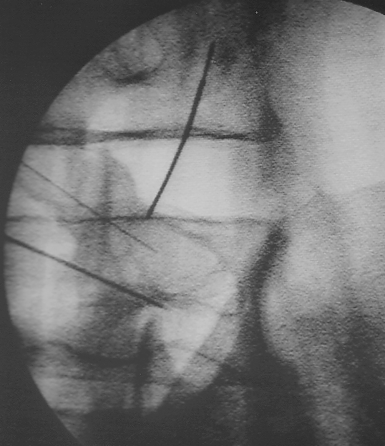
block needle
accessible segment of nerve

Slide 28
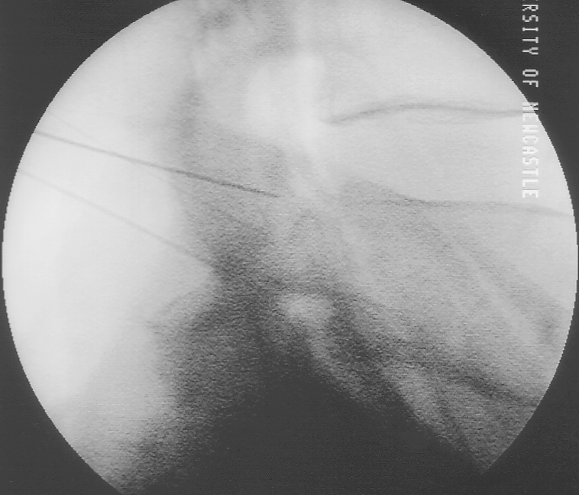
block needle
L4 Lateral view
mal
TP
accessory process

Slide 29
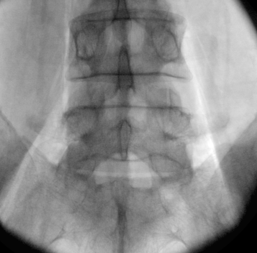
mal

Slide 30
LZJ - Medial Branch Blocks
Effective anesthesia of LZJ (Kaplan 1998)
Predictive of positive outcome of MB neurotomy (Dreyfuss 2000)
Technique important
  0.2 cc contrast (venous uptake > false negative rate)
  0.5 cc (0.3-.4cc ?) anesthetic (0.5cc recommended in SIS Guidelines -used in validation studies)
  Rotate fluoro beam enough to avoid SAP wall
    (+/- 40 degrees)
    Aim for 1/3 2/3 junction along course of MB
Dual diagnostic blocks needed

Slide 31
MBB ZJ Anesthesia Validation
Kaplan, et. al. Spine 23(17), 9/1/98 pp. 1847-52
18 asymptomatic allocated to: R or L, L4-5 or L5-S1 capsule distention with contrast; 3 excluded
Randomized, Blinded
  5 controls 5/5 with pain
  10 MBB 2% lido

Slide 32
MBB ZJ Anesthesia Validation
10 MBB
  6/10 with initial venous uptake
    3/6 with pain relief
    All brought back 1 week later
      1/6 venous uptake – excluded
  8/9 (89%) complete pain relief
False Negative Rate 50% if Venous Uptake
False Negative 11% if No VU
Aberrant Anatomy
Diffusion from Nerve (Inadequate Block)

Slide 33
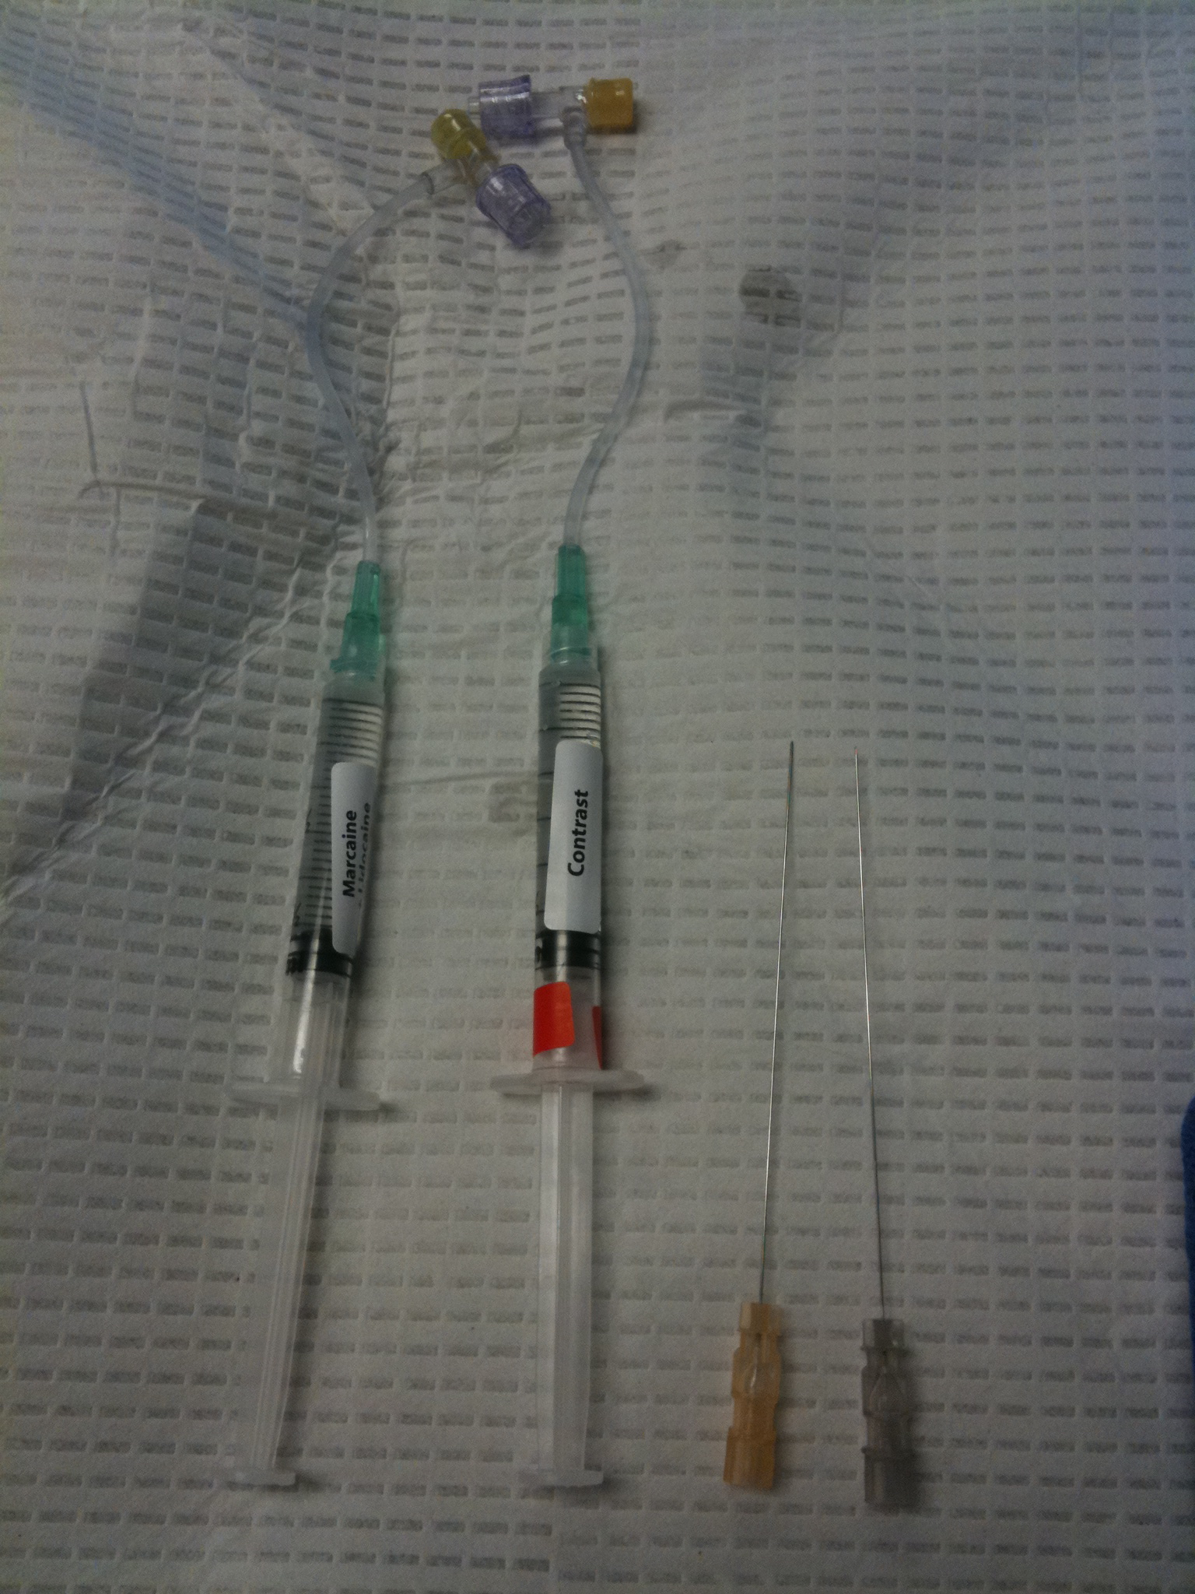
Contrast and local
anesthetic with extension
Tubing
LA: lidocaine or bupivacaine
Lidocaine: 1-4% (2%)
Bupivacaine: 0.25-0.75%
Use 0.5cc
Higher concentration
Desired due to low volumes

Slide 34
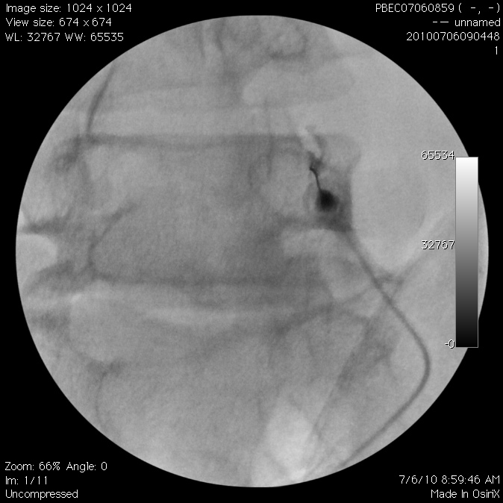

Slide 35
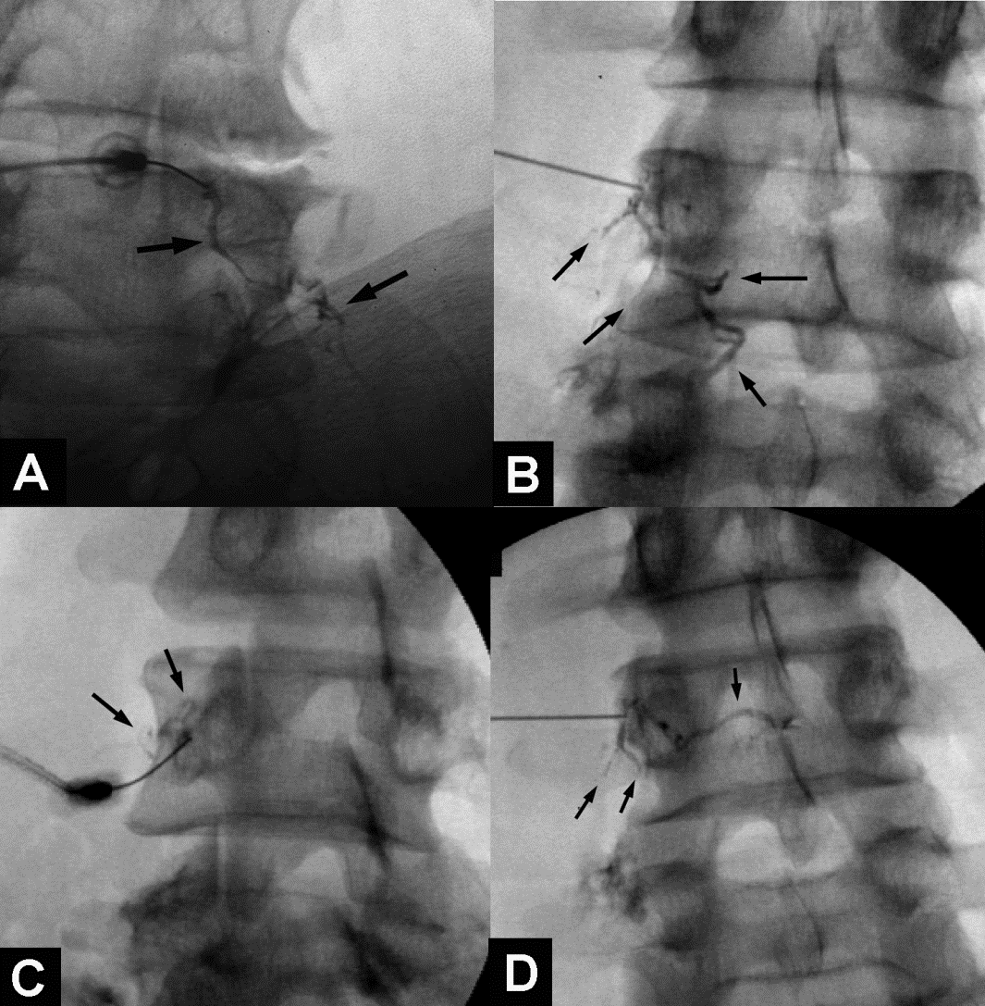
Venous Uptake:
> False negative
Provided by Dr. Paul Dreyfuss
8% incidence (Dreyfuss et al. Spine 1997;22:895-902)
3.7% incidence (Verrills. Spine 2008; 33: 174-177)
6.1% incidence (Lee et al. Anesth Analg 2008;106:1274-8)
Notes:
There is an association of 50% false negative rate in association with venous uptake, even after repositioning (Kaplan study). This spread cannot be picked up with ultrasound!

Slide 36
Medial Branch Radiofrequency Neurotomies (RFN) - Lumbar
Medial branch block and RFN techniques described in:
International Spine Intervention Society Practice Guidelines for Spinal Diagnostic and Treatment Procedures. 2nd Ed. Bogduk (SIS Standards Committee) 2013
Lau P, et al. The surgical anatomy of lumbar medial branch neurotomy (facet denervation). Pain Med 2004

Slide 37
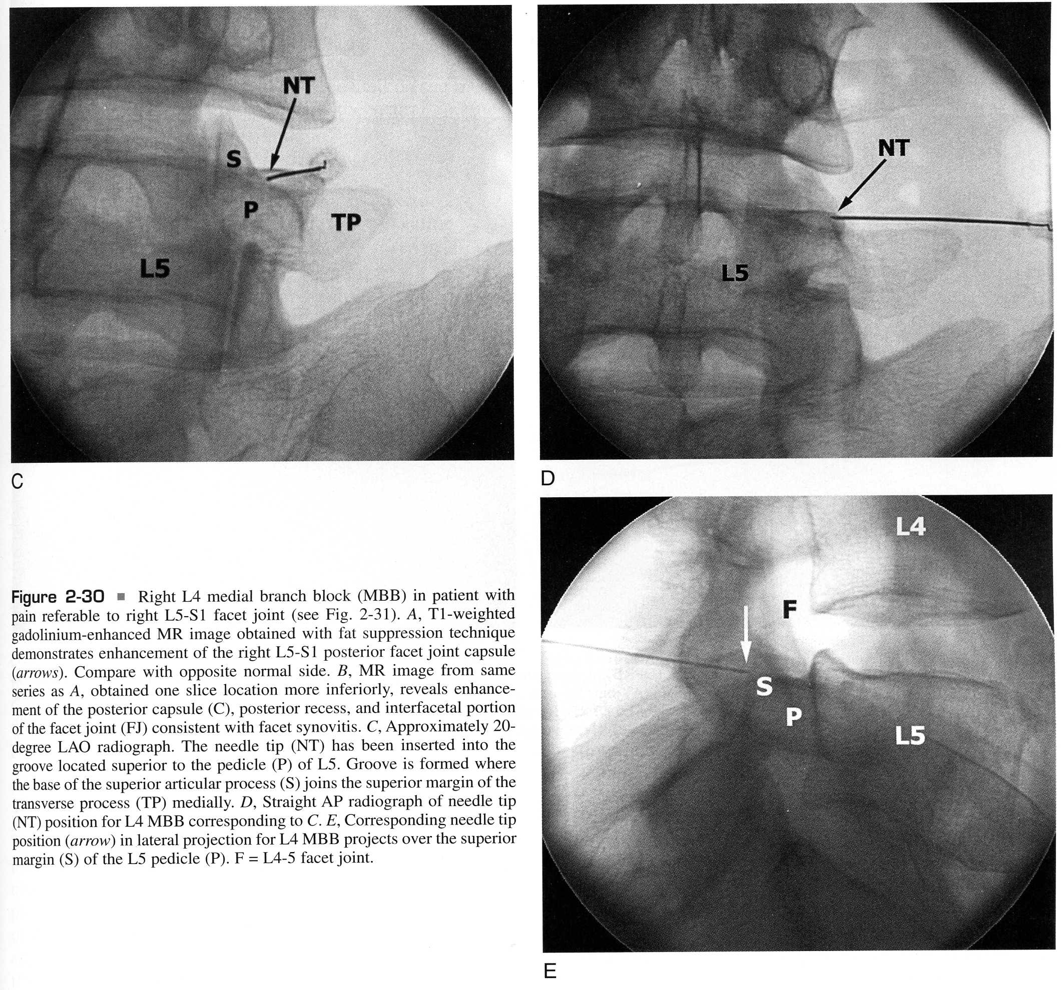
Fenton, Cervionke 2003

Slide 38
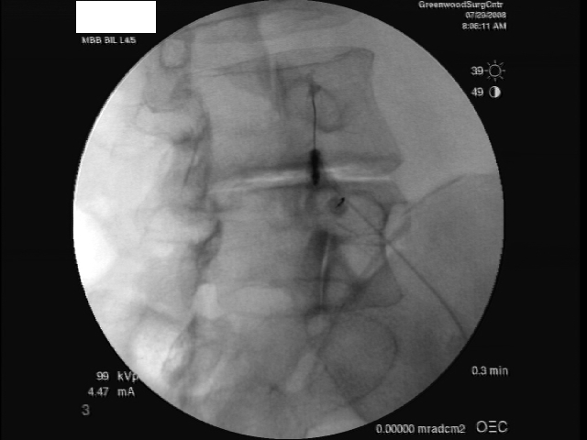

Slide 39
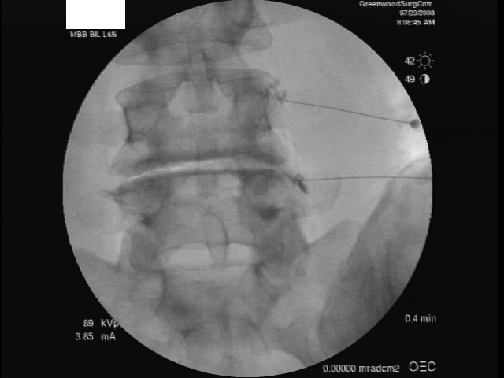

Slide 40
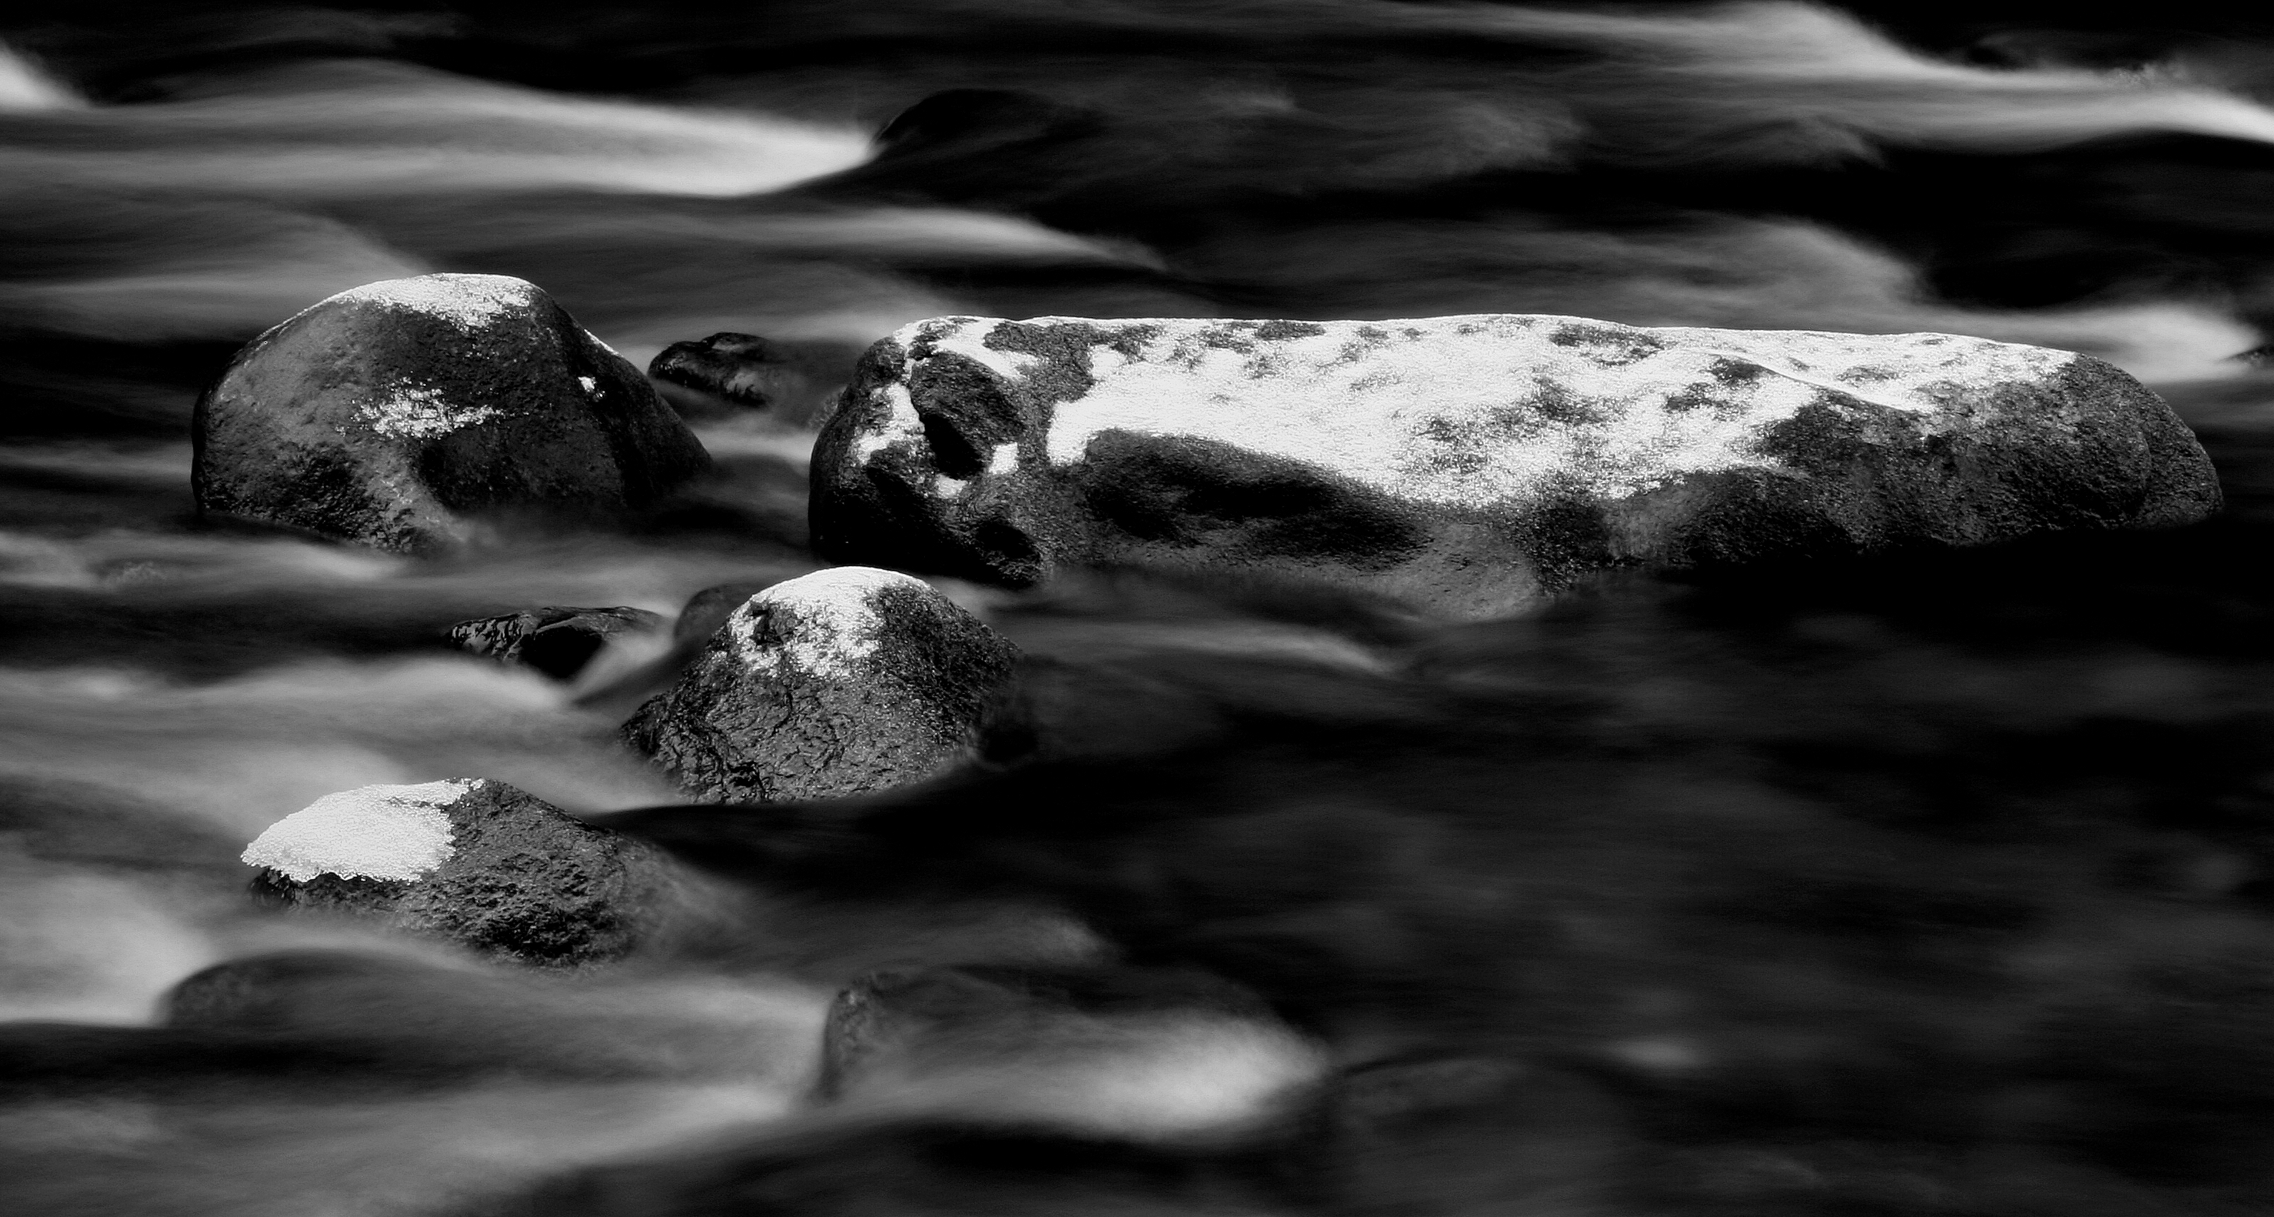
L1-4 MBBs
Courtesy Paul Dreyfuss

Slide 41
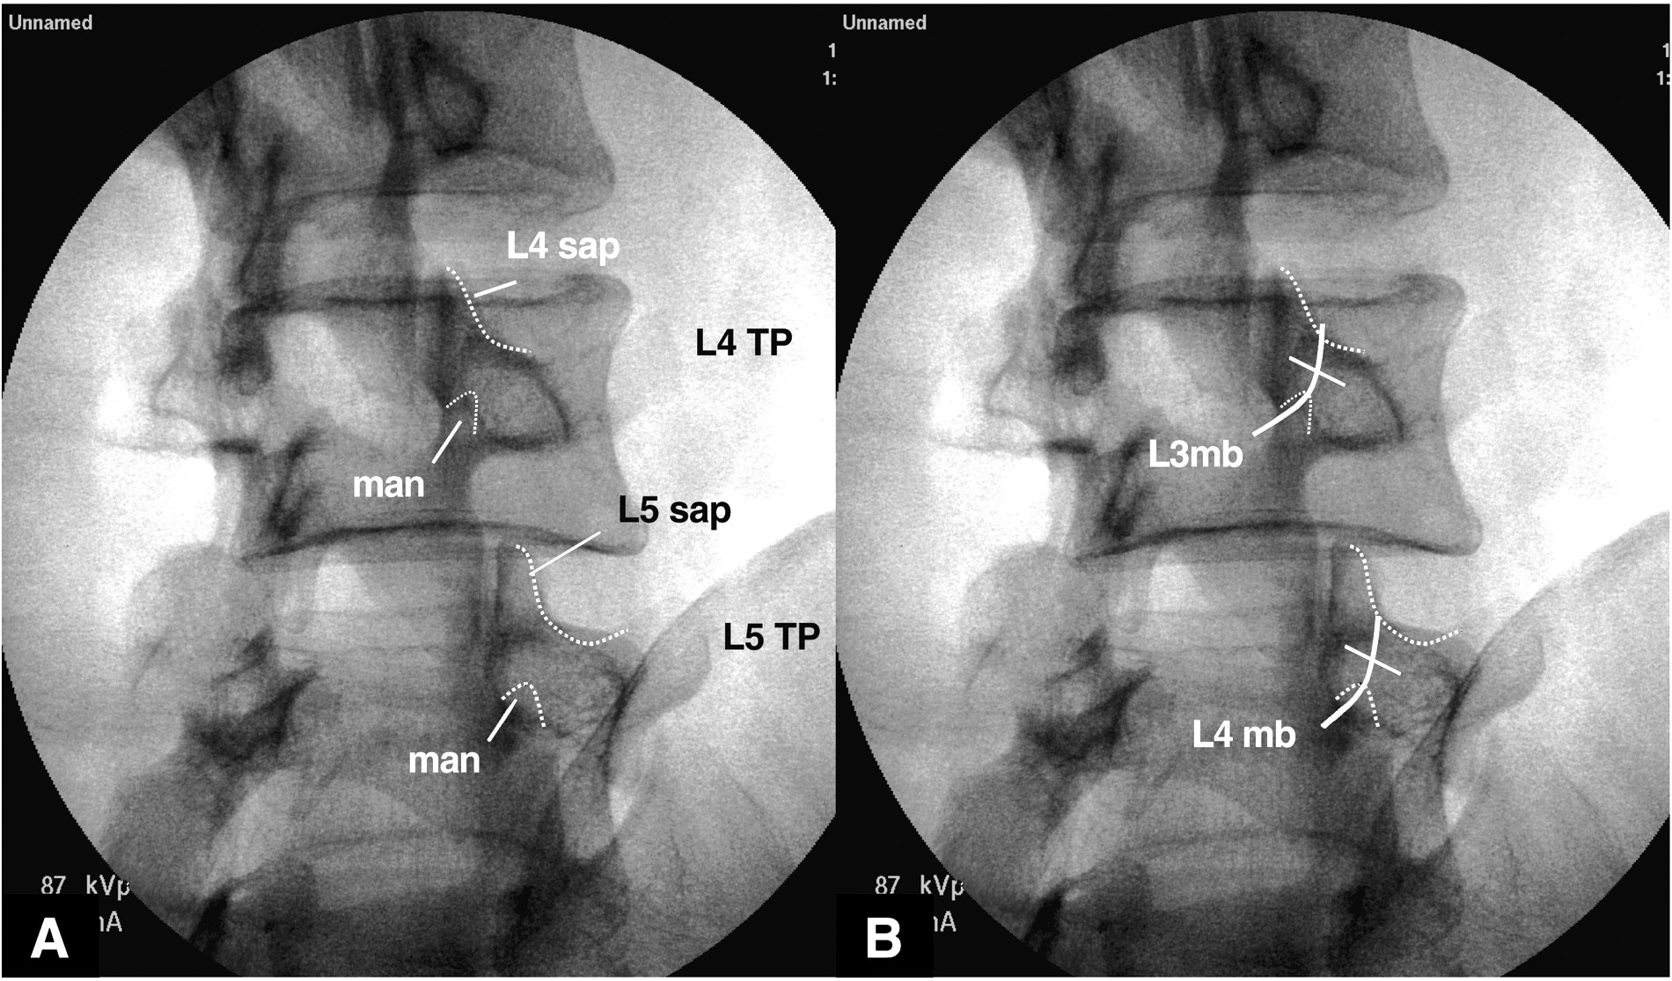
target
Image through the target disc space (segment)
Use approx. a 40^{O} oblique to be able place the needle in the target
groove and not on the posterior aspect of the SAP

Slide 42
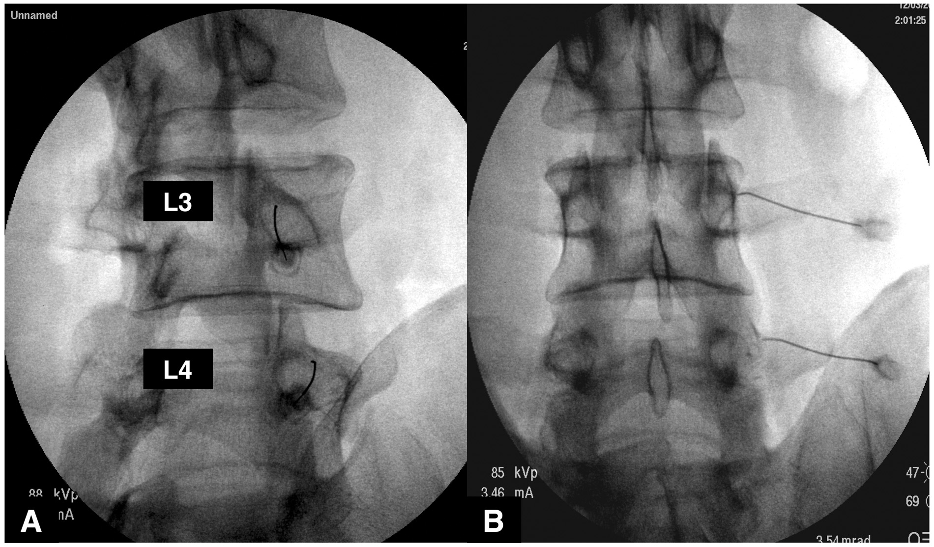
Adequate, but
slightly high
needle position
Image through the target disc space (segment)

Slide 43
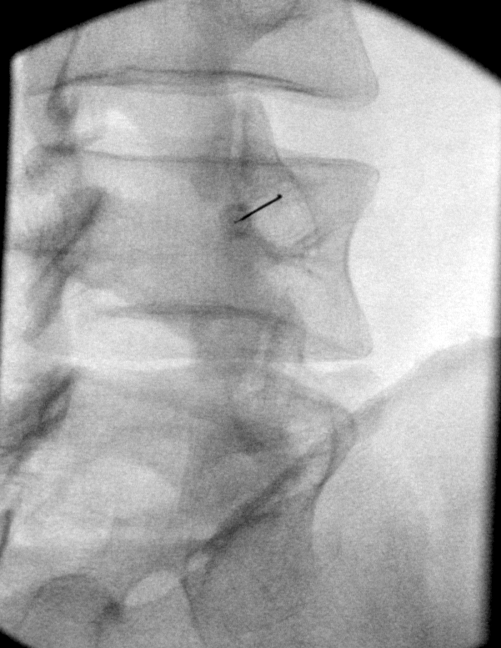

40^{O} oblique
Ideal placement

Slide 44
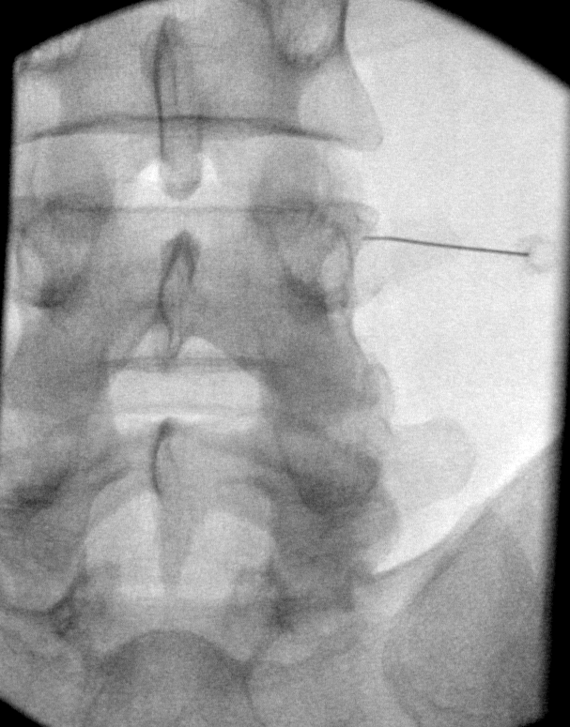
Ideal placement inside
lateral shadow of SAP

Slide 45
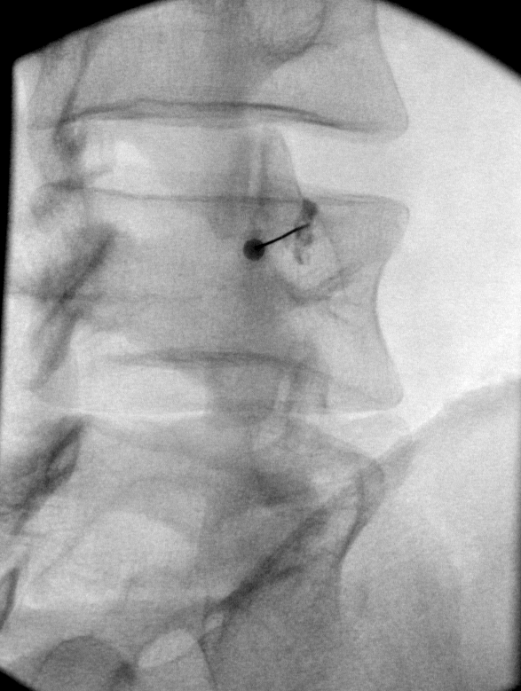
Ideal placement
and contrast flow

Slide 46
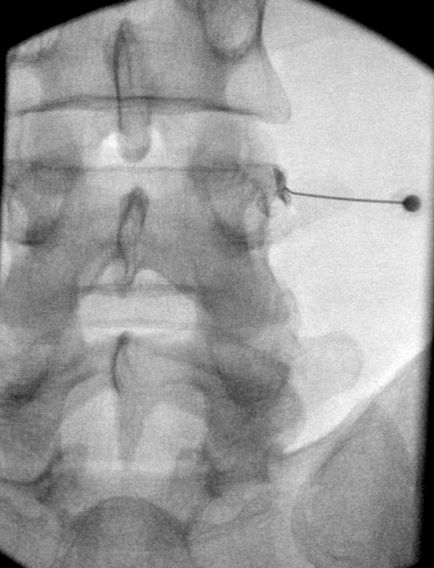
Ideal placement
and contrast flow

Slide 47
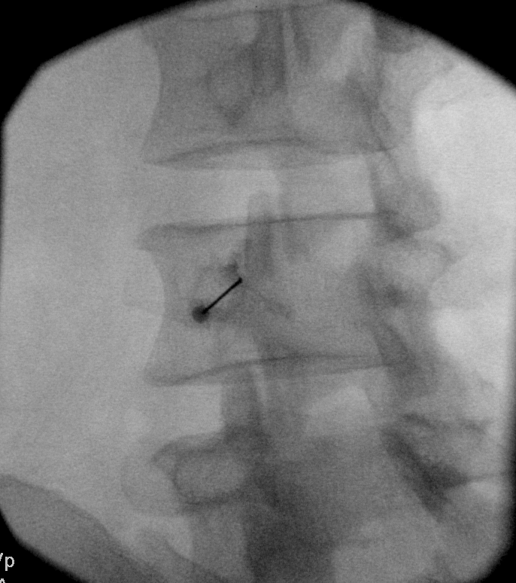
Ideal flow
In target
grove
between
SAP/TP

Slide 48
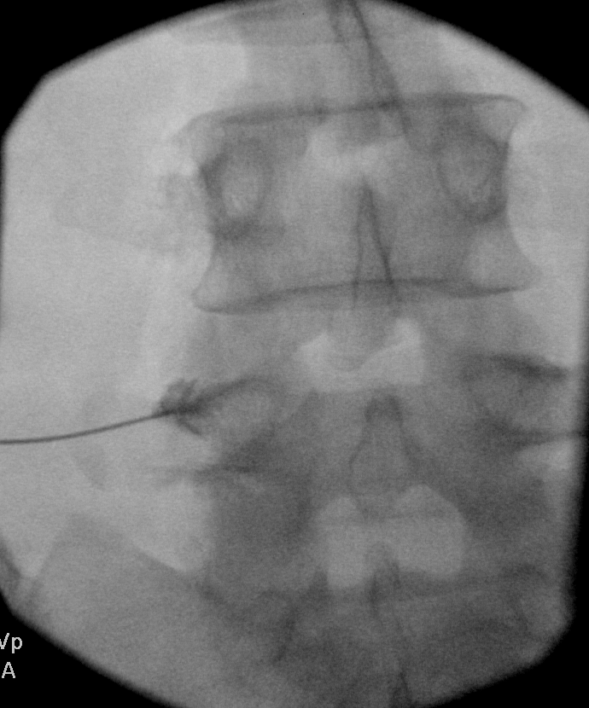
Ideal flow
in target
grove
between
SAP/TP

Slide 49
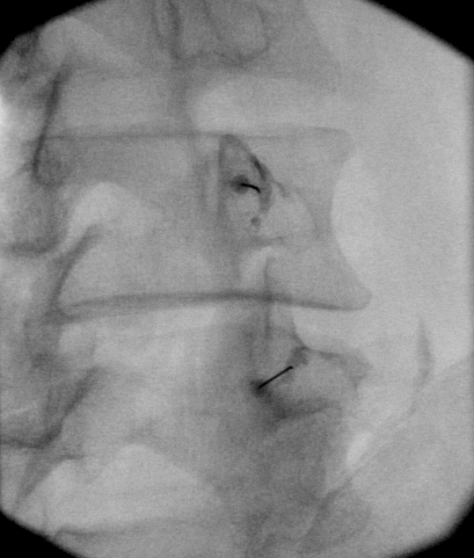
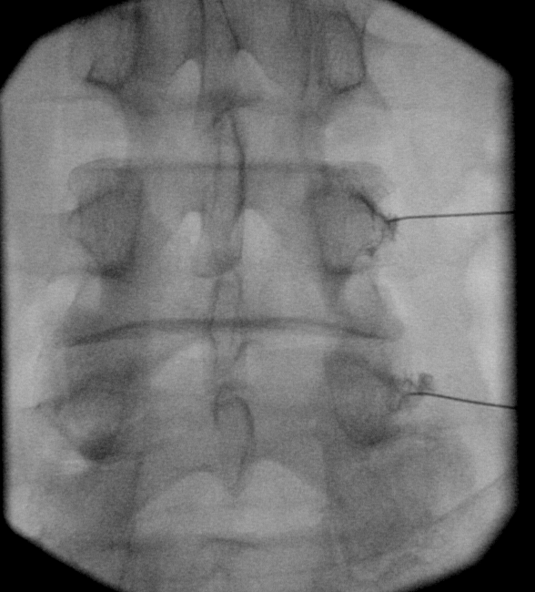
Image through the target disc space (segment)
Ideal flow and target position

Slide 50
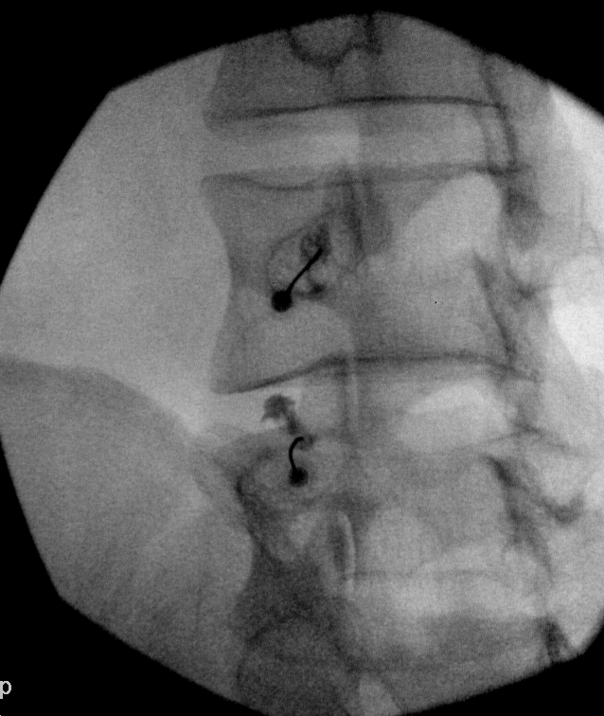
Try to avoid
Contrast flow
superio towards the IVF- consider
re-positioning

Slide 51
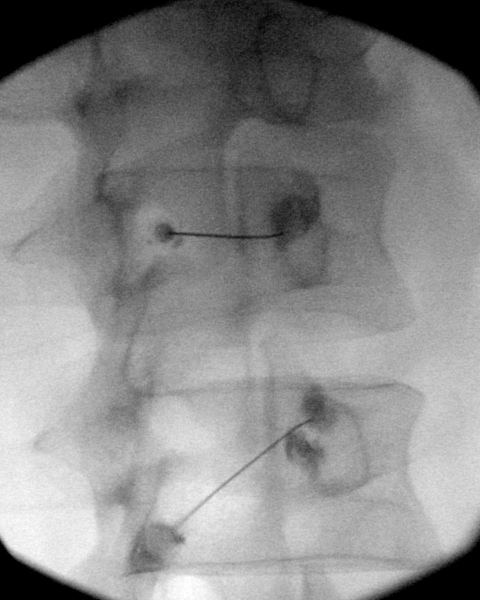
Initial flow at
MAL- needed
to redirect

Slide 52
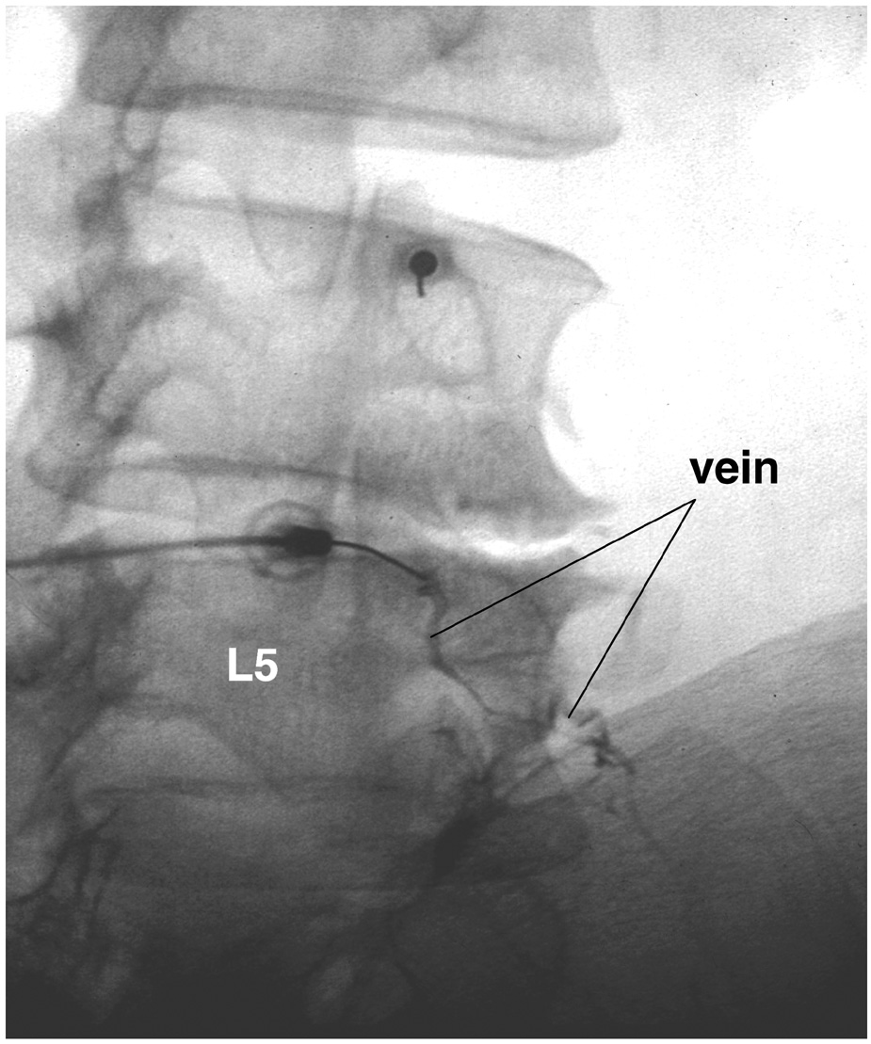
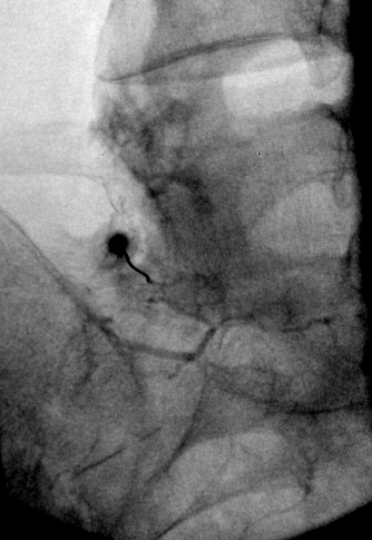
Venous uptake more common than in the
cervical spine

Slide 53

L5 DR Blocks
Courtesy Paul Dreyfuss

Slide 54
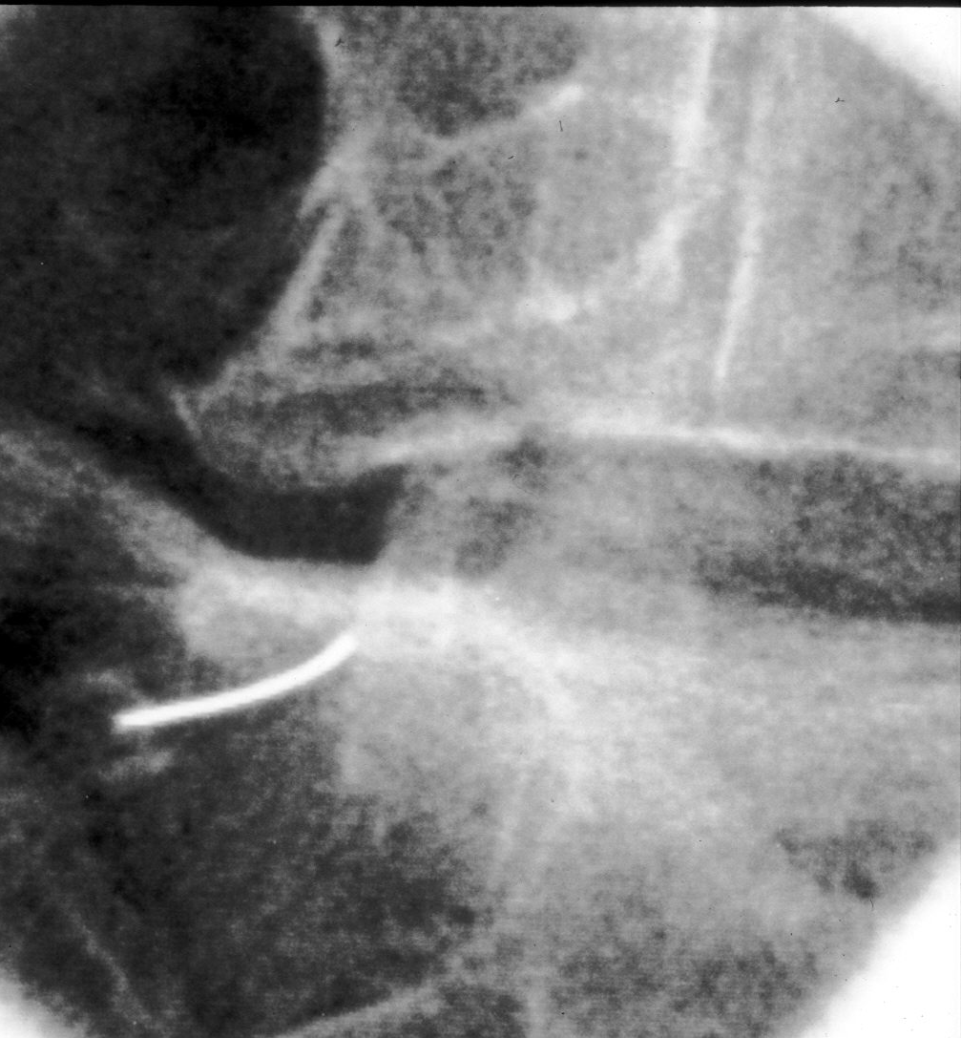
Image through L5-S1 disc space
oblique until can clear the S1 SAP but within the PSIS

Slide 55
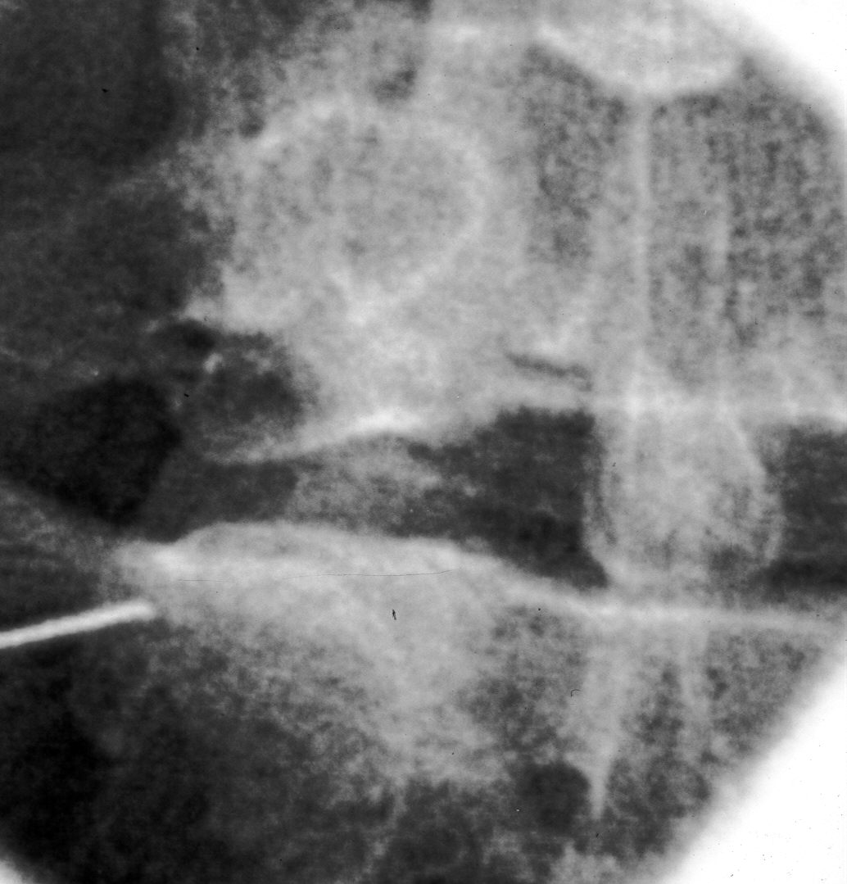
AP Image
With an adequate oblique approach can get in the
target groove (medial to the lateral
silhouette of the S1 SAP)

Slide 56
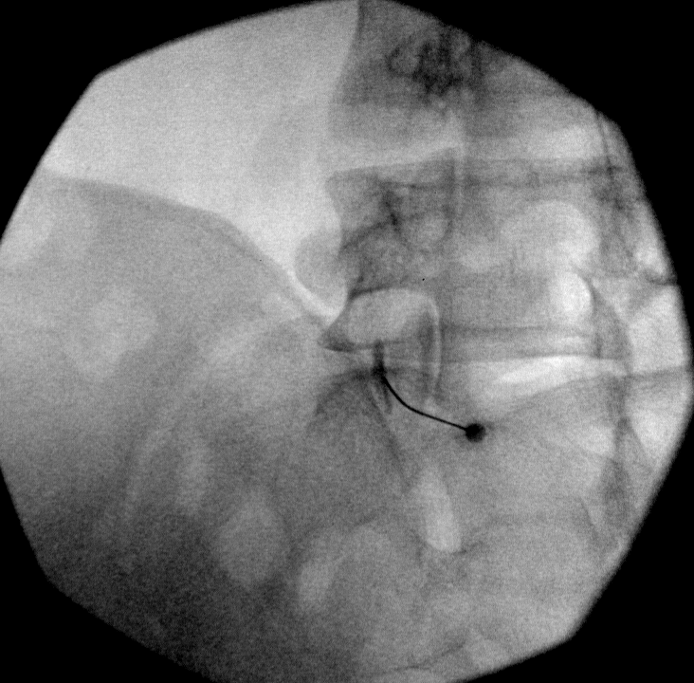
L5 DR block
Usual 15-20^{O}
Oblique to see
target groove and
place the needle,
but need to be
inside the PSIS
Block approx
midway
between the
sup junction of
S1 SAP/ala and
MAL
Tilt through
L5-S1 interspace
MAL
Adequate flow

Slide 57
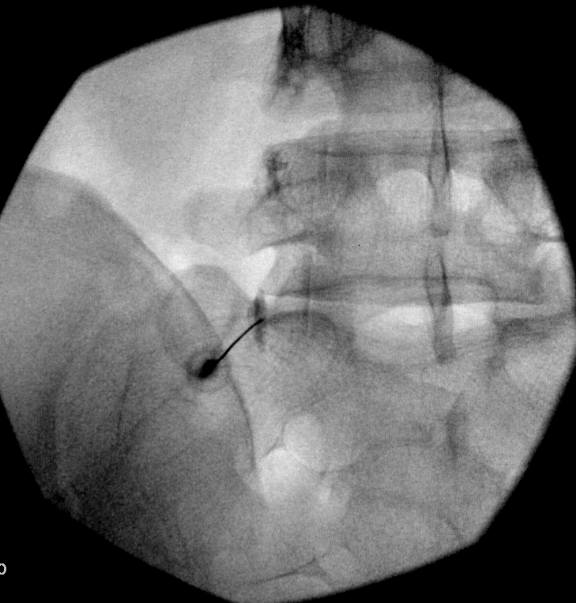
L5 DR block
Tilt through
L5-S1
Interspace
Adequate flow

Slide 58
L3MBB w good
position
L4MBB lateral
contrast flow;
Then, good flow
after
medial
Repositioning
JSB

Slide 59
L4 MB missed due to high SAP placement; needle repositioned and
good MB coverage achieved
Note deep sulcus housing the L5 DR
JSB

Slide 60
TESTING A TEST: VALIDITY
CRITERION STANDARD
+
-
+
a
b
Single MBB false positive
Rate = 25-45%
ISIS PG p.561
TEST
-
-
c
d
DIAGNOSTIC CONFIDENCE = a : b
(expressed as ODDs)
= (a / b) : 1

Slide 61
DIAGNOSTIC = PREVALENCE x LIKELIHOOD
CONFIDENCE ODDS RATIO
chances that the condition is present
versus
chances that the condition is absent
How well the test works
True-positive rate
versus
False-positive rate
= SENSITIVITY
1 - SPECIFICITY

Slide 62
Medial Branch Blocks
Validity - Cervical
Diagnostic Confidence = Prevalence Odds X LR
50% is a reasonable approximation of Z-joint pain in patients with chronic axial neck pain
Concordant criteria: diagnostic confidence = 82%
Conc + discod criteria: diagnostic confidence = 74%
Single blocks: diagnostic confidence = 48%
Comparative MBB are a practical alterative to true placebo controlled blocks, and can attain a reasonable diagnostic confidence in part due to the high prevalence of Z joint pain

Slide 63
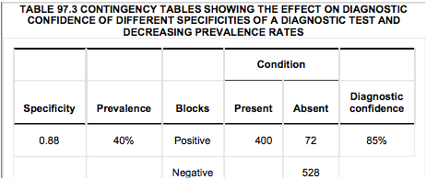
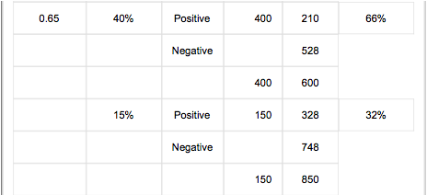
Lumbar Spine
Lower prevalence
Lower diagnostic
confidence
Concordant and discordant responses with Sensitivity 1.00,
Specificity of 0.65
Curatolo, Bonica’s Management of Pain, 2010
SIS Practice Guidelines…pp560-566

Slide 64
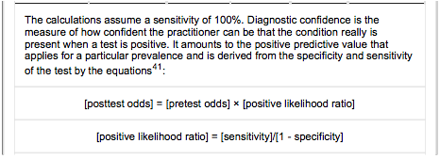
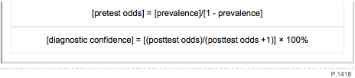
Curatolo, Bonica’s Management of Pain, 2010
SIS Practice Guidelines…pp560-566

Slide 65
Steps towards better LRF outcomes
Select patients so that odds of having facet pain are high
Meticulous medial branch block technique
Select only diagnostic (>70-80% relief) MBB results
Meticulous RF technique

Slide 66
LZJ - Clinical Diagnosis
Cannot Diagnose by any single indicator:
  History
  Clinical exam
  CT scan
  SPECT scan is exception, but not a practical tool
Inc. Likelihood of ZJ Pain:
  Combine history, age, exam

Slide 67
Differentiating Axial LBP Source - Prevalence
Structure | Prevalence | Demographics
Disc | 40% | Young, injured, peak ages: 35-55
Facet (Zygapophysial) Joint (LZJ) | 10-45% | Older: > 52
Lytic L5 Pars Defect | 6-7% | Onset age 5-7, develop by age 18
Sacroiliac Joint (SIJ) | 15-30% | Trauma, older, women, lumbar fusion

Slide 68
Differentiating Sources of Axial LBP
Structure | Image | History (P=pain) | Exam
Disc | MRI: HIZ, Modic Changes | P arising from sit, midline; P w bend, lift, Valsalva | Centralization (McKenzie), flexion
LZJ | DDD/DJD common (not predictive) | P standing, better walking, sitting; age > 52 | P w combined extension / rotation (absent = negative predictor)
SIJ | Not predictive or sensitive/specific but rule out fracture, stress response, tumor, inflammation | P arising from sit, P unilateral at or below PSIS | Fortin finger (pt. points to SIJ as P location; Gillet test; 3 of 5 positive: pelvic distraction, compression, FABER, thigh thrust, Gaenslen’s
Disc: increased
Disc pressure
LZJ: lordosis
and axial load
SIJ: shear
and torsion

Slide 69
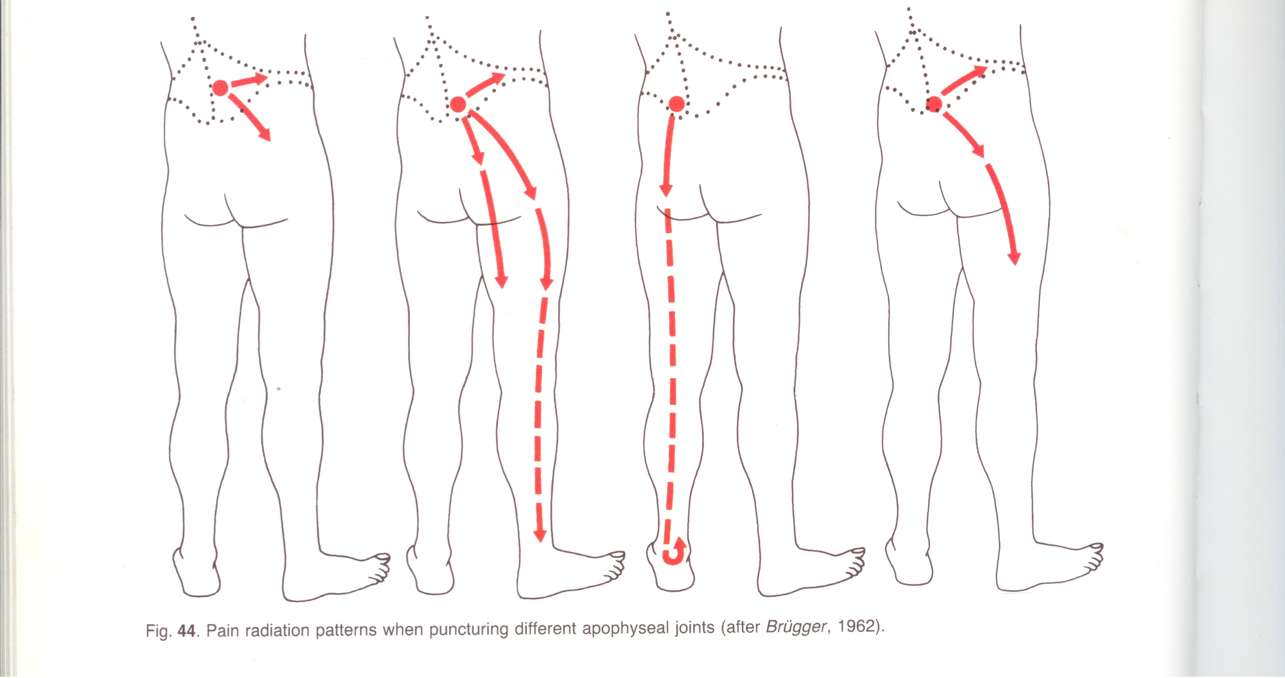
Z-joint pain associated with paralumbar pain and local tenderness.

Slide 70
LZJ Clinical Diagnosis
Jackson 1988 Volvo Award winner – Spine 1988
390 subjects with clinical history and exam who underwent facet blocks
29% relief
Correlation with degree of relief:
  older age,
  prior history of low-back pain,
  normal gait,
  maximum pain on extension following forward flexion in the standing position
Absence of leg pain, muscle spasm and aggravation of pain on Valsalva
Greatest pain relief immediately after injection was seen with lumbar extension and rotation
Could not predict who would respond to facet blocks

Slide 71
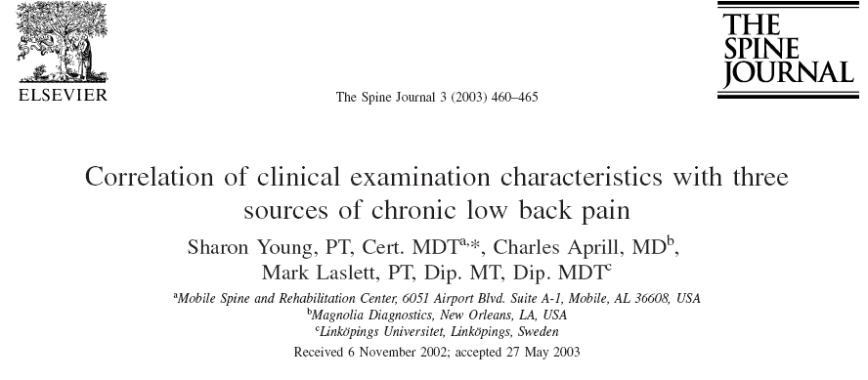
Discogenic: Centralization w McKenzie method
  Pain w rising from sitting
Sacroiliac: Unilateral pain; No lumbar pain
  Pain rising from sitting
  3/5 provocation tests: distraction, compression, sacral thrust, thigh thrust, Gaenslen’s
LZJ: no pain rising from sitting

Slide 72
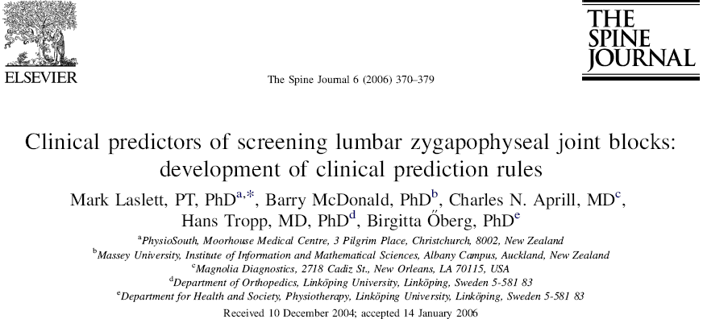

Slide 73
Clinical Prediction Rules Based on 7 Variables
Age > 50
Pain best when walking
Pain best when sitting
Onset of pain was paraspinal
MSPQ score > 13 (somatization)
Extension/Rotation test
Absence of centrilization w repeated movement testing

Slide 74
Extension/Rotation Test
If negative: very unlikely to have 95% pain reduction
NPV = 100, PPV = 13
Sensitivity = 100%
Specificity = 22%

Slide 75
Clinical Predictive Rule (5)
3 or > of 5 clinical signs (age>50, best w walk, best w sit, paraspinal pain onset, extension/rot)
Sensitivity 85
Specificity 91
PPV 55
NPV 98
+LR 9.7
-LR 0.17

Slide 76
LZJ Clinical Diagnosis
Three of five: age >50, sx. best walking, sx. best sitting, onset of pain paraspinal, pain worse with combined extension/rotation
  Sensitivity 85%, specificity 91%, PPV 55, NPV 98
  Laslett, et al, Spine J. 2006 Jul-Aug;6(4):370-9

Slide 77
Clinical Predictors of Pain Generators (Algorithm for LBP)
Nikolai Bogduk
ISIS Practice Guidelines…
First Edition

Slide 78
Algorithm Highlights
L-MRI discs normal
  Investigate synovial joints
L-MRI abnormal
  Young person – investigate discs
  Older person – investigate synovial joints
If pain below L5, unilateral
  Investigate SIJ
If pain above L5, bilateral
  Investigate LZJs in stepwise fashion

Slide 79
MBB Response Interpretation Recommendations
Set tone of objectivity (provider and patient)
Baseline pain level adequate
  3/10 or >50% of maximum pain level or greater
Activities and postures which are limited by pain identified prior to procedure and tracked afterwards (i.e. extension/rotation pain, standing tolerance)
Assess response with provocative maneuvers
  Response within 30 minutes
  Track response over 6-8 hours
  See ISIS Practice Guidelines…pp594-599

Slide 80
What are appropriate selection criteria for MB RF Neurotomy?
Intra-articular vs. MBBs
Single vs. Dual blocks
Percentage pain relief

Slide 81
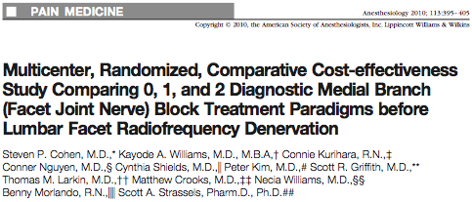

What is the best selection method for optimal lumbar RFN outcomes?

Slide 82
Cohen 0, 1, 2 Block Cost-Effectiveness Study
Comparative Cost-Effectiveness of 0, 1, or 2 MBB before LZJ – RFN
Cohen, et al. Anesthesiology 2010
151 screened and randomized to groups
RFN of 51/51 of 0 block group; 19/50 of 1 block; 14/50 of 2 bl
Parallel single lesion with 20 gauge/ 10mm active tip
Denervation Success Rates (> 50% relief) at 3 months:
  0 mbb - 33% (more get better; costs less)
  1 mbb - 39%
  2 mbb - 64%

Slide 83
Dreyfuss LMB RFN Prospective Audit
(Dreyfuss, et al. Spine 2000)
41 screened
15 passed comparative blocks >80% relief and enrolled
16 gauge RF needle placed parallel to MB
Lesions confirmed with EMG
Outcomes: VAS, McGill, Roland-Morris, SF-36, NASS treatment expectations, functional tests,
Follow-up: 6 weeks, 3, 6, and 12 months
13/15 with 60% or > relief (87% success);
60% w >80%relief

Slide 84
Dual MBB superior to IA block in predicting successful RF outcomes;
Cohen, et al. 2015

Slide 85
Optimal Selection = Optimal RF Outcomes
Dual Blocks with >80% Relief Best
Study | Phys Exam (0 Block) | IA Block | Single Block | Controlled 2 | Outcome >50% Relief
Reiz, Cohen | Yes |  |  |  | 33% placebo
Leclaire, van Wijk |  | Yes - single |  |  | 0-33% placebo
Cohen |  |  | >50% |  | 39% at 3 months
Van Kleef, Burnham, Cohen 6 mo |  |  | >50% or >50 or 80% Cohen |  | 20-56% at 6/12 months
Cohen |  |  |  | >50% | 64% at 3 months
Dreyfuss, Reiz |  |  |  | >80% +/- placebo | 83-87% at 12 months

Slide 86
Derby, et al Pain Medicine 2012
Favorable outcomes with lumbar RF ablation:
With dual blocks with >70% relief
With single blocks with > 80% relief
Cigna Colorado now will not allow 2nd block if first provides >80% relief

Slide 87
Lesion Size (Technique) Important
“Larger lesions mean a larger tolerance of errors in electrode placement and of the inevitable variation in the anatomic position of the medial branches.”
Lord, McDonald, Bogduk 1998
Cosman 2014

Slide 88
Large and multiple lesions necessary

Slide 89
RF Lesion of L3 MB at L4 SAP
Goal of Coverage of Target Zone

Slide 90

L5 sap
L4 mb
mal
L5 TP
L5
S1 sap
L5 dr
ala
S1
A
B
Lesion the middle 2/4^{ths} of the SAP for L1-4 MB RF
Lesion the mid and post 1/3 of the SAP for L5 DR RF

Slide 91


A
B

Slide 92
L5DR RF
16 guage
2 lesions
JSB

Slide 93
JSB

Slide 95
Optimal Technique = Optimal RF Outcomes
Study | Parallel Lesion? | Single/Multi Lesion | Needle Guage | Outcome
Leclaire, van Wijk | No |  | 22 | 33%
Burnham, van Kleef | Yes/near | single/multi | 22 | 55%
Cohen | yes | single | 20 | 64%
Dreyfuss, Reiz, Gofeld | yes | multi | 16-18 | 87%
McCormick 2015 | yes | single | 20 | 55% (pain/fx >50%)
MacVicar 2013 | yes | multi | 16 | 55% (complete relief)

Slide 97
Conclusions:
Steps towards better LRF outcomes
Select patients so that odds of having facet pain are high
Meticulous medial branch block technique
Select only diagnostic (>70-80% relief) MBB results
Meticulous RF technique

Slide 98
Study your art!
…and know your anatomy.

Slide 99
Photo by Paul Dreyfuss

Slide 100
Lumbar Facet Pain:
IA steroid injections
Two new trials exist. Both studies rated by Spectrum as having a “moderate quality of evidence” with a “low risk of bias”
“Significantly greater improvement in pain and function following IA facet injections vs IM steroid injections in the short-term” (Ribeiro. Spine 2013)
“No difference in pain or function in those receiving IA facet injections vs. radiofrequency neurotomy (HCA covered procedure) in the intermediate term” (Lakemeier. Anesth Analg 2013)

Slide 101
Lumbar Facet Pain:
IA steroid injections
Three prospective trials (2 randomized) evaluated IA facet injections in subjects with physiological evidence of facet joint inflammation (+ SPECT)
  Excluded by Spectrum. See appendix for details.
Collectively, these trials showed benefit for IA facet injections in 151 pts, with benefit maintained at 3 months
  Ackerman. Pain relief with intraarticular or medial branch nerve blocks in patients with positive lumbar facet joint SPECT imaging: a 12-week outcome study. South Med J. 2008 Sep;101(9):931-4.
  Dolan. The value of SPECT scans in identifying back pain likely to benefit from facet joint injection. Br J Rheumatol. 1996 Dec;35(12):1269-73.
  Pneumaticos. Low back pain: prediction of short-term outcome of facet joint injection with bone scintigraphy. Radiology. 2006 Feb;238(2):693-8.

