Slide 1
Non-Opioid Pain Management
Jonathan Clapp, M.D.
Colorado Pain Consultants
April 23rd, 2017
Notes:
Hi everyone! Thanks so much for coming. Today I’ll be talking about alternative approaches to pain management.

Slide 2
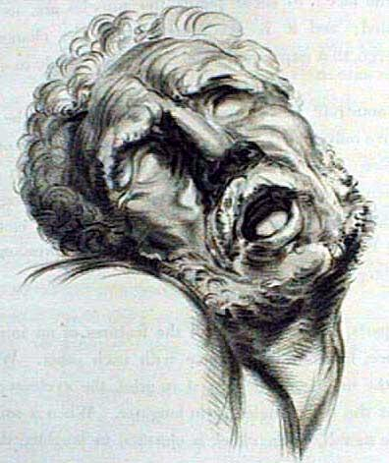
Disclosures
-Paid speaker for Collegium, Depomed & Pfizer Pharmaceuticals.

Slide 3
Objectives
Review DORA’s new opioid prescribing policy.
Describe what complementary & alternative treatments are and what it means to practice “integrative” medicine.
Review commonly used medications.
Notes:
Here’s what we will talk about. **** Now I also apologize for some busy slides, but these are meant to be a resource if you would like to go over them later.
3

Slide 4
What is Pain?
Pain is defined as “an unpleasant sensory and emotional experience associated with actual or potential tissue damage, or described in terms of such damage”. -IASP
“Pain is a subjective and entirely individual personal experience influenced by learning, context, and multiple psychosocial variables”.
Notes:
* But more importantly, *And we must consider all of these influences to effectively treat patient.

Slide 5
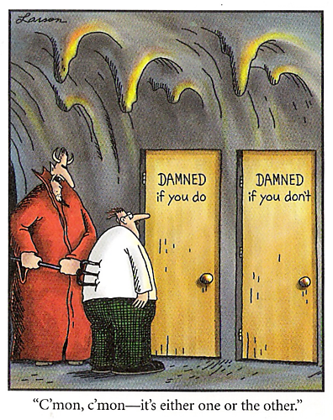
CBME Guidelines for Prescribing Opioids (2009)
The CBME “strongly urges physicians to view effective pain management as a high priority in all patients”.
“Tx may involve several drug and non-drug tx modalities, often in combination”.
“Pain should be assessed and treated promptly, effectively, and for as long as pain persists”.
“Drugs, particularly the opioid analgesics, are considered the cornerstone of treatment for pain associated with trauma, surgery, medical procedures, and cancer.”
Colorado Board of Medical Examiners: Guidelines for Prescribing Controlled Substances for Chronic Non-Malignant Pain
Notes:
The Colorado Board of Medical Examiners developed guidelines in an effort to cut down on fears of prescribing opioids after percieving that patients pain was not being managed adequately.

Slide 6
What do they say NOW?
In response to the epidemic of opioid abuse, over prescribing and deaths many states and federal agencies have sought for ways to counter what was seen to be largely due to a lack of oversight.
In Colorado, on 10/21/2014 DORA publishes an “Open Letter to the General Public on the Quad-Regulator Joint Policy for Prescribing and Dispensing Opioids” followed by their “Policy for Prescribing and Dispensing Opioids”.
“Specifically, the policy recommends additional safeguards be put in place when prescribing and dispensing exceeds the following evidence-based thresholds that have been associated with adverse outcomes:
90 days in duration
120 milligram morphine equivalents dosages, or
certain formulations such as transdermal or long-acting preparations.”
“The evidence-based, bright line thresholds are intended in particular to assist the group of practitioners that find themselves treating pain without specializing in pain. Short-term treatment of pain can often lead into longer-term treatment, and at higher doses or riskier delivery methods. These bright lines caution the practitioner to pause, re-evaluate treatment, and institute additional safeguards.”
DORA mandated that all physicians be registered with the CDPMP by 11/2014.

Slide 7
Diagnosing Pain
Identify the pain generator and contributing factors.
Examples:
Extension-biased LBP are most commonly due to facet joint pathology or a large disc extrusion.
Flexion-biased low back pain is most commonly associated with discogenic or vertebral body pathology.
Be mindful of signs of neurologic deficits
Determine the pain characteristics.
Biomechanical: achy, sharp, positional
Inflammatory: worse at night or in the early am, achy, sore, swollen, stiff.
Neuropathic: burning, electric, pins & needles, numbness, occurs in a nerve/nerve root distribution.

Slide 8
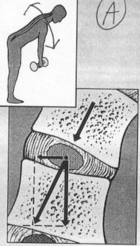
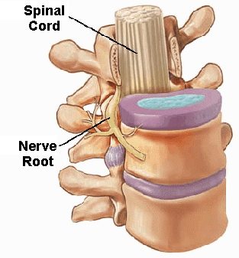

Slide 9
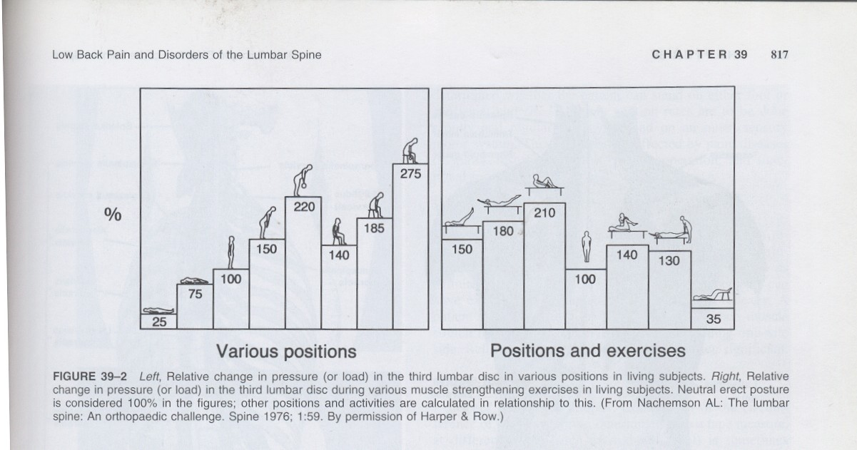
ERGONOMICS

Slide 10
How can we keep patients from becoming “chronic”?
Rule #1: Control the patients pain.
Decreases the pain impulses bombarding the CNS and, as a result, lessens central sensitization.
Rule #2: Limit anxiety/depression and make the patient an ACTIVE participant in their care.
CV exercise releases endogenous opioids that is the cornerstone of treatment for fibromyalgia.
Patient education cannot be understated…
Patients who are accepting, readiness to change, demonstrate self efficacy and are not overwhelmed by their condition have better function, better outcomes, better depression/anxiety scores and lower opioid consumption immediately post-op and at 6 months.

Slide 11
Treatment – Chronic Pain
Studies show multidisciplinary approaches are unequivocally the best model in patients with short- & long-term disability.
Team should optimally include: Physician, PT, OT, Pain Psychologist/Psychiatrist/Biofeedback Specialist, Social Worker, Recreational Therapist, Biofeedback Specialist, Nursing Educator and Vocational Counselor
The team should work together to provide a unified diagnosis and comprehensive treatment program, in which the patient is an active participant.
Notes:
****Activity and shifting focus to getting better is a crucial part of recovery and breaking pain behaviors. Rewards for accomplishing tasks and ignoring pain behaviors are keys in behavior modification and should be consistent across all aspects of their treatment and at home.

Slide 12
Team Goals of Treatment
Maximize & maintain physical activity and function
Reduce the misuse or abuse of dependency-producing meds, invasive procedures, and passive modalities, fostered by a change toward active patient self management.
Return to previous levels of activity at home, in the workplace and in leisure pursuits.
Reduce subjective reported pain intensity and maladaptive pain behaviors.
Assist patients in obtaining resolution and/or closure of contentious work-related or litigation aspects of the pain condition.
Notes:
(*****)The main goal is to make the patient as functional as possible so that they can have some kind of quality in their lives. This is done by making them an active participant in their recovery and giving them the tools to put them in charge of their pain as opposed to the other way around. This is where the hard work starts.

Slide 13
Rehabilitation/PT
“If you have a structural or mechanical problem, it needs to be addressed structurally or mechanically”.
This is often a life-long commitment.
Ex. For low back pain, focus on muscle groups affecting spine (provides better mechanical support):
Low back (multifidi, transversus abdominis), abdomen, pelvis, thighs…
Focus on proper alignment and distribution of forces across the back:
Limb length discrepancies, flat feet, scoliosis, poor posture…
“Osteopathic manipulative treatment significantly reduces low back pain. The level of pain reduction is clinically important, greater than expected from placebo effects alone, and may persist through the first year of treatment.”

Slide 14
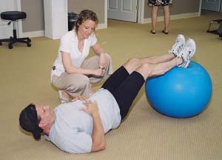
Physical Therapy
↓ Pain
↑ Flexibility to achieve proper mechanics across the spine
↑ Proper Posture
↑ Range of Motion
↑ Relaxation/Stress Relief
↑ Balance
↑ Coordination
Education

Slide 15
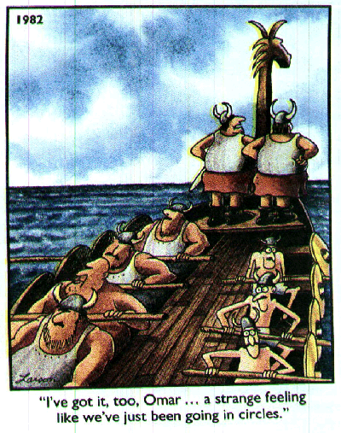
Treatment/Modalities: Exercise
Muscles may shorten as a protective reaction to injury/pain.
Prolonged shortening can be a cause of pain and result in altered biomechanics.
Graded stretching and strengthening, massage and manual therapy can help restore normal body mechanics.
Exercise itself is an important pain reducer, as well.
20 minutes of aerobic exercise per day has been shown to decrease depression, increase self efficacy and increase the release of endogenous opioids.

Slide 16
Movement-Based Therapies
Aquatic Rehabilitation is ideal for px’s with fear and anxiety related to movement.
Weight bearing is decreased 40% in chest deep water & allows for progressive loading.
Resistive force of water = force produced by px
Reports of reduced pain, anxiety, depression, fatigue and increased quality of life for up to 24 months.
Pilates “focuses on core strengthening, power, concentration, breathing and kinesthetic awareness”.
Little literature, but reports of improved strength, flexibility & posture.
Yoga has been reported to reduce pain possibly due to control of stress & depression as well as working on relaxation, stretching & strengthening of targeted muscles.
Notes:
********* These last two should be done by instructors who are aware of the individual’s specific injury, and be able to instruct on how to avoid positions or movements that may hurt them. A general “class” at the local gym isn’t the answer. It may be good for prevention, but not after an injury.

Slide 17
Movement-Based Therapies
Feldenkrais involves slow, fluid reaching, gentle stretching & postural changes for improved kinesthetic awareness & psychologic well-being.
Uses verbal cues and touch to facilitate movement.
Reported to improve QOL and self-efficacy in pain px’s. Also decreases anxiety & improves mood.
Can be done in gravity-eliminated positions, like laying down.
T’ai chi “supreme ultimate boxing” integrates “sharp mental focus with slow, rhythmic, dance-like mov’t sequences & postures that unite mind & body by facilitating the flow of qi throughout the body.
Reports of helping with pain, strength & flexibility.
Notes:
(********) Feldenkrais & T’ai chi are low-impact mov’t-based therapies that can really change somebody who has been sedentary for a long-time.

Slide 18
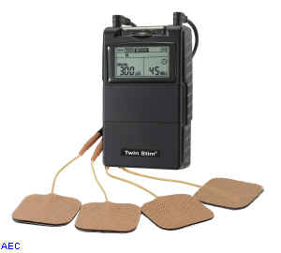
Treatment/Modalities
Transcutaneous Electrical Nerve Stimulation Therapy (TENS)
Theoretically acts via the gate control theory, electrical stimulation preferentially activates large diameter fibers, inhibiting smaller pain fibers.
May involve release of endogenous opioids, as well.
No better than placebo for chronic LBP, but does help with CRPS, phantom limb pain, peripheral nerve injury and post-op incisional pain.
Contraindicated in px’s with pacemakers.
Notes:
**** But we still use it a lot for LBP despite the evidence against it. So think about why that may be & keep that in mind for later. *

Slide 19
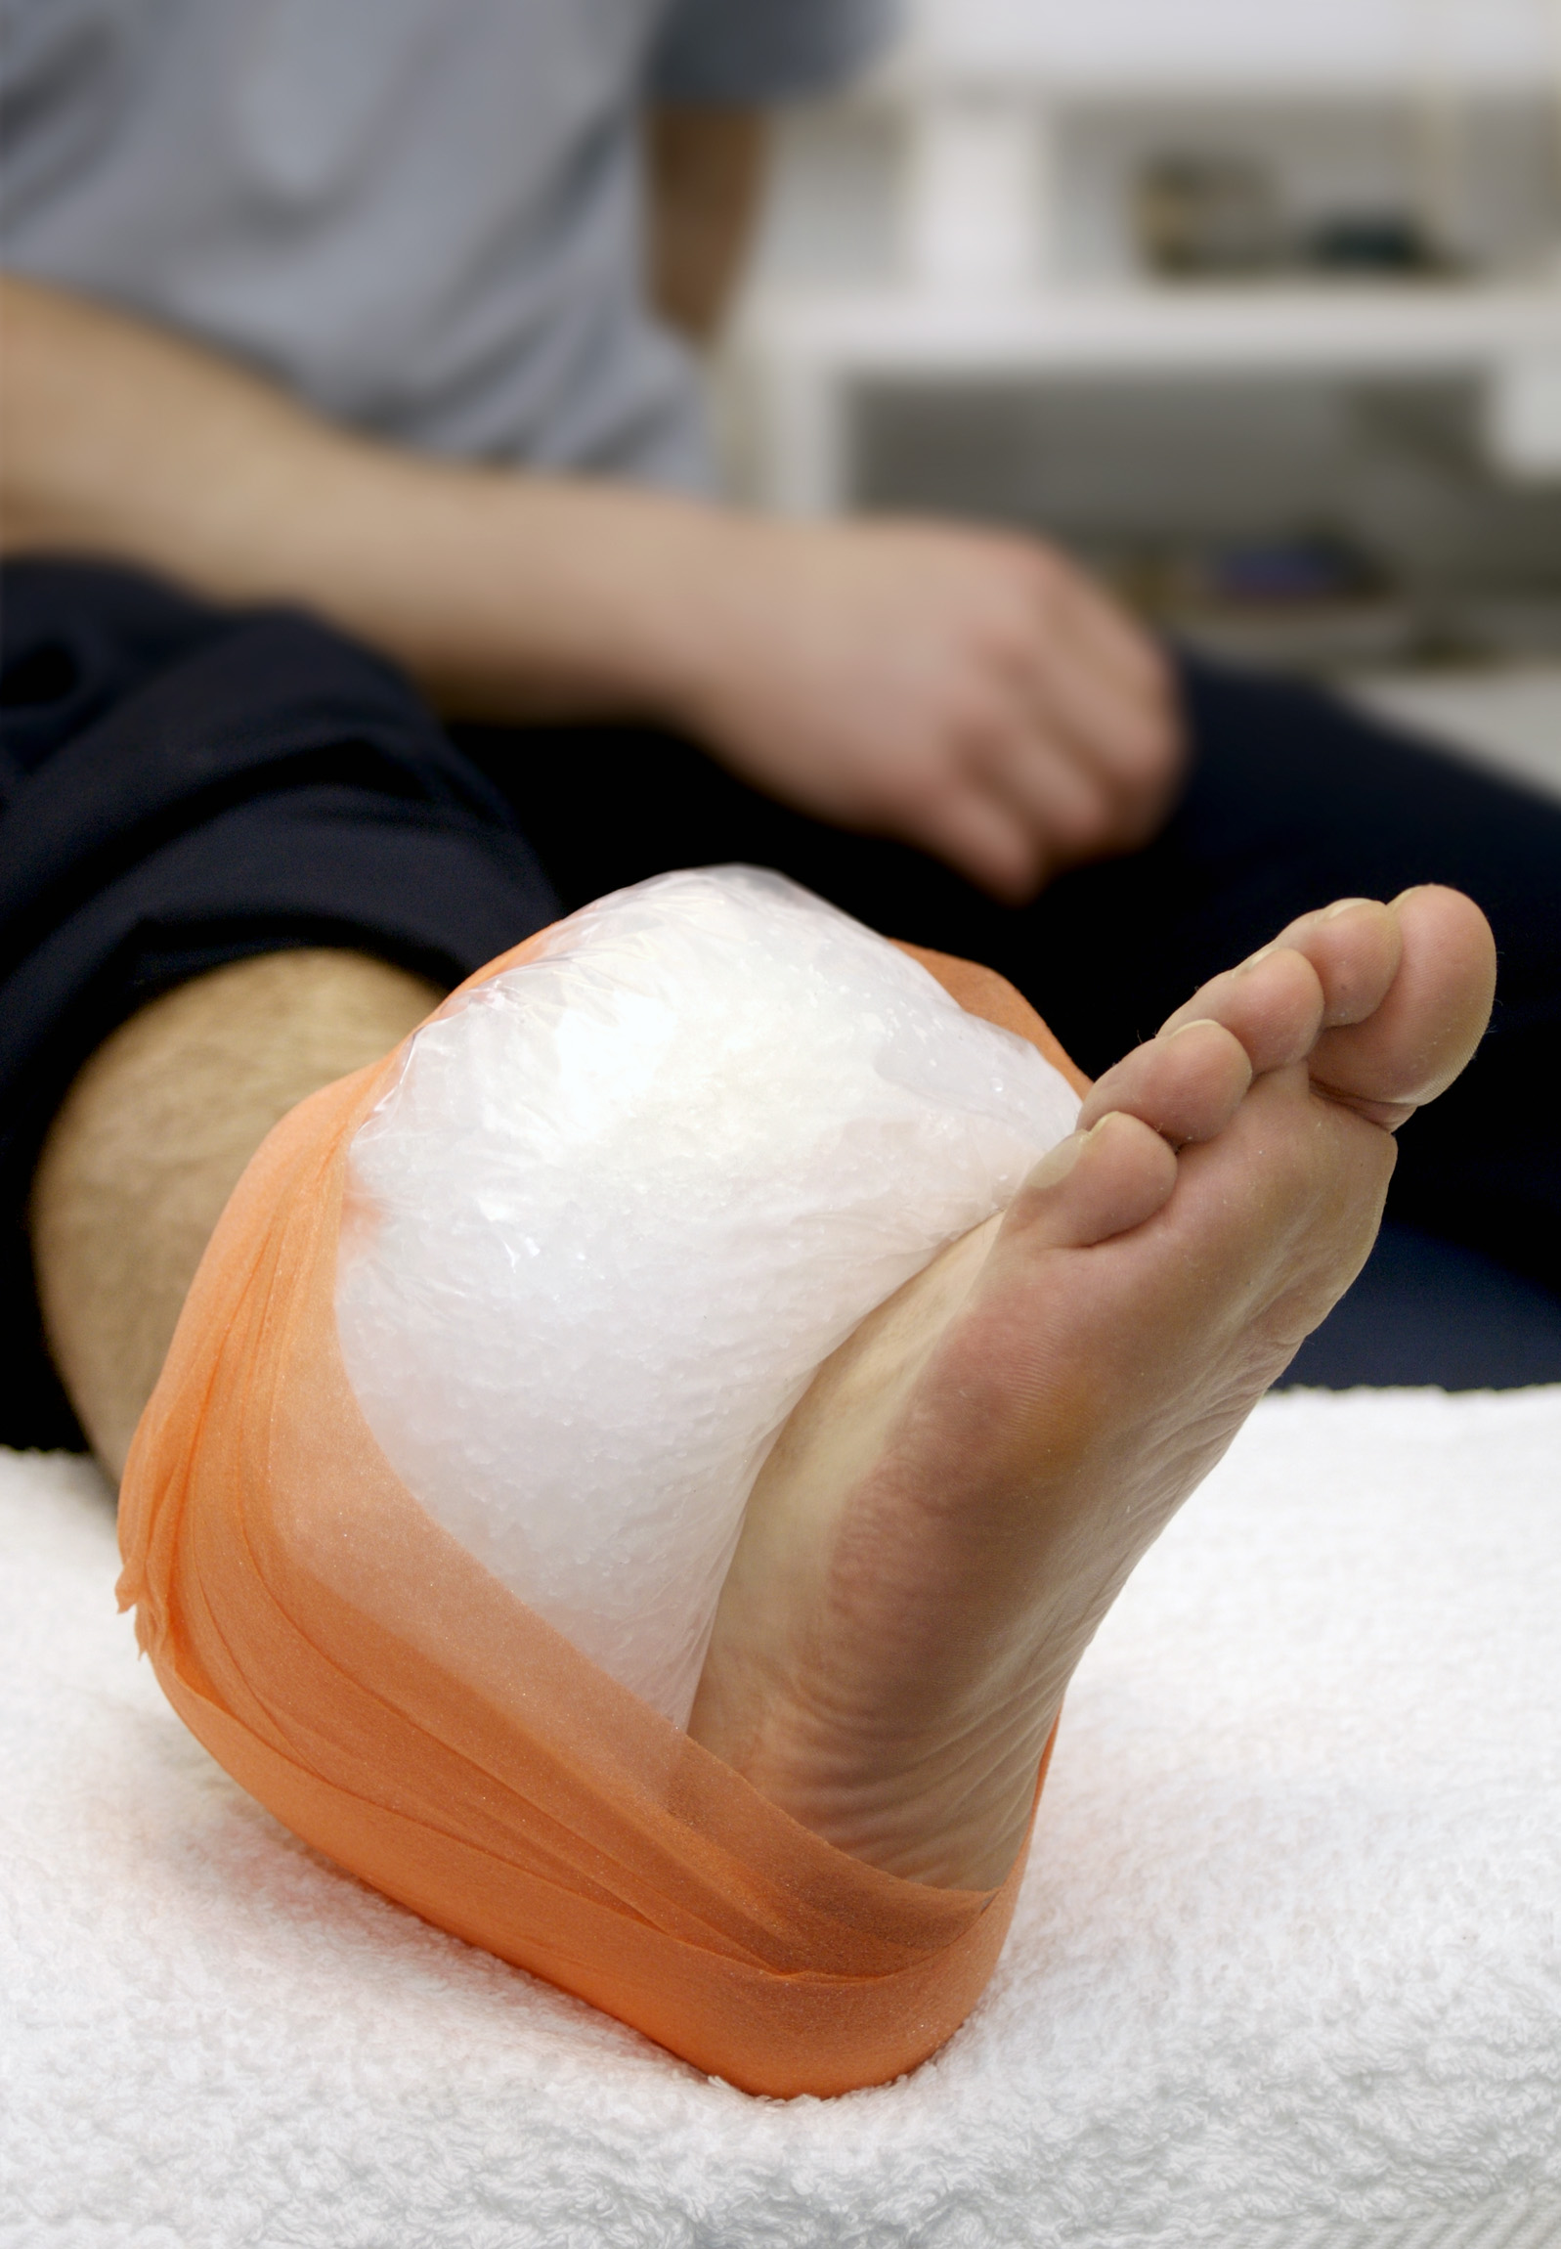
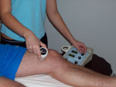
Treatment/Modalities
Heat & Cold
Via unknown mechanisms (“gate control”?), cutaneous heat & cold both serve to reduce muscle spasms by decreasing sensitivity of the muscle spindle’s firing rate and returning it to its normal length.
Cold is better for acute/inflammatory injuries, but can be used long-term based on px’s preference for muscle tightness.
Heat/Ultrasound is best tolerated in subacute/chronic conditions, but is better for loosening collagen and stiff joints than cryotherapy.
Not recommended for inflammation.

Slide 20
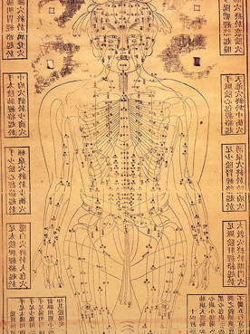
Treatment/Modalities
Acupuncture
2,500 year old Chinese modality aimed at restoring the balance between the yin (blood) and the yang (spirit) which flow in 14 channels or meridians containing 361 acupuncture sites.
Some theories of action:
May stimulate large afferent fibers via the gate control theory
May induce endogenous “opiate-like substances” to effect pain control.
Insertion of a needle, regardless of substance injected, can reduce pain. Called the “needle effect”.
A NIH panel in 1997 concluded there is clear evidence that acupuncture is effective for pregnancy, postoperative and chemotherapy associated N/V, and post-op dental pain. More recently it is recommended for low back pain.
Also concluded that there are other pain-related conditions for which acupuncture may be effective, despite less convincing scientific data.
Addiction, stroke rehabilitation, headache, menstrual cramps, tennis elbow, fibromyalgia (general muscle pain), carpal tunnel syndrome, and asthma.
Notes:
An ancient modality that has withstood the test of time despite our ability to fully understand how it works. (**) But there are a few theories of action: ***. ***.

Slide 21
Psychological Factors in Pain
Affective & Cognitive factors have a large impact on the perception of pain.
Studies show depressed patients have higher levels of pain, decreased cognitive functioning, & greater disability.
Anxiety is a strong predictor of pain severity, disability and pain behavior.
Patients with pain-related fear had increased disability at 6 months.
Catastrophizing is more than 7x more powerful than any other predictor in predicting transition from acute to chronic post-op pain.
Depression & anxiety results in 2-5 times more likelihood.
Patients with pain related fear (kinesiophobia) over-predict the severity of pain they will experience which results in increased avoidance behavior.

Slide 22
Behavioral Treatment Modalities
Cognitive behavior modification (“CBT”) teaches “self-coping statements and problem-solving cognitions” in attempts to alter their perception of their chronic disease.
Strategies of imaginative inattention, imaginative transformation of pain, focused attention & somatization in a dissociation manner are used.
The operant approach reinforces good behavior and ignores adverse pain behavior.
Exercises should be done at a level to avoid “punishment” for activity and reinforce the positive and reward them for achieving goals.
Relaxation Methods involve voluntarily sequentially contracting and relaxing muscle groups.
Allows insight into sensing muscle tension, facilitating relaxation.
Strong support for use in treating anxiety, depression, HA, insomnia & chronic pain.
Biofeedback teaches muscle relaxation & teaches the px self-regulation of pain.
Include imagery, hypnosis, meditation, diaphragmatic breathing.
Positive effects in chronic LBP, FM, HA, and temporomandibular disorders.
Notes:
* (*)** *(*)* *(*)*

Slide 23
Multimodal Analgesia
Strong evidence supporting the use of non-opioids for pain and some have been quantified as to how many morphine equivalents each can reduce over 24 hours.
APAP 1000 mg IV Q4hrs = 6-9 mg less morphine
ibuprofen 400 mg = 10.2 mg less morphine
celecoxib 200-400 mg = 10.2 mg less morphine
diclofenac 30-60 mg = 10.2 mg less morphine
gabapentin 300-1,200 mg = 13-32 mg less morphine
pregabalin <300 mg/d & >300 mg/d = 8.8 mg & 13.4 mg morphine, respectively.

Slide 24
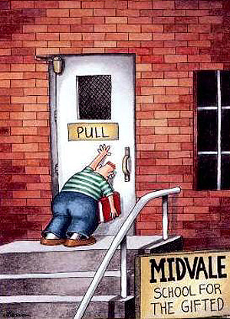
Notes:
We don’t know everything & if we think we do we can look foolish. As a result, we should be open to other ways to help our patients, remembering to first “do no harm”..

Slide 25
Alternative Therapies/Integrative Approach
“When evaluating treatments for our patients, we shouldn’t only look at the number to treat, but we should also look at the costs and risks.” -Dr. Andrew Weil
If there is something out there that may help our patients (especially when conventional medicine has failed); if it has little risk and is not overly expensive, should we be so quick to dismiss it?
TENS unit is a good example

Slide 26
Nutrition
Vit D, B12, B6, and essential fatty acid deficiencies can cause pain.
Excess Omega-6 fatty acids without appropriate balance with Omega-3 fatty acids results in inflammatory mediators that are more reactive.
Pro-Inflammatory Foods
Foods high in Omega-6 fatty acids (red meat, vegetable oit…)
Dairy
Tomatoes
Notes:
*80-90% of people with undiagnosed diffuse musculoskeletal pain had vit D deficiencies. Not as bad here as in Chicago where I trained. *

Slide 27
Herbal Supplements
GREAT RESOURCE! https://nccih.nih.gov/health/herbsataglance.htm
Inflammation:
S-adenosylmethionine (SAMe) shown to be as effective as celebrex in knee OA after 2 months of treatment and as effective as TCA’s in treatment of depression.
Omega-3 supplementation
2.7g/day of EPA & DHA improves pain in RA, OA & IBS after 3 months. Rec BID dosing.
Turmeric, Bromelain, Ginger up to 4grams/day in divided doses.
Sleep dysfunction:
Melatonin, passionflower, casein, 5-HTP, Valerian root
Nerve pain:
Alpha-lipoic acid up to 600mg/day in divided doses.
(Najm WI, et al. BMC Musculoskelet Disord. 2004 Feb 26; 5:6) (Role of S-adenosyl-L-methionine in the treatment of depression: a review of the evidence^{1,}2,3,4American Journal of Clinical Nutrition, Vol. 76, No. 5, 1158S-1161S, November 2002© 2002).
Goldberg RJ, Katz J. Pain 129 (2007) 210-223

Slide 28
Notes:
Now we’ll get into medications and supplements

Slide 29
WHO Pain Pyramid
High Potency Opiods
Low Potency Opioids
NSAID’s
Acetaminophen

Slide 30
Chronic Pain Pyramid
High Potency Opiods
Low Potency Opioids
Tramadol and/or Adjuvant Drugs
Acetaminophen
Gruft, 2005

Slide 31
NSAID’s
Are ideal for acute conditions (2-3 weeks) to reduce inflammation (except Tylenol) and pain by selectively or non-selectively blocking COX-1&2 pain producing cascades and prostaglandin synthesis.
COX-2 is suggested to be more associated with pain via its involvement in peripheral and central sensitization and in mechanisms underlying neuroplastic changes in chronic pain.
Also inhibit tissue reaction to bradykinin, suppress release of histamine and decrease vascular permeability.
All NSAID’s have a ceiling effect.

Slide 32
NSAID’s
Should be avoided in chronic pain due to GI bleeding (most common 5-10%), renal toxicity, platelet dysfunction & cardiac complications.
In 2004, based on review of literature re: NSAID’s, the FDA concluded that adverse CV effects may be a class effect for all NSAID’s (except aspirin).
Other NSAID’s can actually block the cardioprotective effects of ASA.
Ongoing monitoring of BP, hematologic status, and cardiac & kidney function is recommended for px’s on chronic selective & non-selective NSAID’s.

Slide 33
Benzodiazepines
1st line ONLY for alcohol or benzodiazepine withdrawal.
NOT 1st line for anxiety.
Withdrawal symptoms are the same symptoms the drug is designed to treat.
If someone is tolerant and trying to get off of it, they will have anxiety, palpitations & a jittery feeling purely from withdrawal. Not a psychologic disorder.
Not to mention seizures and death are possible with severe acute withdrawal.

Slide 34
Anti-convulsants
Older antiepileptic drugs have severe SE’s (hepatotoxicity, hematologic effects, etc) and require frequent monitoring.
Newer agents have been shown to have good results treating neuropathic pain, sometimes “off-label”.
Block sodium channels in neural membranes.
Used more with HA’s (tegretol, topamax, depakote)
Tegretol FDA approved for migraines.
Oxcarbazepine 150-300mg per day can be very helpful for neuropathic pain and less side effects than carbazepine.

Slide 35
Antispasmodics
Mechanism of action of muscle relaxers is unknown
Sedation?
We only understand dantrolene (inhibits release of calcium from the sarcoplasmic reticulum to inhibit muscle contraction).
Treat muscle or nerve spasms.
Works for neuropathic pain and myofascial pain with spasms.

Slide 36
Tricyclic Antidepressants
Older antidepressants
Have serotonergic > noradrenergic effects and all have antihistaminergic effects.
Except for desipramine
Also antagonize Na channels, alpha-2 & H1 receptors
All are a little distinct from each other.
TCA’s don’t work for pain until 7-14 days, but work for sleep immediately & depression in up to 1 month.
All should be given at 25-100 mg QHS
Except desipramine which is BID
Dangerous at high doses
Can cause irreversible liver necrosis and may be a poor choice for severely depressed.

Slide 37
SNRI’s
Examples: venlafaxine, desvenlafaxine, levomilnacipran & duloxetine
Have serotonergic & noradrenergic effects.
Antagonize reuptake of norepinephrine providing descending inhibition of pain signals.
Generally much better tolerated than TCA’s.

Slide 38
Sleep Medications
Stage III & IV sleep are restorative.
Benzo’s and opioids can both decrease these stages of sleep.
Non-benzo’s don’t.
Sleep is crucial to chronic pain management.
Need to find if trouble falling and/or staying asleep to prescribe the right treatment.
Pain or anxiety a factor?
If pain, use a TCA and can use ambien/flexeril combinations.
Anxiety is best managed with an SSRI/SNRI and psych.

Slide 39
Sleep Medications
If mild insomnia use over-the-counter supplements:
5-HTP at 50-100mg QHS.
Crosses the BBB and converted to serotonin.
Valerian Root at 400-800mg QHS
Has a mild serotonin, norepi- and dopamine reuptake blocker.
Melatonin: a hormone that is good for jet-lag.
Take for 3 days before a trip at the time you will be going to sleep.

Slide 40
Bilbliography
Ballantyne JC, Mao J. Opioid therapy for chronic pain. N Engl J Med 2003; 349:1943-1953.
Bruera E, Macmillan K, Hanson K, et al. The cognitive effects of the administration of narcotic analgesics in patients with cancer pain. Pain 1989; 39:13-16
Braddom R. Physical Medicine & Rehabilitation 3rd Edition. pgs 952-981. 2007. Saunders Elsevier. Philadelphia, PA.
Chabal C, et al. Narcotics for chronic pain. Yes or no? A useless dichotomy. APS Journal 1992; 1(4):276-281.
Ciccone DS, Just N, Bandilla EB, et al. Psychological correlates of opioid use in patients with chronic nonmalignant pain: a preliminary test of the downhill spiral hypothesis. J Pain Symptom Manage 2000; 20:180-192.
Clinical Guideline Subcommittee on Low Back Pain; American Osteopathic Association. American Osteopathic Association guidelines for osteopathic manipulative treatment (OMT) for patients with low back pain. J Am Osteopath Assoc. 2010 Nov;110(11):653-66.
Colorado Board of Medical Examiners: Guidelines for Prescribing Controlled Substances for Chronic Non-Malignant Pain
Colorado Dept. of Regulatory Agencies. Open Letter to the General Public on the Quad-Regulator Joint Policy for Prescribing and Dispensing Opioids. October 15, 2014.
DeLisa J. Physical Medicine & Rehabilitation Principles and Practice. pgs. 493-518 & 361-363. 2005. Lippincott Williams & Wilkins. Philadelphia, PA.
Goldberg RJ, Katz A meta-analysis of the analgesic effects of omega-3 polyunsaturated fatty acid supplementation for inflammatory joint pain. J. Pain 129 (2007) 210-223
Haythornthwaite JA, Menefee LA, Quatrano-Piacentini AL, et al. Outcome of chronic opioid therapy for non-cancer pain. J Pain Symptom Manage 1998; 15:185-194.
http://www.georgiapainphysicians.com/l2_edu_pharma_mod2_slides.htm
http://www.nih.gov/news/pr/nov97/od-05.htm
Katz N, Fanciullo G, Role of urine toxicology testing in the management of chronic opioid therapy. Clin J Pain 2002; 18:S76-S82.
Max MB, et al. Efficacy of desipramine in painful diabetic neuropathy: a placebo controlled trial. Pain 1991; 45:3-9.
National Institute of Health. National Center for Complementary and Alternative Health. https://nccih.nih.gov
Najm WI, et al. BMC Musculoskelet Disord. 2004 Feb 26; 5:6) (Role of S-adenosyl-L-methionine in the treatment of depression: a review of the evidence^{1,}2,3,4American Journal of Clinical Nutrition, Vol. 76, No. 5, 1158S-1161S, November 2002© 2002).
Stambaugh JE. Pharmacokinetics and mechanisms of action of analgesics in clinical pain. J Clin Pharmacol 1981; 21:S295-S298.
U.S. Department of Health and Human Services. Acute pain management: operative or medical procedures and trauma. Clinical Practice Guidelines Feb 1992.
Williams GW. Identifying appropriate patients for NSAIDS. CMEZone.com Sept. 2007.
Zacny JP. A review of the effects of opioids on psychomotor and cognitive functioning in humans. Exp Clin Psychopharmacol 1995; 3:432-466.
Special Thanks to Dr. James Gruft!

Slide 41
Questions???
jclapp@cpcmds.com

