Slide 1

Non-structural causes of low back pain: Spondyloarthritis (SpA)
Drew Trainor, DO MS FAAPMR FAAPM
dtrainor@denverbackpainspecialists.com

Slide 2




Slide 3

We find what we look for and we look for what we know

Slide 4
Lecture Outline
Case
Epidemiology
Pathophysiology
Clinical manifestations
Laboratory findings
Image characteristics
Diagnostic Criteria
Treatment
Questions/Discussion

Slide 5
Case
A 42-year-old female presents with a 4-month history of left buttock pain
Deep and aching with radiation into the posterior thigh and buttock
Denies numbness, tingling, weakness
Associated with >1 hour morning stiffness
Pain improves with physical activity
Pain was significantly reduced with the use ibuprofen (can no longer take NSAIDs)
8-9/10 on NPRS

Slide 6
Case, continued
Allergies: NKDA
Medications: Ambien 5 mg PO QHS PRN
Past Medical History: Ulcerative colitis diagnosed 6-months ago after rupture colon
Past Surgical History: Partial colectomy on setting of above
Family History: Non-contributory

Slide 7
Case, continued
Other relevant data
  MRI L-spine
    Severe left L4-5 facet degeneration with noted synovial cyst
  Prior procedures
    Left L4-5 facet cyst aspiration and injection
      No benefit in anesthetic or corticosteroid phase
    Epidural Steroid Injection (type a location unknown by patient)
      Non-diagnostic

Slide 8
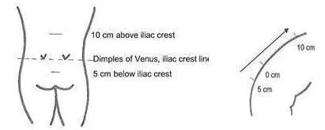
Case, continued
NOTE:
<5 cm excursion indicates lumbar segmental restriction

Slide 9
Case, continued
Plan
  Therapy: patient working 100 + hours/week not logistically possible
  Medications: Tylenol 1000 mg PO TID, Tramadol 50 mg PO Q6H PRN, in future consider Celebrex after clearance with GI
  Injections: left SIJ injection under fluoroscopy
  Surgical considerations: None.
  Diagnostics: HLA-B27, ESR, CRP

Slide 10
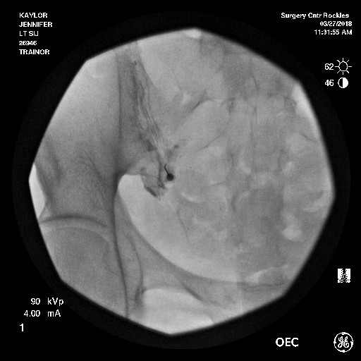
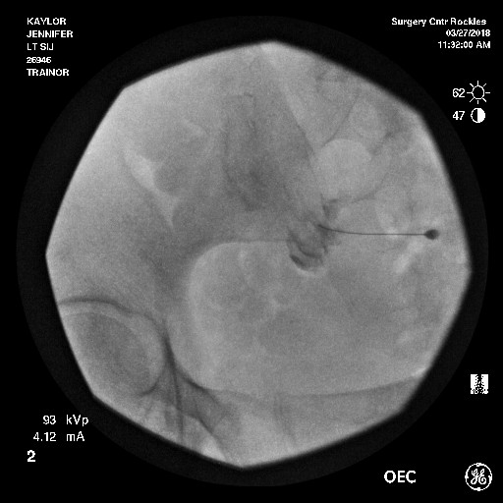
Case, continued
75% IMPROVEMENT IN ANESTHETIC PHASE

Slide 11
Case, continued
HLA-B27 – Positive
CRP – Elevated
ESR – Elevated

Slide 12
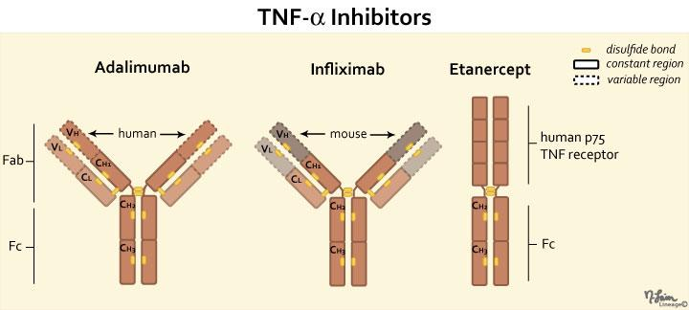
Case, continued
Plan
  Rheumatology referral for consideration of TNF inhibitor therapy

Slide 13
Spondyloarthritis (SpA)
Ankylosing Spondylitis (AS)
Non-radiographic axial spondyloarthritis (nr-SpA)
Psoriatic arthritis
Arthritis associated with inflammatory bowel disease (IBD-SpA)
  Ulcerative colitis and Crohn’s disease
Reactive arthritis (ReA)
  chlamydia, campylobacter, salmonella, shigella
Undifferentiated Spondyloarthropathy (uSpA)
Notes:
Speaking: refers to a group of disorders, which include

Slide 14
Spondyloarthritis (SpA)
More recent classification
  Axial
  Peripheral
Share many phenotypical characteristics (discussed later)

Slide 15
Why do we care?
Higher incidence and prevalence than we realize
Early identification has consequences
  Early treatment makes a difference
As surgeons, pain physicians, and physiatrists will likely be the first ones to encounter these patients
  Back pain is most common presenting complaints

Slide 16
Epidemiology of SpA
Incidence
  0.48 to 63/100,000
Prevalence
  0.1% to 2.5% in general population
    4 million people in the U.S. living with SpA
  Estimated to be 5% in the low back pain population
    Should see more than one patient per week
  Higher than rheumatoid arthritis (RA)
Int J Environ Health Res. 2015;25(3):322-9. Curr Rheumatol Rep 2013; 15:351. J Rheumatol 1994; 21:2281-2285
Notes:
Speaking: Wide range of incidences and prevalence reported depending on methodological difference in different studies

Slide 17
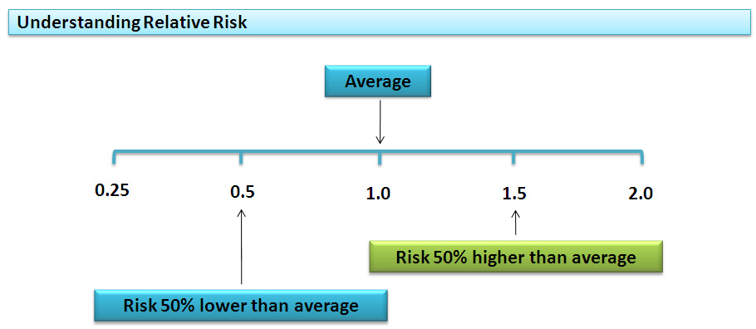
Epidemiology of SpA
Highly Heritable
  Relative Risk
    1st degree relative: 75.5
    2nd degree relative: 20.2
    3rd degree relative: 3.5

Slide 18
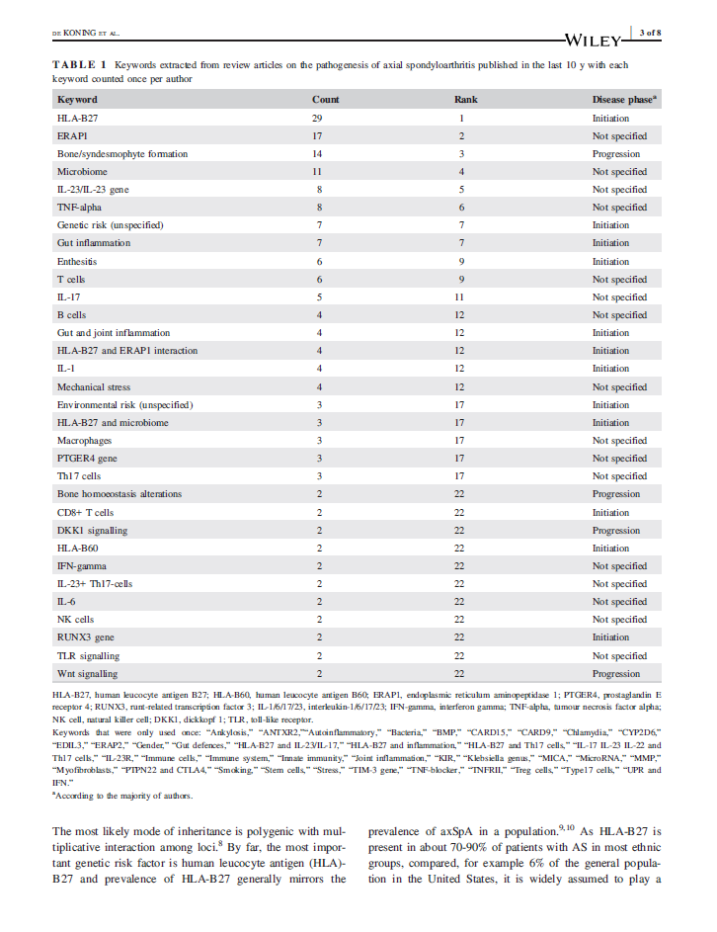
Pathophysiology of SpA
Not well understood
  Likely polygenic

Slide 19
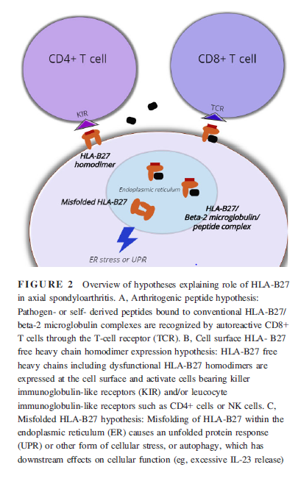
Pathophysiology of SpA
HLA-B27 by far most common
  Present in 70-90% of patients with AS
  Present in 6% of general population
    NOT required for diagnosis
3 main hypothesis
  Arthritogenic peptide hypothesis
  Heavy chain homodimer hypothesis
  HLAB27 misfolding hypothesis
Koning, Anoek De, et al. “Pathophysiology of Axial Spondyloarthritis: Consensus and Controversies.” European Journal of Clinical Investigation, 2018, doi:10.1111/eci.12913.
Notes:
Athritogenic peptide hypothesis
Natural immunological function of HLA-B27 of presenting
antigenic peptides to cytotoxic T cells. The arthritogenic
peptide hypothesis postulates that there are certain
microbial peptides that are very similar to self-peptides that
may be presented by HLA-B27. Due to molecular mimicry,
reactivity of CD8+ T lymphocytes against HLA-B27-peptide
complexes would then lead to autoreactivity and subsequently,
to autoimmune disease including arthritis and
spondylitis.
Heavy chain homodimer hypothesis
HLA-B27 heavy chains can form homodimers without beta-2-microglobulin.
It has been shown that these HLA-B27 homodimers
can bind leucocyte receptors independent of the
sequence of bound peptide.12 Moreover, peptide-linked
HLA-B27 homodimer complexes have been shown to
enhance survival, proliferation of KIR3DL2(+) CD4 T cells
and increase IL-17 production by these cells ex vivo.13 IL-
17-producing CD4(+) T cells have been reported to constitute
a substantial percentage of CD4+ T cells in patients
with long-standing disease but have been difficult to detect
in recent onset axSpA
HLAB27 misfolding hypothesis
misfolding hypothesis states that HLA-B27
starts to contribute to disease before it reaches the surface
of the cell due to protein misfolding. Properly assembled
HLA-B27 has a quaternary structure and contains 3 different
components: 1 HLA-B27 heavy chain, beta-2-microglobulin
and a peptide. This assembly takes place in the
endoplasmic reticulum (ER) of the cell. Because the folding
process of HLA-B27 is slower than that of other HLAalleles,
improperly folded HLA-B27 proteins are thought to
accumulate in the ER. This misfolding process induces cellular
stress, which leads to autophagy or another process
termed the ER unfolded protein response (UPR), which can
also activate the IL-23/IL-17 pathway. Evidence for the
misfolding hypothesis in human disease has thus far been
conflicting

Slide 20
Clinical Manifestations of SpA
Non-musculoskeletal
  Uveitis
  Psoriasis
  Features of IBD
  Genital Lesions
    In Reactive Arthritis

Slide 21
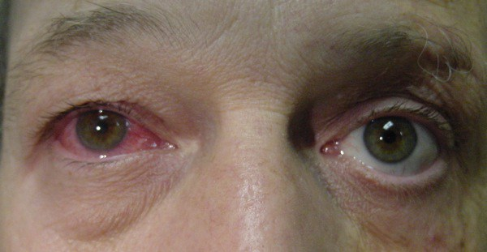
Uveitis
Notes:
Obviously inflammation of the Uvea: Characterized by redness, swelling, photophobia, and blurred vision
If left untreated it can lead to vision loss

Slide 22
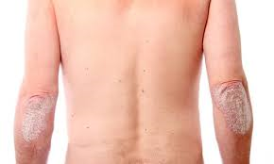
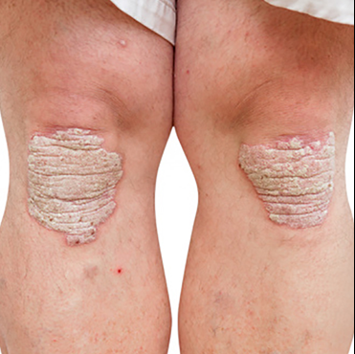
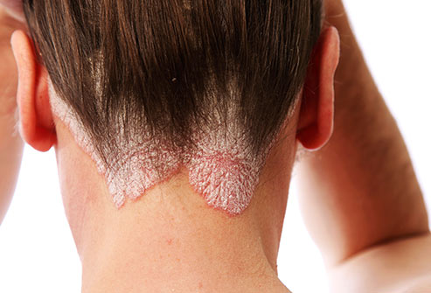
Psoriasis
Notes:
Most commonly effects the knees, elbows, and scalp
Plaque Psoriasis is the most common type (90% of cases): Red patches with white scales on top

Slide 23
IBD
Abdominal pain
Vomiting
Diarrhea
Rectal Bleeding
Severe internal cramps/muscle spasms in the region of the pelvis
Weight Loss

Slide 24

Reactive Arthritis
“Can’t see, pee, or climb a tree”
  Conjunctivitis
  Urethritis
  Arthritis
Notes:
Arthritogenic hypothesis and molecular mimicry
Can also be caused by enteritis infections

Slide 25
Clinical Manifestations of SpA
Musculoskeletal features
  Inflammatory back pain
  Peripheral arthritis
  Enthesitis (enthesopathy)
  Dactylitis

Slide 26
Inflammatory Back Pain
Young age at onset, typically seen in those under 40 years old
Gradual onset of pain
Symptoms of back pain improve with exercise
Response to NSAIDs
Pain does not improve with rest
Pain at night, often waking a person in the second half of the night
Morning stiffness that lasts for more than 30 minutes
Pain lasting for more than 3 months
Alternating buttock pain

Slide 27
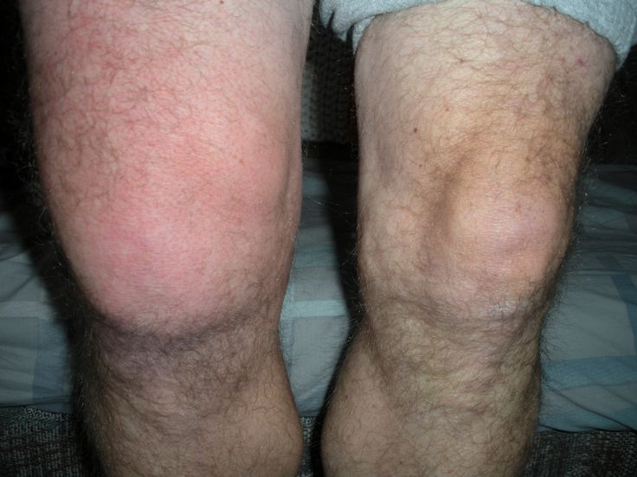
Peripheral Arthritis
Acute Onset
Predominately effects the lower extremities
Associated with swelling
Usually asymmetric
Effects 1 to 3 joints
  Oligoarthritis
Notes:
Most commonly effects the knees and ankles

Slide 28
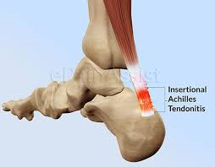
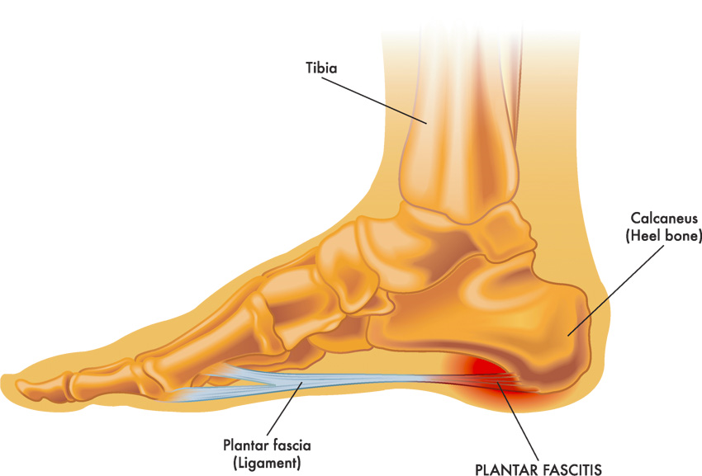
Enthesitis (enthesopathy)
Inflammation
  Ligament to bone
  Tendon to bone
  Joint capsule
  Fascia to bone
Most commonly manifested as:
  Achilles tendinopathy
  Plantar fasciitis

Slide 29
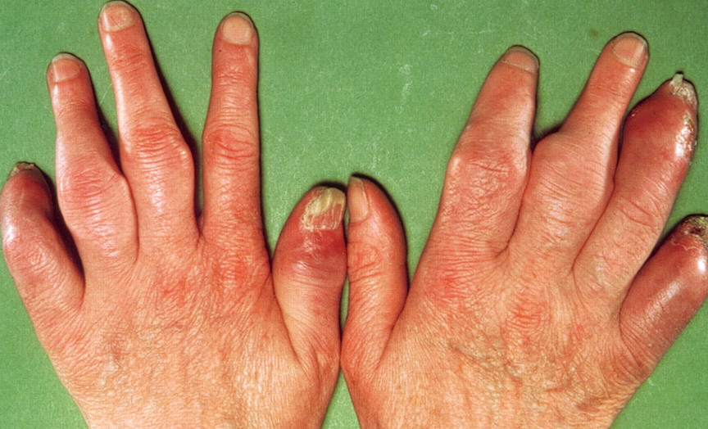
Dactylitis
Notes:
“Sausage Digits”
Swelling of the entire digit- less common manifestation

Slide 30


Slide 31


Slide 32


Slide 33
Laboratory Findings
HLA-B27
  Positive in 70-90% of patients with AS
  Positive in 50% to 70% of patients with other forms of SpA
    Note: HLA-B27 positivity is NOT diagnostic in itself
      Note even required for the diagnosis
        Seen in 6% of the general population
Acute Phase Reactants (ESR and CRP)
  Elevated in 35% to 50% of patients
    Elevated CRP is an indication of:
      Radiographic disease progression
      Positive response to TNF alpha inhibitors

Slide 34
Imaging Findings
Plain Radiographs
  Axial
    Only specific finding is evidence of sacroiliitis (images to follow)
      May take years to develop
    Bridging axial syndesmophytes seen on <5% of patients in the absence of sacroiliitis
      50% of patients develop syndesmophytes during course of disease
  Peripheral
    Erosive joint changes
    Evidence of Enthesitis

Slide 35
Sacroiliitis on Plain Radiographs
Graded 0 to 4
  Grade 0: Normal
  Grade 1: Suspicious changes
  Grade 2: Minimal abnormality – Small localized areas with erosions or sclerosis, without alteration in the joint width
  Grade 3: Unequivocal abnormality – Moderate or advanced sacroiliitis with erosions, evidence of sclerosis, widening, narrowing, or partial ankylosis
  Grade 4: Severe abnormality – Total ankylosis
Considered “Positive for Suggestion of SpA” if:
  Grade 2 or higher bilateral
  Grade 3 or higher unilateral
Notes:
This is the modified New York Criteria

Slide 36
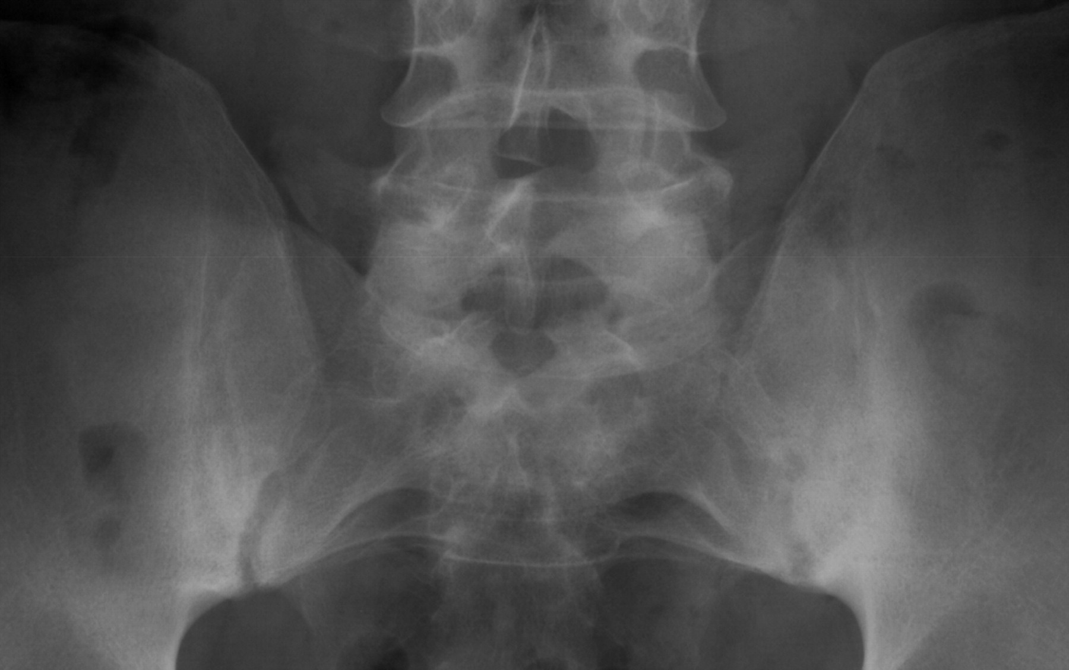
Sacroiliitis on Plain Radiographs (Grade 2)
Both sacroiliac (SI) joints show ill-defined margins, sclerosis, and especially at the left SI joint an irregular joint space (grade 2 bilaterally).

Slide 37
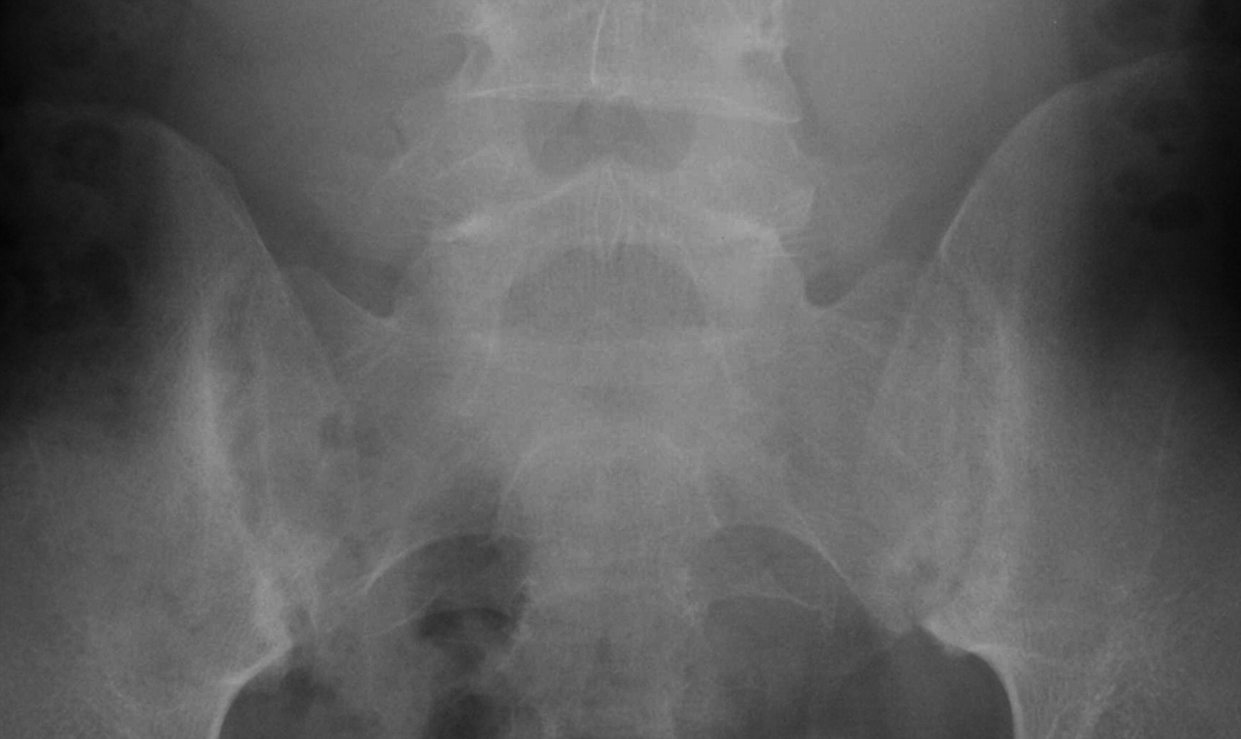
Sacroiliitis on Plain Radiographs (Grade 3)
Sclerosis at the iliac side, widespread erosions, pseudo widening of the joint space, blurring of the joint margins in both sacroiliac (SI) joints (bilateral grade 3).
Notes:
Remember grade 3 or higher, even if unilateral is suggestive of SpA

Slide 38
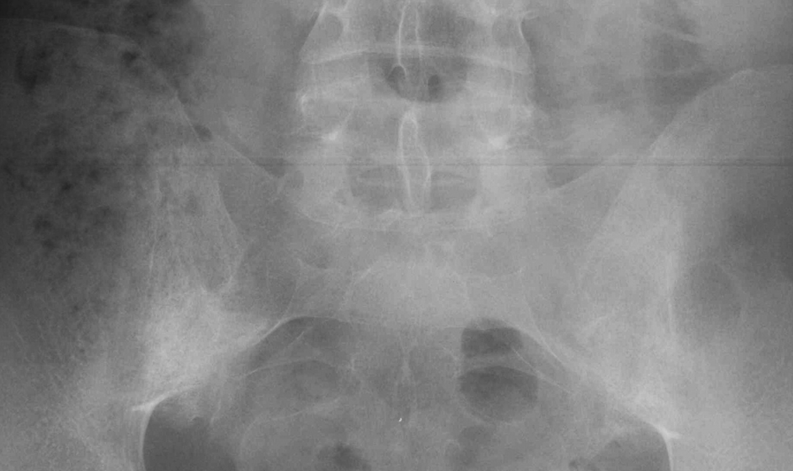
Sacroiliitis on Plain Radiographs (Grade 4)
Both sacroiliac (SI) joints show complete ankylosis (grade 4).

Slide 39
Syndesmophytes on Plain Radiographs

Slide 40
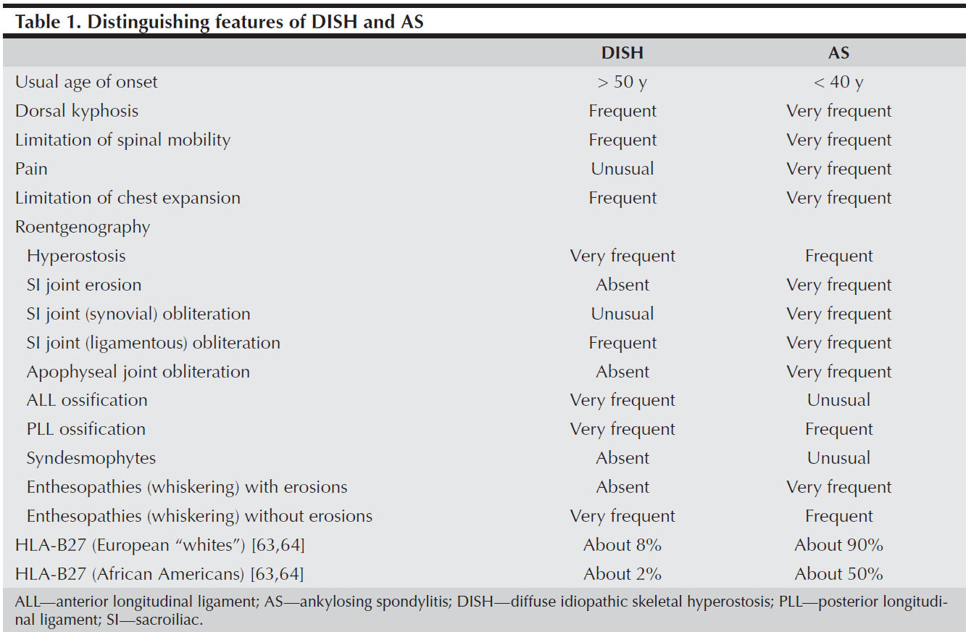
Differentiation from DISH

Slide 41
Imaging Findings of Enthesitis

Slide 42
Evolution in the concepts of SpA
Problems with Radiographic Evidence and AS
  Decision on radiographs challenging
  Late Dx
    Miss opportunity for early treatment TNF-alpha antagonists effective
    Particularly if start in early stage
Solution: New concepts
  Non-radiographic stage of axial SpA identified with MRI
  Inflammatory Back Pain
Notes:
Speaking: Radiographic sacroiliitis is considered the hallmark of AS, but whether it should continue to be used as a diagnostic criterion is a matter of debate. Disagreement among radiologists or rheumatologists reading the same film is frequent, resulting in false-positive or false-negative diagnoses of AS, and additional training does not improve recognition of sacroiliitis.

Slide 43
MRI and SpA
Definition of Sacroiliitis according to the Assessment of SpondyloArthritis International Society (ASAS)
  Bone marrow edema (BME)
    short tau inversion recovery (STIR)
    T2-weighted images with fat suppression
      Bright
      Dark on T1

Slide 44
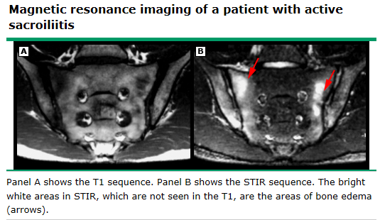
MRI and SpA

Slide 45
MRI and SpA
Marrow Edema on T2 weighted images

Slide 46
Diagnostic Criteria- Axial SpA
Notes:
Speaking: So the first tier, they have to have had the pain for at least 3 months and onset has to be before the age of 45

Slide 47
Diagnostic Criteria- Axial SpA

Slide 48
Diagnostic Criteria- Peripheral SpA

Slide 49
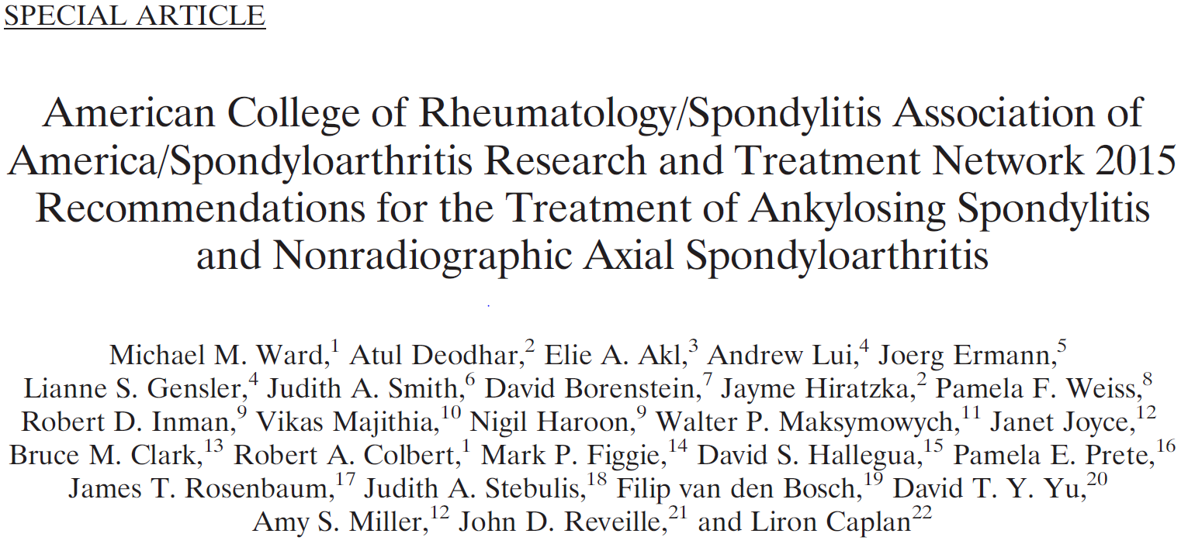
Treatment

Slide 50
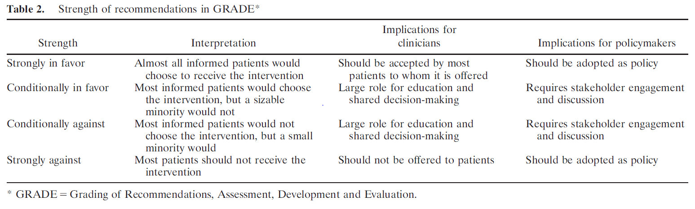
Treatment

Slide 51
Treatment- Medication Management
Non-steroidal Anti-inflammatories (NSAIDs)
  Strongly Recommend
    Treatment with NSAIDs
  Conditionally Recommend
    Continuous treatment with NSAIDs vs. on-demand NSAIDS
  No recommendations on any particular NSAID over another

Slide 52
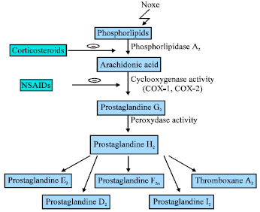
Treatment- Medication Management
NSAIDS
  Maximum dose is usually required
  70% to 80% of patients with AS report significant improvement
  Trials should last at least 4-weeks
  Consider more COX-2 selective in addition to GI PPx
  If cardiac risk factors consider naproxen

Slide 53
Treatment- Medication Management
Tumor Necrosis Factor Inhibitors (TNFi) (adalimumab, etanercept, and infliximab)
  Strongly recommend
    TNFi in patients with active AS despite treatment with NSAIDs
  Do not recommend one TNFi over another, except:
    Monoclonal Ab over etanercept in patients with IBD or iritis/uveitis

Slide 54
Treatment- Medication Management
TNFi
  Callhof, et al. 2014
    Systematic Review
      2400 patients
        Statistically significant improvement in
          Disease activity
          Function
Does timing of treatment matter?
  Studies show that patients are more likely to experience remission, if:
    Shorter disease duration, which is the best predictor
    Elevated CRP
    Young age
Callhoff, Johanna, et al. “Efficacy of TNFÎ± Blockers in Patients with Ankylosing Spondylitis and Non-Radiographic Axial Spondyloarthritis: a Meta-Analysis.” Annals of the Rheumatic Diseases, vol. 74, no. 6, 2014, pp. 1241–1248., doi:10.1136/annrheumdis-2014-205322.

Slide 55
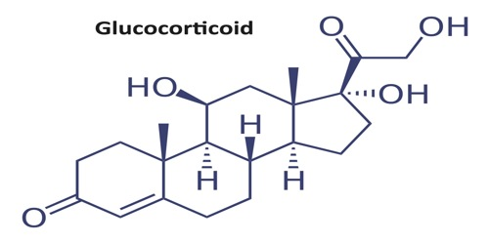
Treatment- Medication Management
Glucocorticoids
  Strongly recommend
    AGAINST the use of systemic steroids
      Note: did not address procedural interventions on guidelines
Literature Review on Sacroiliac Joint Injections in AS
  Limited to case reports

Slide 56
Treatment- DMARDs
DMARDs
  Little evidence to support their use in AS
  Some evidence that Sulfasalazine may be beneficial
    More effective in peripheral disease than axial disease

Slide 57
Treatment- Physical Therapy
Strong recommend
  Physical Therapy vs. no Physical Therapy
Conditionally recommend
  Active physical therapy (supervised exercise) vs. passive therapy interventions (massage, ultrasound, and other thermal modalities)
  Land based vs. aquatic based exercises

Slide 58
Treatment- Physical Therapy
Goals
  alleviate pain
  increase spinal mobility
  Improve functional capacity
  Reduce morning stiffness
  Correct postural deformities
  Increase mobility
  Improve the psychosocial status of the patients
https://www.physio-pedia.com/Ankylosing_Spondylitis

Slide 59
Treatment- Physical Therapy
Common deformities
  Excessive Thoracic Kyphosis
  Compensatory Cervical Lordosis
  Resulting hip flexion contracture
Deformity prevention
  Proper sleeping posture on a solid, flat bed without pillow. Frequent sleeping or lying in prone position.
  Posture exercises with upper back hyperextension (performed with avoidance of lumbar hyperextension).
  Breathing exercises to increase or maintain rib cage excursion, as well as instruction in abdominothoracic breathing.
  Range of motion exercises for hips and knees to prevent flexion limitation and contractures.
  Periodic rest periods with avoidance of fatigue.
  Bracing or corseting (combined with exercises).
https://www.physio-pedia.com/Ankylosing_Spondylitis

Slide 60
Treatment- Prevention
Conditionally recommend
  Screening for osteoporosis/osteopenia with DXA scan
Strongly recommend against
  Screening for cardiac conduction defects with ECG
  Screening for valvular heart disease with Echo

Slide 61
Common Laboratory Tests for other Rheumatologic Diseases
Rheumatoid Factor (RF)- only positive in 60% of patients at time of diagnosis
Anti-cyclic citrullinated peptide (CCP) antibodies- highly sensitive (76%) and specific (96%) for RA
Antinuclear antibody (ANA)- sensitive but not necessarily specific
  98% of patients with SLE
  40%-to 70% of those with other connective tissue
  20% with autoimmune thyroid and liver disease
  5% of general population
Anti double-stranded DNA (anti dsDNA)- specific (95%) but not sensitive (60%) for SLE
Schur, Peter H. “Laboratory Tests in Rheumatic Disorders.” Oxford Medicine Online, 2014, doi:10.1093/med/9780199358274.003.0028

Slide 62
Conclusions
Spondyloarthritis is more common than we realize
  If we don’t look for it we won’t find it
Early diagnosis is important and associated with higher rate of response to treatment
HLA-B27 is common (70-90%) but is NOT required for the diagnosis
Spondyloarthritis is associated with non-musculoskeletal conditions
  ASK as part of HPI in patients with no obvious structural cause of back pain (especially if <45 years)
NSAIDs, TNFi, and PT are mainstays of treatment

Slide 63
Questions?

Slide 64
References
Braun J, van den Berg R, Baraliakos X, et al. 2010 update of the ASAS/EULAR recommendations for the management of ankylosing spondylitis. Ann Rheum Dis 2011; 70:896.
Zochling J, van der Heijde D, Burgos-Vargas R, et al. ASAS/EULAR recommendations for the management of ankylosing spondylitis. Ann Rheum Dis 2006; 65:442.
Smolen JS, Braun J, Dougados M, et al. Treating spondyloarthritis, including ankylosing spondylitis and psoriatic arthritis, to target: recommendations of an international task force. Ann Rheum Dis 2014; 73:6.
Ward MM, Deodhar A, Akl EA, et al. American College of Rheumatology/Spondylitis Association of America/Spondyloarthritis Research and Treatment Network 2015 Recommendations for the Treatment of Ankylosing Spondylitis and Nonradiographic Axial Spondyloarthritis. Arthritis Rheumatol 2016; 68:282.
Jang JH, Green CE, Assassi S, et al. The contribution of disease activity on functional limitations over time through psychological mediators: a 12-month longitudinal study in patients with ankylosing spondylitis. Rheumatology (Oxford) 2011; 50:2087.
Calin A, Garrett S, Whitelock H, et al. A new approach to defining functional ability in ankylosing spondylitis: the development of the Bath Ankylosing Spondylitis Functional Index. J Rheumatol 1994; 21:2281.
Bath Ankylosing Spondylitis Functional Index (BASFI) http://basdai.com/BASFI.php (Accessed on February 10, 2014).
Doward LC, Spoorenberg A, Cook SA, et al. Development of the ASQoL: a quality of life instrument specific to ankylosing spondylitis. Ann Rheum Dis 2003; 62:20.
Ankylosing spondylitis quality of life instrument (ASQol) http://ard.bmj.com.proxy.hsl.ucdenver.edu/content/suppl/2002/12/20/62.1.20.DC1/62120Appendices.pdf (Accessed on February 10, 2014).
Garrett S, Jenkinson T, Kennedy LG, et al. A new approach to defining disease status in ankylosing spondylitis: the Bath Ankylosing Spondylitis Disease Activity Index. J Rheumatol 1994; 21:2286.
van der Heijde D, Lie E, Kvien TK, et al. ASDAS, a highly discriminatory ASAS-endorsed disease activity score in patients with ankylosing spondylitis. Ann Rheum Dis 2009; 68:1811.
Vastesaeger N, Cruyssen BV, Mulero J, et al. ASDAS high disease activity versus BASDAI elevation in patients with ankylosing spondylitis as selection criterion for anti-TNF therapy. Reumatol Clin 2014; 10:204.
Assessment of SpondyloArthritis International Society. Ankylosing Spondylitis Disease Activity Score. http://www.asas-group.org/research.php?id=01#null (Accessed on October 15, 2013).
Machado P, van der Heijde D. How to measure disease activity in axial spondyloarthritis? Curr Opin Rheumatol 2011; 23:339.
Assassi S, Weisman MH, Lee M, et al. New population-based reference values for spinal mobility measures based on the 2009-2010 National Health and Nutrition Examination Survey. Arthritis Rheumatol 2014; 66:2628.
Chilton-Mitchell L, Martindale J, Hart A, Goodacre L. Normative values for the Bath Ankylosing Spondylitis Metrology Index in a UK population. Rheumatology (Oxford) 2013; 52:2086.
Sieper J, Rudwaleit M, Baraliakos X, et al. The Assessment of SpondyloArthritis international Society (ASAS) handbook: a guide to assess spondyloarthritis. Ann Rheum Dis 2009; 68 Suppl 2:ii1.

