Slide 1
Marijuana and Opioids
in Colorado
Kenneth Finn, MD
Springs Rehabilitation, PC

Slide 2
Approved Conditions in Colorado
Pain
Muscle Spasms
Nausea
Cancer
Seizure
Glaucoma
PTSD
Cachexia
HIV/AIDS

Slide 3
Pain

Slide 4
Endocannabinoid System

Slide 5
Endocannabinoid System
CB1 receptor
Primarily localized in the central nervous system
Brain and spinal cord
Multiple neurotransmitter effects
Can be found in the peripheral nervous system

Slide 6
Endocannabinoid System

Slide 7
Endocannabinoid System
CB2 receptor
Inflammation
Neuropathic pain
Cancer pain
http://www.ncbi.nlm.nih.gov/pmc/articles/PMC2435344/
http://www.ncbi.nlm.nih.gov/pubmed/17430144

Slide 8
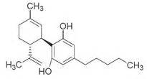
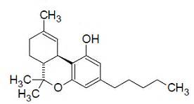
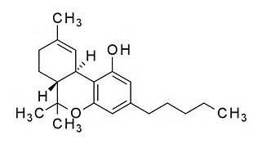

Slide 9
CBD
Marinol
THC

Slide 10
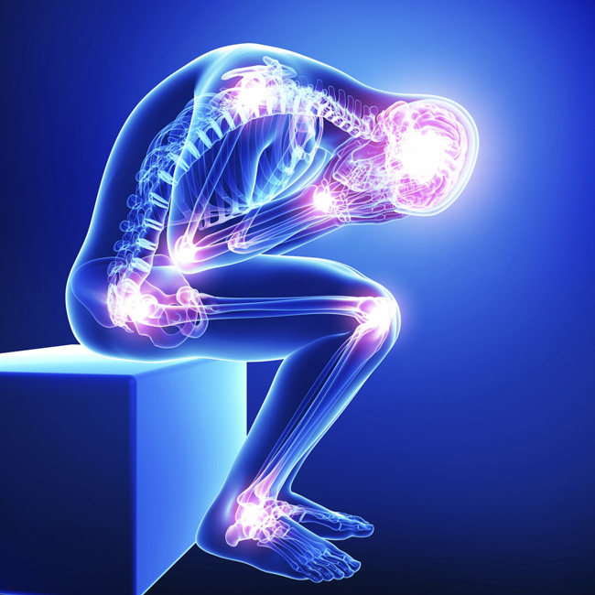

Slide 11
Most Common
Pain Diagnoses
National Ambulatory Medical Care Survey: 2015 State and National Summary Tables
Lower back pain
Knee pain
Abdominal pain
Shoulder pain
Others not in top 20: Neuropathy, Headache, Fibromyalgia, Cancer, other
https://www.cdc.gov/nchs/data/ahcd/namcs_summary/2015_namcs_web_tables.pdf
Table 11

Slide 12
Most Common
Drugs Mentioned
National Ambulatory Medical Care Survey: 2015 State and National Summary Tables
Analgesics (1st, 11%)
Antidepressants (3rd, 4.5%)
Anxiolytics (6th, 3.9%)
Second: Hyperlipidemic agents (4.7%)
https://www.cdc.gov/nchs/data/ahcd/namcs_summary/2015_namcs_web_tables.pdf
Table 25

Slide 13
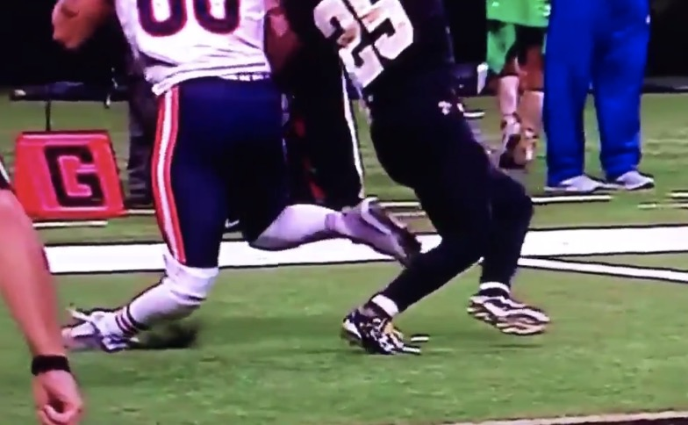
Pain

Slide 14
Cannabinoids for Medical Use
JAMA June 2015
Penny Whiting, PhD, United Kingdom
Cannabis and cannabinoid drugs are widely used to treat diseases or alleviate symptoms, but their efficacy for specific indications is not clear
Conduct a systematic review of the benefits and adverse events of cannabinoids
JAMA. 2015 Jun 23-30;313(24):2456-73. doi: 10.1001/jama.2015.6358.
https://www.ncbi.nlm.nih.gov/pubmed/26103030

Slide 15
Cannabinoids for Medical Use
JAMA June 2015
Chronic Pain was assessed in 28 studies (63 reports, 2454 participants)
13 studies: Nabiximols (Sativex), natural, purified, unavailable in US
5 studies: Nabilone (Cesamet), synthetic, “off label use”
4 studies: smoked THC
3 studies: THC oromucosal spray
2 studies: Dronabinol (Marinol), synthetic, “off label use”
1 study: vaporized cannabis
1 study: oral THC

Slide 16
Cannabinoids for Medical Use
JAMA June 2015
12 studies: Neuropathic pain
3 studies: Cancer pain
3 studies: Diabetic peripheral neuropathy
2 studies: Fibromyalgia
1 study: “Musculoskeletal problems”
1 study: Non-cancer pain

Slide 17
Cannabinoids for Medical Use
JAMA June 2015
17 studies: High risk of bias
9 studies: Unclear risk of bias
2 studies: Low risk of bias
Conclusion: Moderate-quality evidence to support the use of cannabinoids for the treatment of chronic pain (??)

Slide 18
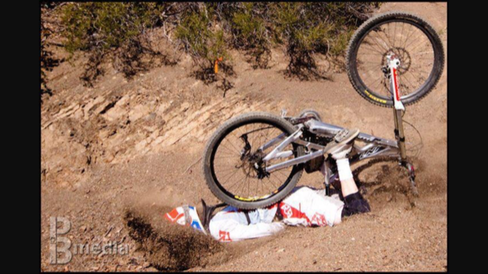
Pain

Slide 19
The Health Effects of Cannabis and Cannabinoids: The Current State of Evidence and Recommendations for Research
January 12, 2017
National Academies of Sciences, Engineering, and Medicine
Multiple authors, respected institutions
None with a pain or anesthesiology background
https://www.nap.edu/catalog/24625/the-health-effects-of-cannabis-and-cannabinoids-the-current-state

Slide 20
The Health Effects of Cannabis and Cannabinoids: The Current State of Evidence and Recommendations for Research
January 12, 2017
Felt the Whiting article was the most comprehensive
Noted the medical condition underlying the chronic pain was most often related to a neuropathy
The majority of studies on pain cited in Whiting et al. (2015) evaluated nabiximols not available in the United States.
https://nationalacademies.org/hmd/Reports/2017/health-effects-of-cannabis-and-cannabinoids.aspx

Slide 21
The Health Effects of Cannabis and Cannabinoids: The Current State of Evidence and Recommendations for Research
January 12, 2017
The committee found that only a handful of studies have evaluated the use of cannabis in the United States
Many of the cannabis products that are sold in state regulated markets bear little resemblance to the products that are available for research at the federal level in the United States.
https://nationalacademies.org/hmd/Reports/2017/health-effects-of-cannabis-and-cannabinoids.aspx

Slide 22
The Health Effects of Cannabis and Cannabinoids: The Current State of Evidence and Recommendations for Research
January 12, 2017
Very little is known about the efficacy, dose, routes of administration, or side effects of commonly used and commercially available cannabis products in the United States.
https://nationalacademies.org/hmd/Reports/2017/health-effects-of-cannabis-and-cannabinoids.aspx

Slide 23
The Health Effects of Cannabis and Cannabinoids: The Current State of Evidence and Recommendations for Research
January 12, 2017
CONCLUSION: There is substantial evidence that cannabis is an effective treatment for chronic pain in adults.
More research is needed on the various forms, routes of administration, and combination of cannabinoids.
https://nationalacademies.org/hmd/Reports/2017/health-effects-of-cannabis-and-cannabinoids.aspx

Slide 24
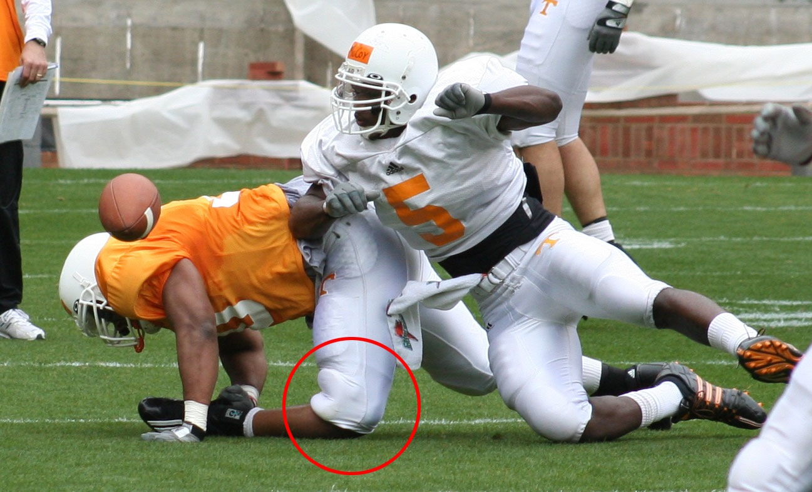
Pain

Slide 25
The Effects of Cannabis Among Adults With Chronic Pain and an Overview of General Harms
Annals of Internal Medicine, August 2017
Few methodologically rigorous trials
Cannabis formulations studied may not reflect commercially available products
Limited applicability to older, chronically ill populations and patients who use cannabis heavily.
VA Portland Health Care System; Oregon Health and Science University

Slide 26
The Effects of Cannabis Among Adults With Chronic Pain and an Overview of General Harms
Annals of Internal Medicine, August 2017
Limited evidence suggests that cannabis may alleviate neuropathic pain in some patients
Insufficient evidence exists for other types of chronic pain.
Evidence suggests that cannabis is associated with an increased risk for adverse mental health effects.

Slide 27
Missouri Medicine 2017
September/October Issue
Is Marijuana Use for Pain Driving Negative Societal Effects
http://www.omagdigital.com/publication/?i=450168#{"issue_id":450168,"page":8}

Slide 28
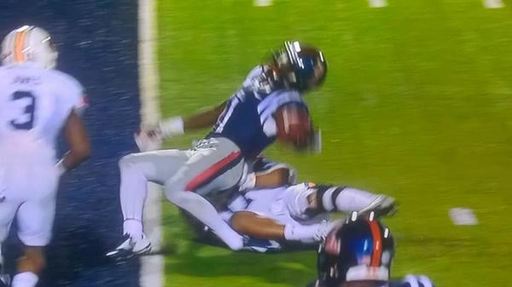
Pain

Slide 29
College of Family
Physicians of Canada
February 2018
Guidelines for recommending cannabis
http://www.cfp.ca/content/64/2/111

Slide 30
College of Family
Physicians of Canada
Acute pain, headache, osteoarthritis and back pain
Strongly against
Neuropathic pain
Can consider
Cancer pain
Can consider

Slide 31
College of Family
Physicians of Canada
Nabiximols (Sativex)
Not available in the US
Synthetic (Nabilone)
“Off label” use
Discourage smoking

Slide 32
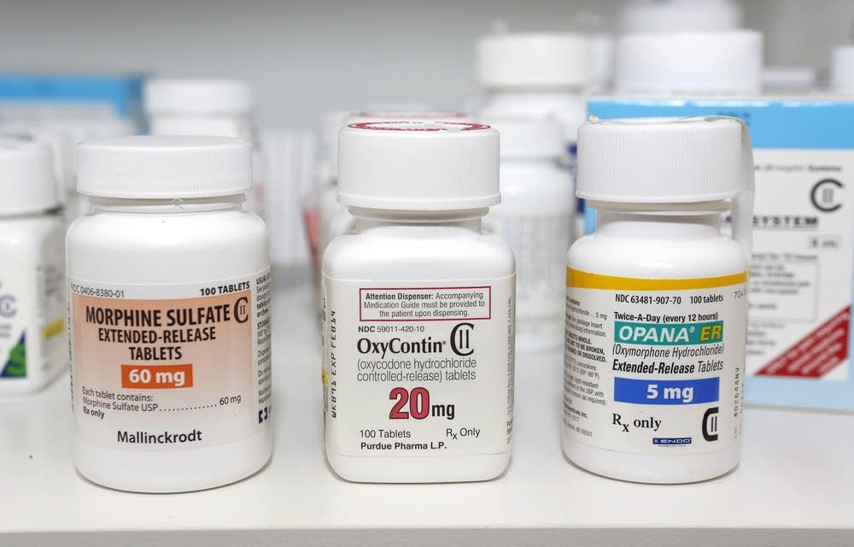

Slide 33
American Pain Society
• Increase federal funding for pain-related cannabis research

Slide 34
American Pain Society
• Increase federal funding for pain-related cannabis research
• Broaden pain conditions being studied to include cannabis for non-neuropathic pain

Slide 35
American Pain Society
• Increase federal funding for pain-related cannabis research
• Broaden pain conditions being studied to include cannabis for non-neuropathic pain
• Ease regulatory restrictions that impede approvals of cannabis and cannabinoid research

Slide 36
American Pain Society
• Increase federal funding for pain-related cannabis research
• Broaden pain conditions being studied to include cannabis for non-neuropathic pain
• Ease regulatory restrictions that impede approvals of cannabis and cannabinoid research
• Improve access to high-quality plant cannabis for research studies

Slide 37
American Pain Society
• Increase federal funding for pain-related cannabis research
• Broaden pain conditions being studied to include cannabis for non-neuropathic pain
• Ease regulatory restrictions that impede approvals of cannabis and cannabinoid research
• Improve access to high-quality plant cannabis for research studies
• Encourage states to collect individual and population level data on patients receiving medical cannabis.
http://americanpainsociety.org/about-us/press-room/american-pain-society-offers-guidance-on-medical-marijuana-for-pain

Slide 38
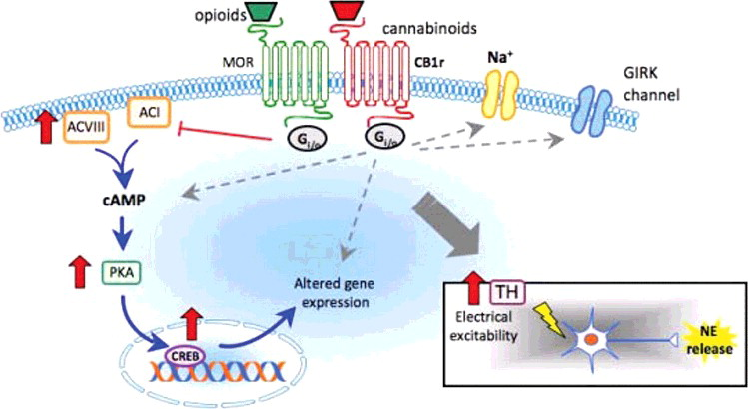

Slide 39
Opioids and Cannabinoids
Synergistic systems
Both belong to the rhodopsin subfamily of G-protein coupled receptors
Both, when activated, reduce cellular levels of cyclic adenosine monophosphate (cAMP) by inhibiting adenylyl cyclase
https://www.tandfonline.com/doi/full/10.1080/24734306.2017.1392715

Slide 40
Opioids and Cannabinoids
Receptor activation modifies permeability of sodium, calcium, and potassium channels
Decreased Ca⁺⁺, increased K⁺ conductance, and increased protein kinase activity
Can suppress inhibition and suppress excitation
Inhibit release of neurotransmitters
L-glutamate, GABA, NE, DA, 5-HT, ACh
https://www.tandfonline.com/doi/full/10.1080/24734306.2017.1392715

Slide 41
Opioids and Cannabinoids
Both receptors found at presynaptic terminals
Both receptors co-localize in GABA-ergic neurons
Both systems share pharmacologic profiles
Sedation, antinociception, hypotension, hypothermia, decreased intestinal motility, drug-reward reinforcement
https://www.tandfonline.com/doi/full/10.1080/24734306.2017.1392715

Slide 42
Opioids and Cannabinoids
Interplay between systems inconsistent and can show cross-agonism, cross-antagonism, cross-sensitization, and cross-tolerance
Naloxone has been shown to have effects on the cannabinoid system in several animal models
https://www.tandfonline.com/doi/full/10.1080/24734306.2017.1392715

Slide 43
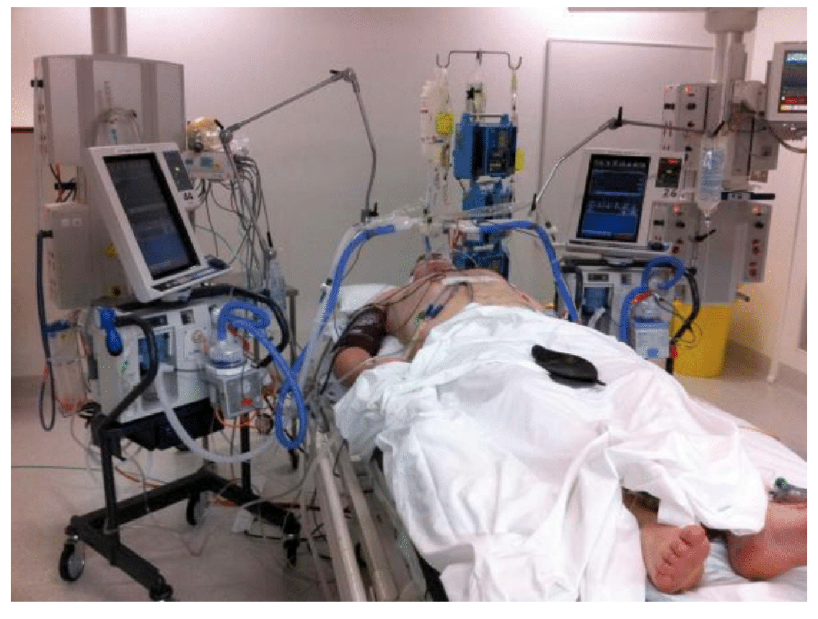

Slide 44
Opioids and Cannabinoids
Treatment of Acute Cannabinoid Overdose with Naloxone Infusion
http://tandfonline.com/doi/full/10.1080/24734306.2017.1392715

Slide 45
Cannabis and Opioids
2014
Medical Cannabis Laws and Opioid Analgesic Overdose Mortality in the United States, 1999-2010
Medical cannabis laws are associated with increased cannabis use among adults
Medical cannabis laws are associated with lower state-level opioid overdose mortality rates.
Further investigation is required to determine how medical cannabis laws may interact with policies aimed at preventing opioid analgesic overdose.
http://archinte.jamanetwork.com/article.aspx?articleid=1898878

Slide 46
Cannabis and Opioids
2016
Medical Marijuana State Laws Associated With Reduced Medicare Prescriptions
The study found that prescription drug use fell in those states by an amount that represented an overall reduction in expenditures of about 0.5%, with an estimated savings of $165.2 million in 2013 alone.
Health Affairs (2016;35:1230-1236)
http://www.painmedicinenews.com/Policy-Management/Article/09-16/Medical-Marijuana-State-Laws-Associated-With-Reduced-Medicare-Prescriptions/37747/ses=ogst

Slide 47
Cannabis and Opioids
2018
Association Between US State Medical Cannabis Laws and Opioid Prescribing in the Medicare Part D Population
2010-2015
Total daily doses decreased
Money saved
Did not discuss USE
Selected population, not whole population
Similar move from SA to ER/LA formulations
Authors do not show directly the relationship between cannabis use and opioid use
JAMA Internal Medicine Published online April 2, 2018

Slide 48
Opioid Deaths
Colorado Drug Overdoses Up In Almost Every County And Ahead Of National Average
http://www.cpr.org/news/story/colorado-drug-overdoses-almost-every-county-and-ahead-national-average
https://blogs.cdc.gov/nchs-data-visualization/drug-poisoning-mortality/

Slide 50
Cannabis and Opioids
2017
Recreational Cannabis Legalization and Opioid-Related Deaths in Colorado, 2000–2015
2014 and 2015 data, decrease
Did not take other factors into consideration
Increase in use of Narcan
Doctors reluctant to prescribe in face of opioid epidemic
Increased use of PDMP
Coincidental rise in heroin deaths, progression to use?
Patients are informed
American Journal of Public Health, November 2017

Slide 51
Cannabis and Opioids
2017
Recreational Cannabis Legalization and Opioid-Related Deaths in Colorado, 2000–2015
Unclear on what data actually included
Graph consistent with CDPHE synthetic opioids, not others, including heroin
Inconsistent with CDC data
American Journal of Public Health, November 2017

Slide 52
Heroin Deaths in Colorado
Heroin-related deaths among Colorado residents have doubled in four years:
2011 – 79 deaths
2015 – 160 deaths
The documented use of Naloxone by emergency medical services (EMS) in Colorado to treat suspected heroin overdoses has increased 240 percent from 2011 – 2015:
2011 – 997 events
2015 – 3,393 events
http://www.corxconsortium.org/wp-content/uploads/Heroin-in-Colorado.pdf

Slide 53
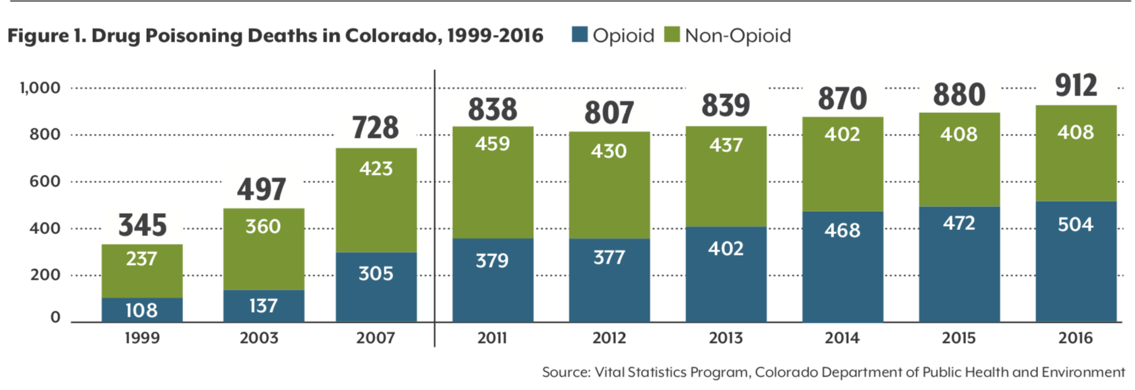

Slide 54
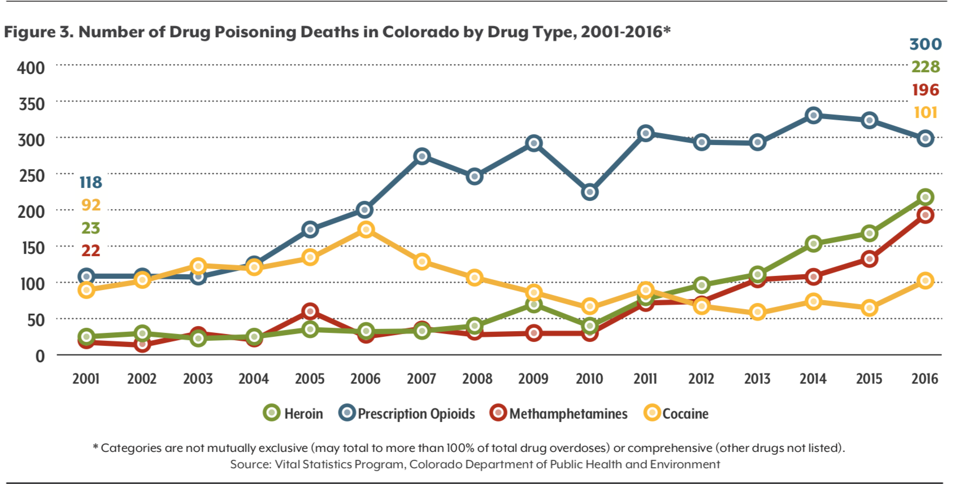

Slide 55
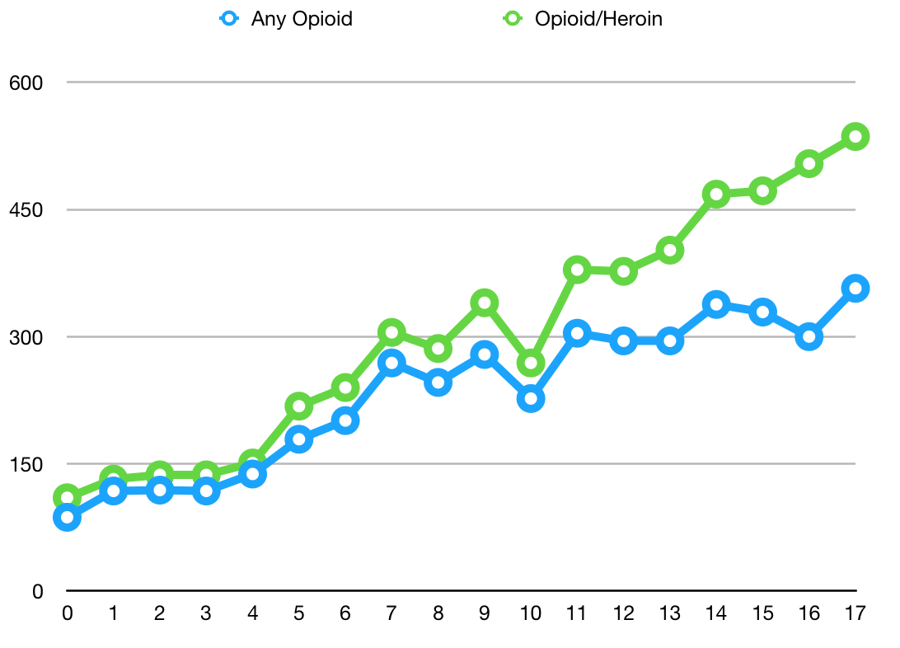
Opioid Overdose Deaths
https://www.colorado.gov/pacific/cdphe/vital-statistics-program

Slide 56
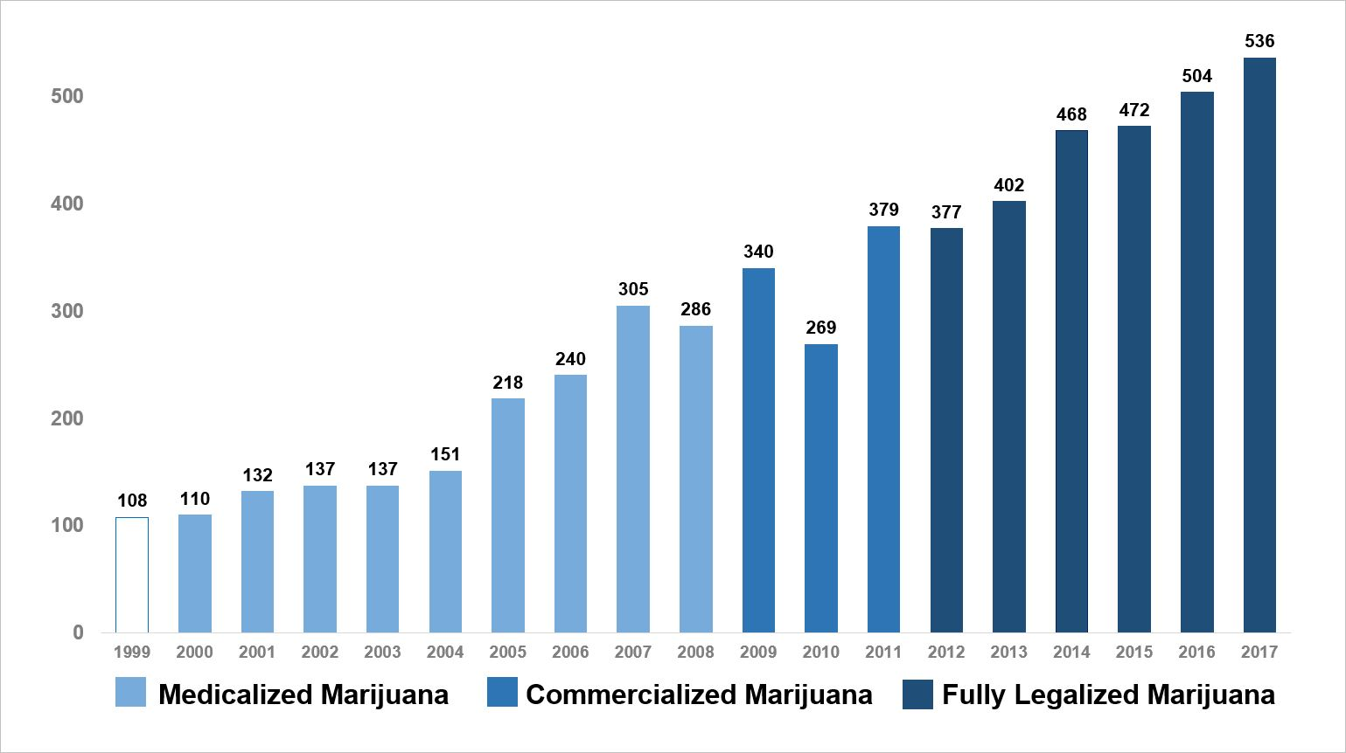
Opioid Overdose Deaths

Slide 57
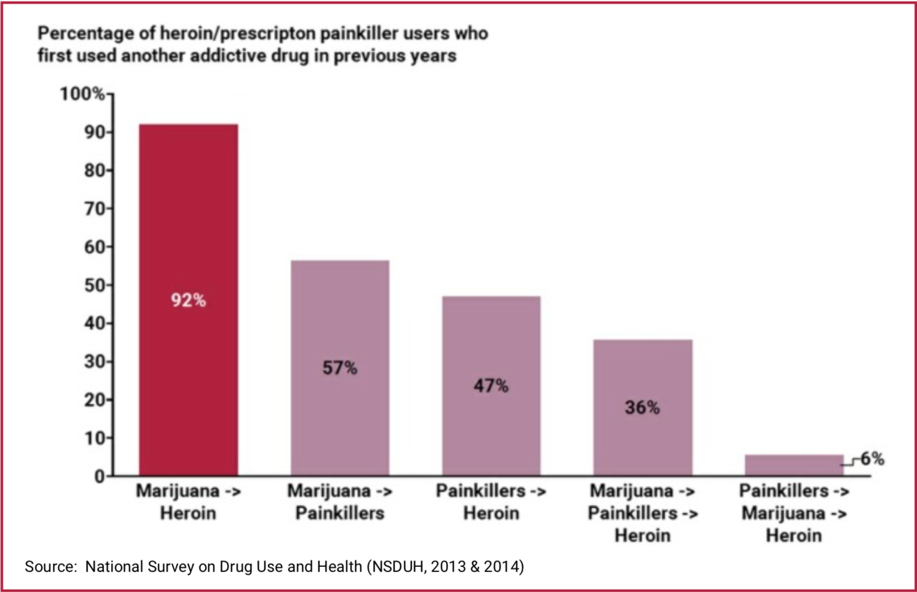

Slide 58
Cannabis and Opioids
Cannabis use appears to increase rather than decrease non-medical prescription opioid use and opioid use disorder.
Surveyed 43,000 adults 2001-2002 and followed up with 34,000 in 2004-2005
http://ajp.psychiatryonline.org/doi/abs/10.1176/appi.ajp.2017.17040413
https://www.healthdata.gov
https://www.drugabuse.gov/news-events/news-releases/2017/09/marijuana-use-associated-increased-risk-prescription-opioid-misuse-use-disorders

Slide 59
Cannabis and Opioids
The Association Between Cannabis Use and Aberrant Behaviors During Chronic Opioid Therapy for Chronic Pain
Concurrent use of cannabis and opioids by patients with chronic pain appears to indicate higher risk for opioid misuse.
Closer monitoring for opioid-related aberrancy is indicated for this group of patients.
Pain Medicine 2017; 0: 1–12

Slide 60
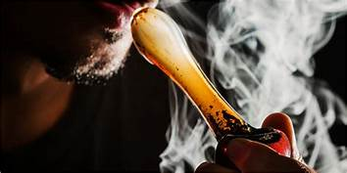

Slide 61
Cannabis and Opioids
In adults with chronic low back pain, does the use of inhaled cannabis reduce overall opioid use??
Persons using cannabis for pain were more likely to meet criteria for substance abuse disorders and more likely to be non-adherent with their prescription opioids
Evidence Based Practice 2017; 20(1), e10

Slide 62
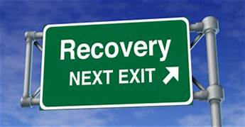

Slide 63
Cannabis and Opioids
Medical cannabis use among patients with chronic pain in interdisciplinary pain rehabilitation program
Patients with chronic pain using cannabis may be at higher risk for substance-related negative outcomes
More likely to report a past history of illicit substance use, alcohol use, and tobacco use
J Subst Abuse Treat. 2017 Jun; 77: 95-100

Slide 65
Cannabis and Opioids
Cannabis use moderates relationship between pain and negative affect in adults with opioid use disorder
Cannabis use strengthens, rather than weakens relationship between pain and depression and pain and anxiety
Increased cannabis use frequency associated with less capacity to self-manage symptoms
Addictive Behaviors 77 (2018); 225-231

Slide 67
Disability Claims
National Bureau of Economic Research
State medical marijuana laws lead to an increase in the probability people will make Social Security Disability Insurance claims
September 25, 2017
Temple University, John Hopkins University, and University of Cincinnati
http://www.nber.org/papers/w23862.pdf

Slide 68
Colorado Medical Marijuana Registry

Slide 69
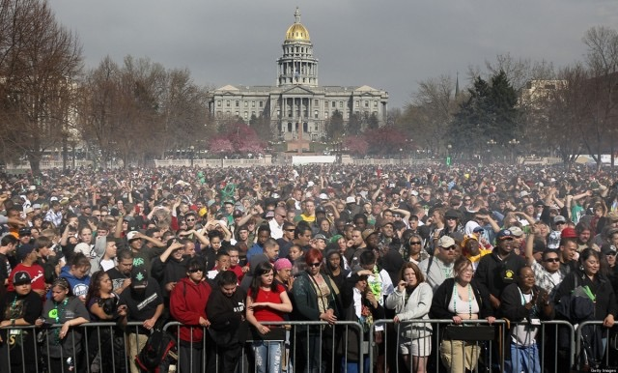

Slide 70
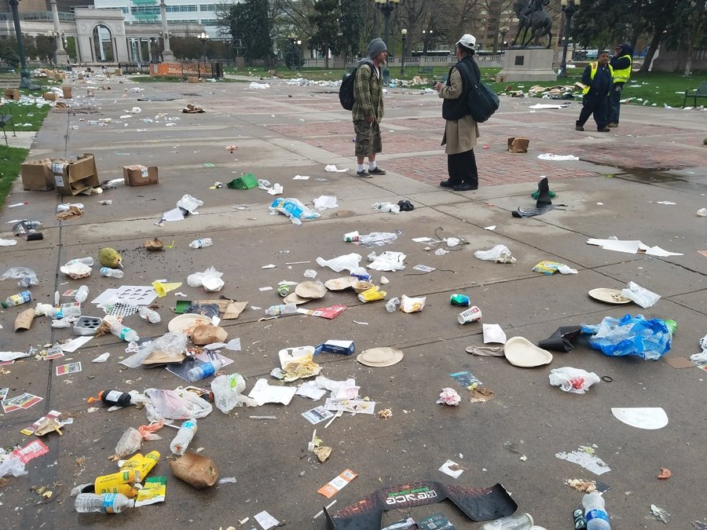

Slide 71
Colorado Medical Marijuana Registry
January 31, 2018
93,095 valid ID cards
62% male (?)
Average age 44
El Paso County: 21%

Slide 72
Colorado Medical Marijuana Registry
Disabling Conditions
Severe pain: (93%)
Spasms: (29%)
Nausea: (13%)
Seizure: (2.8%)
Cancer: (4.4%)
https://www.colorado.gov/pacific/sites/default/files/CHED_MMR_Monthly_Report-NOVEMBER-2017.pdf

Slide 73
CO MJ Cardholders
Jan 2011
Jan 2017

Slide 74
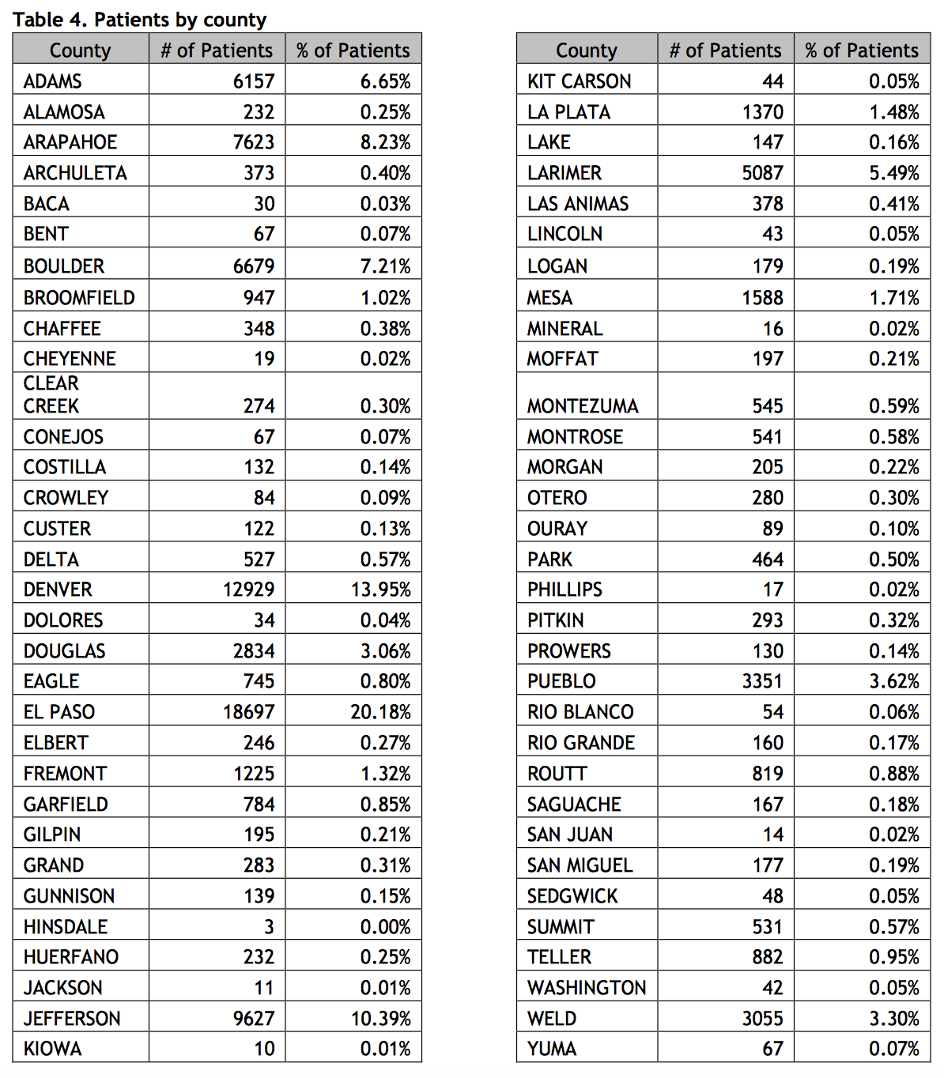
El Paso: 134
Denver: 196
https://www.colorado.gov/pacific/sites/default/files/CHED_MMR_Monthly_Report_January-2018.pdf
https://www.colorado.gov/pacific/enforcement/med-licensed-facilities

Slide 75
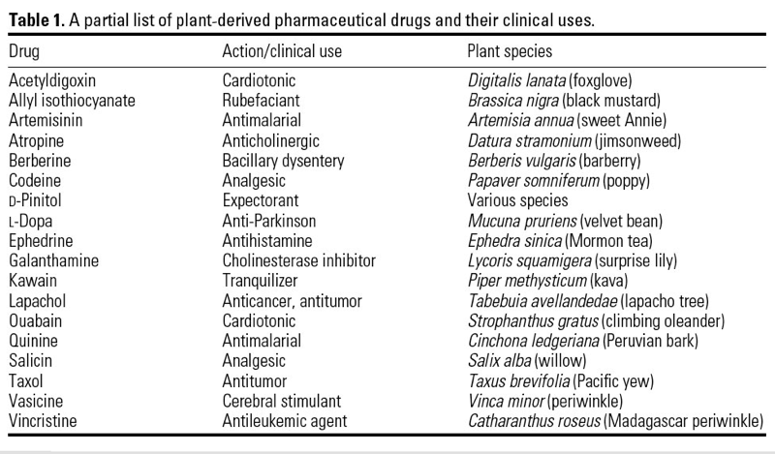
Plant Based Medications
https://ehp.niehs.nih.gov/11501/

Slide 76
Medicine
Drug chemistry must be known and reproducible

Slide 77
Medicine
Drug chemistry must be known and reproducible
Must have adequate safety studies

Slide 78
Medicine
Drug chemistry must be known and reproducible
Must have adequate safety studies
Efficacy must be proven with well controlled studies

Slide 79
Medicine
Drug chemistry must be known and reproducible
Must have adequate safety studies
Efficacy must be proven with well controlled studies
Must be accepted by qualified experts

Slide 80
Medicine
Drug chemistry must be known and reproducible
Must have adequate safety studies
Efficacy must be proven with well controlled studies
Must be accepted by qualified experts
Scientific evidence must be widely available

Slide 81
Medical Marijuana
“We will use [medical marijuana] as a red-herring to give marijuana a good name.”
—Keith Stroup, head of NORML to the Emory Wheel, 1979
NFIA/Emory Wheel Entertainment Staff, 6 February 1979

Slide 82
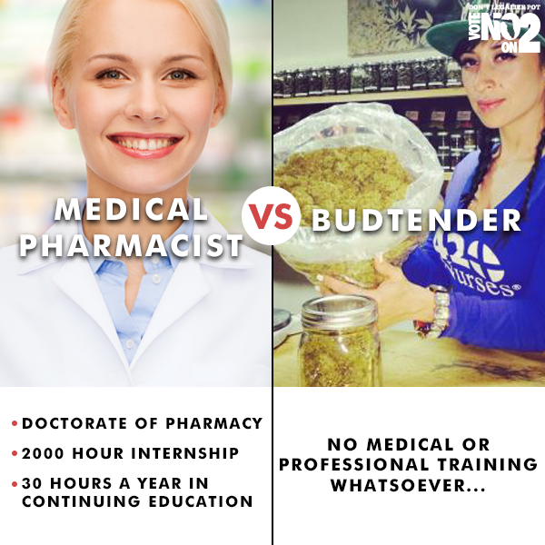

Slide 83
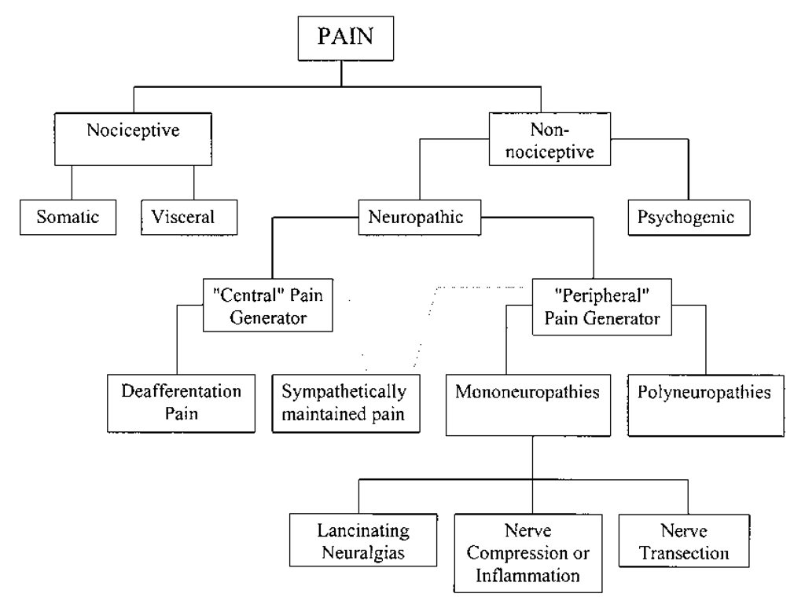

Slide 84
Medicine
Pain of different origins do not necessarily respond the same to different medications
Cannabis is a generic substance that has no defined dose, purity, or how it should be used
Dispensary cannabis can contain over 750 different compounds in comparison with cannabinoids
Cannabinoids are isolated from the plant or created in a laboratory.

Slide 85
Medicine

Slide 86
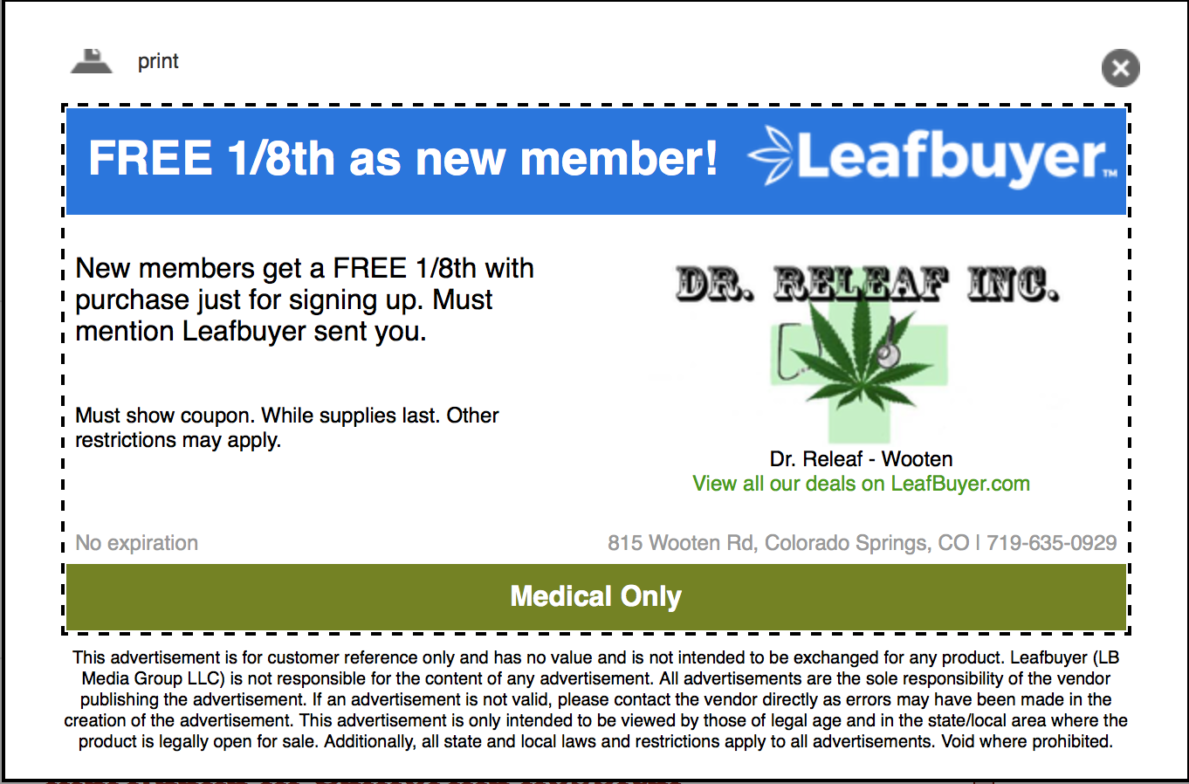
Medicine
http://www.thecannabist.co/?s=medicine

Slide 87
Medicine
http://www.thecannabist.co/?s=medicine

Slide 88
Medicine

Slide 89
Medicine

Slide 90
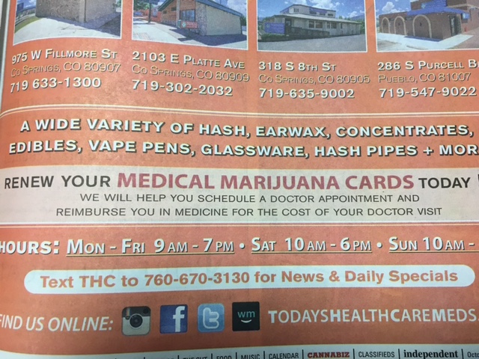
Source: Colorado Springs Independent, October 12-18, 2016, page 95
http://www.csindy.com/coloradosprings/IssueArchives?issue=4097696

Slide 91
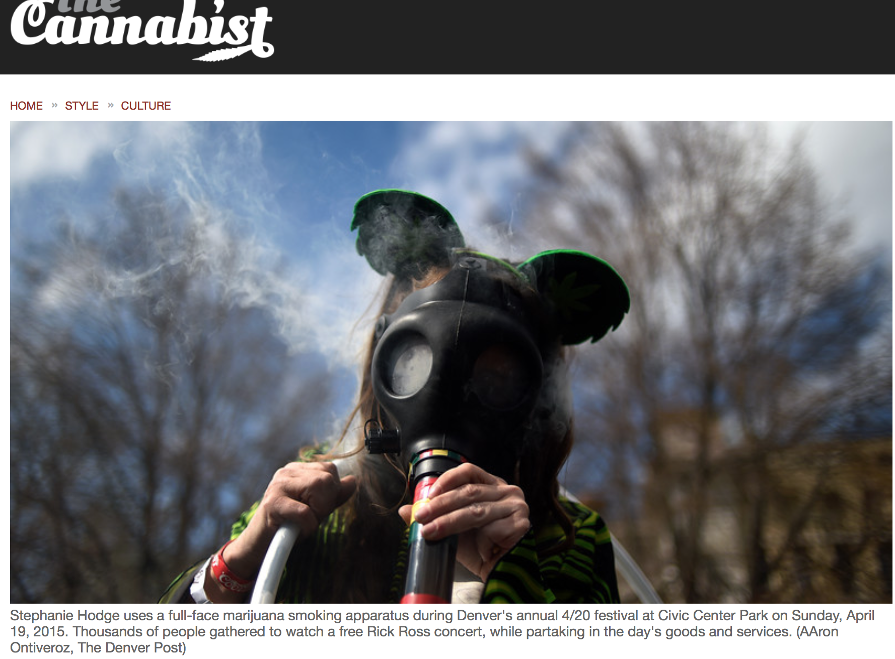

Slide 92
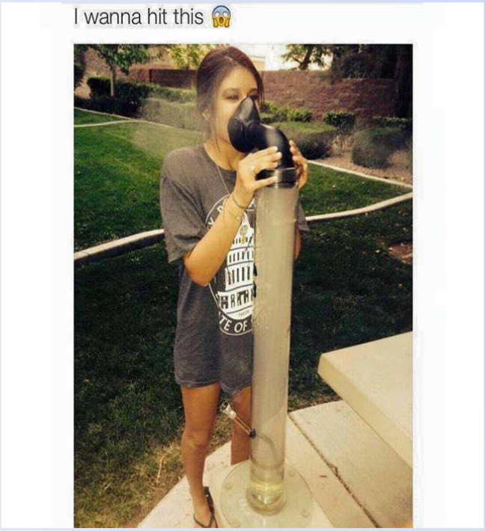

Slide 93
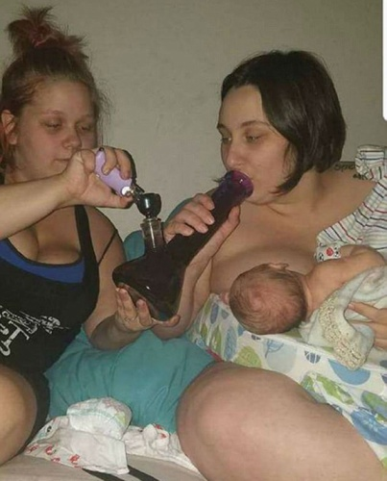

Slide 94
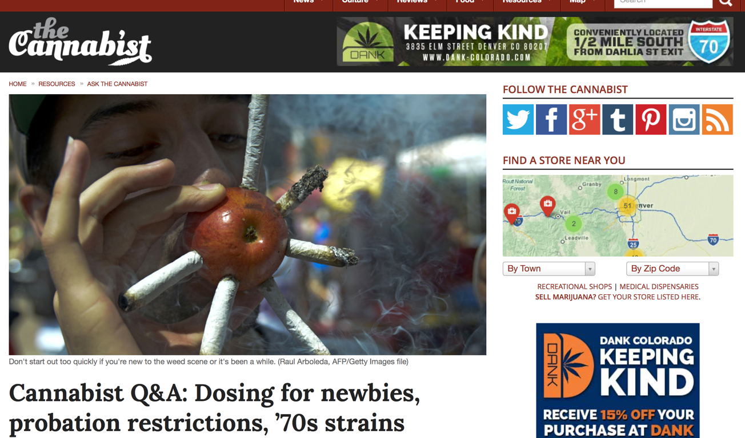
Cannabis Dosing?
http://www.thecannabist.co/2014/09/03/cannabist-q-a-marijuana-dosing-newbies-medical-marijuana-probation-restrictions-70s-strains/18308/

Slide 95
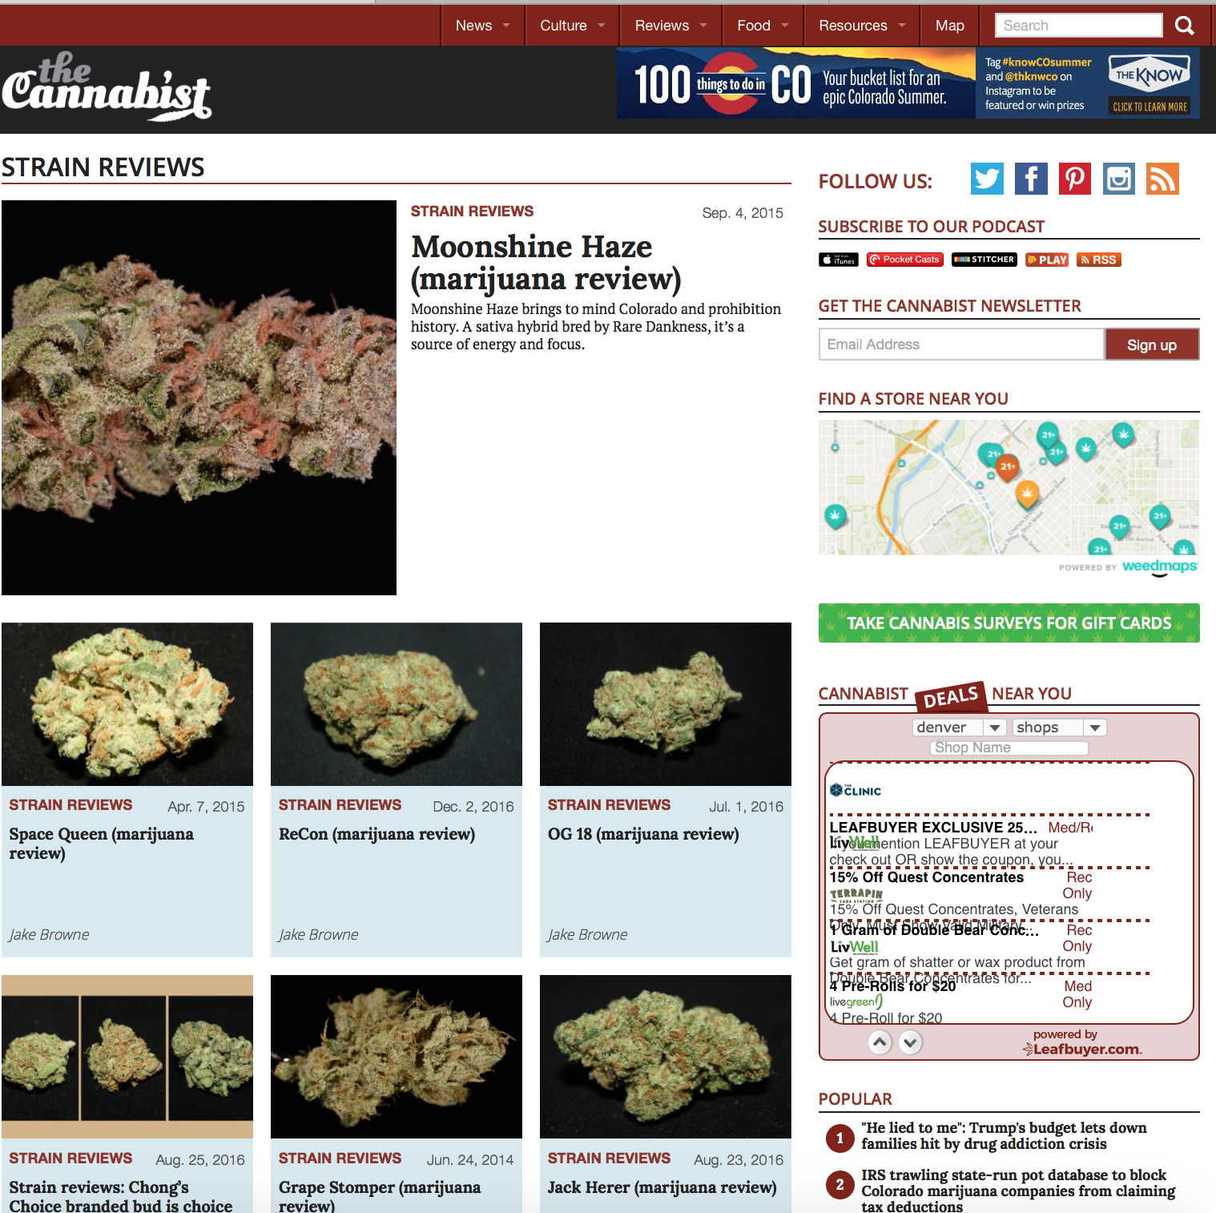

Slide 96
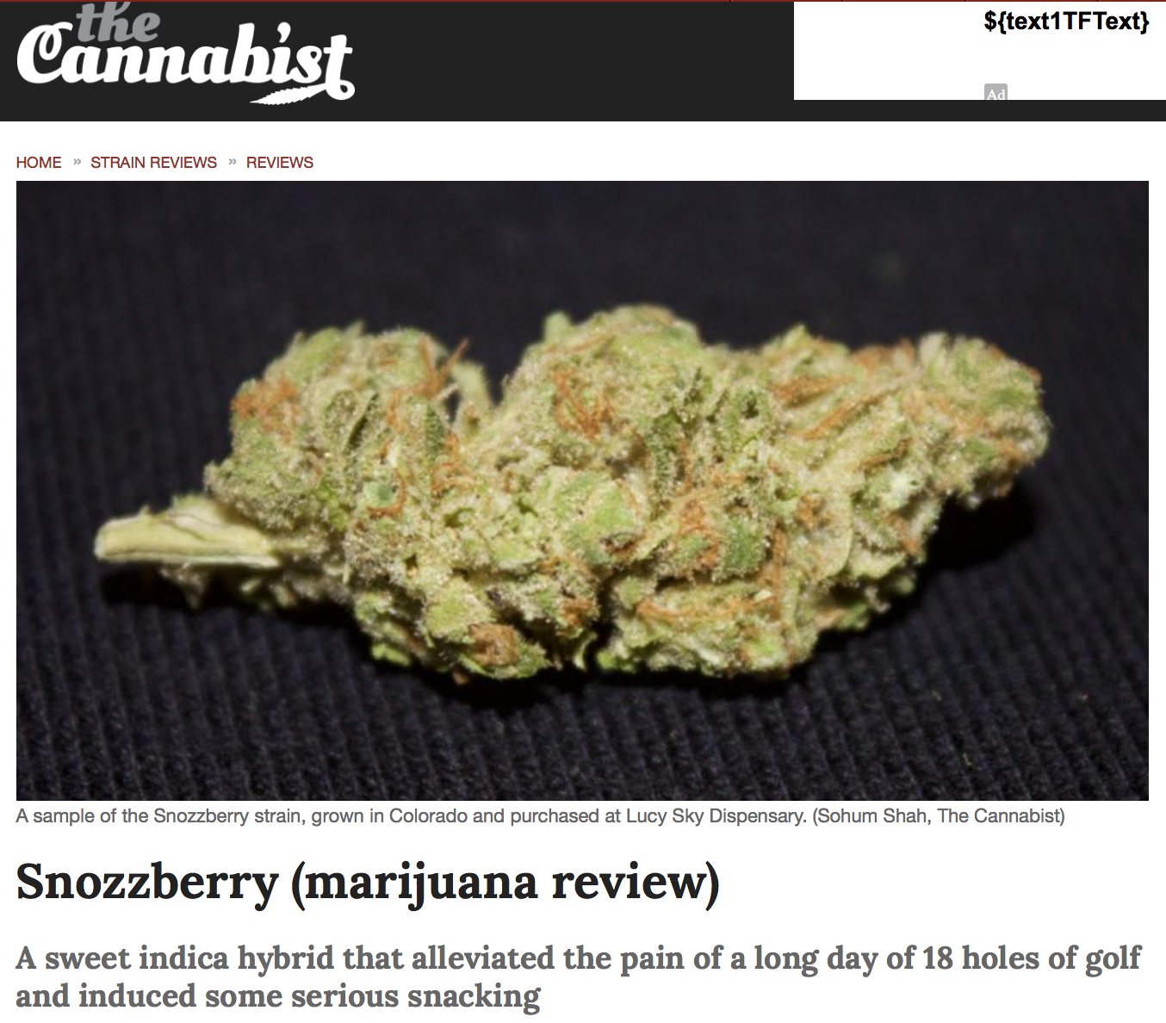

Slide 97
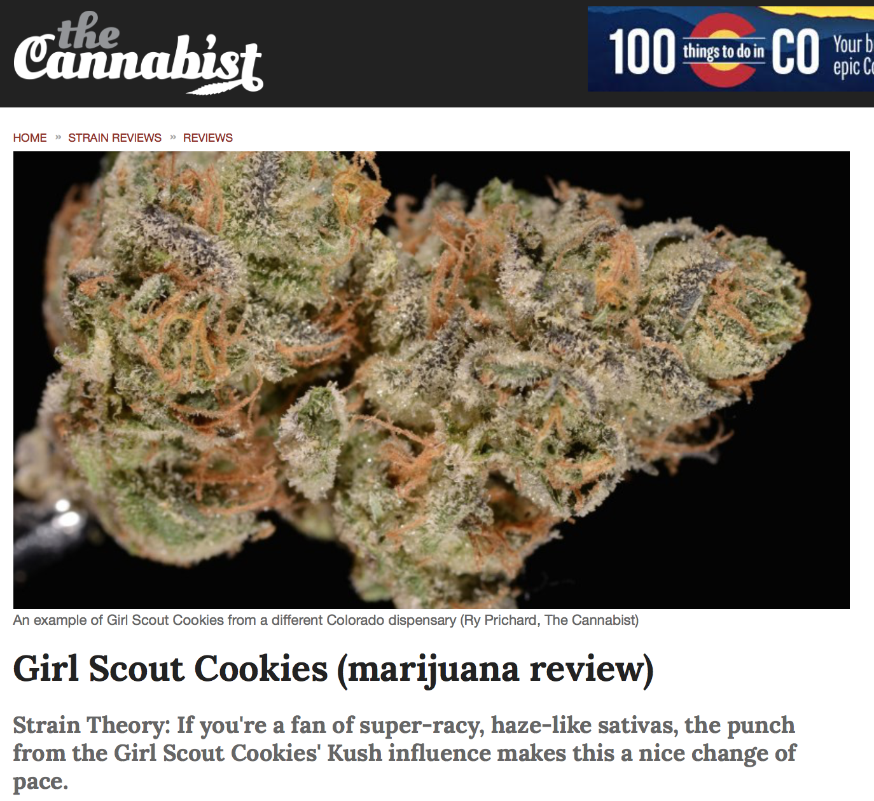
http://www.thecannabist.co/category/reviews/strain-reviews/

Slide 98
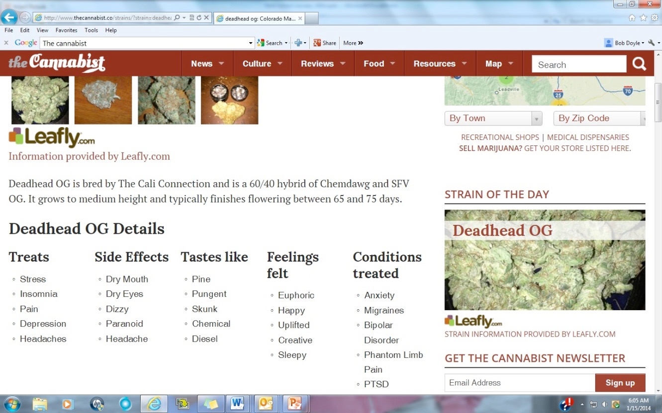
Denver Post In the Medical Recommendation Business
Notes:
Denver post marijuana site proposing this marijuana strain as helping with mental illness

Slide 99
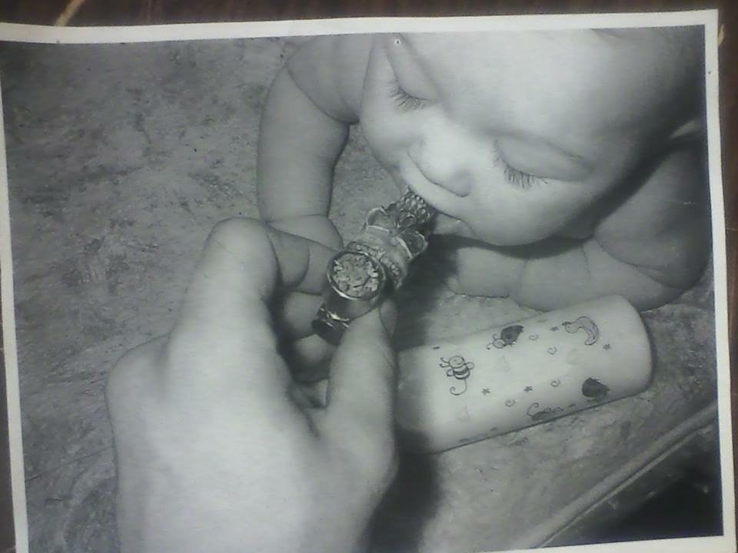
Medicine

Slide 100
Medicine
Several cannabinoids have undergone stringent testing for safety and effectiveness

Slide 101
Medicine
Several cannabinoids have undergone stringent testing for safety and effectiveness
Cannabis as a treatment for pain has not been scrutinized as carefully.

Slide 102
Medicine
Several cannabinoids have undergone stringent testing for safety and effectiveness
Cannabis as a treatment for pain has not been scrutinized as carefully.
Dispensary cannabis has poor product labeling, warnings, guidance on how frequently to dose, potency, or purity

Slide 103
Medicine
Several cannabinoids have undergone stringent testing for safety and effectiveness
Cannabis as a treatment for pain has not been scrutinized as carefully.
Dispensary cannabis has poor product labeling, warnings, guidance on how frequently to dose, potency, or purity
Cannabinoid-based medications have been approved for use, along with dose and frequency of use.

Slide 104
Medicine
Several cannabinoids have undergone stringent testing for safety and effectiveness
Cannabis as a treatment for pain has not been scrutinized as carefully.
Dispensary cannabis has poor product labeling, warnings, guidance on how frequently to dose, potency, or purity
Cannabinoid-based medications have been approved for use, along with dose and frequency of use.
Cannabis has no evidence-based guidelines for use.

Slide 105
CBD
Labelling accuracy of cannabidiol extracts sold online
84 products purchased online and tested
43% under labeled
26% over labeled
31% accurately labeled
THC detected in 21% of samples
JAMA November 7, 2017 Volume 318, Number 17

Slide 106
CBD
Cannabidiol dose and label accuracy in edible medical cannabis products
75 products purchased in regulated markets in California and Washington and tested
23% under labeled with respect to THC content
60% over labeled with respect to THC content
17% accurately labeled with respect to THC content
Non-THC content generally low and only 59% had detectable levels of CBD and only 17% had CBD even labelled
JAMA June 23/30, 2015 Volume 313, Number 24

Slide 107
Contaminants
Medical marijuana felt to have killed a California cancer patient
A rare fungal infection has killed a California man undergoing cancer treatment and it’s believed he got it from medical marijuana
“It started with a couple patients that were undergoing very intensive chemotherapy and a stem cell therapy, and those patients were very immune compromised,” explained Dr. Joseph Tuscano of the University of California, Davis Cancer Center.
http://losangeles.cbslocal.com/2017/02/06/contaminated-medical-marijuana-believed-to-have-killed-california-cancer-patient/#.WJlEKW0Gblg.twitter

Slide 108
Contaminants
Public Health and Safety Advisory
November 3, 2017 - In accordance with the Governor’s Executive Order (D 2015-015), the Colorado Department of Revenue (“DOR”), in conjunction with the Colorado Department of Agriculture (“CDA”) and the Colorado Department of Public Health and Environment (“CDPHE”), are issuing an immediate health and safety advisory due to the identification of potentially unsafe pesticide residues on medical marijuana plant material and marijuana products produced from marijuana cultivated by Tree of Wellness INC, dba Tree of Wellness. CDPHE and DOR deem it a threat to public health and safety when pesticides that are not on the list of approved pesticides for marijuana use as determined by CDA are applied in a manner inconsistent with the pesticide’s label. CDA confirmed the presence of the Off-Label Pesticides, Myclobutanil, in the product samples tested.

Slide 109
Contaminants
Agent Orange 9.8.17 Blue Dream 10.16.17 Blue Dream 10.2.17 Blue Dream 4.8.17 Blue Dream
8.14.17 Blue Dream 9.1.17 Blue Dream 9.21.17 Blue Dream 9.8.17 Buddah Tahoe 7.1.17 Buddah
Tahoe 8.14.17 Cali Orange 10.2.17 Cali Orange 5.23.17 Cali Orange 8.1.17 Celemntine 10.17.17
Chewbacca 10.17.17 Chewbacca 8.14.17 Chewbacca 9.8.17 Critical Mass 7.1.17 Critical Mass 9.1.17 Durban Poison 7.31.17 Durban Poison 8.14.17 Durban Poison 9.1.17 Durban Poison
9.27.17 Fluffhead 7.19.17 Fruity Pebbles 7.19.17 Fruity Pebbles 8.1.17 ICE 9.8.17
Lemon Diesel 3.23.17 Lemon Diesel 9.22.17 Lemon Diesel 9.8.17 Nightmare Cookies 7.19.17
Nightmare Cookies 9.8.17 Northern Lights 10.16.17 Northern Lights 10.2.17 Northern Lights
7.31.17 Northern Lights 8.14.17 Northern Lights 9.1.17 Pink Kush 7.19.17
Pink Kush 8.14.17 Pooty Tang 10.16.17 Pooty Tang 9.1.17 Pooty Tang 9.21.17 Pooty Tang 9.8.17
Purple Headband 10.2.17 Purple Headband 10.23.17 Purple Headband 9.1.17 Purple Headband
9.8.17 Purple Urkel 7.19.17 Purple Urkel 7.31.17 Purple Urkel 9.1.17
Purple VooDoo 7.31.17 Purple VooDoo 9.1.17 Purple VooDoo 9.21.17 Sour Kush 7.1.17
Sour Kush 9.1.17 White Bubba 10.16.17 White Bubba 7.31.17 White Bubba 9.22.17

Slide 110
Case Report
June 2014
33 yo unemployed male
LBP, leg pain
Morphine ER 30mg 2x/day
Pain levels: 9/10
MRI: no surgical lesion, disc bulging, stress fracture

Slide 111
Case Report
July 2014 - November 2014
Several diagnostic/therapeutic spinal injections
No relief
Morphine ER 30mg 2x/day
Pain levels persist 8-10/10
November 2014: requests disability paperwork

Slide 112
Case Report
December 2015
Fentanyl 50ug with Morphine for breakthrough
Pain levels 10/10
Drug screen shows + THC
Patient has MMJ card
Cannot remember recommending physician name
Cannot remember when he saw recommending physician

Slide 113
Case Report
December 2016
Morphine ER 60mg 2x/day with morphine for breakthrough pain
Pain levels 8-10/10
Denies THC use
Drug screen + THC

Slide 114
Case Report
June 2017
Morphine ER 60mg 2x/day with morphine for breakthrough pain
Pain levels 8/10
Reports use of CBD cream is helpful
Discuss opioid taper

Slide 115
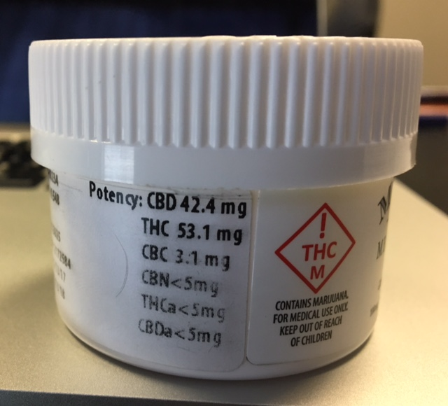
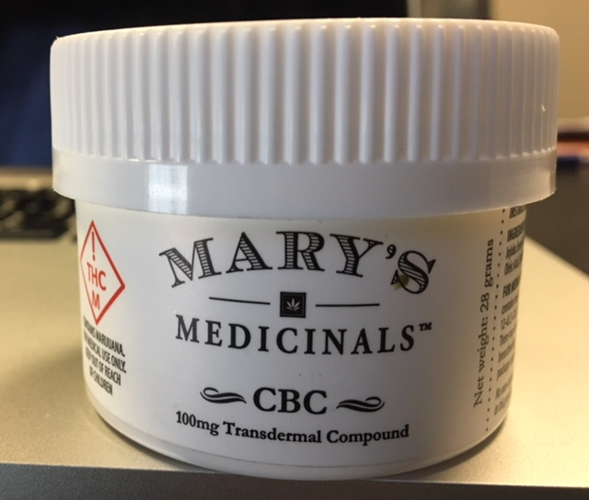
Case Report
July 2017
Tapering off opioids without problem
Reports using CBD cream
Pain levels 9/10

Slide 117
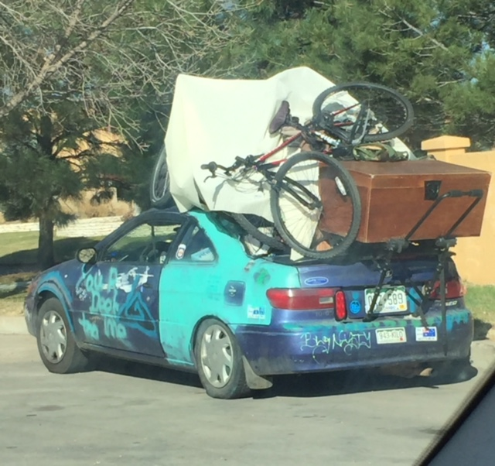

Slide 118
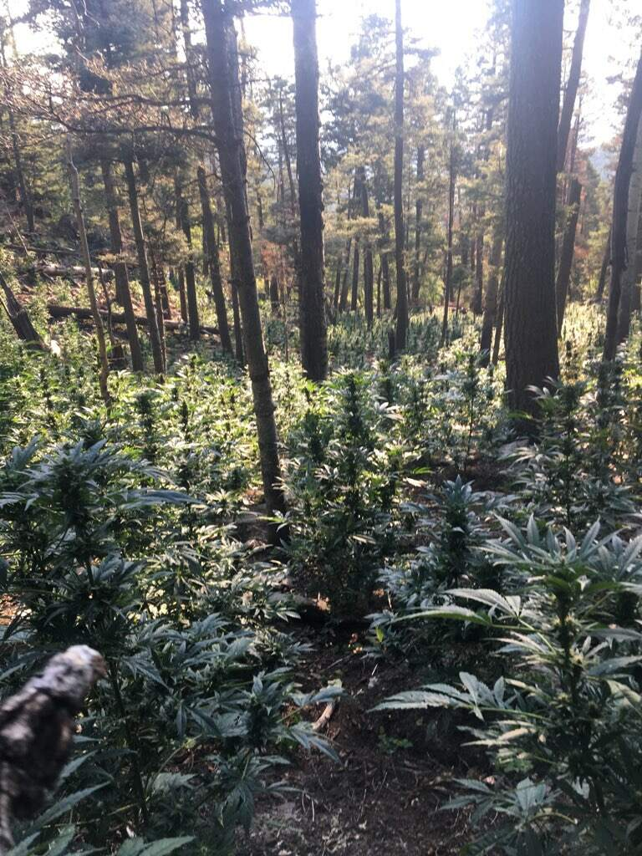

Slide 119
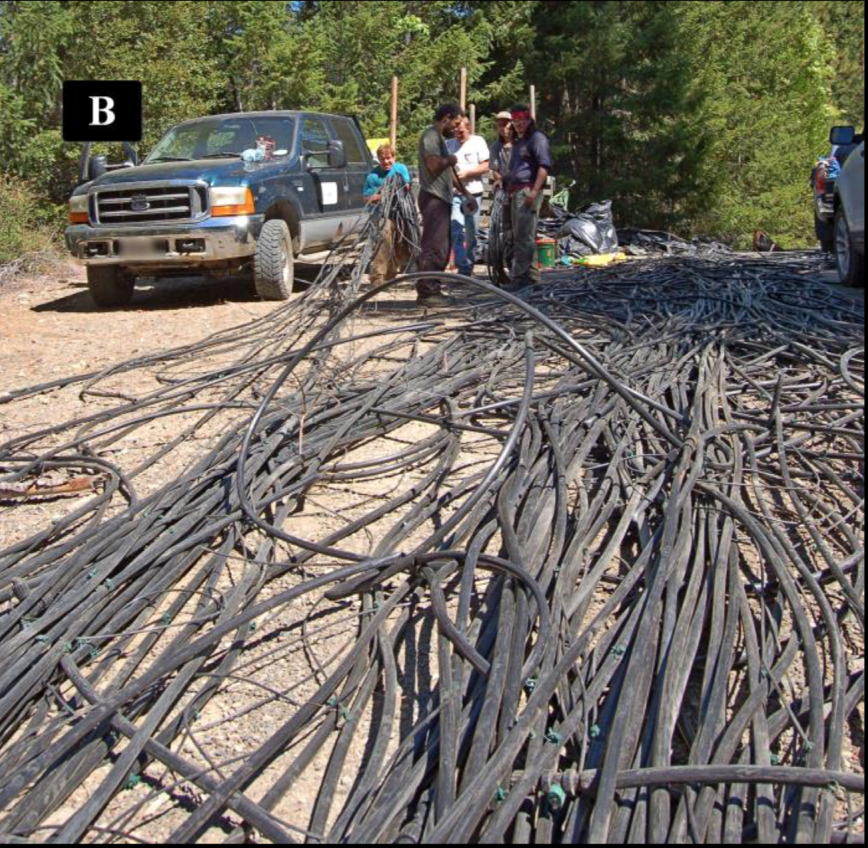
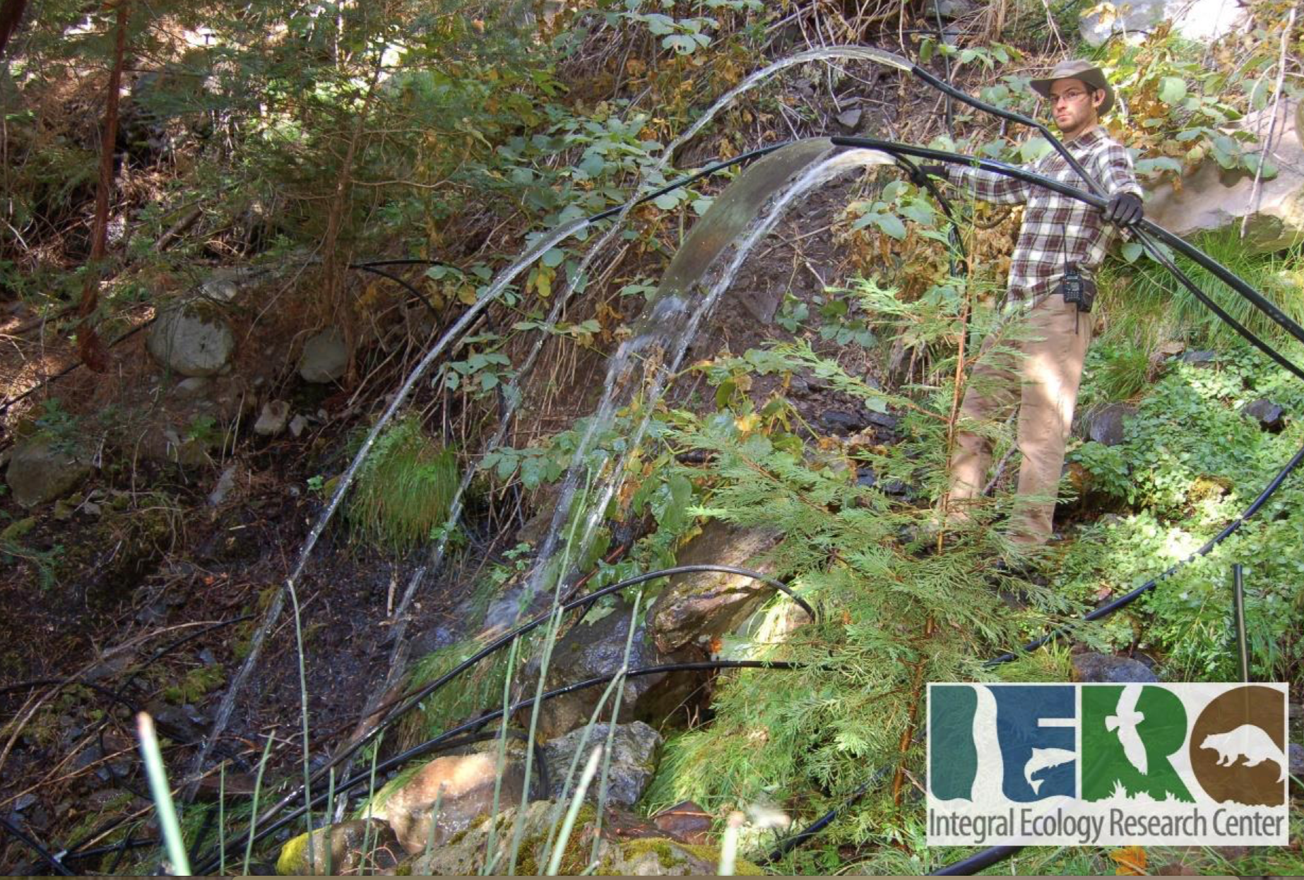
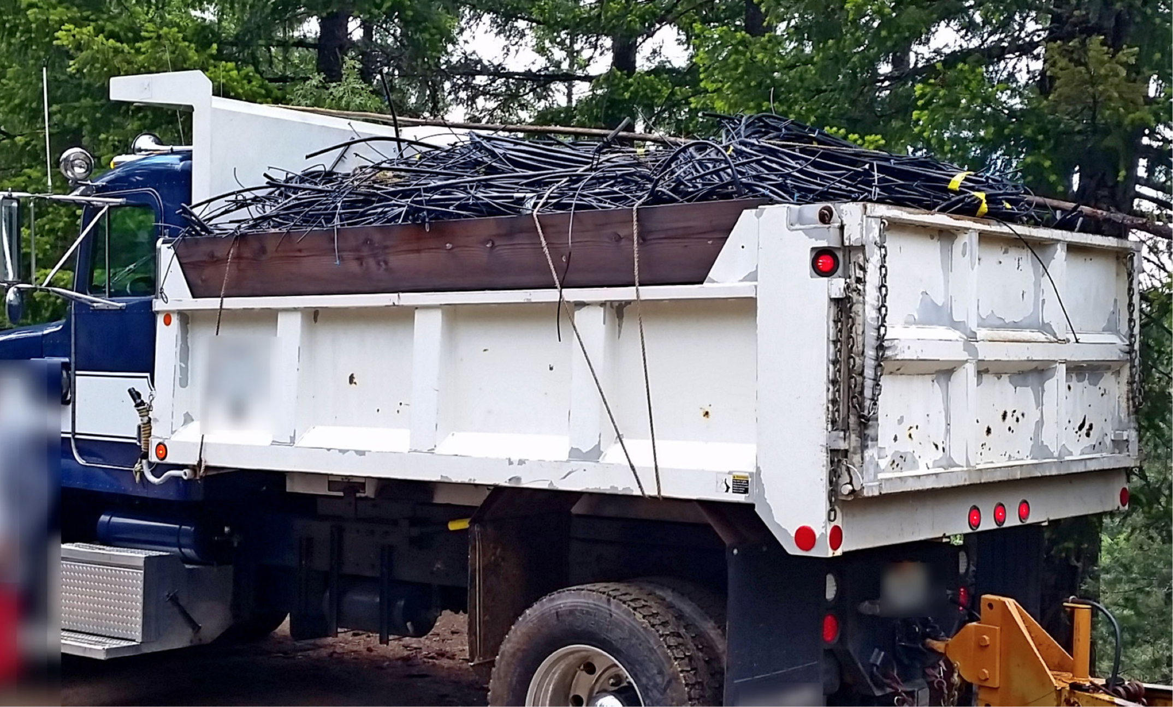
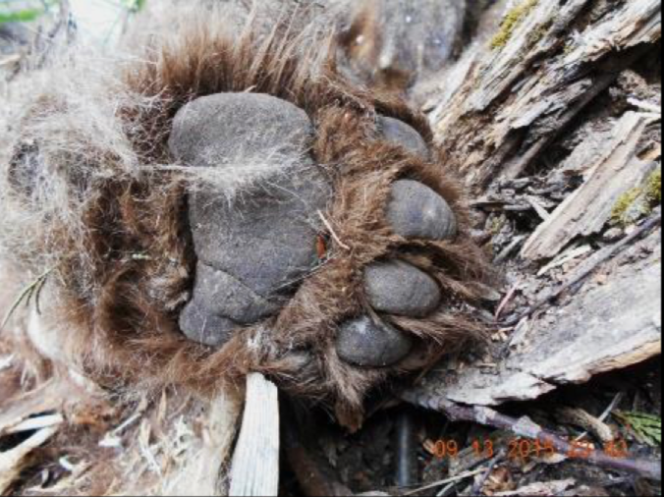

Slide 120
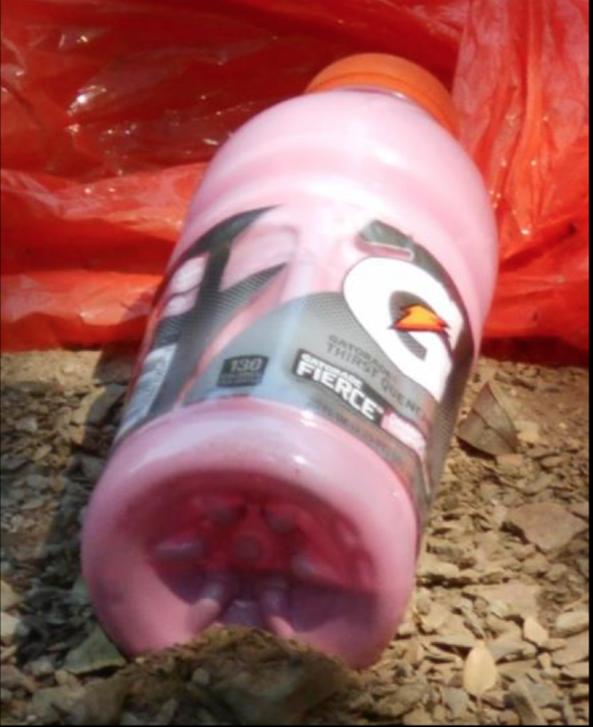
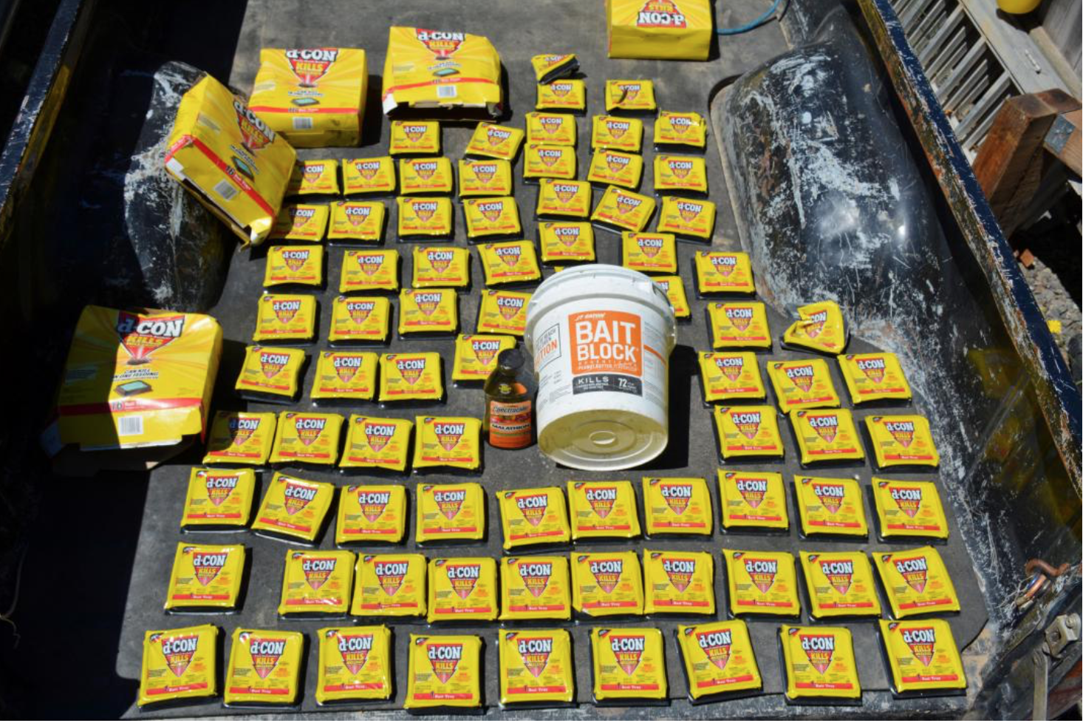
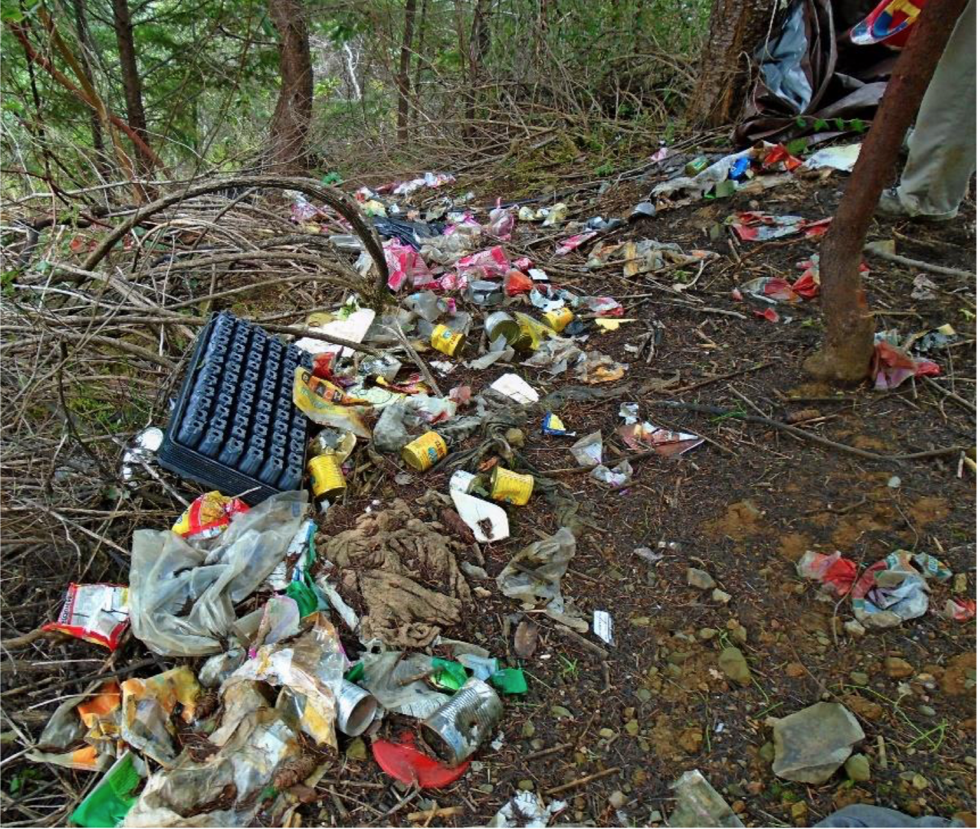
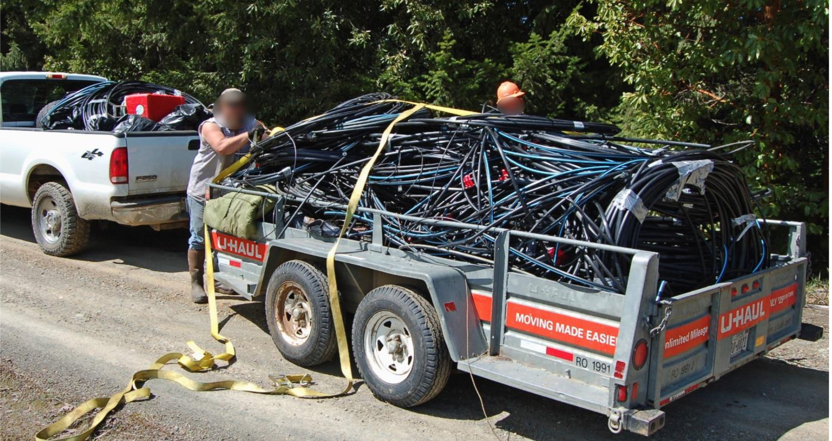

Slide 121
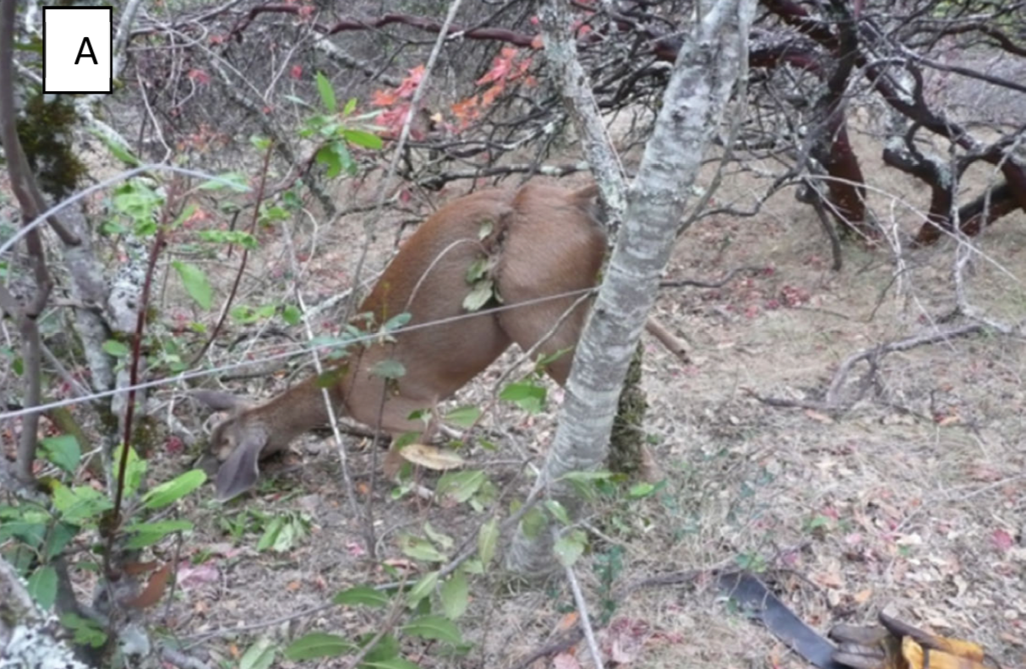

Slide 122
SUMMARY
Cannabinoids may have therapeutic benefit in some pain conditions, most notably cancer pain and neuropathic pain
There appears to be more research with synthetic or well-described natural cannabinoids with controlled dose and delivery systems rather than generally available products
There is no accepted, peer-reviewed research to support cannabinoid use in common pain conditions

Slide 123
SUMMARY
Opioids and cannabinoids share pharmacological profiles, including antinociception
Opioids and cannabinoids modulate similar neurotransmitters governing pain pathways
Cannabinoids HAVE NOT been able to demonstrate an impact on the opioid epidemic
Blinders off

Slide 124
SUMMARY
Longer duration, double-blind, placebo controlled, multi-center studies are imperative to prove efficacy of cannabinoids in the treatment of chronic non-malignant pain syndromes
Well-controlled and regulated products with consistent delivery systems would likely be beneficial for more effective research and more effective pain management or treatment of other conditions
Science-based, plant-based, FDA-approved, regulated and purified medications are needed (Epidiolex, Sativex)

Slide 125
Thank You

