Slide 1
Buprenorphine in the Private Practice Pain Setting
Ajay R. Vellore, M.D., M.S.
Colorado Pain Society
September 24, 2021

Slide 2
Disclosures
None

Slide 3
Learning Objectives
Reanalyze the “opioid epidemic” and gauge if our systematic responses have been appropriate and/or effective
Describe the unique pharmacological properties of buprenorphine
Examine if said pharmacological properties can be exploited to use buprenorphine as a viable first-line opioid analgesic agent
Examine if said pharmacological properties can be exploited to use buprenorphine as an additional treatment option for COT patients

Slide 4
Learning Objectives
Critique the clinical and logistical challenges buprenorphine therapy may offer
Appreciate the clinical and logistical benefits buprenorphine therapy may offer
Differentiate between application of buprenorphine for chronic pain patients versus patients with opioid use disorder
Obtain a level of comfort with potentially prescribing buprenorphine
Use real-world clinical scenarios to reinforce the learning points listed above

Slide 5
“Opioid Epidemic¹”
Per CDC, robust data is available between 1999-2017, and this continues to be updated as is feasible
Incidence of overdose in 2017 was 6x that of 1999 – includes prescription as well as illicit
68% of overdose deaths in 2017 involved an opioid (47,736/70,200)

Slide 6
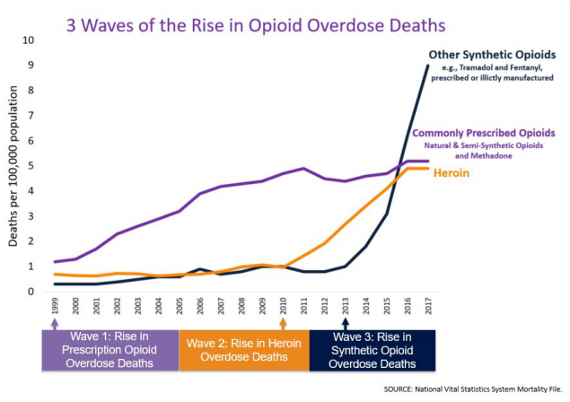
“Opioid Epidemic”

Slide 7
“Opioid Epidemic²”
CDC’s goal is to prevent opioid-related harms and overdose by:
Using data to monitor emerging trends and direct prevention activities
Strengthening state, local, and tribal capacity to respond to the epidemic
Working with providers, health systems, and payers to reduce unsafe exposure to opioids and treat addiction
Coordinating with public safety and community-based partners to rapidly identify overdose threats, reverse overdoses, link people to effective treatment, and reduce harms associated with illicit opioids
Increasing public awareness about the risks of opioids

Slide 8
“Opioid Epidemic²”
CDC Overdose Data to Action (OD2A)
3 year initiative beginning from September 2019
Non-specific terminology including “improved surveillance,” “data driven prevention initiative,” etc.
Unfortunately, many retrospective elements that may end up more punitive than preventative
PDMP

Slide 9
“Opioid Epidemic⁴”
Department of Health and Human Services five-point strategy:
Access: Better Prevention, Treatment, and Recovery Services
$800 million in grants in 2017
Data: Better Data on the Epidemic
Pain: Better Pain Management
Payments, Prescribing Guidelines
Overdoses: Better Targeting of Overdose Reversing Drugs
2019 budget: $74 million
Research: Better Research on Pain and Addiction
???

Slide 10
HHS Pain Management Best Practices Inter-Agency Task Force Report – Updates, Gaps, Inconsistencies, and Recommendations – May 9, 2019^{4a}
GAP 4: Barriers include lack of coverage and reimbursement for buprenorphine as well as the lack of education and training on the proper usage of buprenorphine. There has been a lack of access to buprenorphine treatment for chronic pain.
RECOMMENDATION 4A: Make buprenorphine treatment for chronic pain available for specific groups of patients, and include buprenorphine in third-party payer and hospital formularies.
RECOMMENDATION 4B: Encourage CMS and private payers to provide coverage and reimbursement for buprenorphine treatment, both for OUD and for chronic pain. Encourage primary use of buprenorphine rather than use only after failure of standard mu agonist opioids such as hydrocodone or fentanyl, if clinically indicated.
RECOMMENDATION 4C: Encourage clinical trials using buprenorphine for chronic pain to better understand indication, usage, and dosage.

Slide 11
Additional Responses – Pharmaceutical Industry
Oral morphine, oxycodone, hydrocodone, hydromorphone, oxymorphone, etc. -> physiology has contributed to current situation
Solution? Accelerate “R&D” to create essentially the same products, that are now extended-release and tamper-proof⁵
While admirable, this largely leads us back to square one
But, what if we need to go back even further?

Slide 13
Buprenorphine - History
What’s old becomes new again?
Buprenorphine initially synthesized in 1966 from thebaine (aka paramorphine) – an opiate alkaloid that is a minor component of opium⁷
Twelve years later, Dr. Donald Jasinski published comprehensive studies regarding the molecule, highlighting its potential clinical uses, utilizing morphine as a baseline

Slide 14
Buprenorphine – Dr. Donald Jasinski, April 1978
“In conclusion, buprenorphine has a unique pharmacology with immediately obvious therapeutic applications as an analgesic of low abuse potential.” ⁷
“Moreover, the drug has potential for treating narcotic addiction since it is acceptable to addicts, is long-acting, produces a low level of physical dependence such that patients may be easily detoxified, is less toxic than drugs used for maintenance therapy, and blocks the effects of narcotics.” ⁷

Slide 15
Drug X – Dr. Donald Jasinski, April 2019
“In conclusion, Drug X has a unique pharmacology with immediately obvious therapeutic applications as an analgesic of low abuse potential.”
“Moreover, the drug has potential for treating narcotic addiction since it is acceptable to addicts, is long-acting, produces a low level of physical dependence such that patients may be easily detoxified, is less toxic than drugs used for maintenance therapy, and blocks the effects of narcotics.”

Slide 16
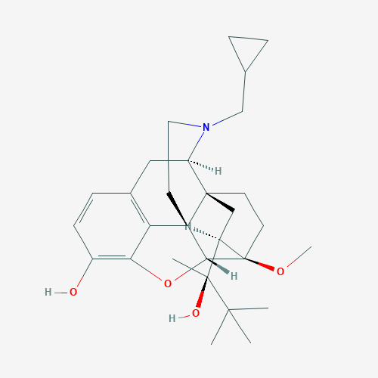
Buprenorphine – Pharmacology⁶
Binds with variable affinity to µ, κ, and δ receptors

Slide 17
Opioid Receptors – Pharmacology⁸
Receptor Type | Functions | Locations
µ | Analgesia, respiratory depression, euphoria, physical dependence, reduced GI motility | Brain, spinal cord, periphery
δ | Analgesia, physical dependence, anti-depression | Brain, periphery
κ | Analgesia, depression, sedation | Brain, spinal cord, periphery

Slide 18
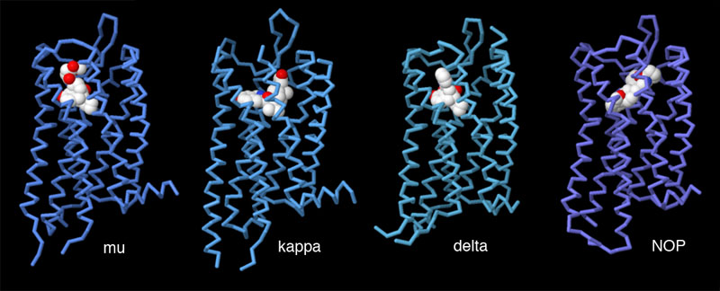
Buprenorphine – Pharmacology^{9,10,11}
However…
µ - partial agonist with high affinity
δ – antagonist with low affinity (30x less than µ or κ)
Clinical significance is suspect
Κ – inverse agonist

Slide 19
Buprenorphine – Pharmacology^{9,10,11}
However…
µ - partial agonist with high affinity
δ – antagonist with low affinity (30x less than µ or κ)
Clinical significance is suspect
Κ – inverse agonist

Slide 20
κ-Receptor Inverse Agonism¹²
Quite possibly the most unique and important pharmacological aspect of buprenorphine
Rodent behavioral models indicate that this is responsible for anti-depressant behavior
As quickly as 7 days!
Correlates with neuroimaging in depressed humans
Low κ-Receptor availability in these patients

Slide 21
κ-Receptor Inverse Agonism¹²
Primary pathway responsible for mitigation of hyperalgesia
Potential novel mechanism exists as a sole target
Anti-depressant
Anti-hyperalgesia
δ-receptor poses challenges in this regard

Slide 22
Buprenorphine - Pharmacology
Reproduced from 13) Walsh et al., 1994

Slide 23
Buprenorphine - Pharmacology
Extensive first-pass hepatic clearance exists
96% bound to α1-acid glycoprotein with large volume of distribution
Highly lipophilic
Metabolized through CYP3A4 and CYP2C8 to norbuprenorphine
Norbuprenorphine almost paradoxically behaves like morphine
Phase II occurs via glucuronidation to buprenorphine-3-glucuronidate and norbuprenorphine-3-glucuronidate

Slide 24
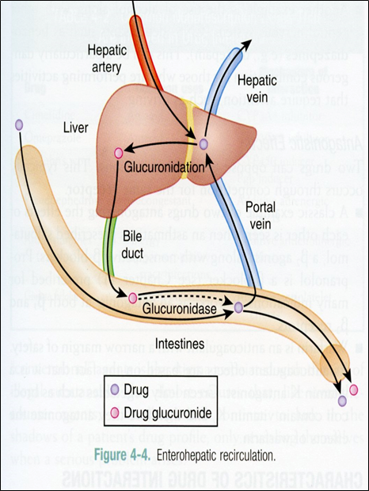
Buprenorphine – Pharmacology¹⁴
Studies are still non-committal, but more than likely B-3-G and N-3-G are clinically insignificant despite their abilities to provide analgesia and sedation (1/4th to 1/50th of the effect)
Primarily enterohepatic circulation dependent, with excretion dependent upon biliary and renal systems
Latter plays a much more insignificant role
CYP3A4 activity decreases in renal failure

Slide 25
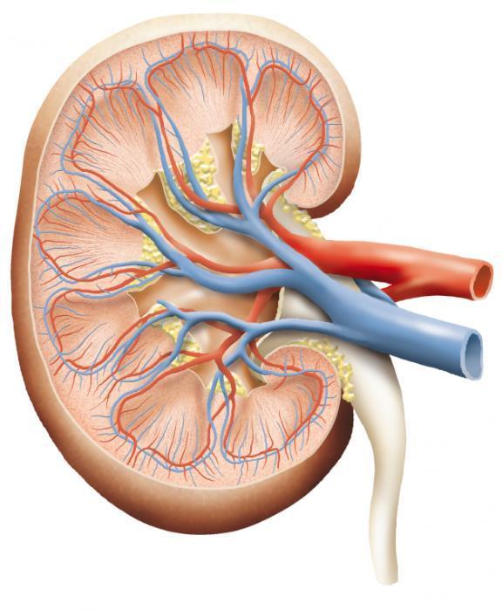
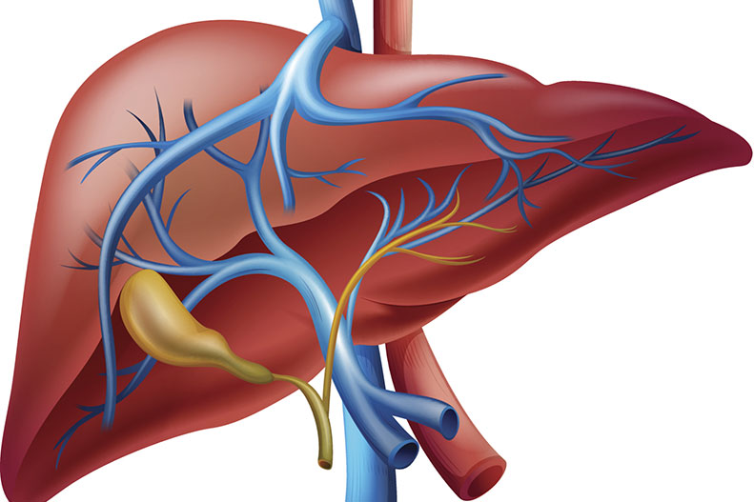
Buprenorphine – Renal and Hepatic Systems^{15,16}
Renal | Hepatic
-Small amount of unchanged buprenorphine initially excreted in urine -Metabolites (NB, N-3-G, B-3-G) also excreted in urine, anywhere from 10-30% -CKD does not induce appreciable changes in peak plasma levels nor half-life time -HD does not affect concentrations in either direction -Verdict: LARGELY SAFE | -Much, if not all clinically significant metabolism occurs in hepatocytes via cytochrome P450 enzymatic activity for phase I and glucuronidation for phase II -Enterohepatic circulation also plays a large role in metabolism and excretion -Functioning hepatobiliary system is important -Cirrhotic patients at risk for toxicity -Verdict: EXERCISE CAUTION

Slide 26
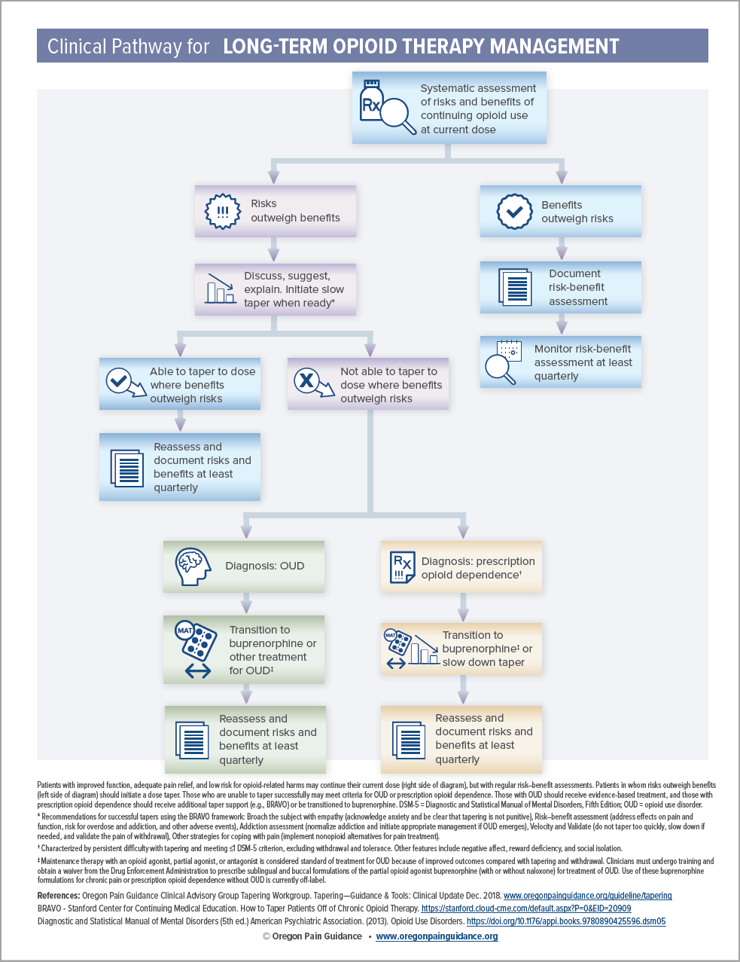
Buprenorphine – Use in Chronic Pain/Opioid Use Disorder
Retrieved from Oregon Pain Guidance, adopted by Department of Health and Human Services

Slide 27
Buprenorphine – Use in Chronic Pain/Opioid Use Disorder Oregon Pain Guidance/Department of Health and Human Services
Opioid Use Disorder: Transition to buprenorphine (or other replacement therapy)
Prescription Opioid Dependence: Transition to buprenorphine (or slow taper)

Slide 28
Buprenorphine – Use in Existing COT Patients¹⁸

Slide 29
Buprenorphine Formulaic Bioavailability¹⁹
Formulation | Bioavailability
Intravenous | 100%
Oral | <10% Welsh
Sublingual | 20-40%
Buccal | 45-65%
Transdermal | 15%
Intranasal | 48%
Intramuscular | 70%
Extended-Release Depot | 100%? With lower peak plasma concentrations

Slide 30
Buprenorphine Formulaic Bioavailability¹⁹
Formulation | Bioavailability
Intravenous | 100%
Oral | <10% Welsh
Sublingual | 20-40%
Buccal | 45-65%
Transdermal | 15%
Intranasal | 48%
Intramuscular | 70%
Extended-Release Depot | 100%? With lower peak plasma concentrations

Slide 31
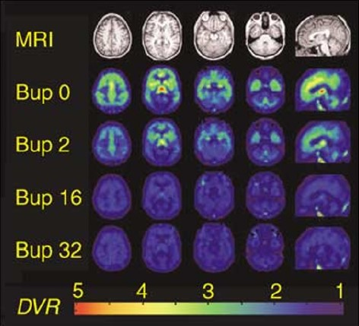
Buprenorphine – Use in Chronic Pain¹⁸
Analgesia: likely upwards of a 2 mg sublingual as maximum total dose for pain
In this case, more than likely that ~70% of µ-receptors are still available!

Slide 32
Buprenorphine Conversions – August 2017²⁰
Understand that these conversions were/are not cut and dry
Film/tablet (mg) – 30
Patch (mcg/hr) – 12.6
Film (mcg) – 0.03

Slide 33
Buprenorphine Conversions – February 2018²¹
Film/tablet (mg) – ???
Patch (mcg/hr) – ???
Film (mcg) – ???
Most likely best course of action for the time being

Slide 34
Buccal Buprenorphine Conversion²²
Webster et al. examined 36 patients on oxycodone or morphine with daily MME > 80 and <220
Two groups
80-160 MME group was given buccal buprenorphine at 300 mcg Q12h or 50% of their native opioid
160-220 MME group was given buccal buprenorphine at 450 mcg Q12h or 50% of their native opioid
Placebo medications were included in both with sugar pills/films

Slide 35
Buccal Buprenorphine Conversion²²
COWS (11 data points) utilized to measure withdrawal signs
After dose 1: 30 minutes, 1 hour, 1.5 hours, 2 hours, 2.5 hours, 3 hours, 3.5 hours, 4 hours, 6 hours, 9 hours, and 12 hours
After dose 2: 30 minutes, 1 hour, 1.5 hours, 2 hours, 4 hours, 12 hours
NRS pain intensity also measured concurrently

Slide 36
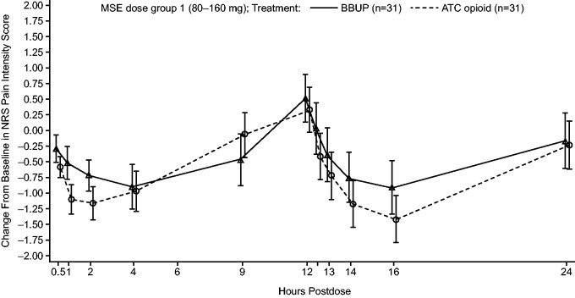
Buccal Buprenorphine Conversion²²

Slide 37
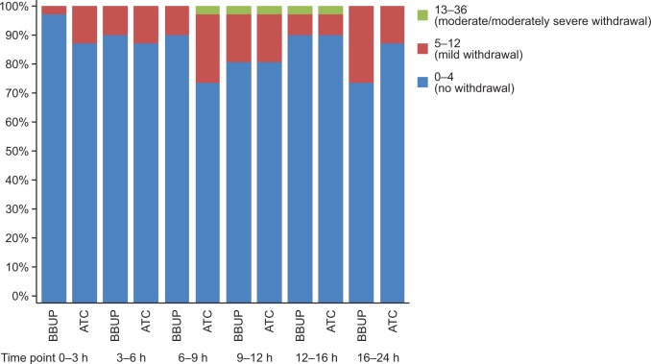
Buccal Buprenorphine Conversion²²

Slide 38
Buccal Buprenorphine Conversion²²
Administration of 300 mcg or 450 mcg of buccal buprenorphine 8 to 12 hours after last dose of oral µ-opioid was “not associated with higher incidence of serious AEs, AEs leading to discontinuation, or treatment-emergent AEs overall compared with the 50% dose of the prescribed full µ-opioid agonist.”
Important to note that this is not establishing a direct switch or conversion factor, but rather provides insight into this unique relationship
40-80 MME -> 300 mcg films
80-110 MME -> 450 mcg films

Slide 39
Buccal <- -> Transdermal
Population pharmacokinetic model-based meta-analysis³³
Buccal | Transdermal
150 mcg BID | 10 mcg/hr
300 mcg BID | 20 mcg/hr

Slide 40
Buprenorphine → Morphine Milligram Equivalents
Simply does not exist (at least, accurately)
Complicated by different proprietary delivery systems
Variable bioavailability, even with these systems

Slide 41
Buprenorphine - Challenges
Diversion
PCP/provider attitudes
Coverage/Access
Clinical pitfalls

Slide 42
Buprenorphine – Diversion²³
Numerous studies have demonstrated that full mu agonists are preferred to buprenorphine for illicit use
Despite this, as access and awareness in addition to treatment has increased for buprenorphine, the number of individuals using buprenorphine for illicit purposes have quadrupled (2008-2013)

Slide 43
Buprenorphine – Diversion²⁴
Current and former opioid users who would partake in these practices were surveyed
Overarching theme – individuals utilized buprenorphine illicitly to:
Treat/prevent withdrawal
“Get high” when other drugs of choice were not available
OUD programs were unavailable/unaffordable

Slide 44
Buprenorphine – Diversion²³
Overwhelming number of responders stated that proper access to care was driving factor of illicit use
81% of respondents (245/303) stated that they would be likely to pursue medically prescribed buprenorphine from a physician if access was available
Open-ended responses revealed three major barriers
Difficulty in accessing physicians
High cost
Social stigma

Slide 45
Primary Care Provider Attitudes²⁵
Louie et al, BMC Family Practice
Narrative review – intentionally used to broaden study capacity and boost subjectivity
Searches performed across PubMed, PsychINFO, Scopus, Google Scholar, and Web of Science
Search keywords included “buprenorphine,” “Suboxone,” “Attitudes,” “Barriers,” “Implementation,” “Adoption,” “Primary Care,” “Family Medicine,” “PCPs.”

Slide 46
Primary Care Provider Attitudes²⁶
Why is this important?
As of 2012, in 48/50 states, the number of opioid dependent patients were substantially higher than buprenorphine capacity rates
Only upwards of 28% of XDEA certified providers were actually prescribing buprenorphine/OUD
Time and investment upfront costs not resulting in appropriate returns

Slide 47
Primary Care Provider Attitudes²⁶
Buprenorphine does not belong in primary care
Philosophical objections
Stigma – legitimate concerns that their practices would be overrun by homeless individuals
OUD patient behaviors
Negativity towards substance abuse in general
Diversion
Lack of confidence in their own abilities

Slide 48
Primary Care Provider Attitudes²⁶
Two studies showed a dramatic shift in attitude once buprenorphine was prescribed by providers in question
Providers became more comfortable if a provider in the practice was prescribing buprenorphine
General education
Patient stories within practices

Slide 49
SAMHSA Statutes, Regulations, and Guidelines²⁷
Keepers of all things related to MAT, Substance Abuse Treatment, and Licensing
The SUPPORT (Substance Abuse Disorder Prevention that Promotes Opioid Recovery and Treatment for Patients and Communities) Act of 2018
Expanded buprenorphine prescribing abilities to PAs, NPs, CRNAs and other practitioners until at least October 1, 2023
Expanded ability of first-year prescribing physicians and other qualifying prescribers to go past treating up to 30 patients instead to up to 100 patients
After a successful year one, these individuals can then prescribe for up to 275 patients per year

Slide 50
Buprenorphine – Miscellaneous Pitfalls^{28,29,30}
QTc Prolongation
440-470 ms --- > 500 ms
Most evidence shows a lack over 450 ms
Pregnant Patients
Consider methadone
Liver Failure Patients
Avoid
HIV Patients
Safe but monitor due to interactions with anti-virals

Slide 51
Pick a Side – Buprenorphine vs. Classic Oral Opioids
Buprenorphine? Classic oral opioids?
RESPIRATORY DEPRESSION

Slide 52
Pick a Side – Buprenorphine vs. Classic Oral Opioids
Buprenorphine Classic oral opioids
As imagined, also likely safer with combination therapy with other sedating medications³¹
RESPIRATORY DEPRESSION

Slide 53
Pick a Side – Buprenorphine vs. Classic Oral Opioids
Buprenorphine? Classic oral opioids?
CONSTIPATION

Slide 54
Pick a Side – Buprenorphine vs. Classic Oral Opioids
Buprenorphine Classic oral opioids
Additionally, no Sphincter of Oddi dysfunction¹⁸
CONSTIPATION

Slide 55
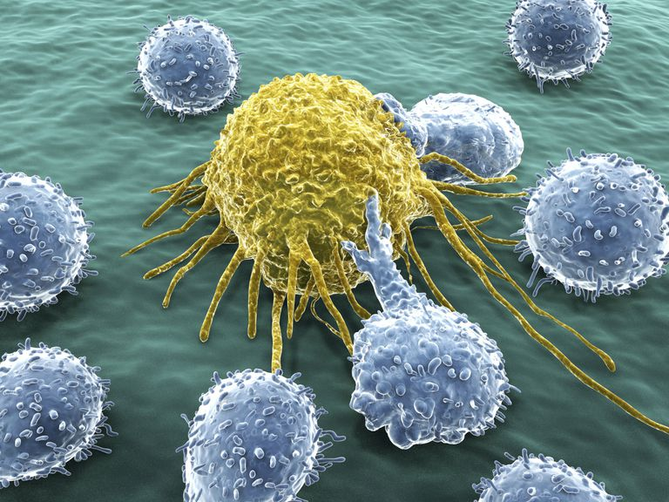
Pick a Side – Buprenorphine vs. Classic Oral Opioids
Buprenorphine? Classic oral opioids?
IMMUNOSUPPRESSION

Slide 56
Pick a Side – Buprenorphine vs. Classic Oral Opioids
Buprenorphine Classic oral opioids
No increase in cortisol, reduction in ACTH, or reduction in NK cell function¹⁸
IMMUNOSUPPRESSION

Slide 57
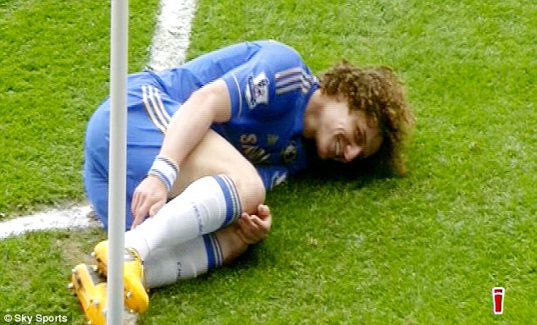
Pick a Side – Buprenorphine vs. Classic Oral Opioids
Buprenorphine? Classic oral opioids?
HYPERALGESIA

Slide 58
Pick a Side – Buprenorphine vs. Classic Oral Opioids
Buprenorphine Classic oral opioids
Due to inverse agonism at K-receptor, stimulation of ORL-1?¹⁸
HYPERALGESIA

Slide 59
Pick a Side – Buprenorphine vs. Classic Oral Opioids
Buprenorphine? Classic oral opioids?
COGNITION/PSYCHOMOTOR
ACTIVITY

Slide 60
Pick a Side – Buprenorphine vs. Classic Oral Opioids
Buprenorphine Classic oral opioids
Better visual, psychomotor, and cognitive function vs. morphine, fentanyl, and methadone
No different than placebo!¹⁸
COGNITION/PSYCHOMOTOR
ACTIVITY

Slide 61
Clinical Case Scenarios

Slide 62
Clinical Case Scenario #1
36 y/o female, G2P2 (6 y/o and 3 y/o)
PMH, SH, FH all non-contributory
Long-distance runner and former college soccer player
PSH: One second trimester abdominal surgery during each of her pregnancies
Cecal volvulus requiring resection with ileocolonic anastomosis
Cholecystectomy
Presents as a referral from GI for chronic abdominal pain

Slide 63
Clinical Case Scenario #1
Presents on tramadol 50 mg upwards of 8-10 per day
Does not like this and cannot take while she is with her kids
Has occasional severe breakthrough pain (1-4x/month) that mimics volvulus pain
Patient regrettably goes to ER out of fear each time
Colonoscopy reveals significant ulceration at and around anastomosis site
Repeat laparoscopy shows significant adhesions/scar tissue
What to do next?

Slide 64
Clinical Case Scenario #1
A) Switch to tramadol ER
B) Add low-dose Percocet or Dilaudid to monthly Rx for breakthrough pain
C) Begin a trial of transdermal buprenorphine
D) Some or all of the above
E) None of the above
F) Something completely different

Slide 65
Clinical Case Scenario #1
A) Switch to tramadol ER
B) Add low-dose Percocet or Dilaudid to monthly Rx for breakthrough pain
C) Begin a trial of transdermal buprenorphine
D) All of the above
E) None of the above
F) Something completely different

Slide 66
Clinical Case Scenario #2
58 y/o female
PMH: Hypothyroidism, Sjogren’s syndrome, Osteoarthritis
PSH, FH, SH: Non-contributory
Referred due to persistent bilateral knee pain attributable to osteoarthritis without structural defects or otherwise
Referred from primary care due to escalating opioid requirements

Slide 67
Clinical Case Scenario #2
Has utilized hydrocodone/APAP 5/325 mg 0, ½, or 1 tab/day at most for last 24 months, typically at end of an active day
Has recently requested 1 tab/day as pain is beginning to worsen
Intraarticular steroid injections utilized prn in conjunction
What to do next?

Slide 68
Clinical Case Scenario #2
A) Keep things as is
B) Agree with increase to one tablet daily dosing
C) Begin a trial of transdermal buprenorphine
D) Consider extended-release oral opioid
E) Refer to Ortho for STAT bilateral TKAs
F) All of the above
G) None of the above

Slide 69
Clinical Case Scenario #2
A) Keep things as is
B) Agree with increase to one tablet daily dosing
C) Begin a trial of transdermal buprenorphine
D) Consider extended-release oral opioid
E) Refer to Ortho for STAT bilateral TKAs
F) All of the above
G) None of the above

Slide 70
Clinical Case Scenario #3
80 y/o female with severe thoracolumbar scoliosis and rheumatoid arthritis
PFTs were indicative of decreased TLC and VC, among others
Largely inactive but with low BMI due to pain and depression
5’1”, 94 lbs
Boutonniere deformities, swan-neck deformities, and ulnar deviation present

Slide 71
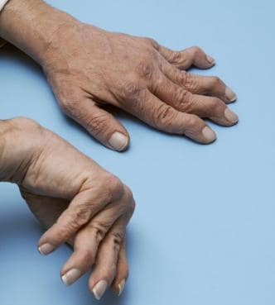
Clinical Case Scenario #3

Slide 72
Clinical Case Scenario #3
PCP began chronic opioid therapy three years ago
Patient notes dramatically improved pain control, but cannot endorse increased function as she feels more fatigued on a daily basis
Opioid requirements began escalating 18 months into treatment
Now currently on MS ER 15 mg TID and oxycodone 5 mg QID prn

Slide 73
Clinical Case Scenario #3
No signs of drug abuse, diversion, or otherwise
Patient starting to “look” and “feel” worse
What to do next?

Slide 74
Clinical Case Scenario #3
Let’s assume you astutely gradually uptitrated transdermal buprenorphine and concurrently downtitrated her oral opioids
She is now doing very well on transdermal buprenorphine 20 mcg/hr as a sole therapeutic agent with increased energy, focus, functionality, and equivalent pain control
On this therapy for one month until…

Slide 75
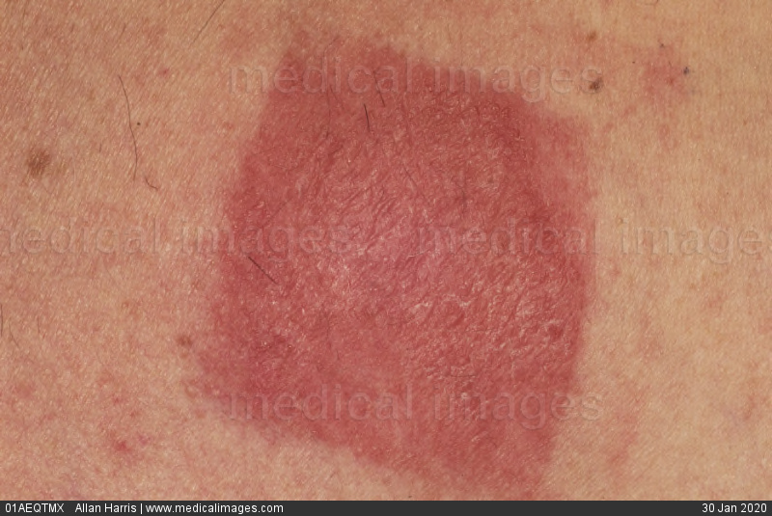
Clinical Case Scenario #3
Extremely itchy, painful at site.
No other rashes appreciated elsewhere.
Symptoms are severe/annoying enough that patient does not want to/cannot continue this therapy.
What to do next?

Slide 76
Clinical Case Scenario #3
A) Tell her to tough it out
B) Provide a prescription for hydroxyzine and instruct her to use Benadryl
C) Consult to dermatology
D) Switch to sublingual buprenorphine tablets
E) Switch to buccal buprenorphine
F) Switch back to old oral medications
G) None of the above

Slide 77
Clinical Case Scenario #3
A) Tell her to tough it out
B) Provide a prescription for hydroxyzine and instruct her to use Benadryl
C) Consult to dermatology
D) Switch to sublingual buprenorphine tablets
E) Switch to buccal buprenorphine
F) Switch back to old oral medications
G) None of the above

Slide 78
Assessment of Knowledge
As mandated by CME activity regulations
20 questions, randomized individuals in audience will be called on to answer
30 second time limit

Slide 80
Conclusions
Buprenorphine is NOT a “panacea,” nor a one-size-fits-all therapy
Buprenorphine is STILL an opioid
Buprenorphine STILL has certain qualities that conventional opioids share
Buprenorphine STILL has clinical limitations and pitfalls
Buprenorphine is not an ideal ACUTE pain therapy
Coverage still worse than for oral opioids³²
Path of least resistance aka $$$
HOWEVER…

Slide 81
Conclusions
If chronic opioid therapy is adjudged to be indicated, buprenorphine is a GREAT option
If your patient has common medical co-morbidities, buprenorphine MAY likely be the safer option
Buprenorphine CAN work for both opioid-naïve as well as chronic opioid patients
Converting chronic opioid patients is not complex and should not be intimidating
Buprenorphine commonly offers a FRACTION of the risk as well as EQUAL analgesia in addition to supplemental benefits

Slide 83
Acknowledgements
Dr. Mancia Ko, Pharm. D.

Slide 84
Questions?
avellore@cpcmds.com

Slide 85
References
Centers for Disease Control. “Opioid Basics.”Available at https://www.cdc.gov/drugoverdose/epidemic/index.html
Centers for Disease Control. Overdose Data to Action. Available at https://www.cdc.gov/drugoverdose/OD2A/
Wide-ranging online data for epidemiologic research (WONDER). Atlanta, GA: CDC, National Center for Health Statistics; 2017. Available at http://wonder.cdc.gov.
4. Department of Health and Human Services. “5-Point Strategy to Combat the Opioid Crisis” Available at https://www.hhs.gov/opioids/about-the-epidemic/hhs-response/index.html
4a. HHS Pain Management Best Practices Inter-Agency Task Force Report – Updates, Gaps, Inconsistencies, and Recommendations. May 2019. Available at https://www.hhs.gov/sites/default/files/pmtf-final-report-2019-05-23.pdf
5.Davis MP. Twelve reasons for considering buprenorphine as a frontline analgesic in the management of pain. J Support Oncol. 2012;10(6):209–19. [PubMed: 22809652]
Davis MP. Treating Chronic Pain: An Overview of Clinical Studies Centered on the Buprenorphine Option. Drugs . 2018 August ; 78(12): 1211–1228. doi:10.1007/s40265-018-0953-z
Jasinski DR, Pevnick JS, and Griffith JD. Human Pharmacology and Abuse Potential of the Analgesic Buprenorphine - A Potential Agent for Treating Narcotic Addiction Arch Gen Psychiatry. 1978;35(4):501-516. doi:10.1001/archpsyc.1978.01770280111012
Feng, Y et al. Current Research on Opioid Receptor Function. Curr Drug Targets. 2012 February; 13(2): 230-246
Helm II et al. Opioid Antagonists, Partial Agonists, and Agonists/Antagonists: The Role of Office Based Detoxification. Pain Physician 2008; 11:225-235.
Negus, SS et al. Delta opioid antagonist effects of buprenorphine in rhesus monkeys. Behavioral Pharmacology. 2002 Nov 13(7):557-70.

Slide 86
References
Lutfy K, and Cowan A. Buprenorphine: A Unique Drug with Complex Pharmacology. Current Neuropharmacology. 2004 October; 2(4): 395-402.
Falcon, E et al. Antidepressant-like Effects of Buprenorphine are Mediated by Kappa Opioid Receptors. Neuropharmacology (2016) 41, 2344-2351.
Walsh, SL et al. Clinical pharmacology of buprenorphine: ceiling effects at high doses. Clin Pharmacol Ther. 1994 May;55(5):569-80.
Brown, SM et al. Buprenorphine Metabolites, Buprenorphine-3-glucuronide and Norbuprenorphine-3-glucuronide, Are Biologically Active. Anesthesiology 2011;115(6):1251-1260. doi: https://doi.org/10.1097/ALN.0b013e318238fea0.
Cone EJ et al. The metabolism and excretion of buprenorphine in humans. Drug Metabolism and Disposition. September 1984 12 (5) 577-581.
Davison S. Clinical Pharmacology Considerations in Pain Management in Patients with Advanced Kidney Failure. June 2019, 14(6) 917-931. DOI: https://doi.org/10.2215/CJN.05180418
Tapering – Guidance and Tools. Retrieved from Oregon Pain Guidance. https://www.oregonpainguidance.org/guideline/tapering/
Khanna IK et al. Journal of Pain Research 2015:8 859–870
Mendelson J, et al. Bioavailability of sublingual buprenorphine. J Clin Pharmacol. 1997 Jan;37(1):31-7.
Centers for Medicare and Medicaid Services: Opioid-Morphine Equivalents Conversion Factors. August 2017. https://www.cms.gov/Medicare/Prescription-Drug-Coverage/PrescriptionDrugCovContra/Downloads/Opioid-Morphine-EQ-Conversion-Factors-Aug-2017.pdf

Slide 87
References
Centers for Medicare and Medicaid Services: Opioid-Morphine Equivalents Conversion Factors. February 2018. https://www.cms.gov/Medicare/Prescription-Drug-Coverage/PrescriptionDrugCovContra/Downloads/Oral-MME-CFs-vFeb-2018.pdf
Webster, L et al. Evaluation of the Tolerability of Switching Patients on Chronic Full µ-Opioid Agonist Therapy to Buccal Buprenorphine. Pain Medicine 2016; 17: 899-907. doi: 10.1093/pm/pnv110
Cicero TJ, Ellis MS, and Chilcoat HD. Understanding the use of diverted buprenorphine. Drug and Alcohol Dependence 193 (2018) 117-123. https://doi.org/10.1016/j.drugalcdep.2018.09.007
Bazazi,A.R., Yokell,M., Fu,J.J., Rich,J.D., Zaller,N.D. 2011. Illicit use of buprenorphine/naloxone among injecting and noninjecting opioid users. Journal of Addiction Medicine.5, 175–180.
Louie et al. BMC Family Practice (2019) 20:157 https://doi.org/10.1186/s-12875-019-1047-z
Jones CM, Campopiano M, Baldwin G, McCance-Katz EF. National and state treatment need and capacity for opioid agonist medication-assisted treatment. Am J Public Health. 2015;105(8):e55–63.
MAT Statutes, Regulations, and Guidelines. https://www.samhsa.gov/medication-assisted-treatment/statutes-regulations-guidelines
Poole, SA et al. The Presence or Absence of QTc Prolongation in Buprenorphine-Naloxone Among Youth with Opioid Dependence. J Addict Med. 2016 February ; 10(1): 26–33.
Fareed A. Comparison of QTc interval prolongation for patients in methadone versus buprenorphine maintenance treatment: a 5-year follow-up. J Addict Dis. 2013;32(3):244-51.
Welsh C and Valadez-Meltzer A. Buprenorphine: A (Relatively) New Treatment For Opioid Dependence. Psychiatry December 2005:29-39.
McCance-Katz EF, Sullivan LE, Nallani S. Drug interactions of clinical importance among the opioids, methadone and buprenorphine, and other frequently prescribed medications: a review. Am J Addict. 2010 Jan-Feb; 19(1):4-16.
Fishman, MA et al. Limited Access to On-Label Formulations of Buprenorphine for Chronic Pain as Compared with Conventional Opioids. Pain Medicine, 7 November 2019, https://doi.org/10.1093/pm/pnz197
Priestley, T et al. Converting from Transdermal to Buccal Formulations of Buprenorphine: A Pharmacokinetic Meta-Model Simulation in Healthy Volunteers. Pain Medicine, Volume 19, Issue 10, October 2018, Pages 1988–1996, https://doi.org/10.1093/pm/pnx235

Slide 88
Image Citations
http://www.cdc.gov
https://www.cdc.gov/drugoverdose/images/epidemic/3WavesOfTheRiseInOpioidOverdoseDeaths-medium.png
https://www.nasa.gov%2Fmission_pages%2Fapollo%2Fapollo11.html&psig=AOvVaw0krtl1SMH1KviMxSpopoZ1&ust=1580941128118000&source=images&cd=vfe&ved=0CAIQjRxqFwoTCIjUl-f2uOcCFQAAAAAdAAAAABAD
http://www.hhs.gov
https://pubchem.ncbi.nlm.nih.gov/image/imgsrv.fcgi?cid=644073&t=l
https://cdn.rcsb.org/pdb101/motm/images/217-Opioid_Receptors-OpioidReceptorsJSmol.jpg
https://www.socialunderground.com%2F2018%2F09%2Fphysicists-solve-which-came-first-the-chicken-or-the-egg-riddle
https://d1yboe6750e2cu.cloudfront.net/i/69ba17029e17e21233045103d9599cc8c6e47d91
https://www.oregonpainguidance.org/wp-content/uploads/2019/10/Clinical_Pathway_for_Long_Term_Opioid_Therapy_Management_Oct_2019.pdf?x91687
https://visittheoregoncoast.com/img/flickr/2/12683206564.jpg
https://www.popsci.com%2Fstop-snoring%2F&psig=AOvVaw1Ht3CG5n4CamK9Zr2aUzXi&ust=1580518405805056
https://www.health24.com%2FMedical%2FConstipation%2FNews%2Fconstipation-how-a-simple-step-may-help-20171019&psig=AOvVaw0f0K0muB0VqTl2UJdQBTav&ust=1580519045498243
https://www.verywellhealth.com%2Ft-cells-2252171&psig=AOvVaw36KL2V_49KSgYDkirQVNTD&ust=1580519526626497
https://www.dailymail.co.uk%2Fsport%2Ffootball%2Farticle-2320606%2FDavid-Luiz-says-smile-Manchester-United-fans-calling-Sideshow-Bob.html&psig=AOvVaw25pO6eS8Equsr8gGtiisNr&ust=1580519895996435
https://www. Fengineering.eckovation.com%2Fprogramming-languages-develop-virtual-reality-apps%2F&psig=AOvVaw3wVv6ltaMfQfJhpBXfcull&ust=1580520137396746
https://cdn.hswstatic.com/gif/laughing-bonobo-360x240.jpg
https://i.imgflip.com/x55oa.jpg
https://www.medicalimages.com%2Fstock-photo-image-image9256060.html&psig=AOvVaw1ezLNV-_90g9g_Un3BE7CF&ust=1580431239100769
https://www.merckmanuals.com%2Fhome%2Fbone%2C-joint%2C-and-muscle-disorders%2Fhand-disorders%2Fswan-neck-deformity&psig=AOvVaw2wiwVdqHs6BLr4iFLDdlby&ust=1580430565220314

