Slide 1
The Hip-Spine Connection
Eric Shoemaker, DO, FAAPMR, DABPM
Physical Medicine of the Rockies
Thornton, Colorado

Slide 2






Slide 3
Disclosures/Conflicts of Interest
None

Slide 4
The Hip-Spine Connection
Outline
Presentation of intra-articular hip pain
Femoroacetabular Impingement
High yield exam maneuvers for hip-spine syndrome
Origins of “hip-spine syndrome”
Literature on hip-spine syndrome
Lumbopelvic motion
A deeper connection – chronic pain, core and pelvic stability
Literature on FAI and low back pain
Imaging FAI

Slide 5
Intra-articular Hip Pain
Presentation
51 consecutive patients
  Evidence of hip pathology on plain Xray or MRI
  At least 90% pain reduction 30 min Dx hip injection
Pre procedure pain drawing completed
  A composite made from all areas of pain noted
  Areas of pain divided into categorical region
Pain Med. 2008 Jan-Feb;9(1):22-5. Hip joint pain referral patterns: a descriptive study. Lesher JM, Dreyfuss P, Hager N, Kaplan M, Furman M.

Slide 6
Intra-articular Hip Pain
Presentation
51 consecutive patients
  Evidence of hip pathology on plain Xray or MRI
  At least 90% pain reduction 30 min Dx hip injection
Pre procedure pain drawing completed
  A composite made from all areas of pain noted
  Areas of pain divided into categorical region
Pain Med. 2008 Jan-Feb;9(1):22-5. Hip joint pain referral patterns: a descriptive study. Lesher JM, Dreyfuss P, Hager N, Kaplan M, Furman M.

Slide 7
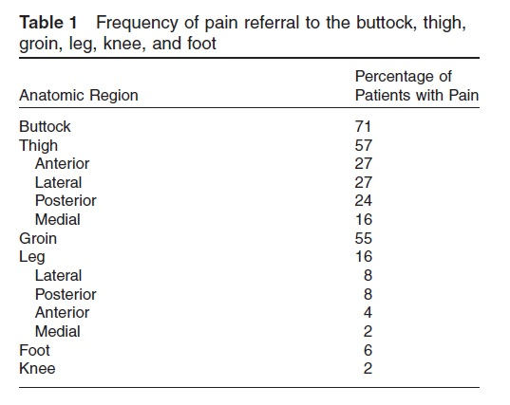
Intra-articular Hip Pain
Presentation
51 consecutive patients
  Evidence of hip pathology on plain Xray or MRI
  At least 90% pain reduction 30 min Dx hip injection
Pre procedure pain drawing completed
Pain Med. 2008 Jan-Feb;9(1):22-5. Hip joint pain referral patterns: a descriptive study. Lesher JM, Dreyfuss P, Hager N, Kaplan M, Furman M.

Slide 8
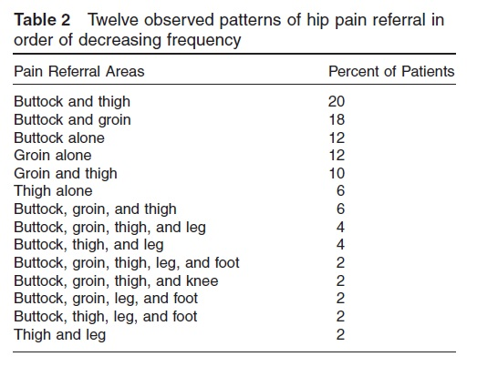
Intra-articular Hip Pain
Presentation
51 consecutive patients
  Evidence of hip pathology on plain Xray or MRI
  At least 90% pain reduction 30 min Dx hip injection
Pre procedure pain drawing completed
Pain Med. 2008 Jan-Feb;9(1):22-5. Hip joint pain referral patterns: a descriptive study. Lesher JM, Dreyfuss P, Hager N, Kaplan M, Furman M.

Slide 9
Intra-articular Hip Pain
Presentation
51 consecutive patients
  Evidence of hip pathology on plain Xray or MRI
  At least 90% pain reduction 30 min Dx hip injection
Pre procedure pain drawing completed
Pain Med. 2008 Jan-Feb;9(1):22-5. Hip joint pain referral patterns: a descriptive study. Lesher JM, Dreyfuss P, Hager N, Kaplan M, Furman M.

Slide 10
Intra-articular Hip Pain
Presentation – Posterior Pelvic Pain
130 patients
  Inclusion
    Clinical Dx of EIAHD (early intra-articular hip disorder) without severe structural deformity
      Xrays, MRI, diagnostic hip injection
    Did not respond to conservative care and underwent surgical intervention
      education and counseling, activity modification, medications, physical therapy +/- steroid injection
PM R. 2009 Sep;1(9):809-15. Early intra-articular hip disease presenting with posterior pelvic and groin pain. Prather H, Hunt D, Fournie A, Clohisy JC.

Slide 11
Intra-articular Hip Pain
Presentation – Posterior Pelvic Pain
130 patients
  Inclusion
    Clinical Dx of EIAHD (early intra-articular hip disorder) without severe structural deformity
      Xrays, MRI, diagnostic hip injection
    Did not respond to conservative care and underwent surgical intervention
      education and counseling, activity modification, medications, physical therapy +/- steroid injection
  26 of 130 had posterior pelvic pain
    All 26 had associated pain in either groin, lateral thigh or anterior thigh
    None had isolated ppp
PM R. 2009 Sep;1(9):809-15. Early intra-articular hip disease presenting with posterior pelvic and groin pain. Prather H, Hunt D, Fournie A, Clohisy JC.

Slide 12
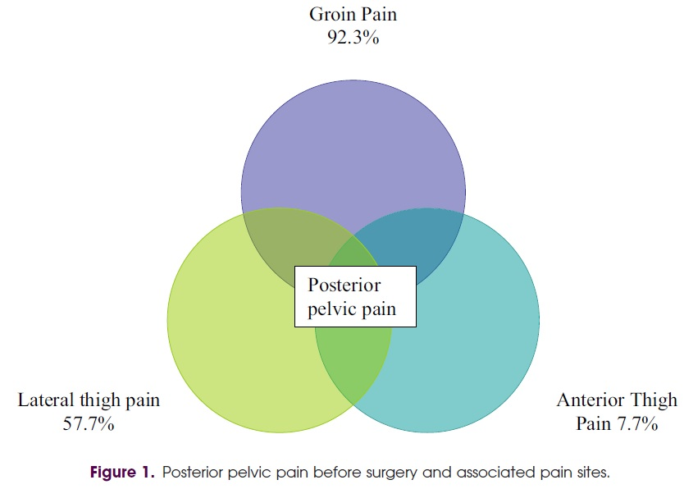
Intra-articular Hip Pain
Presentation – Posterior Pelvic Pain
130 patients
  Inclusion
    Clinical Dx of EIAHD (early intra-articular hip disorder) without severe structural deformity
      Xrays, MRI, diagnostic hip injection
    Did not respond to conservative care and underwent surgical intervention
      education and counseling, activity modification, medications, physical therapy +/- steroid injection
  26 of 130 had posterior pelvic pain
    All 26 had associated pain in either groin, lateral thigh or anterior thigh
    None had isolated ppp
PM R. 2009 Sep;1(9):809-15. Early intra-articular hip disease presenting with posterior pelvic and groin pain. Prather H, Hunt D, Fournie A, Clohisy JC.

Slide 13

Femoral Acetabular Impingement
Definition:
  A condition that is characterized by abnormal contact between the proximal femur and the rim of the acetabulum
  Excessive femoral head coverage, aspherical femoral head, and/or insufficient offset of the femoral head–neck junction and resultant repetitive abutment of the acetabular labral–femoral articulation
PM R. 2012 Jul;4(7):479-87. 2012 May 16. Clinical outcomes analysis of conservative and surgical treatment of patients with clinical indications of prearthritic, intra-articular hip disorders. Hunt D, Prather H, Harris Hayes M, Clohisy JC.

Slide 14

Femoral Acetabular Impingement proposed causes
Association with Legg-Perthes, SCFE, Coxa Vara
Most are not associated with these diagnoses
Theory
  Physeal stresses placed on the femoral head and/or acetabulum during development
  Rigorous sports during childhood and adolescence
    Gymnastics and dancing
    Rotational athletes – cause or effect
Labral ossification in adult acquired form of pincer type FAI (subset)
  Autoimmune process has been postulated

Slide 15
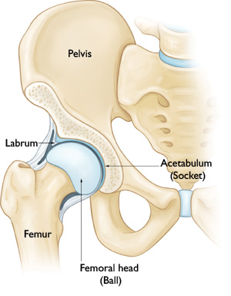
Hip Anatomy normal hip

Slide 16
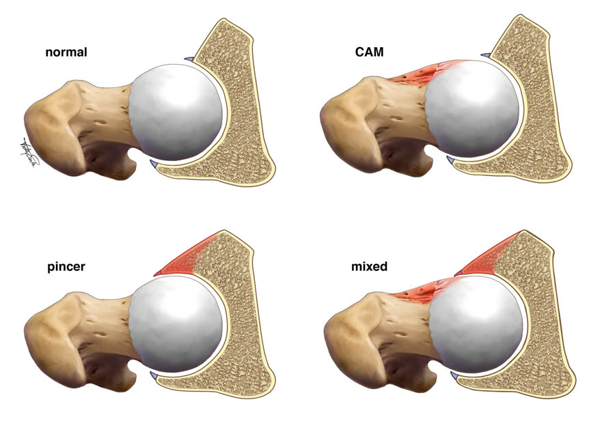
Hip Anatomy normal vs. FAI

Slide 17
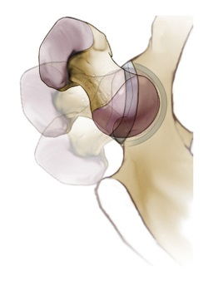
Hip Anatomy normal hip motion

Slide 18
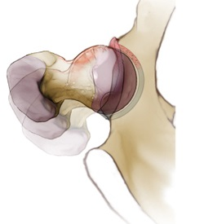
Hip Anatomy
CAM hip motion

Slide 19
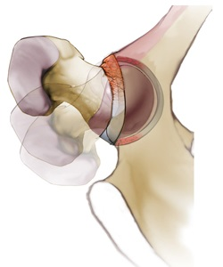
Hip Anatomy pincer hip motion

Slide 20
Hip Anatomy
Cam impingement
Aspherocity of the femoral head
Decreased head-neck off set
Cam “bump” can exist anterior, lateral or anterolateral

Slide 21
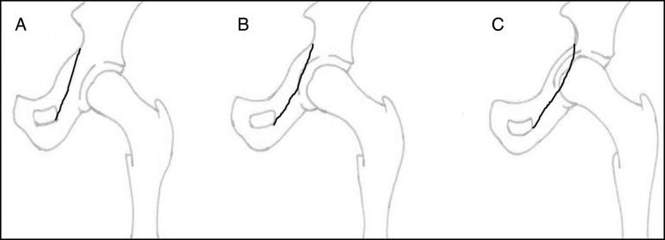
Hip Anatomy pincer impingement
Deep socket
  opposite of dysplasia
  Coxa Profunda
  Acetabular Protusio
  Relation of the acetabulum to the Ilioischial line
  Lateral center of edge angle
Acetabular retroversion
  Axis of the acetabular is facing more posterior
  Cross over sign
  Ischial spine sign

Slide 22
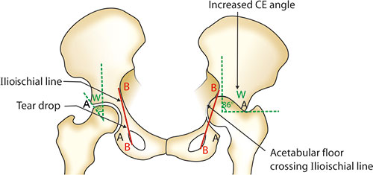
Hip Anatomy pincer impingement
Deep socket
  opposite of dysplasia
  Coxa Profunda
  Acetabular Protusio
  Relation of the acetabulum to the Ilioischial line
  Lateral center of edge angle
Acetabular retroversion
  Axis of the acetabular is facing more posterior
  Cross over sign
  Ischial spine sign

Slide 23
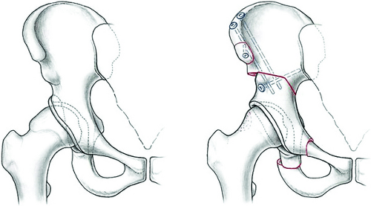
Hip Anatomy pincer impingement
Deep socket
  opposite of dysplasia
  Coxa Profunda
  Acetabular Protusio
  Relation of the acetabulum to the Ilioischial line
  Lateral center of edge angle
Acetabular retroversion
  Axis of the acetabular is facing more posterior
  Cross over sign
  Ischial spine sign

Slide 24
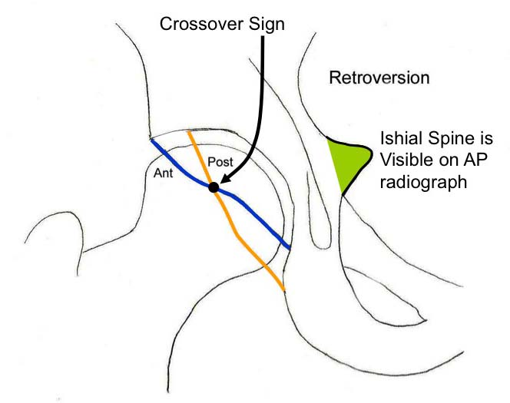
Hip Anatomy pincer impingement
Deep socket
  opposite of dysplasia
  Coxa Profunda
  Acetabular Protusio
  Relation of the acetabulum to the Ilioischial line
  Lateral center of edge angle
Acetabular retroversion
  Axis of the acetabular is facing more posterior
  Cross over sign
  Ischial spine sign

Slide 25
Femoral Acetabular Impingement
Epidemiology
Multicenter, prospective, longitudinal cohort
  8 institutions – 12 surgeons
  1076 pts undergoing surgery
  47.6% CAM FAI
  44.5% combined cam/pincer FAI
  7.9% pincer FAI
  >90% of the hips were noted to have labral and articular cartilage abnormalities at surgery
Am J Sports Med. 2013 Jun;41(6):1348-56. doi: 10.1177/0363546513488861. Epub 2013 May 13. Descriptive epidemiology of femoroacetabular impingement: a North American cohort of patients undergoing surgery. Clohisy JC, Baca G, Beaulé PE, Kim YJ, Larson CM, Millis MB, Podeszwa DA, Schoenecker PL, Sierra RJ, Sink EL, Sucato DJ, Trousdale RT, Zaltz I

Slide 26

Synovium
Labrum
Cartilage
>90% of the hips were noted to have labral and articular cartilage abnormalities at surgery

Slide 27

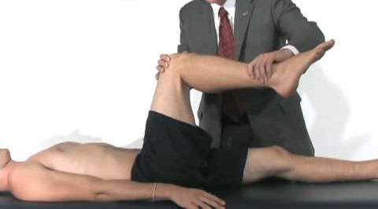
Assess Hip Range of Motion
Test in supine
Hip Flexion (HF)
  Normal >95-100°
Internal Rotation at 90°of hip flexion (IRf)
  Normal >10-15°
External Rotation at 90°of hip flexion (ERf)
  Normal > 25-30°

Slide 28

Hip-Spine Syndrome
History
First described by Offierski and MacNab in 1983
  Secondary hip-spine syndrome
    “cases in which spine symptoms are aggravated by deformity of the hip”
  “Symptoms from both sites gives a confusing clinical picture and may require ancillary investigations to diagnose the major source of disability.”
  “Failure to recognize concurrent disease at both the hip and spine may lead to misdiagnosis and possibly erroneous treatment.”
  Spine (Phila Pa 1976). 1983 Apr;8(3):316-21. Hip-spine syndrome. Offierski CM, MacNab I.

Slide 29
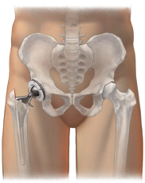
Evidence
Hip-spine syndrome: the effect of total hip replacement surgery on low back pain in severe osteoarthritis of the hip
          Cohort study
          25 consecutive patients with severe hip OA and low back pain
            Underwent THA
          Statistically significant decrease in ODI and LBP following THA
Spine. 2007 Sep 1;32(19):2099-102. Hip-spine syndrome: the effect of total hip replacement surgery on low back pain in severe osteoarthritis of the hip. Ben-Galim P, Ben-Galim T, Rand N, Haim A, Hipp J, Dekel S, Floman Y.

Slide 30
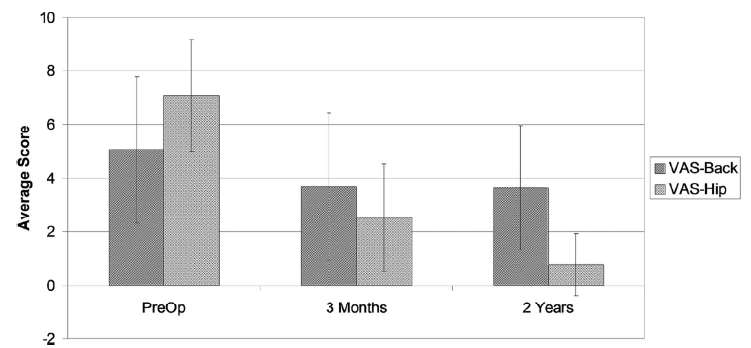
Evidence
Hip-spine syndrome: the effect of total hip replacement surgery on low back pain in severe osteoarthritis of the hip
          Cohort study
          25 consecutive patients with severe hip OA and low back pain
            Underwent THA
          Statistically significant decrease in ODI and LBP following THA
Spine. 2007 Sep 1;32(19):2099-102. Hip-spine syndrome: the effect of total hip replacement surgery on low back pain in severe osteoarthritis of the hip. Ben-Galim P, Ben-Galim T, Rand N, Haim A, Hipp J, Dekel S, Floman Y.

Slide 31
Evidence
Hip-spine syndrome: A cadaveric analysis between osteoarthritis of the lumbar spine and hip joints
625 cadaveric specimens analyzed
  Randomly selected from 3000 available
Arthritis of the hip, spine and knee were graded
Hip arthritis was a stronger predictor of spine arthritis than was knee arthritis (standardized betas 0.215 and 0.155, respectively, P < 0.001 for both).
Spine arthritis was also a stronger predictor of hip arthritis than was knee arthritis (standardized betas 0.232 and 0.173, P < 0.001 for both).
Weinberg DS, Gebhart JJ, Liu RW. Hip-spine syndrome: A cadaveric analysis between osteoarthritis of the lumbar spine and hip joints. Orthopaedics & Traumatology: Surgery & Research. 2017 Sep 1;103(5):651-6.

Slide 32
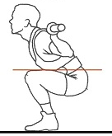
Evidence
Hip flexion ROM is inversely proportional to lumbar spine flexion during squat
Many similar studies
Hip motion is integrally related biomechanically to lumbar motion
Esola MA, McClure PW, Fitzgerald GK, Siegler S. Analysis of lumbar spine and hip motion during forward bending in subjects with and without a history of low back pain. Spine 1996;21:71–78.
Mok NW, Brauer SG, Hodges PW. Failure to use movement in postural strategies leads to increased spinal displacement in low back pain. Spine 2007;32:E537–E543
Porter JL, Wilkinson A. Lumbar-hip flexion motion. A comparative study between asymptomatic and chronic low back pain in 18- to 36-year-old men. Spine 1997;22:1508–1513.
Shum GL, Crosbie J, Lee RY. Effect of low back pain on the kinematics and joint coordination of the lumbar spine and hip during sit-to-stand and stand-to-sit. Spine 2005a;30:1998–2004.
Shum GL, Crosbie J, Lee RY. Symptomatic and asymptomatic movement coordination of the lumbar spine and hip during an everyday activity. Spine 2005b;30:E697–E702.

Slide 33
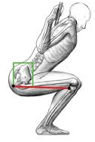
Evidence
A compensation of angular displacements of the hip joints and lumbosacral spine between subjects with and without idiopathic low back pain during squatting
30 Subjects
  15 chronic low back pain
  15 control subjects
Squatting maneuver
  5 repetitions
  2kg weight
Hip and lumbar angular displacement
J Electromyogr Kinesiol. 2013 Jun;23(3):741-5. A compensation of angular displacements of the hip joints and lumbosacral spine between subjects with and without idiopathic low back pain during squatting. Sung PS.

Slide 34
Evidence
A compensation of angular displacements of the hip joints and lumbosacral spine between subjects with and without idiopathic low back pain during squatting
LBP group demonstrated
  increased ROM in flexion of the dominant (p=0.03) and non-dominant (p=0.03) hips
  Decreased lumbar spine flexion ROM (p=0.03)
“compensation strategy to increase hip flexion with a stiffened lumbar spine”
J Electromyogr Kinesiol. 2013 Jun;23(3):741-5. A compensation of angular displacements of the hip joints and lumbosacral spine between subjects with and without idiopathic low back pain during squatting. Sung PS.

Slide 35
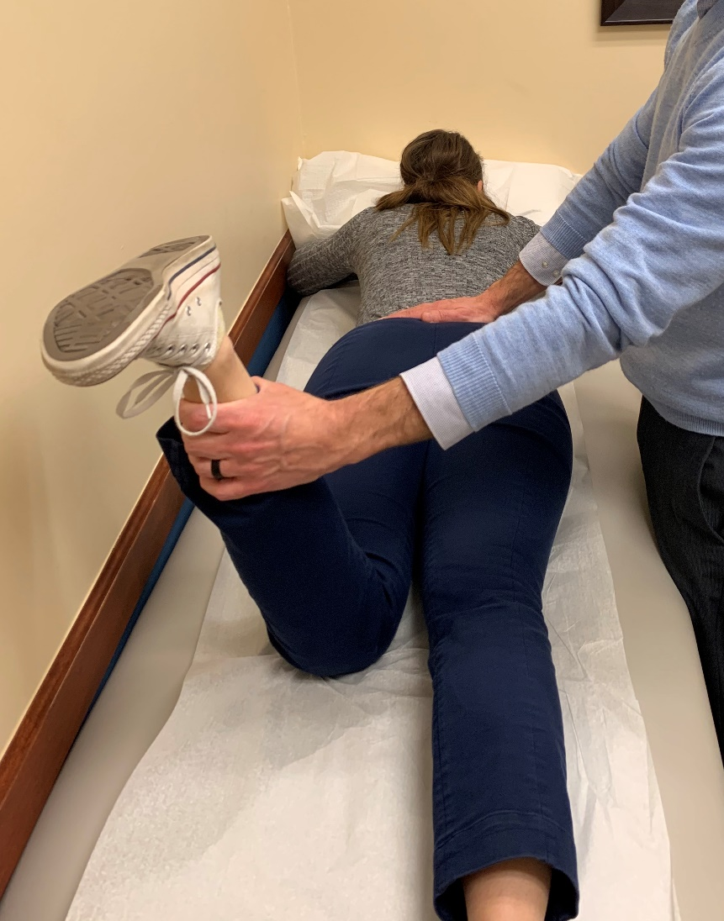
Assess Lumbopelvic Motion
Test in prone:
Hip neutral
Knee flexed to 90°
Examiner has one hand at the lumbosacral junction and one hand grasping ipsilateral ankle
Internally and externally rotate the hip and assess motion at the lumbopelvic junction

Slide 36
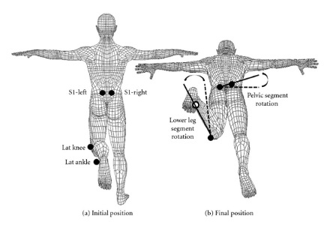
Lumbopelvic Motion
If the lumbopelvic region moves during the early ranges of a limb movement, then the frequency of lumbopelvic motion will be increased across the day
Leads to increased tissue stress in the lumbar spine → cumulative microtrauma and tissue failure
Adams, MA.; Bogduk, N.; Burton, K.; Dolan, P. The Biomechanics of Back Pain. Churchill Livingstone; Edinburgh, England: 2002.

Slide 37
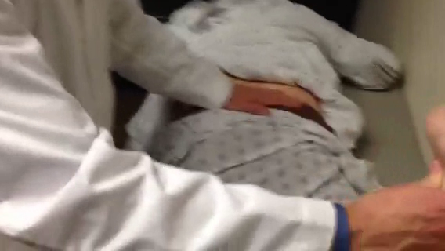
Early Lumbopelvic Motion

Slide 38
Lumbopelvic Motion
Scholtes et. al.
91 subjects
  40 without LBP
  50 with LBP
LBP group demonstrated significantly
  Greater maximal lumbopelvic motion
  Earlier lumbopelvic rotation
Clin Biomech. 2009 Jan;24(1):7-12. doi: 10.1016/j.clinbiomech.2008.09.008. Epub 2008 Nov 5.Differences in lumbopelvic motion between people with and people without low back pain during two lower limb movement tests. Scholtes SA, Gombatto SP, Van Dillen LR.

Slide 39
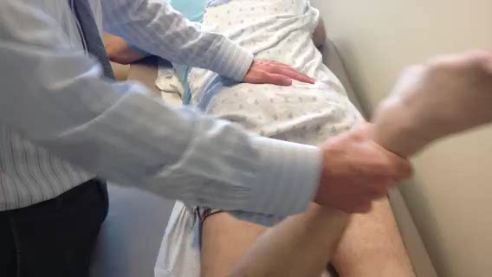
Early Lumbopelvic Motion

Slide 40
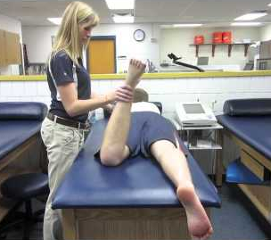
Lumbopelvic Motion
When patients are taught to modify early and increased lumbopelvic motion LBP symptoms decrease
Van Dillen LR, Sahrmann SA, Norton BJ, Caldwell CA, McDonnell MK, Bloom NJ. Movement system impairment-based categories for low back pain: Stage 1 validation. J Orthop Sports Phys Ther 2003b; 33:126–142
Van Dillen LR, Maluf KS, Sahrmann SA. Further examination of modifying patient-preferred movement and alignment strategies in patients with low back pain during symptomatic tests. Man Ther 2007b; 88:351–361.
Clin Biomech (Bristol, Avon). 2009 Jan;24(1):7-12. doi: 10.1016/j.clinbiomech.2008.09.008. Epub 2008 Nov 5.Differences in lumbopelvic motion between people with and people without low back pain during two lower limb movement tests. Scholtes SA, Gombatto SP, Van Dillen LR.

Slide 41
Lumbopelvic Motion
Early lumbopelvic motion
  With normal HIP ROM
    Movement system impairment syndrome
  With limited Hip ROM
    Early LPM is secondary to the hip abnormality
  Mixed

Slide 42
A deeper connection?
Referral Patterns from inta-articular hip pain

Slide 43
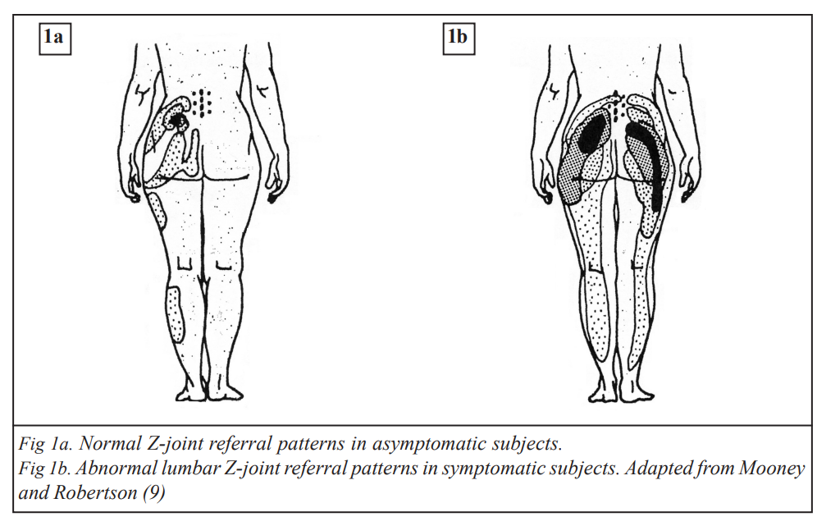
A deeper connection?
Referral Patterns from lumbar facet pain
Windsor RE, King FJ, Roman SJ, Tata NS, Cone-Sullivan LA, Thampi S, Acebey M, Gilhool JJ, Rao R, Sugar R. Electrical stimulation induced lumbar medial branch referral patterns. Pain Physician. 2002 Oct 1;5(4):347-53.
Mooney V, Robertson J. The facet syndrome. Clinical orthopaedics and related research. 1976 Mar 1(115):149-56.

Slide 44
A deeper connection?
Pain referral patterns from responders to dual intraarticular SIJ injections
van der Wurff P, Buijs EJ, Groen GJ. Intensity mapping of pain referral areas in sacroiliac joint pain patients. Journal of manipulative and physiological therapeutics. 2006 Mar 1;29(3):190-5.

Slide 45
A deeper connection?
Pain referral patterns from noxious stimulation of interspinous ligament
Kellgren JH. On the distribution of pain arising from deep somatic structures with charts of segmental pain areas. Clin Sci 1939;4:35–46.

Slide 46
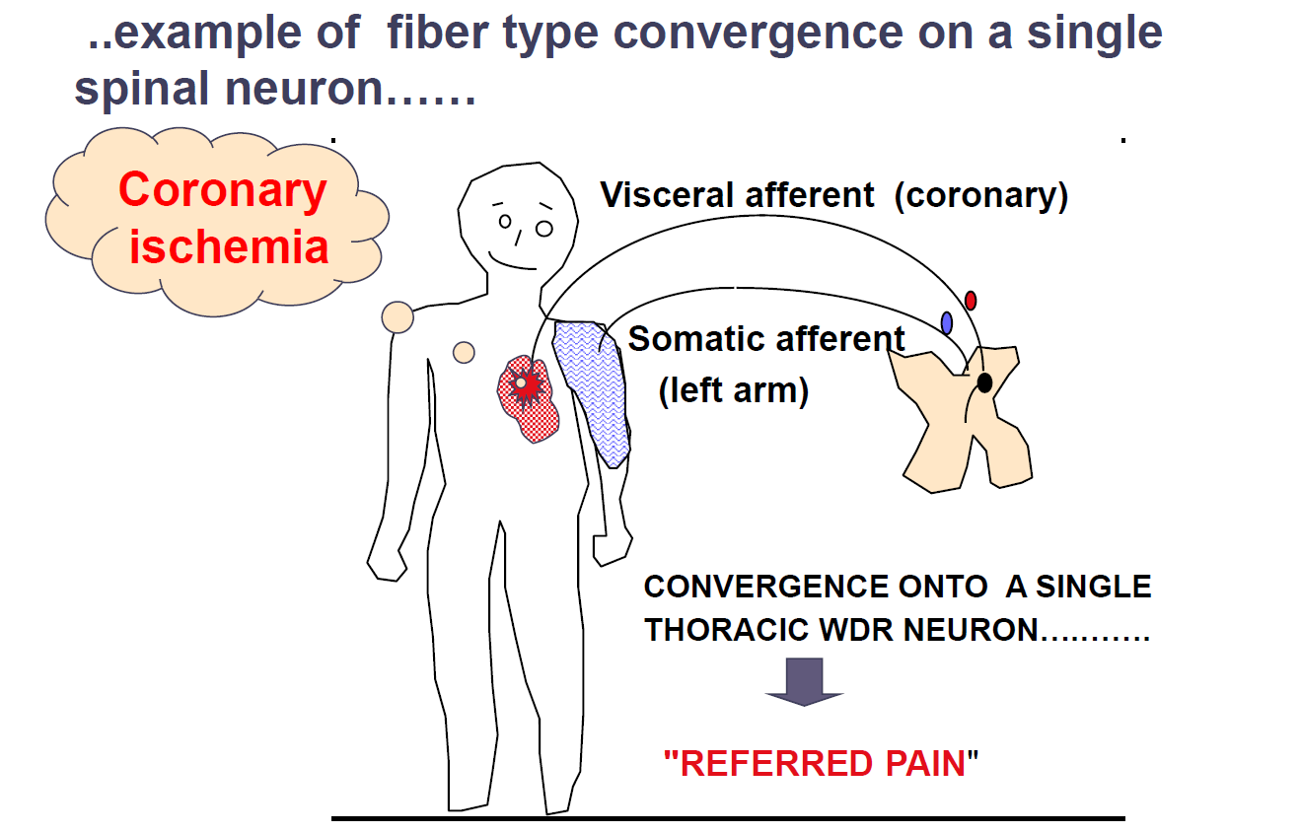
A deeper connection?
Why? Like any pain referral phenomenon, input into the dorsal columns of the spinal cord via primary afferent neurons converge onto second order neurons at this segment.
Credit: Tony Yaksh PhD, University of Wisconsin Comprehensive Review of Pain Medicine

Slide 47
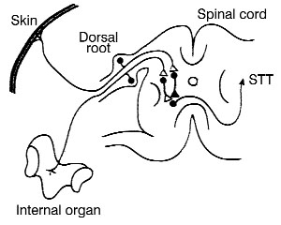
A deeper connection?
Why? Like any pain referral phenomenon, input into the dorsal columns of the spinal cord via primary afferent neurons converge onto second order neurons at this segment.
Credit: practicalpainmanagement.com

Slide 48

A deeper connection?
A severe amount of sensory input can release a large number of excitatory neurotrasmitters to the dorsal column which can theoretically overflow to adjacent segments
Latent interneuron activation generate excitatory neurotransmitters
Glial cell activation
Credit: practicalpainmanagement.com

Slide 49
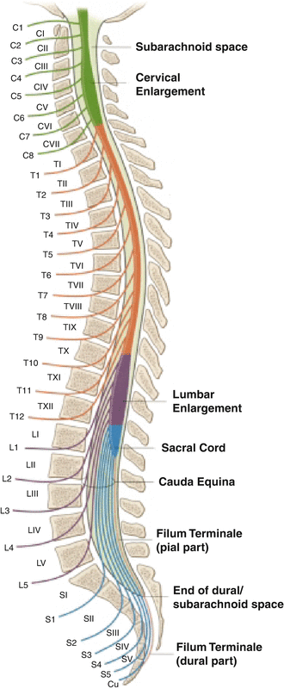
A deeper connection?
A severe amount of sensory input can release a large number of excitatory neurotrasmitters to the dorsal column which can theoretically overflow to adjacent segments
Latent interneuron activation generate excitatory neurotransmitters
Glial cell activation
Credit: practicalpainmanagement.com

Slide 50
A deeper connection?
A severe amount of sensory input can release a large number of excitatory neurotrasmitters to the dorsal column which can theoretically overflow to adjacent segments
Latent interneuron activation generate excitatory neurotransmitters
Glial cell activation
Credit: practicalpainmanagement.com

Slide 51
A deeper connection?
A severe amount of sensory input can release a large number of excitatory neurotrasmitters to the dorsal column which can theoretically overflow to adjacent segments
Latent interneuron activation generate excitatory neurotransmitters
Glial cell activation
Windsor RE, King FJ, Roman SJ, Tata NS, Cone-Sullivan LA, Thampi S, Acebey M, Gilhool JJ, Rao R, Sugar R. Electrical stimulation induced lumbar medial branch referral patterns. Pain Physician. 2002 Oct 1;5(4):347-53.
Mooney V, Robertson J. The facet syndrome. Clinical orthopaedics and related research. 1976 Mar 1(115):149-56.

Slide 52
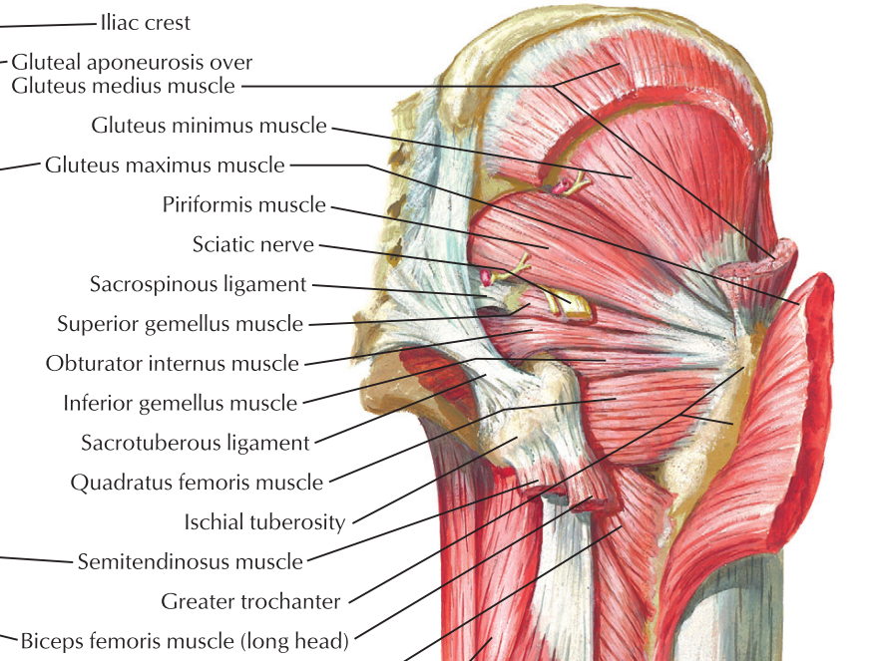
A deeper connection?
How does this affect core and lower extremity muscle control and pelvic stability?
Credit: Netter’s Anatomy

Slide 53
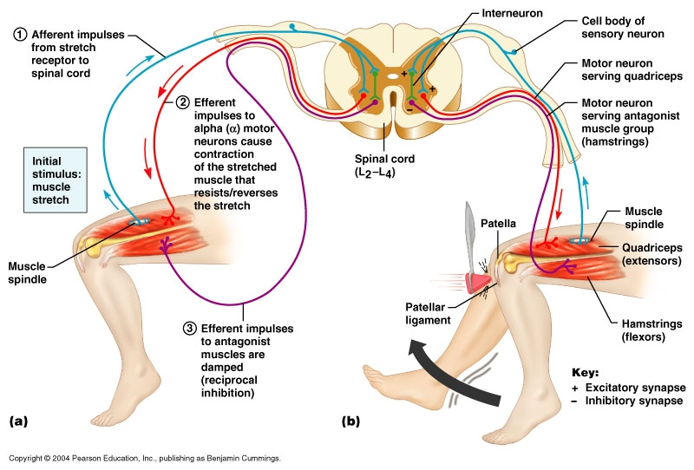
A deeper connection?
How does this affect core and lower extremity muscle control and pelvic stability?
This is part of the loop that these muscle groups rely upon for proper function –proprioception
Credit: Pearson Education Inc, Benjamin Cummings

Slide 54
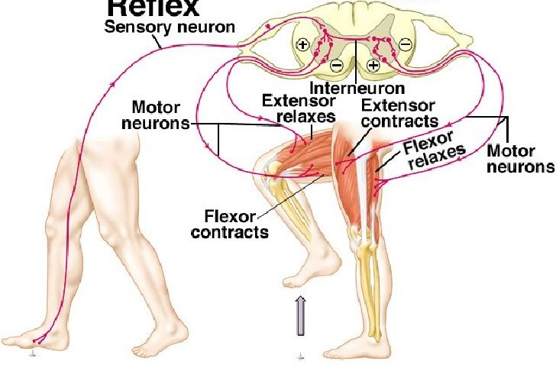
A deeper connection?
How does this affect core and lower extremity muscle control and pelvic stability?
This is part of the loop that these muscle groups rely upon for proper function –proprioception
There is a lot of fine tune work involved in pelvic stability

Slide 55
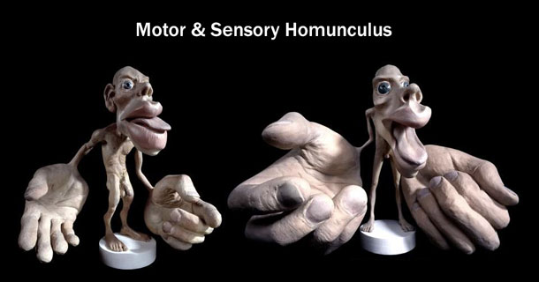
A deeper connection?
Poor Cortical Representation

Slide 56
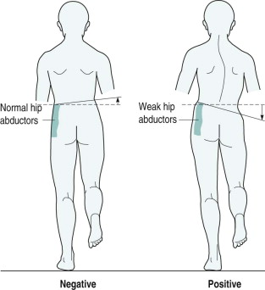
Assess Pelvic Stability
Stand behind patient:
“stand on one leg”
Assess PSIS and iliac crest motion/level
  esp during the first moments of single leg stance
Visual and tactile if necessary
Uncompensated Trendelenburg – hip drop
Compensated Trendelenburg – excessive hip hike
Rate: good, fair or poor

Slide 57
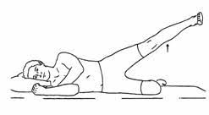
Assess Pelvic Stability
Patient in side-lying:
Roll 10-15° toward prone to eliminate TFL
  Block them from rolling back
Assist them into position and see how they maintain
Unable to maintain position = grade 3 or less
If Grade 4
  Full hand at ankle
  2 fingers at ankle
  2 fingers at knee
Unable to overpower with full hand at ankle =5/5

Slide 58
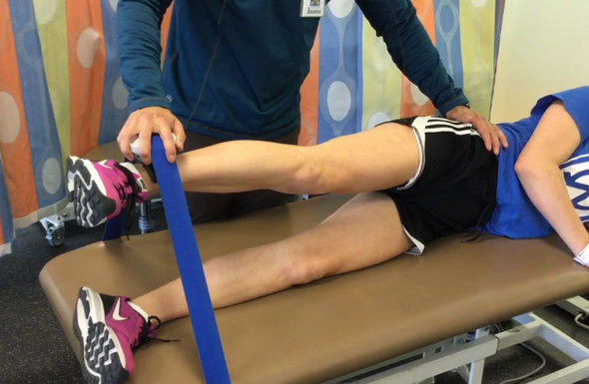
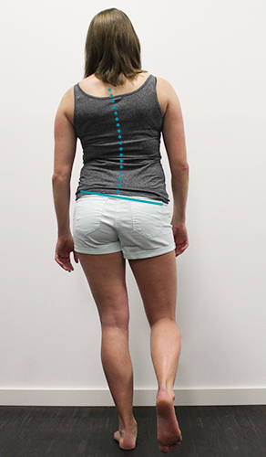
Assess Pelvic Stability
Compensated or uncompensated Trendelenburg sign with weak hip abduction in side-lying =
  Weak gluteus medius.
  Deconditioning, Radiculopathy, Tendon Tear, plexopathy, peripheral nerve injury

Slide 59
Assess Pelvic Stability
Compensated or uncompensated Trendelenburg sign with weak hip abduction in side-lying =
  Weak gluteus medius.
  Deconditioning, Radiculopathy, Tendon Tear, plexopathy, peripheral nerve injury
Compensated or uncompensated Trendelenburg sign with strong hip abduction in side-lying =
  Movement System Impairment Syndrome - impaired recruitment
  Pain inhibition – intraarticular hip pain

Slide 60


Hip-Spine Syndrome
Decreased hip ROM leads to increased lumbar flexion forces, early lumbopelvic motion and altered biomechanical forces on the spine.
  Increased tissue stress, cumulative microtrauma and tissue failure

Slide 61
Hip-Spine Syndrome
Decreased hip ROM leads to increased lumbar flexion forces, early lumbopelvic motion and altered biomechanical forces on the spine.
  Increased tissue stress, cumulative microtrauma and tissue failure
Low back pain leads to compensatory increase in hip flexion/range of motion and increased stress forces on the hip

Slide 62
Hip-Spine Syndrome
Decreased hip ROM leads to increased lumbar flexion forces, early lumbopelvic motion and altered biomechanical forces on the spine.
  Increased tissue stress, cumulative microtrauma and tissue failure
Low back pain leads to compensatory increase in hip flexion/range of motion and increased stress forces on the hip
Chronic pain from either lumbar spine or hip sources interferes with pelvic and core muscle control and stability → Movement system impairment syndromes
  Pelvic instability
  Early/increased lumbopelvic motion

Slide 63
Hip-Spine Syndrome
SIJ dysfunction is thought to increase acetabular retroversion
  SIJ dysfunction → innominate rotation → retroversion → Pincer impingement
Cibulka MT. Sacroiliac joint dysfunction as a reason for the development of acetabular retroversion: a new theory. Physiotherapy theory and practice. 2014 May 1;30(4):249-53.
Krishnamoorthy VP, Beck EC, Kunze KN, Cancienne JM, Krivicich LM, Suppauksorn S, Ayeni OR, Nho SJ. Radiographic Prevalence of Sacroiliac Joint Abnormalities and Clinical Outcomes in Patients With Femoroacetabular Impingement Syndrome. Arthroscopy: The Journal of Arthroscopic & Related Surgery. 2019 Sep 1;35(9):2598-605.
Corten K, Ganz R, Chosa E, Leunig M. Bone apposition of the acetabular rim in deep hips: a distinct finding of global pincer impingement. JBJS. 2011 May 4;93(Supplement_2):10-6.
Cibulka MT, Delitto A, Koldehoff RM. Changes in innominate tilt after manipulation of the sacroiliac joint in patients with low back pain: an experimental study. Physical Therapy. 1988 Sep 1;68(9):1359-63.
Köhnlein W, Ganz R, Impellizzeri FM, Leunig M. Acetabular morphology: implications for joint-preserving surgery. Clinical orthopaedics and related research. 2009 Mar 1;467(3):682-91.

Slide 64
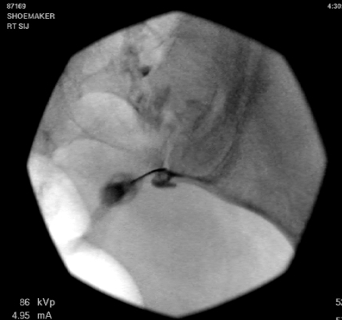
Hip-Spine Syndrome
FAI and Low Back Pain
33 patients with SIJ pain
  Confirmed by 2 sequential diagnostic SIJ blocks with >50% relief
  AP pelvis assessed:
42% (4/33) - OA Tönnis grade 2 or greater
21% (7/33) – retroversion
12% (4/33) -lateral centre edge angle >40° with 3% >45°
27% (9/33) - Tönnis angle was <0°
47% (17/33) Coxa profunda and 3% (1/33) acetabuli protrusion
33% (11/33) - cam impingement
Overall, 76% (25/33) had at least one abnormality hip x-ray
No control. These findings may also be prevalent in the asymptomatic population
Hip Int. 2013 Mar-Apr;23(2):212-7. Epub 2013 Feb 12. Symptomatic sacroiliac joint disease and radiographic evidence of femoroacetabular impingement. Morgan PM, Anderson AW, Swiontkowski MF.

Slide 65
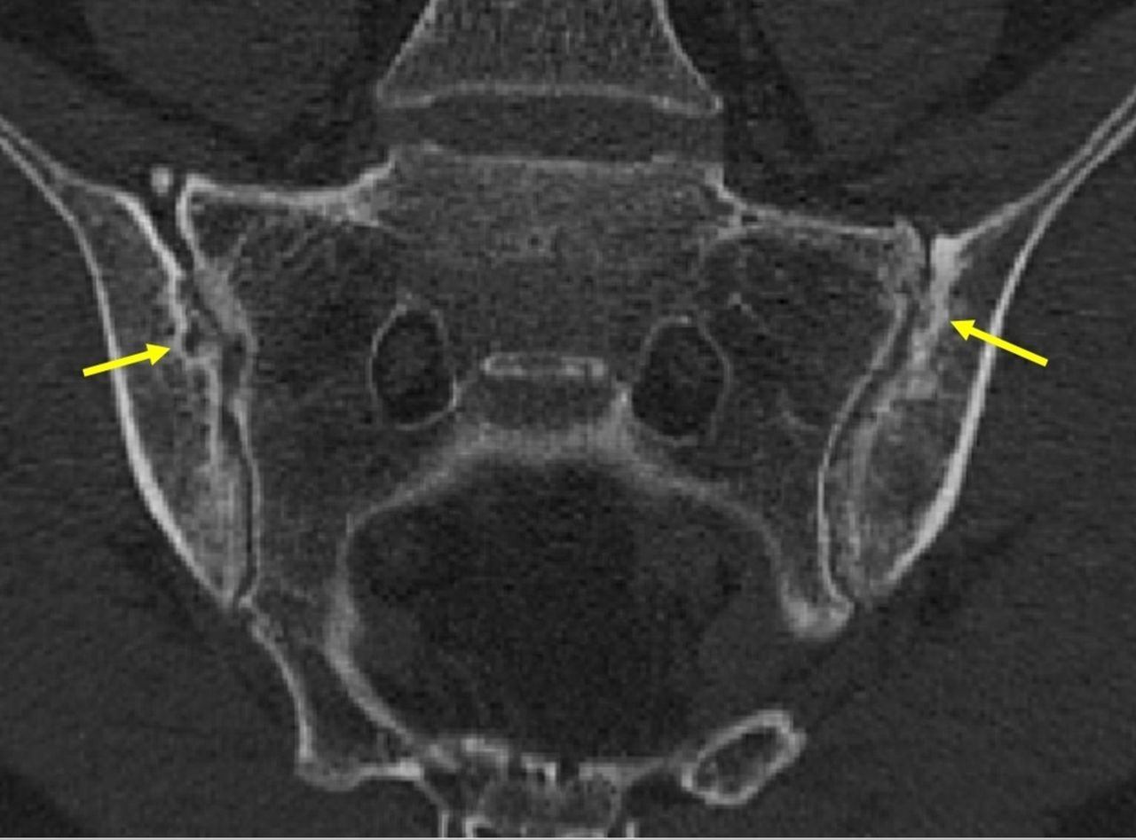
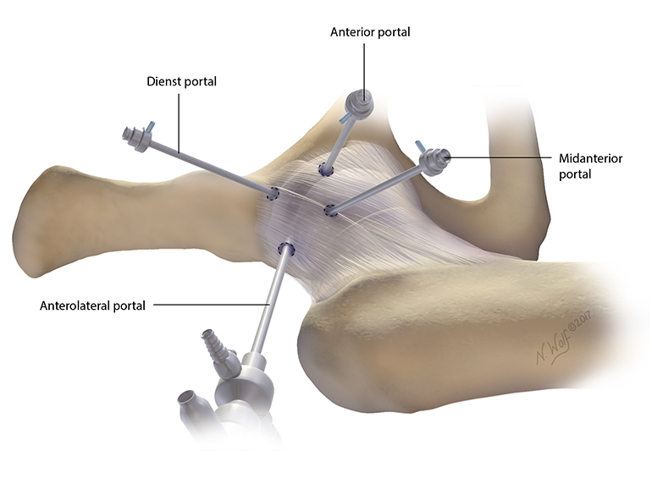
Hip-Spine Syndrome
FAI and Low Back Pain
743 patients undergoing hip arthroscopy for FAI
  Retrospective cohort - No control group
  Excluded patients undergoing bilateral FAI surgery??
  SIJs assessed by CT, MRI and X-ray
    Modified NY Criteria for Spondyloarthropathy
    Also joint space loss, adjacent marrow edema, bone bridging intra-articular or adjacent enhancement
  Functional outcomes measures:
    Hip outcome score-ADL, Hip outcome score-sports, modified Harris Hip score, VAS-pain and VAS-satisfaction
Krishnamoorthy VP, Beck EC, Kunze KN, Cancienne JM, Krivicich LM, Suppauksorn S, Ayeni OR, Nho SJ. Radiographic Prevalence of Sacroiliac Joint Abnormalities and Clinical Outcomes in Patients With Femoroacetabular Impingement Syndrome. Arthroscopy: The Journal of Arthroscopic & Related Surgery. 2019 Sep 1;35(9):2598-605.

Slide 66
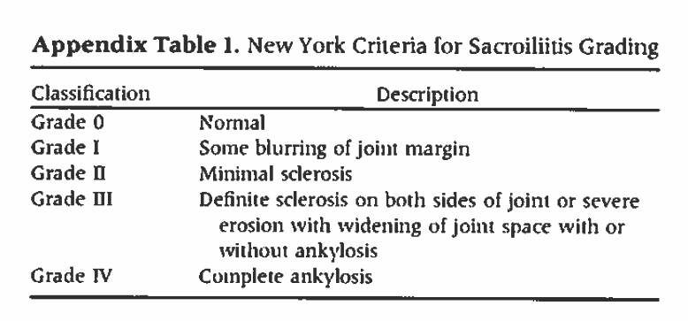
Hip-Spine Syndrome
FAI and Low Back Pain
743 patients undergoing hip arthroscopy for FAI
  Retrospective cohort - No control group
  Excluded patients undergoing bilateral FAI surgery??
  SIJs assessed by CT, MRI and X-ray
    Modified NY Criteria for Spondyloarthropathy
    Also joint space loss, adjacent marrow edema, bone bridging, intra-articular or adjacent enhancement
  Functional outcomes measures:
    Hip outcome score-ADL, Hip outcome score-sports, modified Harris Hip score, VAS-pain and VAS-satisfaction
Krishnamoorthy VP, Beck EC, Kunze KN, Cancienne JM, Krivicich LM, Suppauksorn S, Ayeni OR, Nho SJ. Radiographic Prevalence of Sacroiliac Joint Abnormalities and Clinical Outcomes in Patients With Femoroacetabular Impingement Syndrome. Arthroscopy: The Journal of Arthroscopic & Related Surgery. 2019 Sep 1;35(9):2598-605.

Slide 67
Hip-Spine Syndrome
FAI and Low Back Pain
743 patients undergoing hip arthroscopy for FAI
  187 (25.2%) had SIJ changes on one or more of the imaging studies
    Conclusion: “A high prevalence” but there was not control group.
      The prevalence of these findings in the asymptomatic population is high
  Compared to patients without SIJ changes this group had significantly worse outcome scores across all measures (except VAS-satisfaction)
    at 34.1 +/- 9.7 months
Krishnamoorthy VP, Beck EC, Kunze KN, Cancienne JM, Krivicich LM, Suppauksorn S, Ayeni OR, Nho SJ. Radiographic Prevalence of Sacroiliac Joint Abnormalities and Clinical Outcomes in Patients With Femoroacetabular Impingement Syndrome. Arthroscopy: The Journal of Arthroscopic & Related Surgery. 2019 Sep 1;35(9):2598-605.

Slide 68
Systematic Approach to Radiographic
Evaluation of the Young Adult Hip
“It is essential that physicians have common and reliable radiographic views as well as parameters for plain radiographic assessment that can serve as a foundation for accurate diagnosis, disease classification and surgical decision-making.”
  Recommendations from ANCHOR (Academic Network for Conservational Hip Outcomes Research) study group.
4 views
  AP pelvis, cross-table lateral, Dunn view (45 or 90 degree), frog-leg lateral
J Bone Joint Surg Am. 2008 Nov;90 Suppl 4:47-66. A systematic approach to the plain radiographic evaluation of the young adult hip. Clohisy JC, Carlisle JC, Beaulé PE, Kim YJ, Trousdale RT, Sierra RJ, Leunig M, Schoenecker PL, Millis MB.

Slide 69
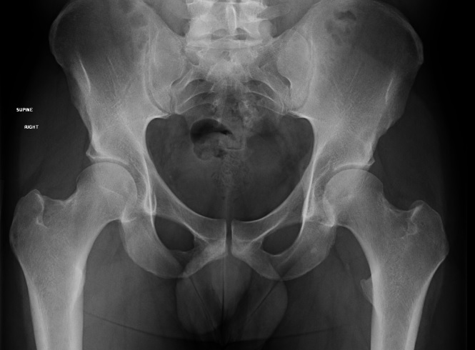
Hip Anatomy normal AP pelvis

Slide 70
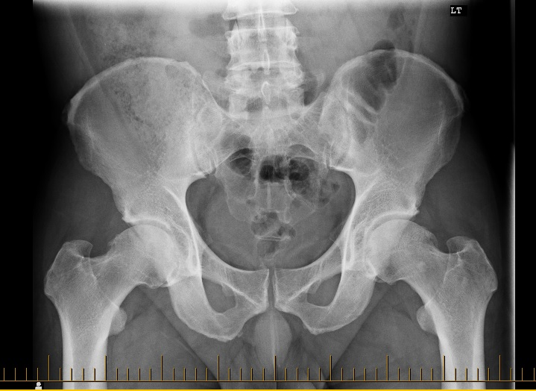
Hip Anatomy
CAM AP pelvis

Slide 71
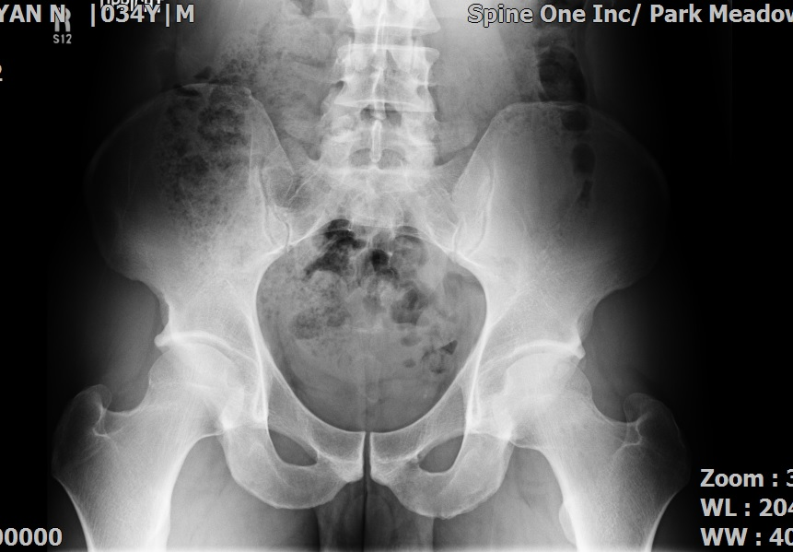
Hip Anatomy pincer AP pelvis

Slide 72
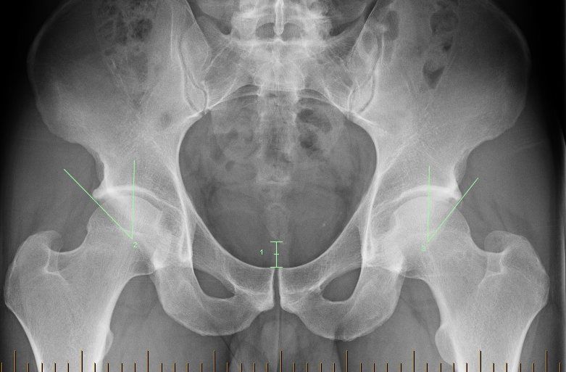
Hip Anatomy pincer AP pelvis

Slide 73
Hip Anatomy pincer AP pelvis
Lateral Center-edge angle
  <25 degrees- dysplasia
  >35 degrees – acetabular overcoverage

Slide 74
Systematic Approach to Radiographic
Evaluation of the Young Adult Hip
AP pelvis
  15 deg IR BLE
  Tube-to-film 120 cm
  Crosshairs midway between pubic symphysis and a line connecting the ASIS
.
J Bone Joint Surg Am. 2008 Nov;90 Suppl 4:47-66. A systematic approach to the plain radiographic evaluation of the young adult hip. Clohisy JC, Carlisle JC, Beaulé PE, Kim YJ, Trousdale RT, Sierra RJ, Leunig M, Schoenecker PL, Millis MB.

Slide 75
Systematic Approach to Radiographic
Evaluation of the Young Adult Hip
AP pelvis
  The coccyx should be directly in line with the pubic symphysis
  The iliac wings, obturator foramina, and radiographic teardrops should be symmetrical in appearance
  For appropriate pelvic inclination the distance between the superior border of the pubic symphysis and the tip of the coccyx should be approximately 1 to 3 cm
.
J Bone Joint Surg Am. 2008 Nov;90 Suppl 4:47-66. A systematic approach to the plain radiographic evaluation of the young adult hip. Clohisy JC, Carlisle JC, Beaulé PE, Kim YJ, Trousdale RT, Sierra RJ, Leunig M, Schoenecker PL, Millis MB.

Slide 76
Systematic Approach to Radiographic
Evaluation of the Young Adult Hip
Dunn
  Hips flexed to 45 deg and abducted to 20 deg
  Can be done bilaterally to get both hips in a single view
  Crosshairs midway between pubic symphysis and a line connecting the ASIS
.
J Bone Joint Surg Am. 2008 Nov;90 Suppl 4:47-66. A systematic approach to the plain radiographic evaluation of the young adult hip. Clohisy JC, Carlisle JC, Beaulé PE, Kim YJ, Trousdale RT, Sierra RJ, Leunig M, Schoenecker PL, Millis MB.

Slide 77
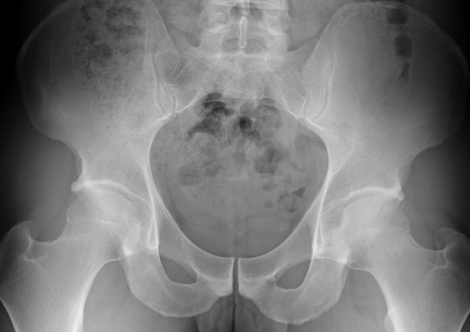
Hip Anatomy
AP pelvis

Slide 78
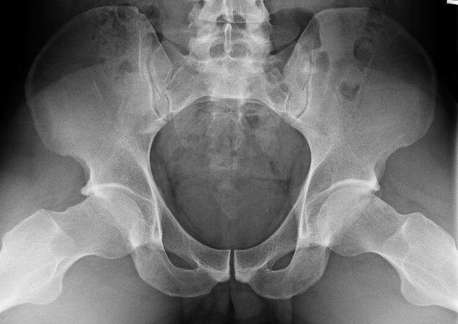
Hip Anatomy
Bilateral Dunn View

Slide 79
FAI imaging findings in the “asymptomatic” population
Systematic review of 26 studies which including imaging studies in “asymptomatic” volunteers
  Some studies were meta-analyses
  MRI, CT or Xray
  Definition of FAI findings very heterogenous
  CAM deformity: 37% (58% athletes and 23% general population)
  Pincer deformity: 67% (no population breakdown)
  Labral tear on noncontrast MRI 68% of hips (based on 7 studies)
Conclusion: “FAI morphologic features and labral injuries are common in asymptomatic patients.”
  Asymptomatic meant no hip pain.
  We don’t know how many individuals had low back pain.
Frank JM, Harris JD, Erickson BJ, Slikker III W, Bush-Joseph CA, Salata MJ, Nho SJ. Prevalence of femoroacetabular impingement imaging findings in asymptomatic volunteers: a systematic review. Arthroscopy: The Journal of Arthroscopic & Related Surgery. 2015 Jun 1;31(6):1199-204.

Slide 80
Hip-Spine Syndrome
FAI and Low Back Pain
Patients with FAI often present with low back pain.
  There may be a lesser component of intra-articular hip pain or none at all.
Hip ROM, lumbopelvic motion and pelvic stability should be assessed on all patients with LBP
  Education, activity modification and therapy directed at these underlying biomechanical factors are indicated

Slide 81

The Hip-Spine Connection

