Slide 1

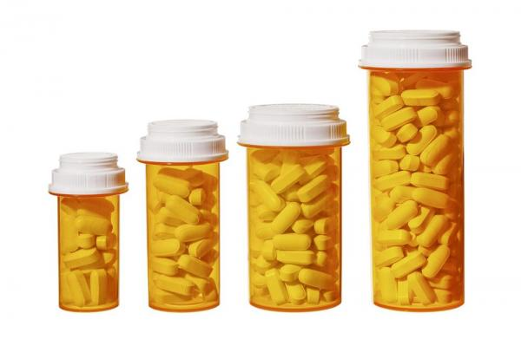


Patient-Centered Prescription Opioid Tapering: Colorado Leads the Way
Beth Darnall, PhD
Associate Professor
Stanford University School of Medicine
Anesthesiology, Perioperative and Pain Medicine
Psychiatry and Behavioral Sciences (by courtesy)
Wu Tsai Neurosciences Institute (affiliated faculty)
@BethDarnall

Slide 2




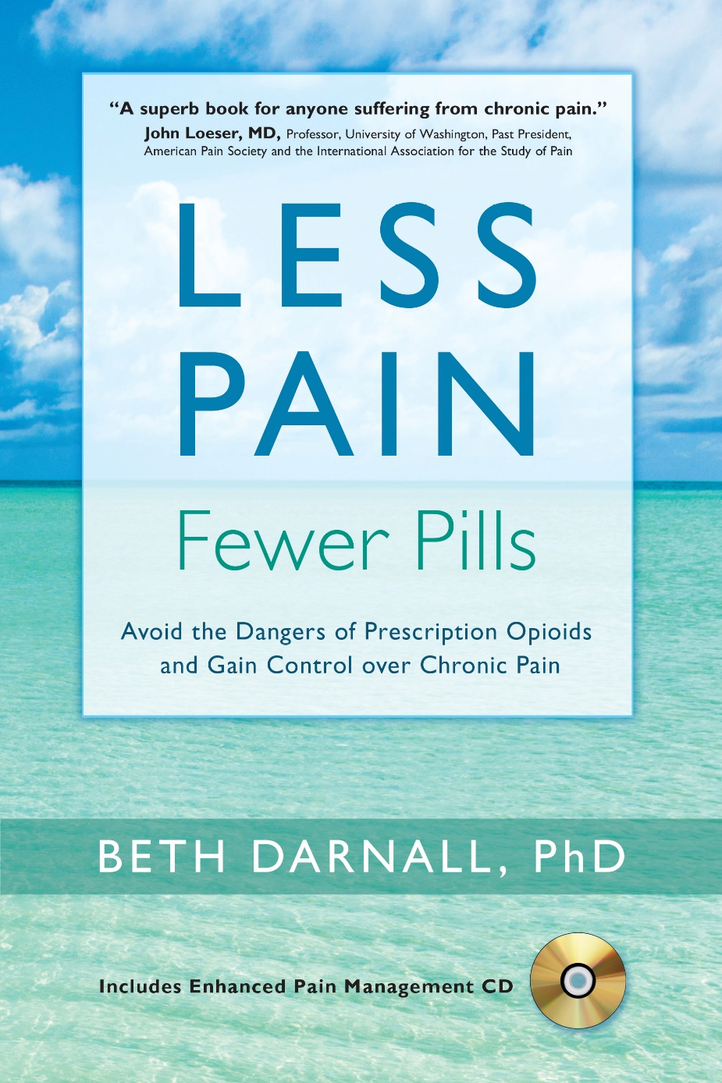
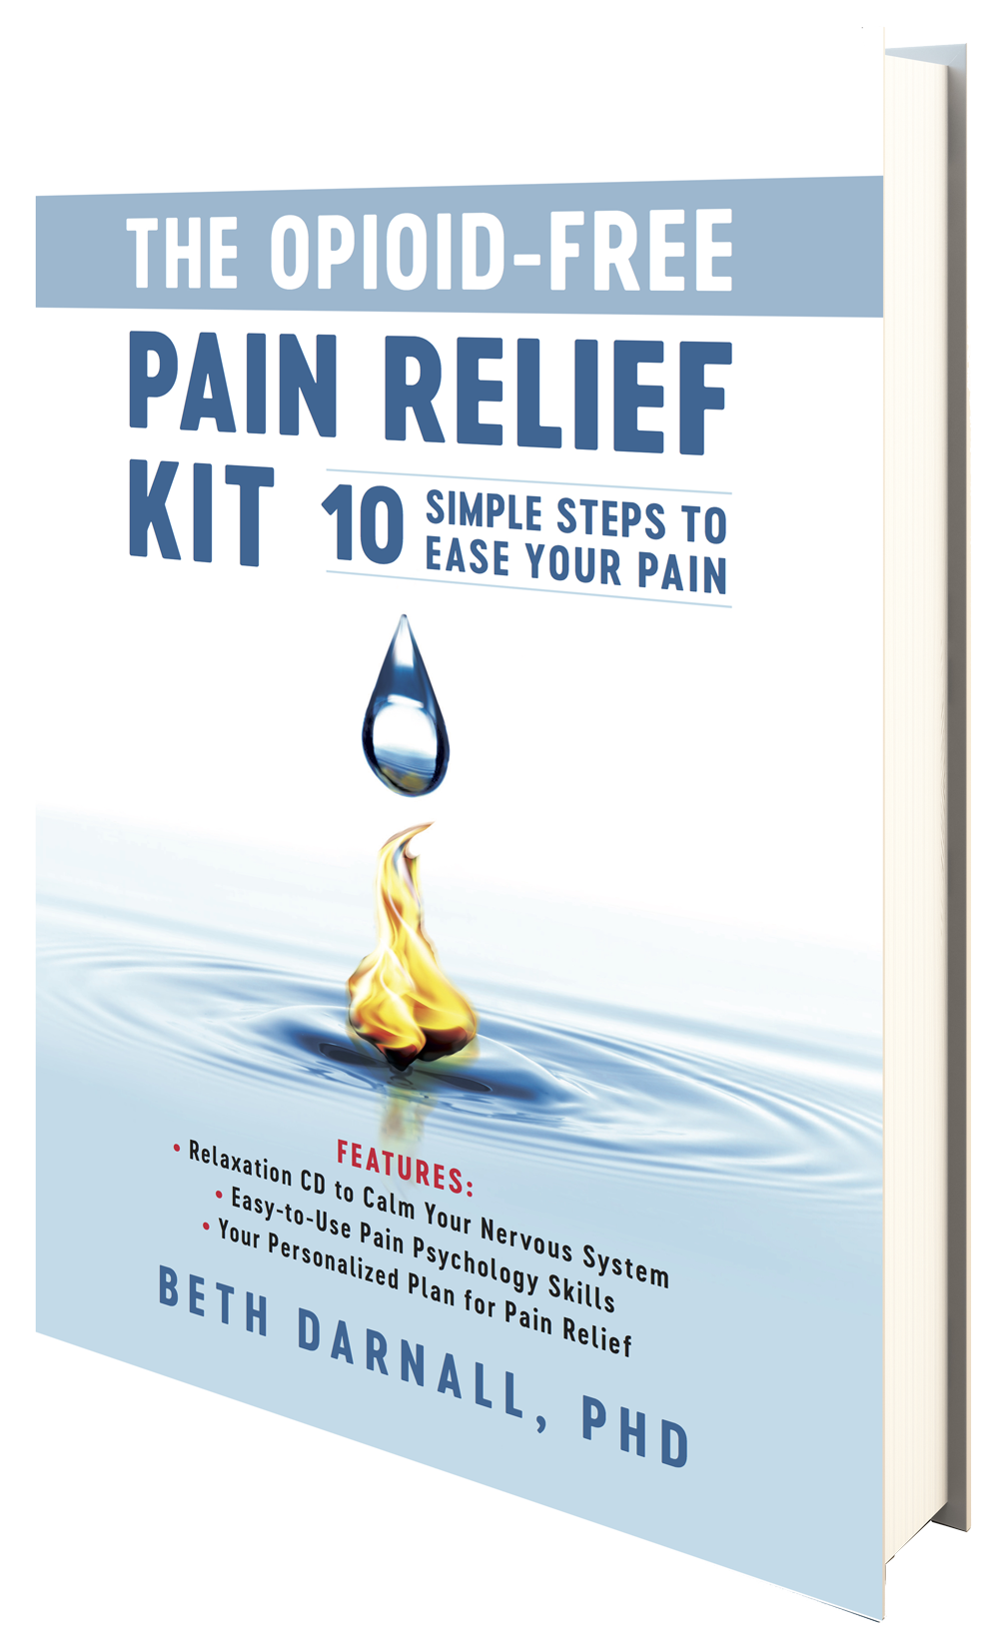
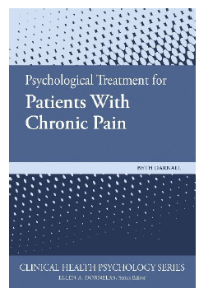

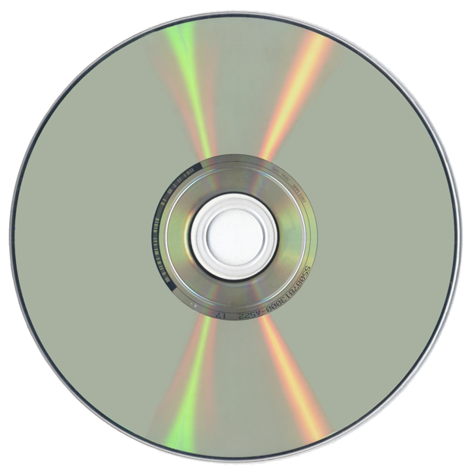
Contracts and Grants
Disclosures
Chief Science Advisor: AppliedVR
NIH / NIDA Brief digital treatment for chronic pain
PCORI Patient-Centered Opioid and Pain Reduction
NIH / NCCIH Behavioral Treatment for Chronic Pain
Board of Directors
American Academy of Pain Medicine
Institute for Brain Potential
Scientific Member
CDC Opioid Workgroup
NIH Interagency Pain Research
Coordinating Committee (IPRCC)

Slide 3

2011 IOM Report: Relieving Pain in America
100 million adults
$635 billion annually
Erodes quality of life,
confers suffering
Notes:
Increased opioid prescribing that was seen in early 2000s was a reflection in our poor investment, as a nation, to treat pain comprehensively, offering lowest risks treatments first

Slide 4
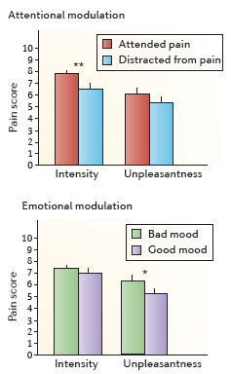
Pain is Complex
Context
Meaning
Cognition
Emotion
Affect
Mood
Attention
Social factors
Villemure C & Bushnell MC. Cognitive modulation of pain: how do attention and emotion influence pain processing? Pain (2002).
Notes:
Multiple psychosocial factors modulate pain and pain unpleasantness.
AND MANY IF NOT MOST ARE MODIFIABLE.

Slide 5
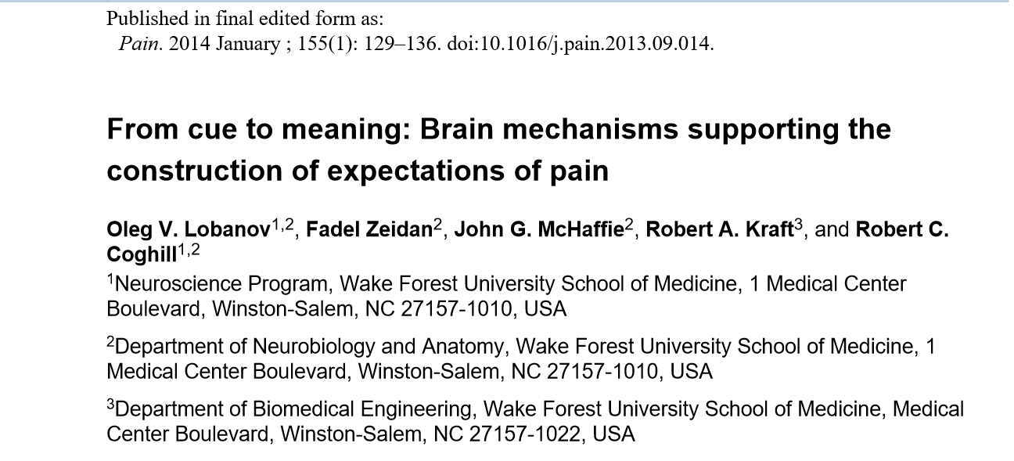
EXPECTATIONS
Analgesic (Pollo, Amanzio, et al 2001)
Amplify pain (Benedetti, Lanotte, Lupiano, Colloca 2007)

Slide 6
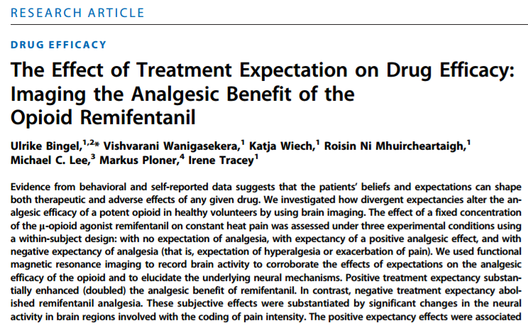
Notes:
Positive tx expectancy doubled the effect of remifentanil
Negative tx expectancy abolished it
Think of the implications for opioid tapering, and particularly when patients are feeling forced to do so.

Slide 7
All received: - heat pain + IV remifentanil
- all 3 conditions in which expectations were manipulated
Receiving powerful opioid Painkiller
Receiving nothing; saline
Receiving a substance that will worsen pain
1
2
3
Notes:
All participants received all 3 conditions (counter balanced)
Patient expectations for pain and analgesia were modulated in this experiment

Slide 8
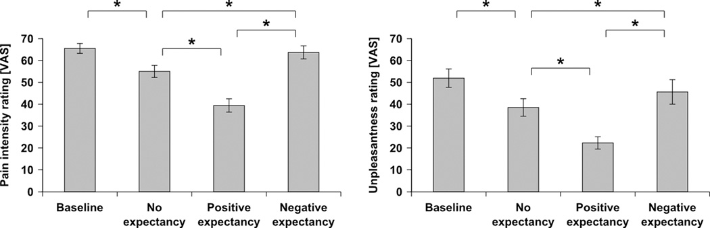

Psychological modulation of opioid analgesia
Ulrike Bingel et al., Sci Transl Med 2011;3:70ra14
Notes:
Behavioral effects of the contextual modulation of opioid analgesia. (Left) Pain intensity ratings obtained on the VAS (0 to 100) for the four experimental runs. (Right) Pain unpleasantness ratings obtained at the end of each of the four experimental runs show the same context-dependent pattern. Error bars indicate SEM. *P < 0.05.

Slide 9
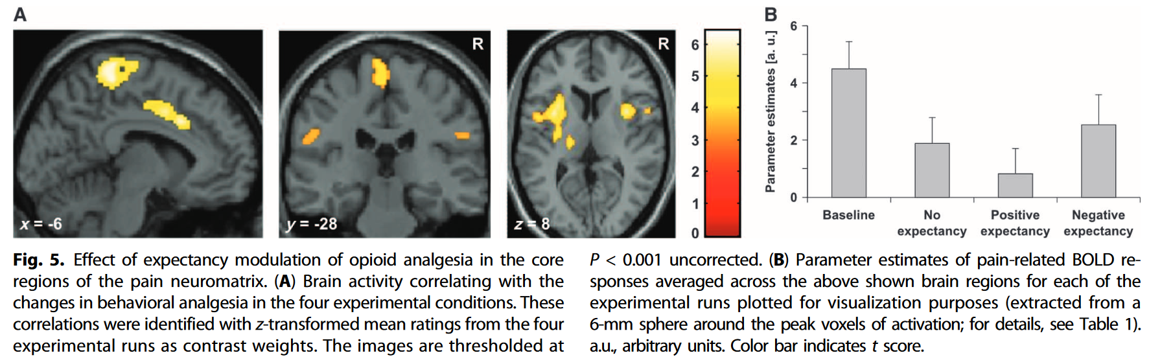

Slide 10
Long‐Term Use of Daily Prescription Opioids
3.4 % of US adults
11 million individuals
Notes:
By 2015
Being told that opioids will be reduced can induce Nocebo which undermines opioid analgesia precisely when opioid are being reduced.
Physiologic and neurobiological adaptations can occur from long-term opioid use
Some patients may be benefitting and require opioids. How do we discern? Data were lacking.

Slide 11

New starts
Provided benchmarks of caution for increasing dose
Dowell D, Haegerich TM, Chou R. CDC Guideline for Prescribing Opioids for Chronic Pain — United States, 2016. MMWR Recomm Rep 2016;65(No. RR-1):1–49.
Notes:
2016 CDC guidelines were directed at non-pain-expert PCPs.
Focused on conservative new starts
Became generalized to opioid tapering
Included misapplication of blanket tapering based on rigid dose-based limits
WAS NEVER recommended
Failed to account for opioid benefits
Assumed risks from taking opioid was greater than reducing opioids
Applied a one-size-fit-all approach

Slide 12
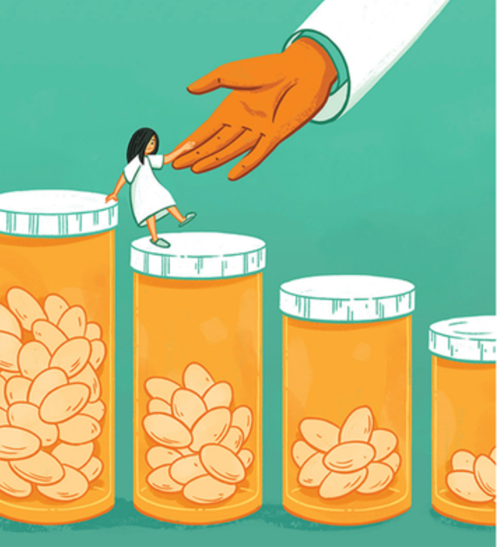
Fewer new starts is the best way to decrease opioid prescriptions
Patients taking long-term prescription
opioids require careful considerations
Reducing opioid doses creates new risks
Right methodology can be applied to
minimize iatrogenic risks from de-prescribing
Apply patient-centered principles
Credit: Celia Krampien

Slide 13
Growing Outcry Against Iatrogenic Opioid Reduction Risks and Harms
Nov 2018
Dec 2018
April 2019
April 2019
April 2019
International Stakeholder Letter publishes
Human Rights Watch
HP3 Letter
FDA
CDC
Darnall BD, Juurlink D, Kerns R, et al.
Reuters Wire service
>20 news outlets worldwide
Declares the issue a “human rights violation”
Laura Mills
Kertesz, Satel, et al.
300+ signatories
3 former U.S. Drug Czars
AMA signs support
Clarifies labeling and cautions against abrupt discontinuation
Dowell et al. Clarification of opioid prescribing guidelines publish in NEJM.
Notes:
POOR OUTCOMES FOR FORCED OPIOID TAPERING
We cannot be harming patients in the name of helping them.
How do we fix this?
Need better data on iatrogenic harms

Slide 14
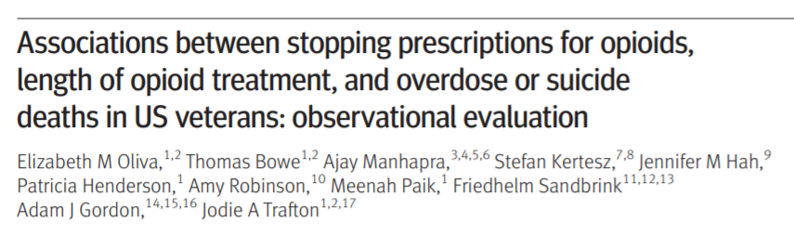
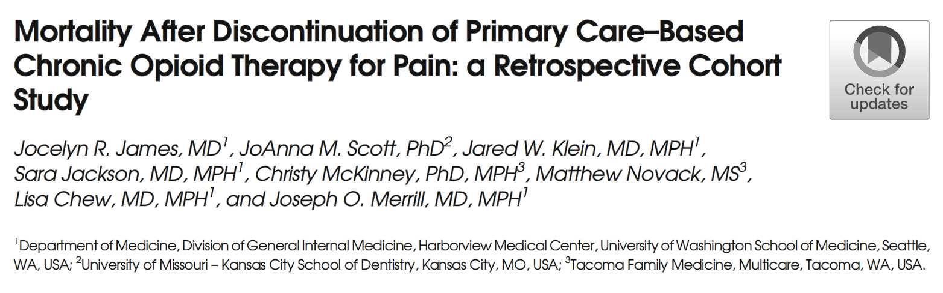

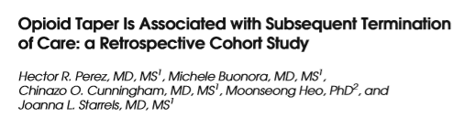
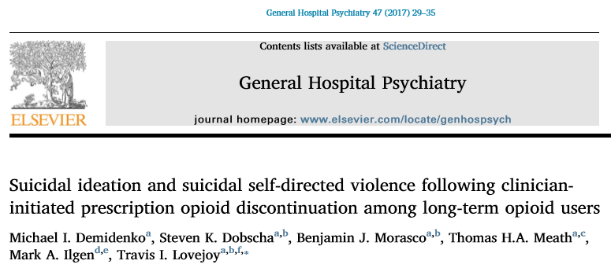
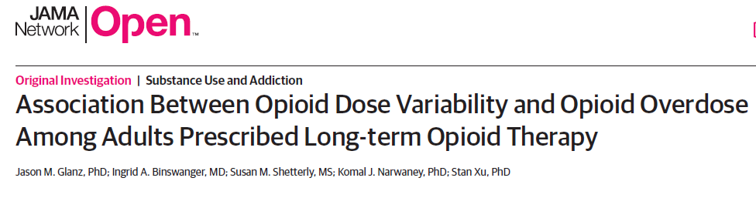
Notes:
Iatrogenic risks: abandonment, overdose, suicidal ideation, suicide.
Glanz: opioid dose CHANGES confer risk for overdose. CHANGE CONFERS RISK
Oliva and Trafton: 1.5M VA patients (2013-2014). Patient monitoring should be intensified for at least 3 months after starting opioids and changing doses.

Slide 15
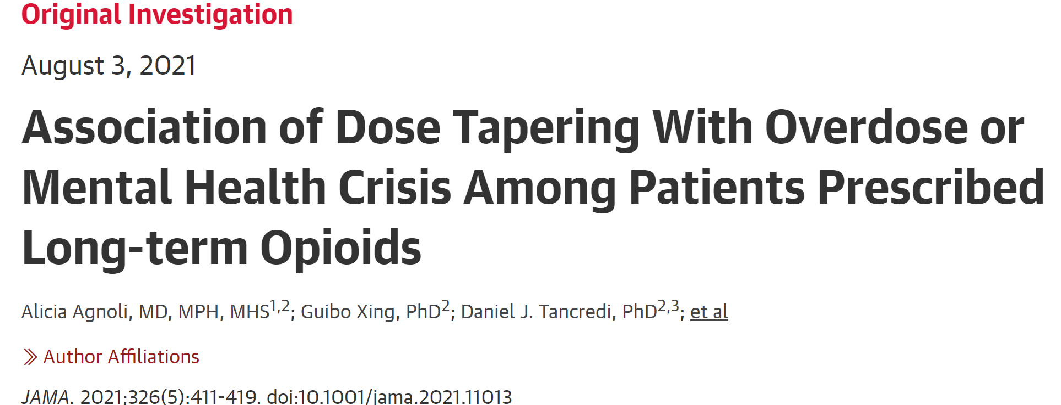

Slide 16
What we are getting wrong
Lack of patient-centered pain care
Failure to integrate PROs (ask the patients!)
One-size-fits-all practices that gravely increase risks for some
Lack of flexible policies that support clinicians and patients
Lack of meaningful access to comprehensive pain care
Failure to implement tapers properly: phenotype, screen properly, mitigate risks, tailor OUD care, monitor closely when tapering is undertaken, provide support, minimize nocebo, and maintain flexibility based on patient response to taper
Notes:
This is what happens when we treat a pill, not the person
And now, an overfocus on yet another pill, buprenorphine, for pain treatment!

Slide 17
Tapering the wrong way
Withdrawal Symptoms
Discomfort
Distress
Failed tapers
False belief that outpatient tapering
is impossible
Remaining on high doses
Overdose
Suicidal ideation
Suicide
Aggressive
Taper
Forced
Taper

Slide 18
Treat the person, not the pill
Notes:
This is the first thing we are getting wrong.
Policies at the state-level and in healthcare organizations.
The original 2016 opioid prescribing guidelines were meant to guide PCPs on new opioids starts, NOT DEPRESCRIBING

Slide 19

The biopsychosocial model of tapering
Psychological
Biological
⇨
Sociological
Opioid
Reduction
Notes:
Failure to apply patient-centered approaches
Failure to integrate PROs carefully and adjust care plan based on patient response
Lack of flexible policies that support clinicians and patients
Failure to implement tapers properly: phenotype, screen properly, mitigate risks, tailor OUD care, monitor closely when tapering is undertaken, provide support, minimize nocebo, and maintain flexibility based on patient response to taper

Slide 20

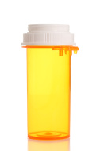
Notes:
Key gaps in knowledge and infrastructure:
How to safely and effectively taper
How to best support patients and clinicians

Slide 21

Tapering Opioids
Patients’ number one concern/fear?
Not Interested!
Notes:
CHOIR survey (N=250)
cannot do outpatient taper without major resources
High dose patients will not do well with opioid taper
Tapering opioid leads to increased pain

Slide 22
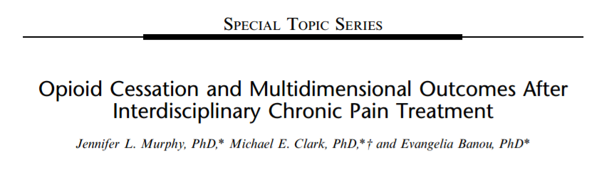

Notes:
700 patients enrolled
Reported data for roughly 600 completers RESOURCE INTENSIVE TREATMENT

Slide 23
Community-Based Solutions are Needed
Low-cost
Low-risk
Scalable
Effectively reduce health risks
Provide education and support
Structured
Address anxiety of patients and prescribers alike
Promote patient trust and a good doctor-patient bond
Enhance patient willingness to try a gentle opioid taper

Slide 24
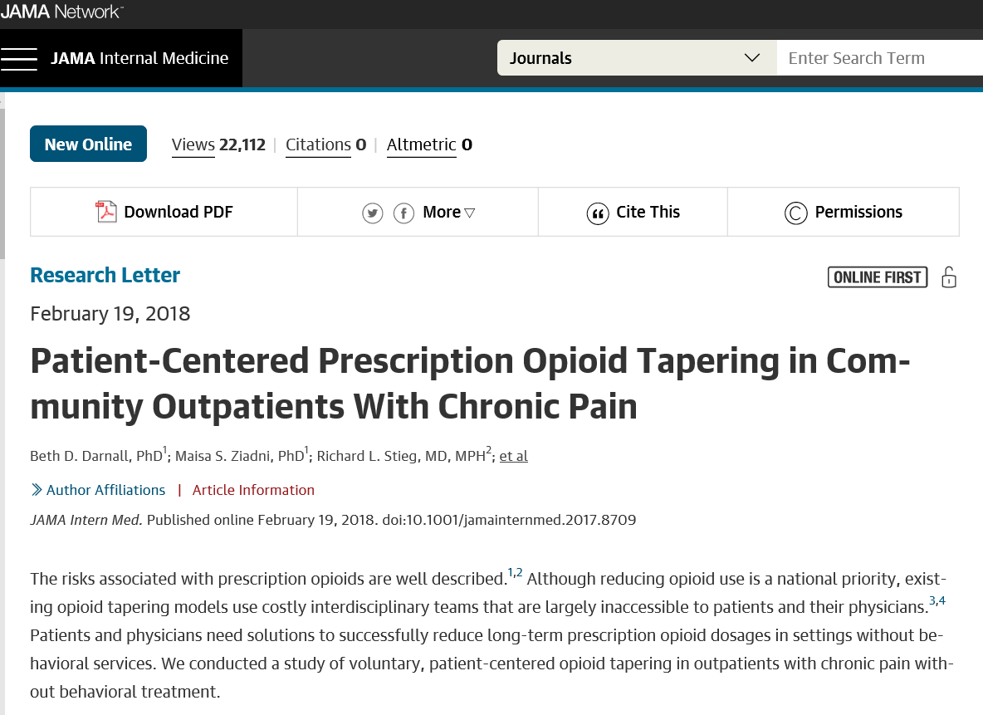

Notes:
We invited anyone taking daily prescription opioids to join the study
We excluded only for active treatment
111 were invited
68 joined the study. Of those 51 completed a 4 month survey.
17 dropped out. One characteristic: Higher on DEPRESSION

Slide 25

Minimize Nocebo
Darnall BD & Colloca L. Int Rev Neurobiol. 2018;139:129-157
Darnall BD & Fields HL. Pain. Aug, 2021 PMID: 34382602

Slide 26
Opioid Cessation vs. Opioid Reduction
VS.

Slide 27
We Optimized Patient Choice and Control in Their Taper
Participation was VOLUNTARY
Patients could control the pace of their taper
Patients could pause their taper
Patients were free to drop out of the study at any time
The taper goal was not zero unless the patient chose that goal
The taper was NOT to a pre-defined opioid dose
Patients partnered with their doctor to achieve their lowest comfortable dose over 4 months
The taper was NOT unidirectional
Darnall BD & Colloca L. Optimizing Placebo and Minimizing Nocebo to Reduce Pain, Catastrophizing, and Opioid Use. Int Rev Neurobiol. 2018;139:129-1572018;139:129-157.
U.S. HHS Guide for Clinicians on the Appropriate Dosage Reduction or Discontinuation of Long-Term Opioid Analgesics (2019)
Notes:
We believe that our high level of patient engagement was because we did not FORCE patients to taper, and because we used patient-centered methods

Slide 28
Study Variables
Demographics (Gender, Age)
Pain Treatment History (Pain Dx, Duration of Opioid Use)
Opioid Dose (MEDD)
Average Pain Intensity (0-10)
Pain Catastrophizing Scale
PROMIS Measures
Marijuana use (Y/N)
16 Weeks
Notes:
AIMS / Outcomes
1. Will patients volunteer to taper?
2. Change in opioid dose: Baseline – 16 Weeks
3. Psychosocial correlates and outcomes

Slide 29
Sample Characteristics (N=51)
55% female
52 years of age (range = 25 – 72)
6 years on opioids (range = 1 – 38)
Moderate pain intensity
Marijuana: 37% (18)
Opioid MEDD = 288 (60, 1005)
Darnall BD, Ziadni MS, Mackey IG, Kao MC, Flood P (FEB 2018; JAMA Int Med)
Notes:
Median values (IQRs omitted for brevity)

Slide 30
 | Baseline | 16 weeks
Variable | Median (IQR) |  | P-val
Opioid Dose (MEDD) | 288 (153, 587) | 150 (54, 248) | 0.002
Pain Intensity (NRS) | 5.0 (3.0, 7.0) | 4.5 (3.0, 7.0) | 0.29
PCS (catastrophizing) | 22 (10, 30) | 15 (7, 23) | 0.04
Fatigue | 61 (54, 65) | 59 (51, 65) | 0.64
Anxiety | 60 (53, 64) | 54 (46, 62) | 0.06
Depression | 56 (49, 64) | 55 (48, 61) | 0.31
Sleep Disturbance | 59 (54, 70) | 56 (50, 64) | 0.13
Pain Interference | 63 (58, 67) | 63 (57, 67) | 0.44
Pain Behavior | 60 (57, 63) | 59 (56, 64) | 0.47
Physical Function | 39 (34, 41) | 39 (34, 43) | 0.78
Kruskal-Wallis rank sum test
Notes:
Minimal missing data;
With minimal resources, the opioid taper was successful!

Slide 31
Notes:
Even people on high dose opioids were able to reduce substantially in 16 weeks

Slide 32
Notes:
Pain did not worsen with opioid taper (though 10-15% of sample did have increase)

Slide 33
Notes:
FOCUS ON OUTLIERS HERE
Pain did not worsen with opioid taper (though 10-15% of sample did have increase)
We don’t treat averages. And we don’t treat opioid doses. We treat people.

Slide 34
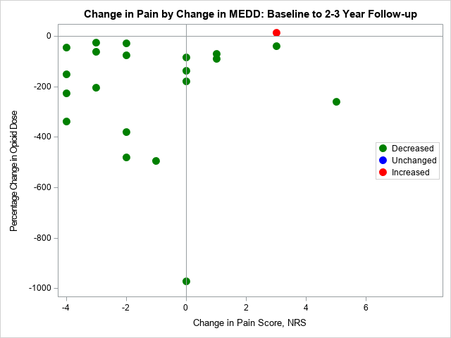
Ziadni MS, Chen A, Krishnamurthy P, Flood P, Stieg RL, Darnall BD. Patient-Centered Prescription Opioid Tapering in Community Outpatients with Chronic Pain: 2- to 3-year follow-up in a subset of patients. PAIN Reports®: September/October 2020 - Volume 5 - Issue 5 - p e851

Slide 35
Comparative Effectiveness of Pain Cognitive Behavioral Therapy and Chronic Pain Self-Management Within the Context of Voluntary Opioid Reduction
Darnall BD (PI)
https://empower.stanford.edu/
Funded by the Patient-Centered Outcomes Research Institute®
Notes:
“PSYCHOLOGICALLY – INFORMED patient centered opioid reduction
*** voluntary ***

Slide 36

1865 patients taking long-term opioids for chronic pain
Stanford Pain Management Center (CA)
Stanford Primary Care (CA)
Kaiser Permanente (Oakland, CA)
Intermountain Health (Utah)
Veterans Affairs (Phoenix, AZ)
MedNOW Primary Care (Aurora, CO)
Notes:
Pragmatic trial, embedded into clinics, we carefully vet for suitability for tapering and monitor very closely for symptoms and problems.
low (10-49 MEDD)
moderate (50-89 MEDD)
high (90-199 MEDD)
super high (>200 MEDD)

Slide 37
Eligibility
> 10 MEDD daily for 3 months
Pain for 6 months
Exclusions:
Active suicidality
Unable to participate in behavioral groups
Moderate to severe Opioid Use Disorder
Screening: 3 items from the TAPS + DSM-V OUD

Slide 38


Slide 39
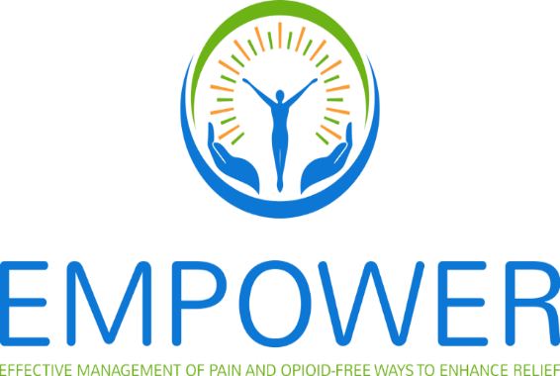
We must create a caring and safe system that makes patients want to join and remain in EMPOWER

Slide 40
The biopsychosocial model of tapering
Psychological
Biological
⇨
Sociological
Opioid
Reduction

Slide 41

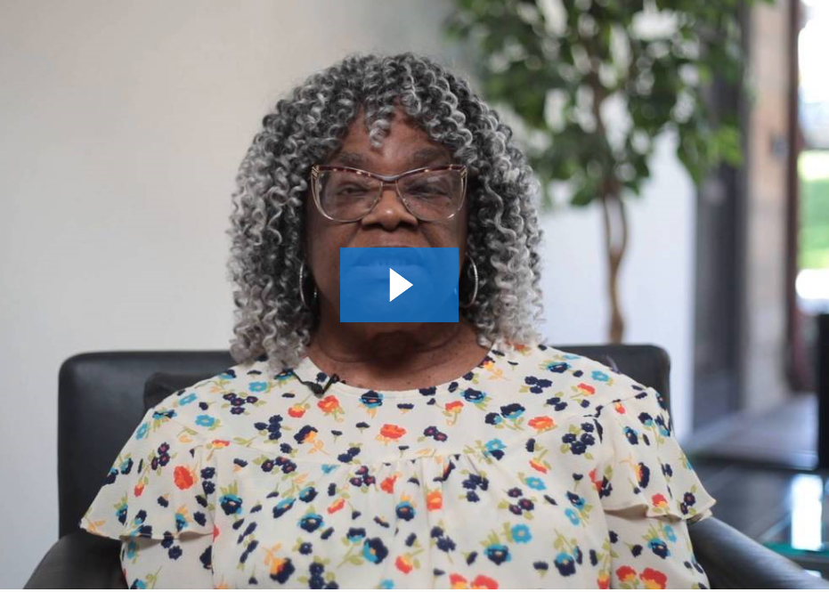
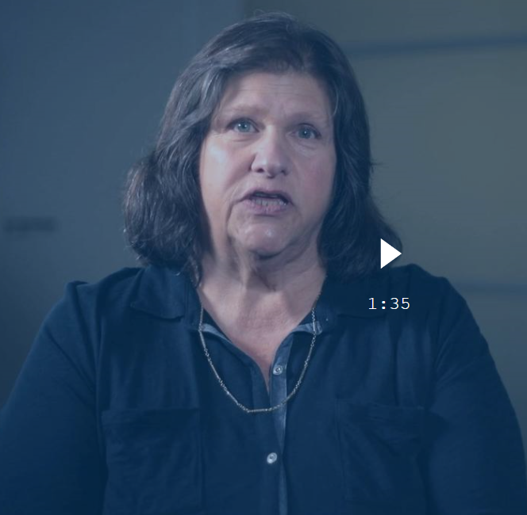
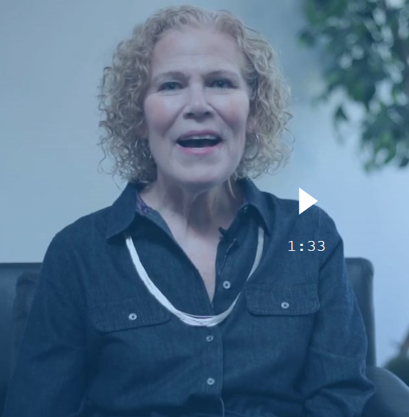
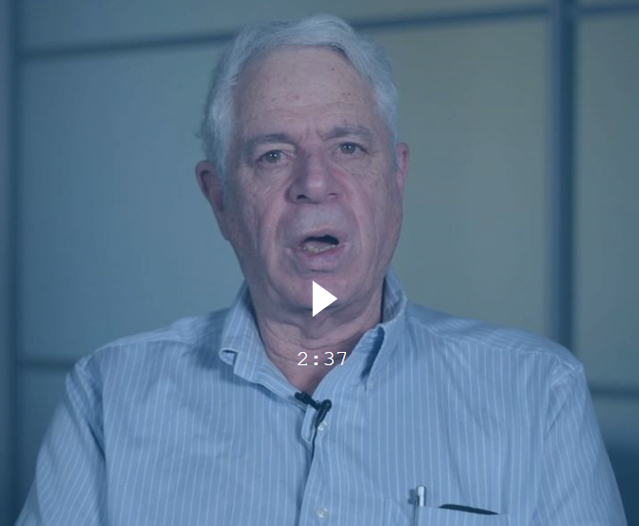

Slide 42
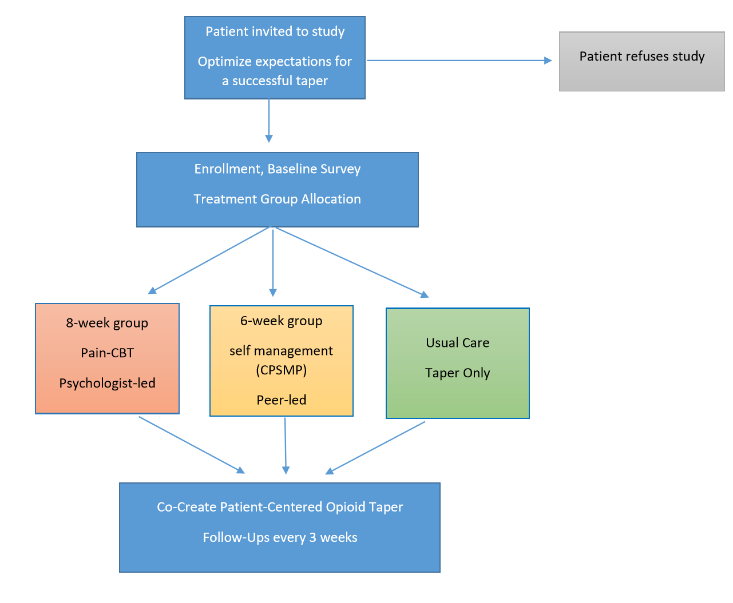
Darnall BD et al.
(protocol manuscript; Pain Med. DEC 2019)
Notes:
Patients partner with their doctor to achieve their lowest comfortable dose over 12 months

Slide 43

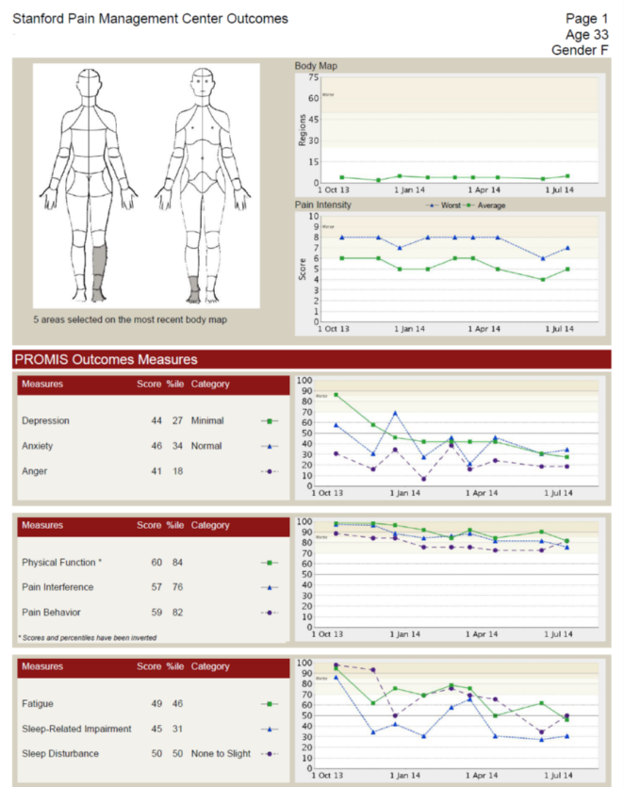
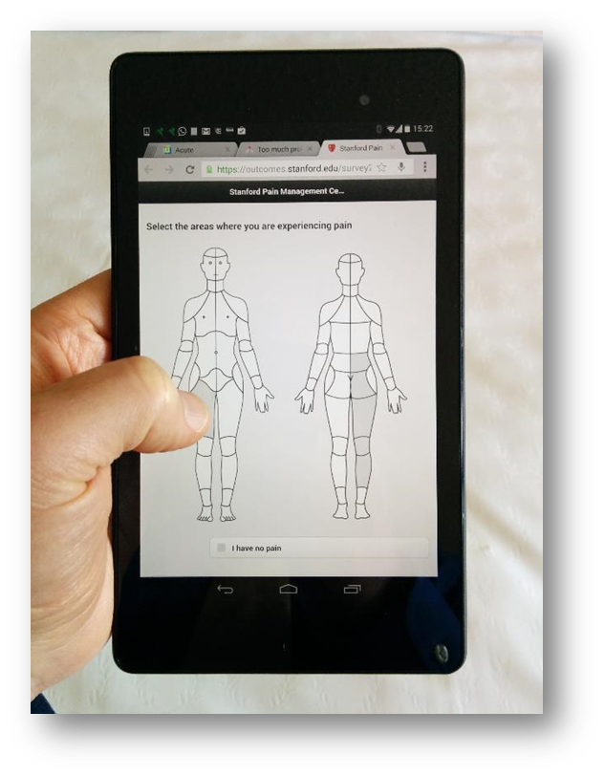

Psychosocial factors (PROMIS)
Opioids
Substance use
Degree of choice
Readiness to taper
Taper beliefs
Satisfaction with clinician relationship
Comments
http://choir.stanford.edu

Slide 44
Minimize Nocebo
Darnall BD & Colloca L. Int Rev Neurobiol. 2018;139:129-157
Darnall BD & Fields HL. Pain. August 2021.

Slide 45

Close Monitoring of Patient Response to Opioid Reduction
WEEKLY surveys for withdrawal symptoms, mood, comments
MONTHLY surveys for mood, suicidality, opioid dose, satisfaction, comments
Alerts are sent to prescribers in real time
Patients receive tailored messages
We track patients over 12 months
Notes:
Alerts are sent in real time
PATIENTS GET BETTER CARE IN EMPOWER THAN OTHERWISE

Slide 46
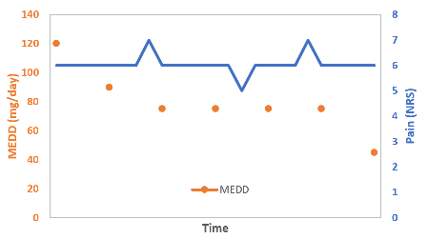

Slide 47
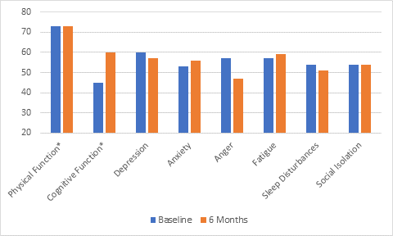

Slide 48
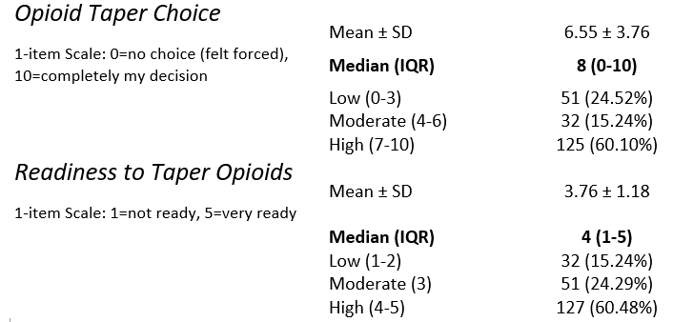
Notes:
N=210

Slide 49
How to refer your patients
Dr. Nathan Moore
MedNOW Clinics
15101 E. Iliff Avenue , Suite 140
Aurora, CO 80014
Phone: 720-878-7055
Dr. Abigail Norris
Mt. San Rafael Hospital
400 Benedicta Avenue
Trinidad, CO 81082
Phone: 719-846-2206

Slide 50
Patient-Centered Opioid Stewardship
Voluntary
Enhance choice and control
During and after taper, increase follow-up and communication
Track closely with PROs, adjust care plan
Patient safety and health are priority
Patient-centeredness is the key
Notes:
Not everyone can/should reduce their doses.
Stop taper when patients are in distress and deteriorating.
Programs that espouse “never go backwards on a taper” are not patient-centered
Poor response to an opioid taper is not itself “a mental illness”
TAPERING
Safety is the priority, not the taper

Slide 51
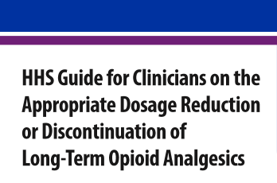
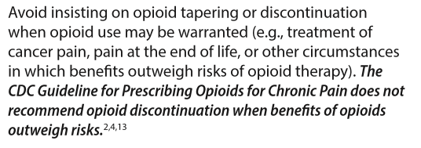
October 2019
Notes:
October 2019.
This is terrific.
One step further would be to require PRO data as a critical metric.
Remains a persistent omission

Slide 52

Colleagues and Collaborators
Kate Lorig, PhD
Wendy Schadle
Anu Roy, MA
Lu Tian, PhD
Joel Porter, MD
Penney Cowan
Mark McGovern, PhD
Ting Pun, PhD
Matt Cheung, PharmD
Nathan Moore, MD
Luana Colloca, MD, PhD
Maisa Ziadni, PhD
Pamela Flood, MD
Heather King, PhD
Sophia You, PhD
Corinne Jung, PhD
Richard Stieg, MD, MPH
Korina DeBruyne, MD
Phil Lavori, PhD
Angie Chen, MD
Jim Weil
Penney Cowan
Patient Advisors
Jessica Root
Joshua Goff
Kelly Adams
Luzmercy Perez
Lanja Sinjary
Ming-Chih Kao, PhD, MD
Jesmin Ram
Aram Mardian, MD
Ming-Chih Kao, PhD, MD
Sean Mackey, MD, PhD
Heather Okvat, PhD
Jeremiah West, MD
Garrick Olsen

Slide 53
Additional Cautionary Notes
Pharmacy refusal to fill opioid prescriptions
Insurance companies incentivizing doctors to write fewer/smaller prescriptions or to NOT prescribe
DEA and medical boards investigating and censuring prescribers without recourse
Chilling effects seen in US, Canada, and Australia
Patients required to visit clinic ~ 7-14 days for refill script
Patients having difficulty accessing even primary care
Notes:
Observe the burden to patients
And we are supposed to be helping them?

